Slide 1
Combining Deep Reinforcement Learning and Search for Imperfect-Information Games
Noam Brown, Anton Bakhtin, Adam Lerer, Qucheng Gong
the 34th International Conference on Neural Information Processing Systems, December 2020, pp. 17057–17069
Presenter: Ying-Yu Lin
Date: Sept.27, 2022

Slide 2
Abstract
The combination of deep reinforcement learning and search at both training and test time is a powerful paradigm that has led to a number of successes in single-agent settings and perfect-information games, best exemplified by Alpha Zero. However, prior algorithms of this form cannot cope with imperfect-information games. This paper presents ReBeL, a general framework for self-play reinforcement learning and search that provably converges to a Nash equilibrium in any two-player zero sum game. In the simpler setting of perfect-information games, ReBeL reduces to an algorithm similar to Alpha Zero. Results in two different imperfect-information games show ReBeL converges to an approximate Nash equilibrium. We also show ReBeL achieves superhuman performance in heads-up no-limit Texas hold’em poker, while using far less domain knowledge than any prior poker AI.

Slide 3
Milestone AI achievement
AlphaGo
-used human data
-used expert features
AlphaZero
-plays Chess, Go, and Shogi
-limited to perfect information games

Slide 4
Recursive Belief-based Learning (ReBeL)
Work for both perfect and imperfect information games
Provably converges to Nash in two-player zero-sum games
Superhuman in two-player no-limit hold’em poker
Uses far less domain knowledge than prior poker bots
In perfect-information games, ReBeL reduces to an algorithm similar to Alpha Zero

Slide 5
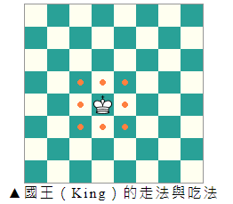
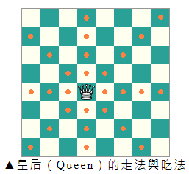
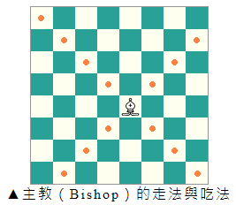
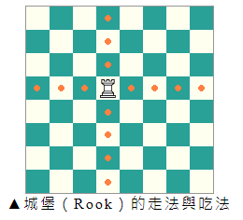
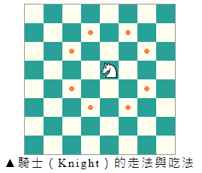
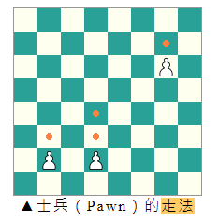
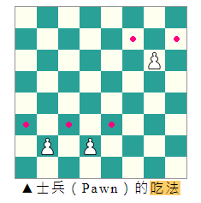
Rule of Chess

Slide 6
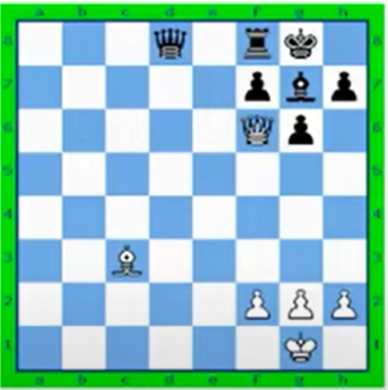
Search in perfect information games
In perfect information games, the value of a state is the unique value resulting from both players playing optimally from that point forward
A value network takes a state as input and outputs an estimate of the state value
f_{white}( )=1

Slide 7
Search in perfect information games
In principle, backward induction alone can solve Chess
But this would be far too expensive in practice
Whole game is too large to solve

Slide 8
Search in perfect information games
Instead, chess AI’ s do search:
1.Look ~10 moves ahead
2.Estimate those state values using the value network
3.Do backward induction using those state values (ignore the game below those states)
In other word , solve a subgame
If the value network is perfect, this computes the optimal action
Subgame
Solve with search
Leaf node

Slide 9
Search in perfect information games
In AlphaZero, the subgame grows in size as it is solved
In principle, ReBeL can do the same
For simplicity, we assume subgames are fixed in size
-Imagine subgames as containing every state reachable within 5 actions
Subgame
Solve with search
Leaf node

Slide 10
AlphaZero
Whenever an agent acts, generate a subgame and solve it
- Set leaf node values based on value net
Start of game

Slide 11
AlphaZero
Whenever an agent acts, generate a subgame and solve it
- Set leaf node values based on value net
Choose next action based on solution to subgame
Repeat until end of game
Final value is used as a training example for all encountered states
Start of game

Slide 12
AlphaZero
With some random exploration, AlphaZero will eventually encounter every state and learn every state’s true value
AlphaZero doesn’t work in imperfect information games
-because “state” do not have unique values in imperfect information games
Blue wins

Slide 13
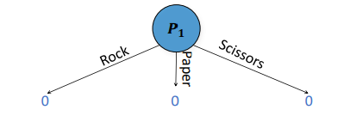
Search in Imperfect information games
Our entire policy is common knowledge, but the outcomes of random processes are not common knowledge
Rock-Paper-Scissors+
Depth-Limited Rock-Paper-Scissors+
P₁
Rock
Scissors
P = 0.4
P = 0.4
P = 0.2
P = 0.1
Paper
P = 0.8
P = 0.1
P₂
P₂
P₂
-1
0
2
Rock
Rock
Rock
Scissors
Scissors
Paper
Scissors
Paper
Paper
0
-1
2
1
0
-2
-2
2
0

Slide 14
Search in Imperfect information games
Our solution: condition value on probability distribution over possible states
V(Rock) is not well-defined
V([0.8Rock, 0.1Paper, 0.1Scissors]) = -0.6
Rock-Paper-Scissors+
Depth-Limited Rock-Paper-Scissors+
P₁
Rock
Scissors
P = 0.4
P = 0.4
P = 0.2
P = 0.1
Paper
P = 0.8
P = 0.1
P₂
P₂
P₂
-1
0
2
Rock
Rock
Rock
Scissors
Scissors
Paper
Scissors
Paper
Paper
0
-1
2
1
0
-2
-2
2
0

Slide 15
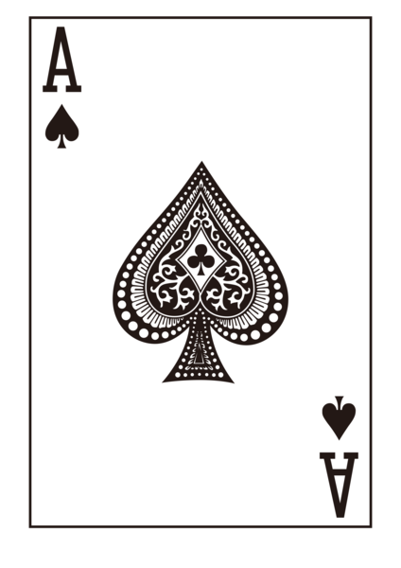


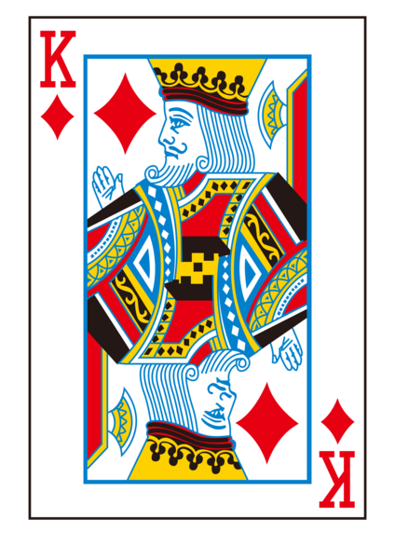

Converting imperfect information games to continuous-state perfect information games
Discrete Representation
Belief Representation
If I have a 2 I bet 50%.
If I have a 3 I fold 100%.
…
If I have a A I bet 100%.
I bet
Player1 bets

Slide 16
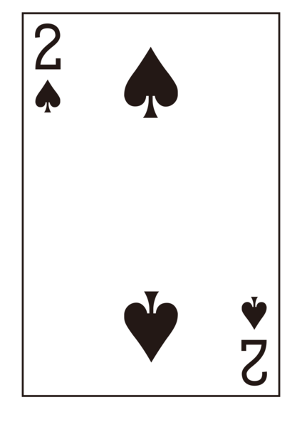
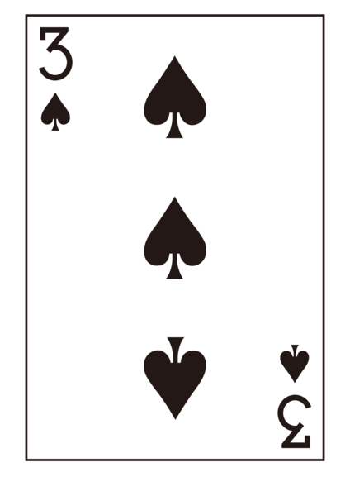


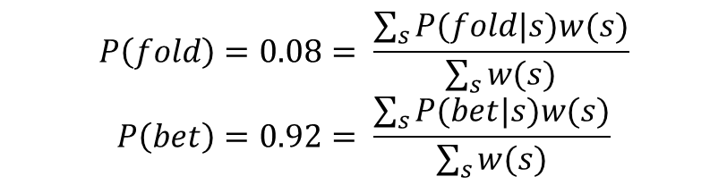




Converting imperfect information games to continuous-state perfect information games
$$w\left(2\right)= \frac{1}{13}$$
$$w\left(3\right)= \frac{1}{13}$$
$$w\left(A\right)= \frac{1}{13}$$
…
I bet with my 2.
I fold with my 3.
…
I bet with my A.
$$P\left(fold\right)=0.08= \frac{\sum_{s}{P(fold|s)w(s)}}{\sum_{s}{w(s)}}$$
$$P\left(bet\right)=0.92= \frac{\sum_{s}{P(bet|s)w(s)}}{\sum_{s}{w(s)}}$$
$$w\left(2\right)= \frac{1}{13}$$
$$w\left(3\right)= \frac{1}{13}$$
$$w\left(A\right)= \frac{1}{13}$$
…

Slide 17



Converting imperfect information games to continuous-state perfect information games
Public Belief State
$$w\left(2\right)= \frac{1}{12}$$
$$w\left(A\right)= \frac{1}{12}$$
$$w\left(3\right)=0$$
Public Belief
Action
…
I bet with my 2.
I fold with my 3.
…
I bet with my A.
$$P\left(fold\right)=0.08= \frac{\sum_{s}{P(fold|s)w(s)}}{\sum_{s}{w(s)}}$$
$$P\left(bet\right)=0.92= \frac{\sum_{s}{P(bet|s)w(s)}}{\sum_{s}{w(s)}}$$
$$w\left(2\right)= \frac{1}{13}$$
$$w\left(3\right)= \frac{1}{13}$$
$$w\left(A\right)= \frac{1}{13}$$
Player1 bets
…

Slide 18
Properties of Public Belief States
Identical to perfect-information states in perfect-information games
Always have a single unique value (in two player zero-sum games)
Action/state space is continuous and high-dimensional
-In Texas hold’em, action/state space has thousands of dimensions
But the action space is a convex optimization problem
-Can use iterative gradient-descent-like algorithms to find the optimal policy
-Typically use Fictitious Play or Counterfactual Regret Minimization (CFR)

Slide 19
ReBeL
Whenever an agent acts, generate a subgame and solve it
- Solve using Fictitious Play or CFR
-Take next action
FP/CFR are iterative, so value net must be accurate on every iteration
To ensure proper exploration, we stop FP/CFR on a random iteration
Initial PBS of the game
Solve with FP/CFR
Leaf node

Slide 20
ReBeL
Whenever an agent acts, generate a subgame and solve it
- Solve using Fictitious Play or CFR
-Take next action
Repeat until end of game
Final value is used as a training example for all encountered PBSs
Blue wins

Slide 21
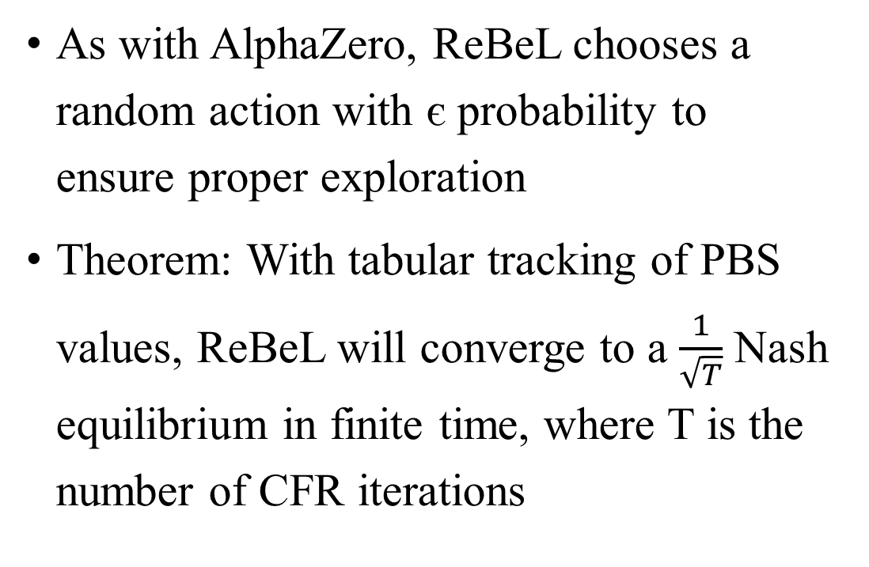
ReBeL
As with AlphaZero, ReBeL chooses a random action with є probability to ensure proper exploration
Theorem: With tabular tracking of PBS values, ReBeL will converge to a $\frac{1}{\sqrt{T}}$ Nash equilibrium in finite time, where T is the number of CFR iterations
Blue wins

Slide 22
Playing Nash at Test Time
Rock-Paper-Scissors+
Rock-Paper-Scissors+ Subgame
P₁
Rock
Scissors
P = 0.401
P = 0.4
P = 0.199
P = 0.401
P = 0.4
P = 0.199
Paper
P₂
P₂
P₂
P₂
P₂
P₂
Rock
Rock
Rock
Rock
Rock
Rock
Scissors
Scissors
Paper
Scissors
Scissors
Paper
Paper
Scissors
Paper
Scissors
Paper
Paper
0
-1
2
1
0
-2
-2
2
0
0
-1
2
1
0
-2
-2
2
0

Slide 23
Playing Nash at Test Time
Rock-Paper-Scissors+
Rock-Paper-Scissors+ Subgame
P₁
Rock
Scissors
P = 0.401
P = 0.4
P = 0.199
P = 0
P = 0
P = 1
Paper
P₂
P₂
P₂
P₂
P₂
P₂
Rock
Rock
Rock
Rock
Rock
Rock
Scissors
Scissors
Paper
Scissors
Scissors
Paper
Paper
Scissors
Paper
Scissors
Paper
Paper
0
-1
2
1
0
-2
-2
2
0
0
-1
2
1
0
-2
-2
2
0
Solution: Stop FP/CFR on a random iteration and assume beliefs from that iteration

Slide 24
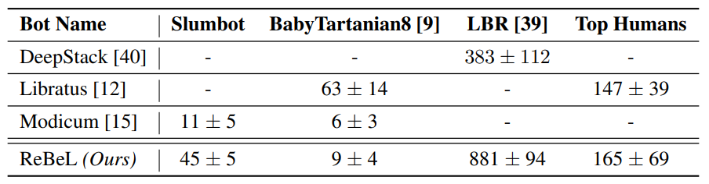
Result in Two-Player No Limit Texas Hold’em

