Slide 1
Computing a Longest Common Subsequence that is Almost Increasing On Sequences Having No Repeated Elements
Johra Muhammad Moosa, M. Sohel Rahman, Fatema Tuz Zohora
Journal of Discrete Algorithms
Volume 20, May 2013, Pages 12–20
Presenter: Chien-Ting Lee
Date: Oct. 12, 2022

Slide 2
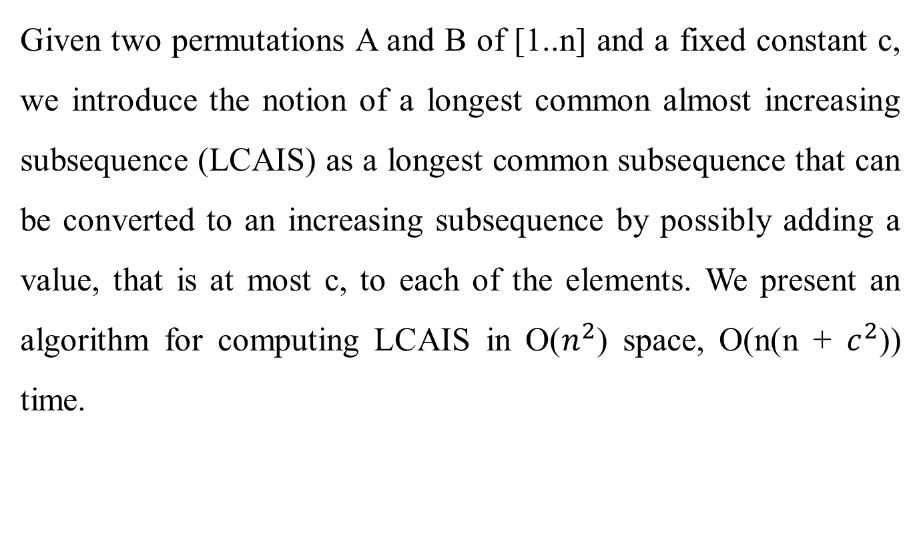
Abstract
Given two permutations A and B of [1..n] and a fixed constant c, we introduce the notion of a longest common almost increasing subsequence (LCAIS) as a longest common subsequence that can be converted to an increasing subsequence by possibly adding a value, that is at most c, to each of the elements. We present an algorithm for computing LCAIS in O($n^{2}$) space, O(n(n + $c^{2}$)) time.
Notes:
ellipsis
Squared
multiplied by

Slide 3

Longest almost increasing subequence (c = 3)
S1= (1, 2, 5, 3, 4, 7)
LIS= 1, 2, 3, 4, 7
LAIS:
$∀y_{i}>\max_{j=1}^{i−1}{ y}_{j}−c$
LAIS= 1, 2, 5, 3, 4, 7
Notes:
所找出來的subequence 允許些微下降

Slide 4
Given two permutations
A (20, 7, 15, 1, 14, 3, 6, 13, 11, 18, 10, 9), m = 12
B (7, 12, 15, 14, 21, 13, 6, 11, 10, 9), n = 10
and a constant c = 3

Slide 5


$$pre(7)=(null)$$
_{A(i)} ^{B(j)} |  | 1 | 2 | 3 | 4 | 5 | 6 | 7 | 8 | 9 | 10
 |  | 7 | 12 | 15 | 14 | 21 | 13 | 6 | 11 | 10 | 9
1 | 20
2 | 7 | *
3 | 15
4 | 1
5 | 14
6 | 3
7 | 6
8 | 13
9 | 11
10 | 18
11 | 10
12 | 9
$$L_{j}[k]$$
_{k} ^{j} | 1 | 2 | 3 | 4 | 5 | 6 | 7 | 8 | 9 | 10
1 | 7 | 7 | 7 | 7 | 7 | 7 | 7 | 7 | 7 | 7
2
3
4
5
6
7
8
9
10
CAIS: 7
Notes:
我們會的一行行衡的去尋找是否match

Slide 6


$$pre(7)=(null)$$
$$pre(15)=(7)$$
_{A(i)} ^{B(j)} |  | 1 | 2 | 3 | 4 | 5 | 6 | 7 | 8 | 9 | 10
 |  | 7 | 12 | 15 | 14 | 21 | 13 | 6 | 11 | 10 | 9
1 | 20
2 | 7 | *
3 | 15 |  |  | *
4 | 1
5 | 14
6 | 3
7 | 6
8 | 13
9 | 11
10 | 18
11 | 10
12 | 9
$$L_{j}[k]$$
$$L_{j}[k]$$
_{k} ^{j} | 1 | 2 | 3 | 4 | 5 | 6 | 7 | 8 | 9 | 10
1 | 7 | 7 | 7 | 7 | 7 | 7 | 7 | 7 | 7 | 7
2
3
4
5
6
7
8
9
10
_{k} ^{j} | 1 | 2 | 3 | 4 | 5 | 6 | 7 | 8 | 9 | 10
1 | 7 | 7 | 7 | 7 | 7 | 7 | 7 | 7 | 7 | 7
2 |  |  | 15 | 15 | 15 | 15 | 15 | 15 | 15 | 15
3
4
5
6
7
8
9
10
CAIS: 7, 15

Slide 7


$$pre(15)=(7)$$
_{A(i)} ^{B(j)} |  | 1 | 2 | 3 | 4 | 5 | 6 | 7 | 8 | 9 | 10
 |  | 7 | 12 | 15 | 14 | 21 | 13 | 6 | 11 | 10 | 9
1 | 20
2 | 7 | *
3 | 15 |  |  | *
4 | 1
5 | 14 |  |  |  | *
6 | 3
7 | 6
8 | 13
9 | 11
10 | 18
11 | 10
12 | 9
$$L_{j}[k]$$
$$L_{j}[k]$$
$$pre(14)=(7, 15)$$
_{k} ^{j} | 1 | 2 | 3 | 4 | 5 | 6 | 7 | 8 | 9 | 10
1 | 7 | 7 | 7 | 7 | 7 | 7 | 7 | 7 | 7 | 7
2 |  |  | 15 | 15 | 15 | 15 | 15 | 15 | 15 | 15
3
4
5
6
7
8
9
10
_{k} ^{j} | 1 | 2 | 3 | 4 | 5 | 6 | 7 | 8 | 9 | 10
1 | 7 | 7 | 7 | 7 | 7 | 7 | 7 | 7 | 7 | 7
2 |  |  | 15 | 15 | 15 | 15 | 15 | 15 | 15 | 15
3 |  |  |  | 14 | 14 | 14 | 14 | 14 | 14 | 14
4
5
6
7
8
9
10
CAIS: 7, 15, 14

Slide 8





$$pre(7)=(null)$$
$$pre(14)=(7, 15)$$
_{A(i)} ^{B(j)} |  | 1 | 2 | 3 | 4 | 5 | 6 | 7 | 8 | 9 | 10
 |  | 7 | 12 | 15 | 14 | 21 | 13 | 6 | 11 | 10 | 9
1 | 20
2 | 7 | *
3 | 15 |  |  | *
4 | 1
5 | 14 |  |  |  | *
6 | 3
7 | 6 |  |  |  |  |  |  | *
8 | 13
9 | 11
10 | 18
11 | 10
12 | 9
$$L_{j}[k]$$
$$L_{j}[k]$$
$$pre(15)=(7)$$
$$pre(6)=(7)$$
_{k} ^{j} | 1 | 2 | 3 | 4 | 5 | 6 | 7 | 8 | 9 | 10
1 | 7 | 7 | 7 | 7 | 7 | 7 | 7 | 7 | 7 | 7
2 |  |  | 15 | 15 | 15 | 15 | 15 | 15 | 15 | 15
3 |  |  |  | 14 | 14 | 14 | 14 | 14 | 14 | 14
4
5
6
7
8
9
10
_{k} ^{j} | 1 | 2 | 3 | 4 | 5 | 6 | 7 | 8 | 9 | 10
1 | 7 | 7 | 7 | 7 | 7 | 7 | 7 | 7 | 7 | 7
2 |  |  | 15 | 15 | 15 | 15 | 6 | 6 | 6 | 6
3 |  |  |  | 14 | 14 | 14 | 14 | 14 | 14 | 14
4
5
6
7
8
9
10
CAIS: 7, 15, 14
CAIS: 7, 6

Slide 9
_{A(i)} ^{B(j)} |  | 1 | 2 | 3 | 4 | 5 | 6 | 7 | 8 | 9 | 10
 |  | 7 | 12 | 15 | 14 | 21 | 13 | 6 | 11 | 10 | 9
1 | 20
2 | 7 | *
3 | 15 |  |  | *
4 | 1
5 | 14 |  |  |  | *
6 | 3
7 | 6 |  |  |  |  |  |  | *
8 | 13
9 | 11
10 | 18
11 | 10
12 | 9
CAIS: 7, 15, 14
CAIS: 7, 6

Slide 10




$$pre(15)=(7)$$
$$pre(6)=(7)$$
_{A(i)} ^{B(j)} |  | 1 | 2 | 3 | 4 | 5 | 6 | 7 | 8 | 9 | 10
 |  | 7 | 12 | 15 | 14 | 21 | 13 | 6 | 11 | 10 | 9
1 | 20
2 | 7 | *
3 | 15 |  |  | *
4 | 1
5 | 14 |  |  |  | *
6 | 3
7 | 6 |  |  |  |  |  |  | *
8 | 13 |  |  |  |  |  | *
9 | 11
10 | 18
11 | 10
12 | 9
$$L_{j}[k]$$
$$pre(14)=(7, 15)$$
$$pre(13)=(7, 15, 14)$$
_{k} ^{j} | 1 | 2 | 3 | 4 | 5 | 6 | 7 | 8 | 9 | 10
1 | 7 | 7 | 7 | 7 | 7 | 7 | 7 | 7 | 7 | 7
2 |  |  | 15 | 15 | 15 | 15 | 6 | 6 | 6 | 6
3 |  |  |  | 14 | 14 | 14 | 14 | 14 | 14 | 14
4 |  |  |  |  |  | 13 | 13 | 13 | 13 | 13
5
6
7
8
9
10
CAIS: 7, 15, 14
CAIS: 7, 6
CAIS: 7, 15, 14, 13

Slide 11
_{A(i)} ^{B(j)} |  | 1 | 2 | 3 | 4 | 5 | 6 | 7 | 8 | 9 | 10
 |  | 7 | 12 | 15 | 14 | 21 | 13 | 6 | 11 | 10 | 9
1 | 20
2 | 7 | *
3 | 15 |  |  | *
4 | 1
5 | 14 |  |  |  | *
6 | 3
7 | 6 |  |  |  |  |  |  | *
8 | 13 |  |  |  |  |  | *
9 | 11 |  |  |  |  |  |  |  | *
10 | 18
11 | 10
12 | 9
CAIS: 7, 6
CAIS: 7, 15, 14, 13

Slide 12





$$pre(15)=(7)$$
$$pre(6)=(7)$$
$$L_{j}[k]$$
$$pre(14)=(7, 15)$$
$$pre(13)=(7, 15, 14)$$
_{k} ^{j} | 1 | 2 | 3 | 4 | 5 | 6 | 7 | 8 | 9 | 10
1 | 7 | 7 | 7 | 7 | 7 | 7 | 7 | 7 | 7 | 7
2 |  |  | 15 | 15 | 15 | 15 | 6 | 6 | 6 | 6
3 |  |  |  | 14 | 14 | 14 | 14 | 14 | 14 | 14
4 |  |  |  |  |  | 13 | 13 | 13 | 13 | 13
5
6
7
8
9
10

Slide 13





$$pre(15)=(7)$$
$$pre(6)=(7)$$
$$pre(11)=(7, 6)$$
$$L_{j}[k]$$
$$pre(14)=(7, 15)$$
$$pre(13)=(7, 15, 14)$$
_{k} ^{j} | 1 | 2 | 3 | 4 | 5 | 6 | 7 | 8 | 9 | 10
1 | 7 | 7 | 7 | 7 | 7 | 7 | 7 | 7 | 7 | 7
2 |  |  | 15 | 15 | 15 | 15 | 6 | 6 | 6 | 6
3 |  |  |  | 14 | 14 | 14 | 14 | 11 | 11 | 11
4 |  |  |  |  |  | 13 | 13 | 13 | 13 | 13
5
6
7
8
9
10

Slide 14



$$pre(10)=(7, 6, 11)$$
$$pre(11)=(7, 6)$$
_{A(i)} ^{B(j)} |  | 1 | 2 | 3 | 4 | 5 | 6 | 7 | 8 | 9 | 10
 |  | 7 | 12 | 15 | 14 | 21 | 13 | 6 | 11 | 10 | 9
1 | 20
2 | 7 | *
3 | 15 |  |  | *
4 | 1
5 | 14 |  |  |  | *
6 | 3
7 | 6 |  |  |  |  |  |  | *
8 | 13 |  |  |  |  |  | *
9 | 11 |  |  |  |  |  |  |  | *
10 | 18
11 | 10 |  |  |  |  |  |  |  |  | *
12 | 9 |  |  |  |  |  |  |  |  |  | *
$$L_{j}[k]$$
$$pre(9)=(7, 6, 11, 10)$$
_{k} ^{j} | 1 | 2 | 3 | 4 | 5 | 6 | 7 | 8 | 9 | 10
1 | 7 | 7 | 7 | 7 | 7 | 7 | 7 | 7 | 7 | 7
2 |  |  | 15 | 15 | 15 | 15 | 6 | 6 | 6 | 6
3 |  |  |  | 14 | 14 | 14 | 14 | 11 | 11 | 11
4 |  |  |  |  |  | 13 | 13 | 13 | 10 | 10
5 |  |  |  |  |  |  |  |  |  | 9
6
7
8
9
10
CAIS: 7, 6, 11
CAIS: 7, 15, 14, 13
CAIS: 7, 6, 11, 10, 9

Slide 15

Analysis
O($n^{2}$) space
O(n(n + $c^{2}$)) time
Notes:
確認接在甚麼後面花$c^{2}$

