Slide 1
Music Matching Based on Rough Longest Common Subsequence
Hwei-Jen Lin (林慧珍), Hung-Hsuan Wu (吳宏宣), Chun-Wei Wang (王駿瑋)
JOURNAL OF INFORMATION SCIENCE AND ENGINEERING, 2011
Volume 27, pp. 95-110
Presenter: Tsung-Lin Lu
Date: Oct. 12, 2022

Slide 2
Abstract (1/2)
In this paper we proposed a music matching method, called the RLCS (rough longest common subsequence) method. It is an improved version of the LCS to avoid some problems occurring in global alignment matching. First a rough equality for two notes is defined for constructing the RLCS of two music fragments. The length of the RLCS of two music sequences defined in this work is a real number, called a weighted length. It is evaluated according to the degree of similarity of every pair of matched notes from the two sequences. This method takes into account both the width-across-query (WAQ) and the width-across-reference (WAR) and combines them with the weighted length of the corresponding RLCS to define a score measurement for the RLCS. The measurement associated with WAQ and WAR enables the proposed method to tolerate dense errors.

Slide 3
Abstract (2/2)
A dynamic programming algorithm is presented for simultaneously calculating the weighted length of RLCS, the WAQ, the WAR, and the score to determine the RLCS. As a result, the proposed method can perform the matching in a better and simpler manner. In order to speed up the matching process, we use the filtering algorithm proposed by Tarhio and Ukkonen to filter the reference and discard most of the reference areas that do not match. We applied the proposed algorithm to content-based music retrieval. The experimental results showed that with our proposed algorithm the retrieval system provides a higher retrieval rate than that with the local alignment method proposed by Suyoto et al. . The use of the filtering algorithm has been shown to greatly reduce the computation time for exact matching and for approximate matching with a low error tolerance.

Slide 4
Outline
LCS
WAR / WAQ
DP for LCS, WAR, WAQ
Rough LCS for Music Matching
DP for RLCS, RWAR, RWAQ
Filtering Algorithm
Results

Slide 5
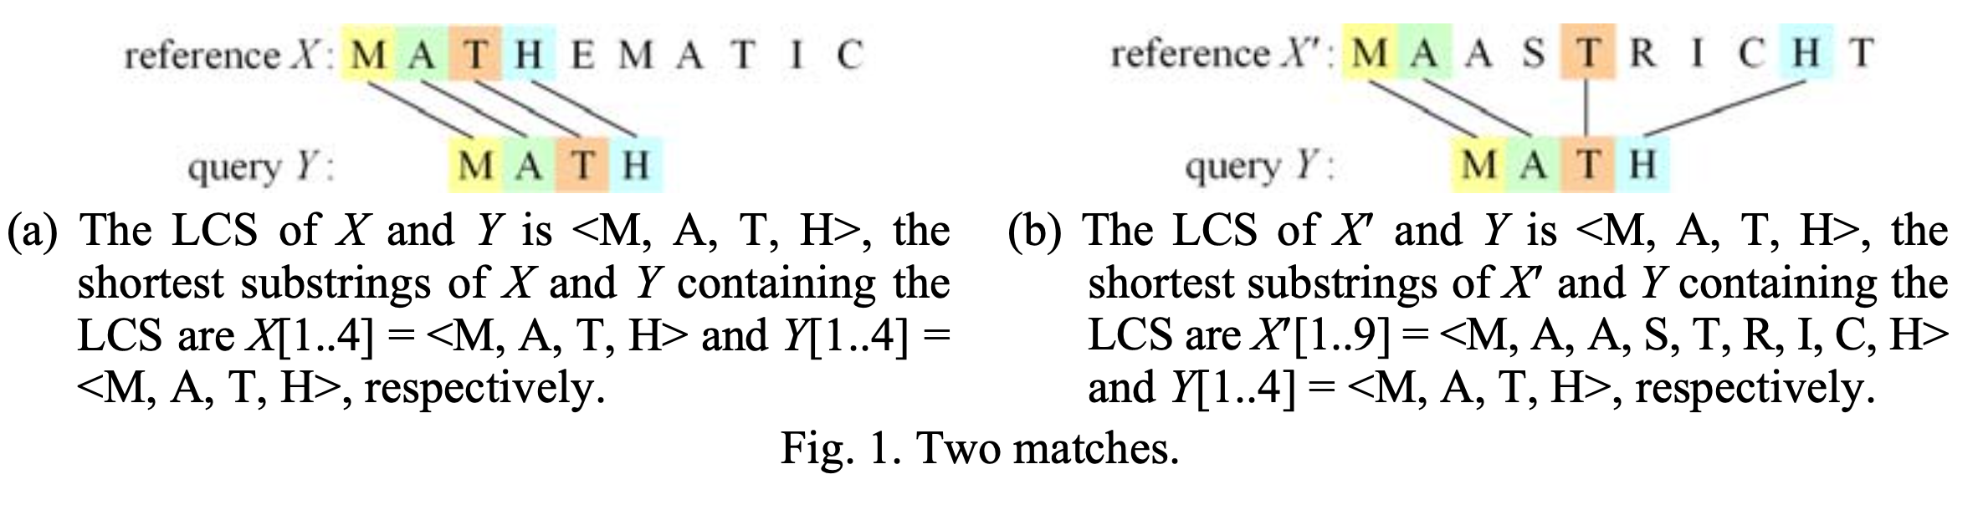
LCS

Slide 6
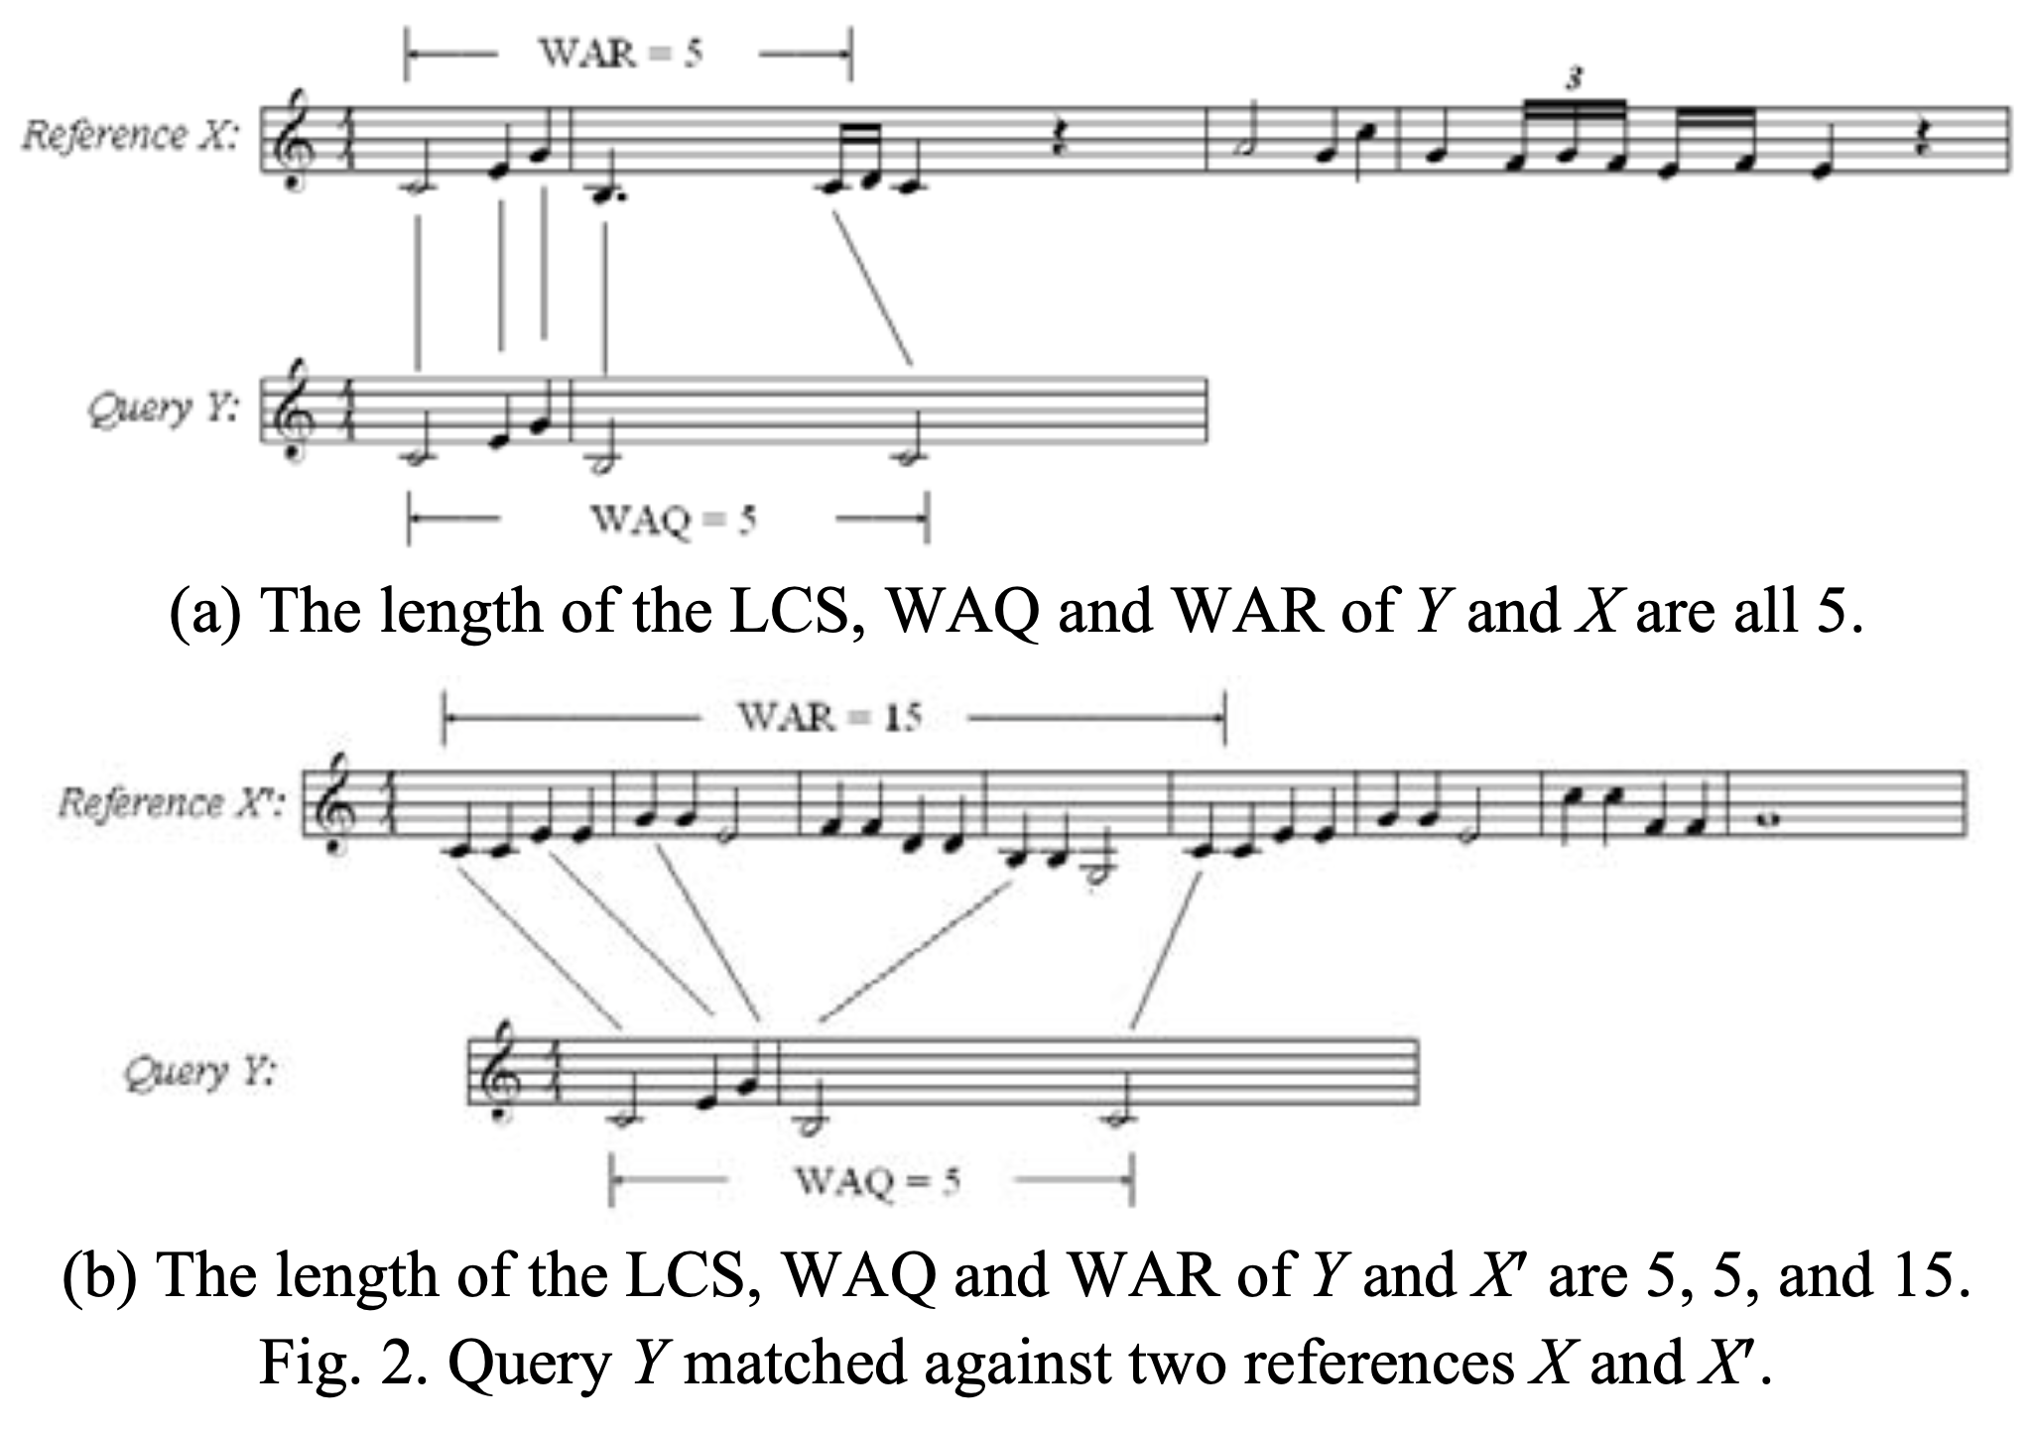
WAR / WAQ
Width- across-reference (WAR)
Width-across-query (WAQ)

Slide 7
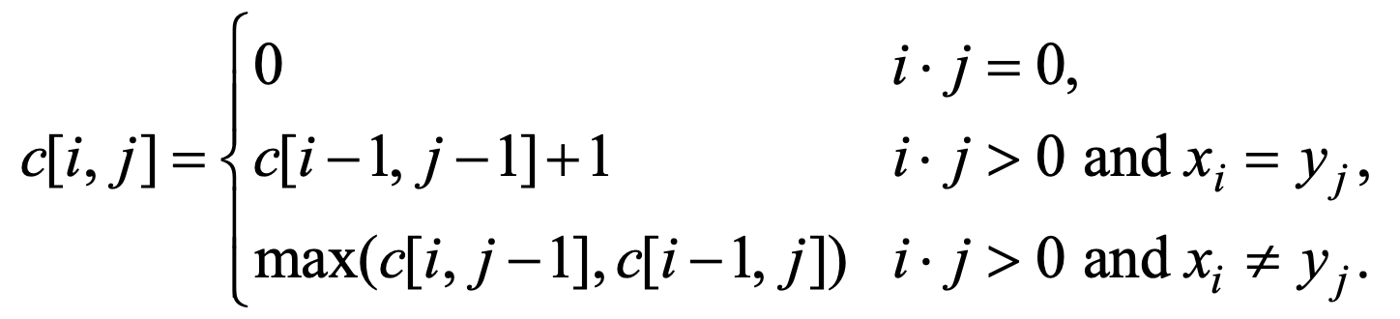
DP for LCS, WAR, WAQ (1/2)
(a) DP for LCS

Slide 8
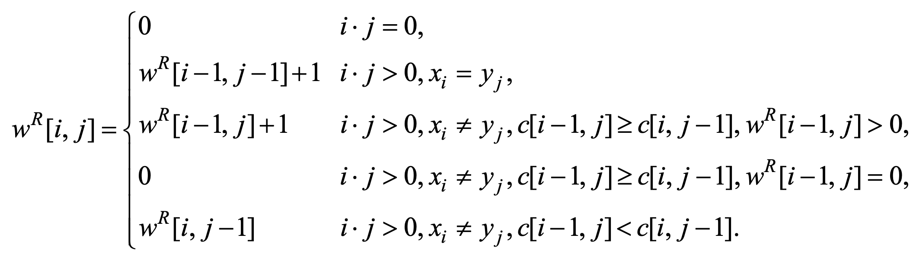
DP for LCS, WAR, WAQ (2/3)
Row is reference, and col is query.
①
(b) DP for WAR
②
③
不相等 & c_{上} ≥ c_{左} & W^{R}_{上} > 0 → W^{R}_{上} + 1
④
不相等 & c_{上} ≥ c_{左} & W^{R}_{上} = 0 → 0
⑤
不相等 & c_{上} < c_{左} → W^{R}_{左}
② | 1 | 2 | 3
R | a | a | c
Q | a | b | c
③ | 1 | 2 | 3
R | a | c | a
Q | a | b | c
⑤ | 1 | 2 | 3
R | a | a | c
Q | a | c | b
② W^{R}[3, 3] = W^{R}[2, 2] + 1 = 2 + 1 = 3 ，因為R尾匹配
③ W^{R}[3, 3] = W^{R}[2, 3] + 1 = 2 + 1 = 3 ，因為R尾不匹配
⑤ W^{R}[3, 3] = W^{R}[3, 2] = 3 ，因為R尾匹配
②' W^{R}[5, 3] = W^{R}[4, 2] = 1 + 1 = 2
②' | 1 | 2 | 3 | 4 | 5
R | a | a | c | a | c
Q | a | b | c

Slide 9
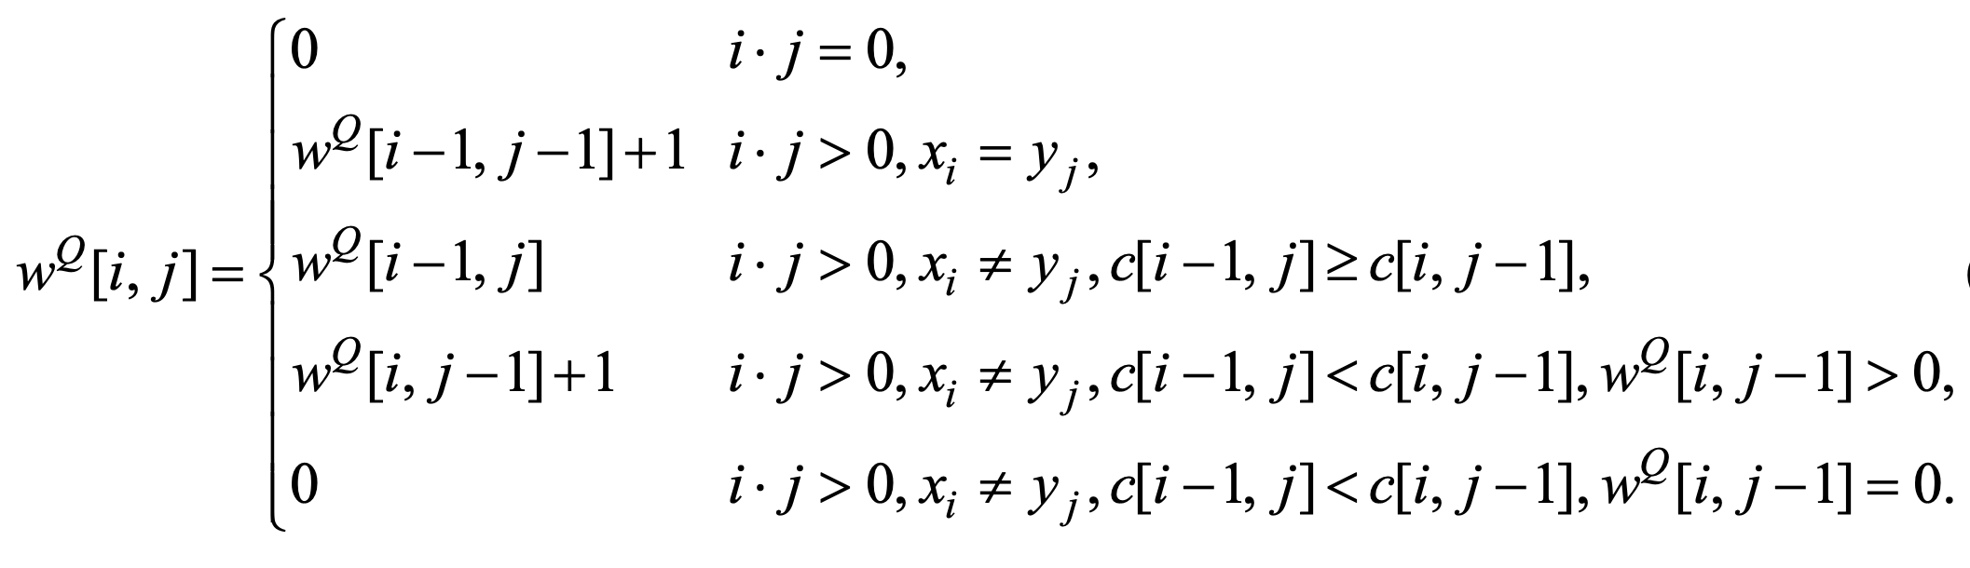
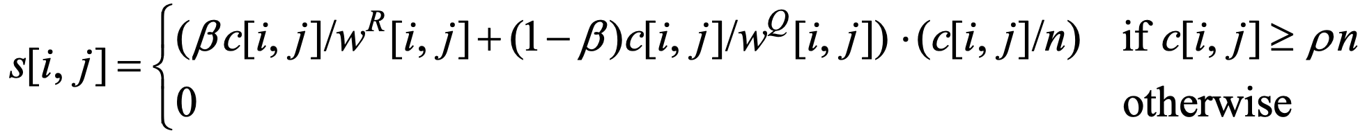
DP for LCS, WAR, WAQ (3/3)
Row is reference, and col is query.
不相等 & c_{上} ≥ c_{左} & W^{R}_{上} > 0 → W^{R}_{上} + 1
不相等 & c_{上} ≥ c_{左} & W^{R}_{上} = 0 → 0
不相等 & c_{上} < c_{左} → W^{R}_{左}
(b) DP for WAR
不相等 & c_{上} ≥ c_{左} → W^{Q}_{上}
不相等 & c_{上} < c_{左} & W^{Q}_{左} > 0 → W^{Q}_{左} + 1
不相等 & c_{上} < c_{左} & W^{Q}_{左} = 0 → 0
(c) DP for WAQ
(d) The score of the match

Slide 10
Rough LCS for Music Matching
Pitch value（音高）：The quality that makes it possible to judge sounds as "higher" and "lower" in the sense associated with musical melodies.
Duration value（音長）：An amount of time or how long or short a note, phrase, section, or composition lasts.
Rough match：If d(r_{i}, q_{j}) ≤ T_{d}, then r_{i} ≈ q_{j}.
Musical notes : Pitch, duration, loudness（響度） timbre（音色）, ...
r : reference
q : query
p : pitch
d : duration
𝛼 : a weight value
Distance
Pitch
Duration

Slide 11
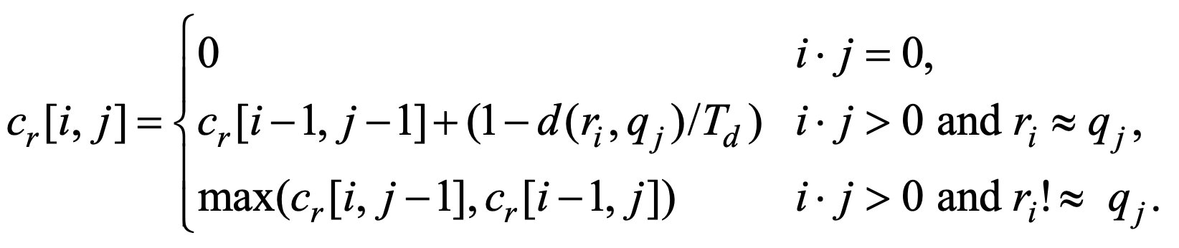
DP for RLCS, RWAR, RWAQ (1/3)
(a) DP for RCLS

Slide 12
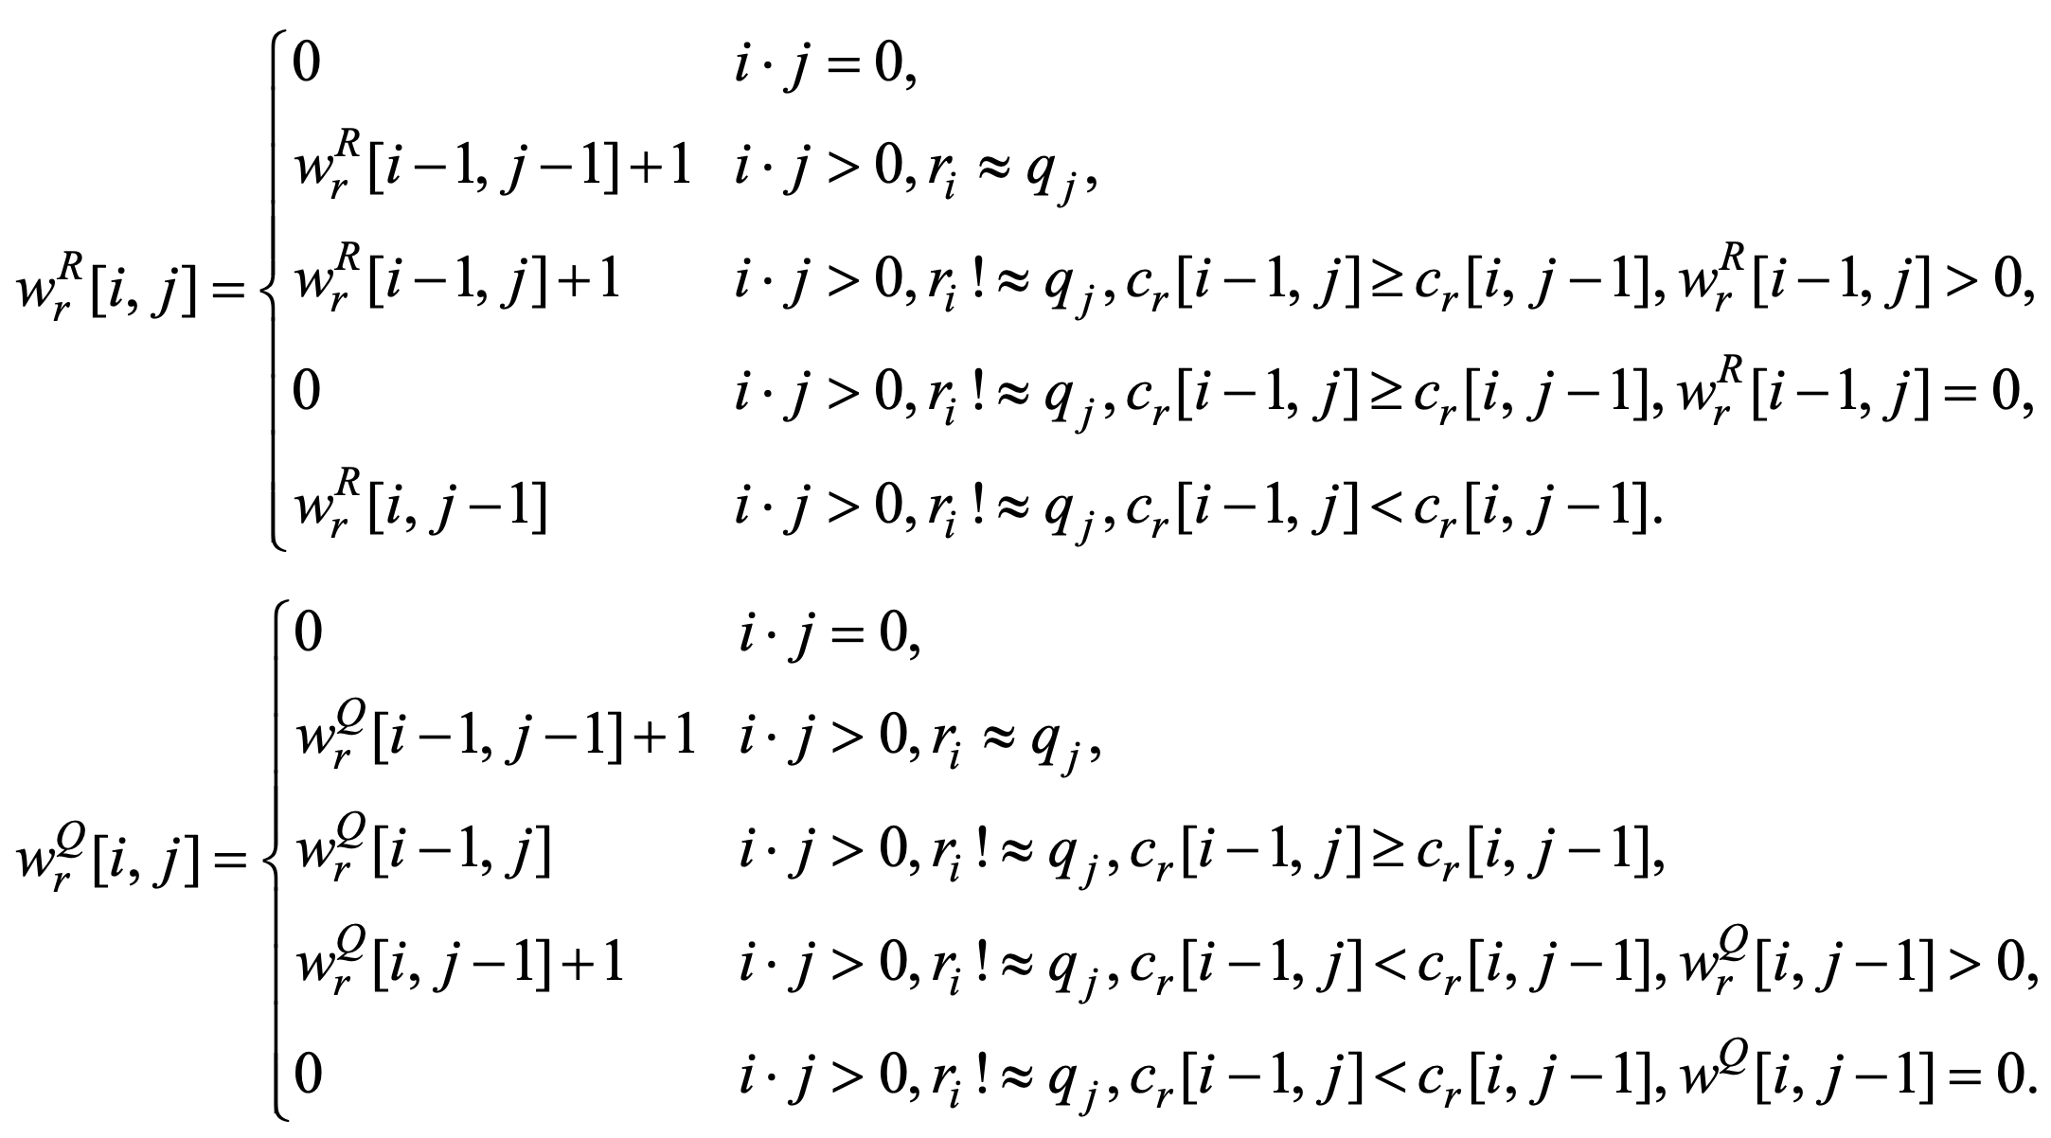
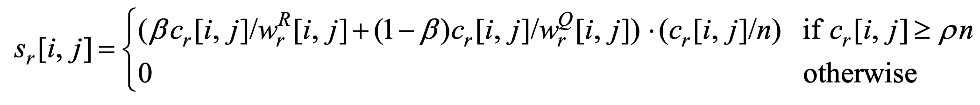
DP for RLCS, RWAR, RWAQ (2/3)
(b) DP for RWAR
(c) DP for RWAQ
(d) The score of the rough match

Slide 13
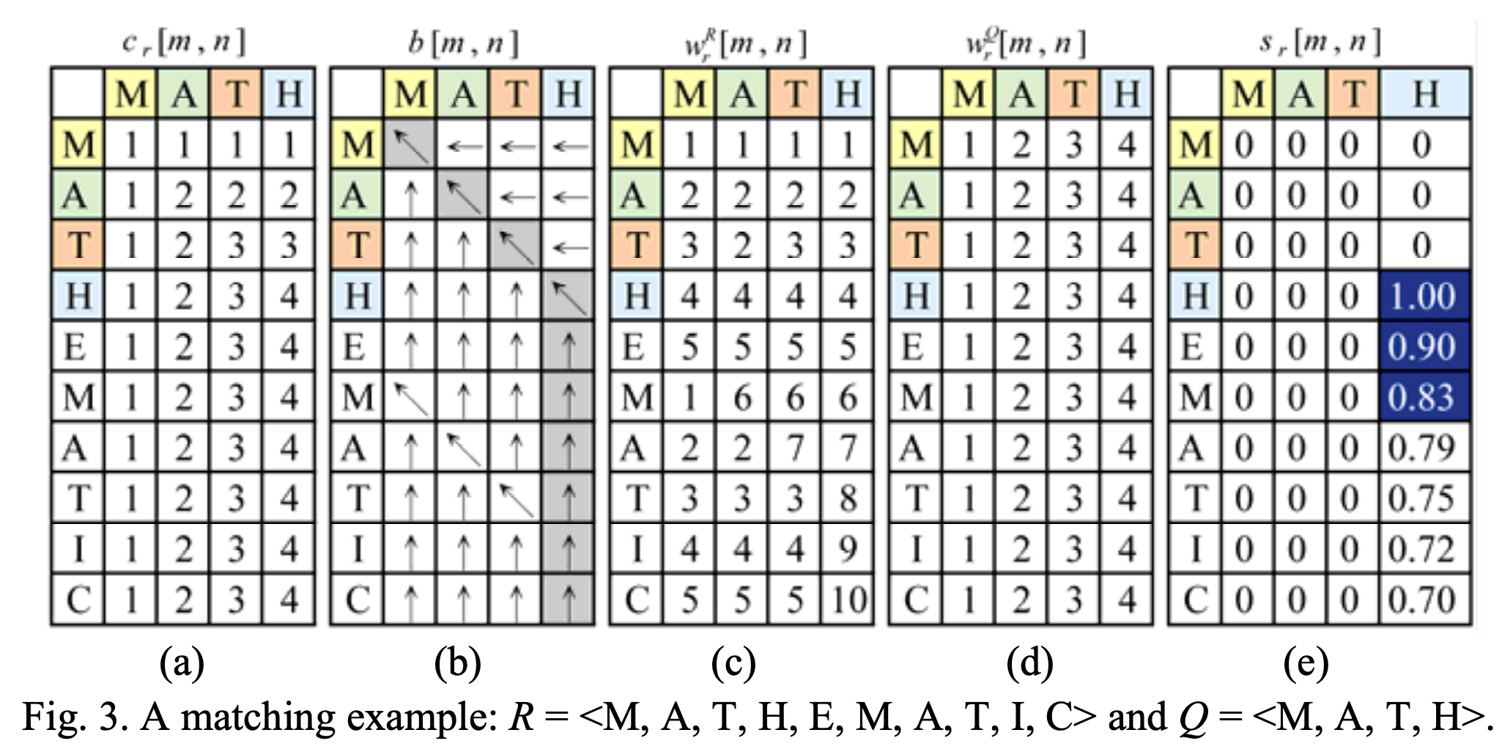
DP for RLCS, RWAR, RWAQ (3/3)
3

Slide 14
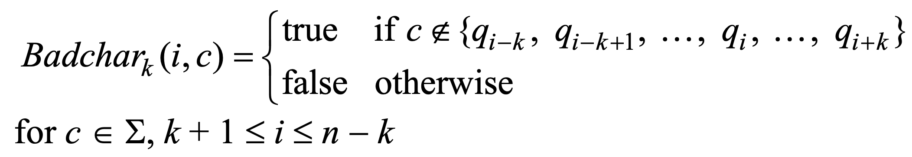
Filtering Algorithm (1/4)
Their potential of not needing to inspect all notes in the reference.
Align the query with a reference window and scan the reference backwards.
Q[i-k : i+k]是否不存在c
Index | 1 | 2 | 3 | 4 | 5 | 6 | 7 | 8 | 9 | 10
Q | b | a | b | b | a | a | c | c | a | a
q : query
i : the index of query
n : the length of query
i : the index of query
k : the threshold of bad character
c : the character
Σ : alphabet set
Badc₂ | 1 | 2 | 3 | 4 | 5 | 6 | 7 | 8 | 9 | 10
a |  |  | 0 | 0 | 0 | 0 | 0 | 0
b |  |  | 0 | 0 | 0 | 0 | 1 | 1
c |  |  | 1 | 1 | 0 | 0 | 0 | 0

Slide 15
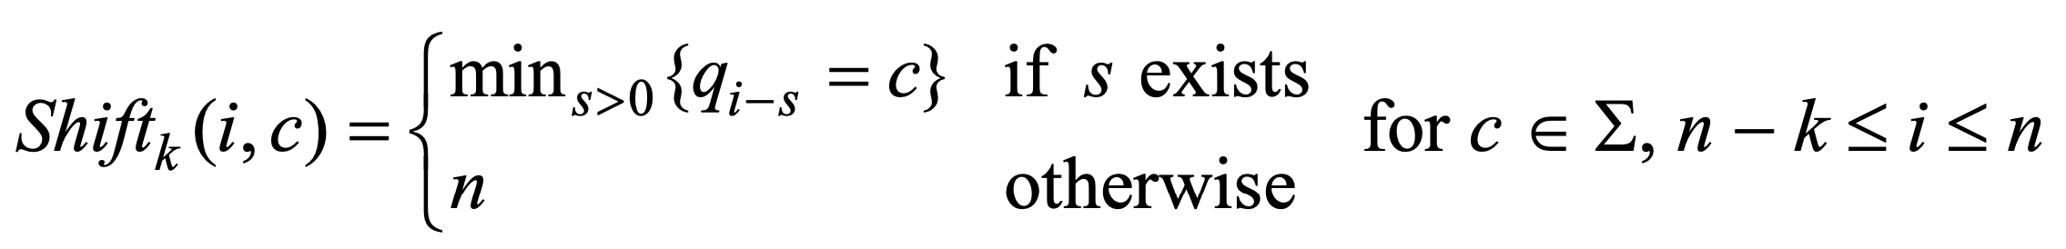
Filtering Algorithm (2/4)
如果c在Q[1 : i-1]之中，則紀錄最後一個c和i的位移
q : query
i : the index of query
n : the length of query
i : the index of query
k : the threshold of bad character
c : the character
Σ : alphabet set
Index | 1 | 2 | 3 | 4 | 5 | 6 | 7 | 8 | 9 | 10
Q | b | a | b | b | a | a | c | c | a | a
Shift₂ | 1 | 2 | 3 | 4 | 5 | 6 | 7 | 8 | 9 | 10
a |  |  |  |  |  |  |  | 2 | 3 | 1
b |  |  |  |  |  |  |  | 4 | 5 | 6
c |  |  |  |  |  |  |  | 1 | 1 | 2

Slide 16
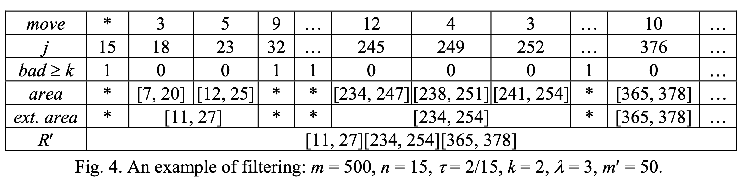
Filtering Algorithm (3/4)
The sequence of moves.
The sequence of positions pointer j travels (starting from j = n = 15)
Is the reference window pointed by pointer j is bad?
The reference windows with pointer values j are potential.
Merging the overlapping areas yields λ extended areas.
A filtered reference (R') are these extended reference areas.
m : the length of reference
m' : the length of filtered reference
n : the length of query
𝜏 : the error tolerance rate
k = 𝜏n : the threshold of bad character
𝜆 : the number of extended areas

Slide 17
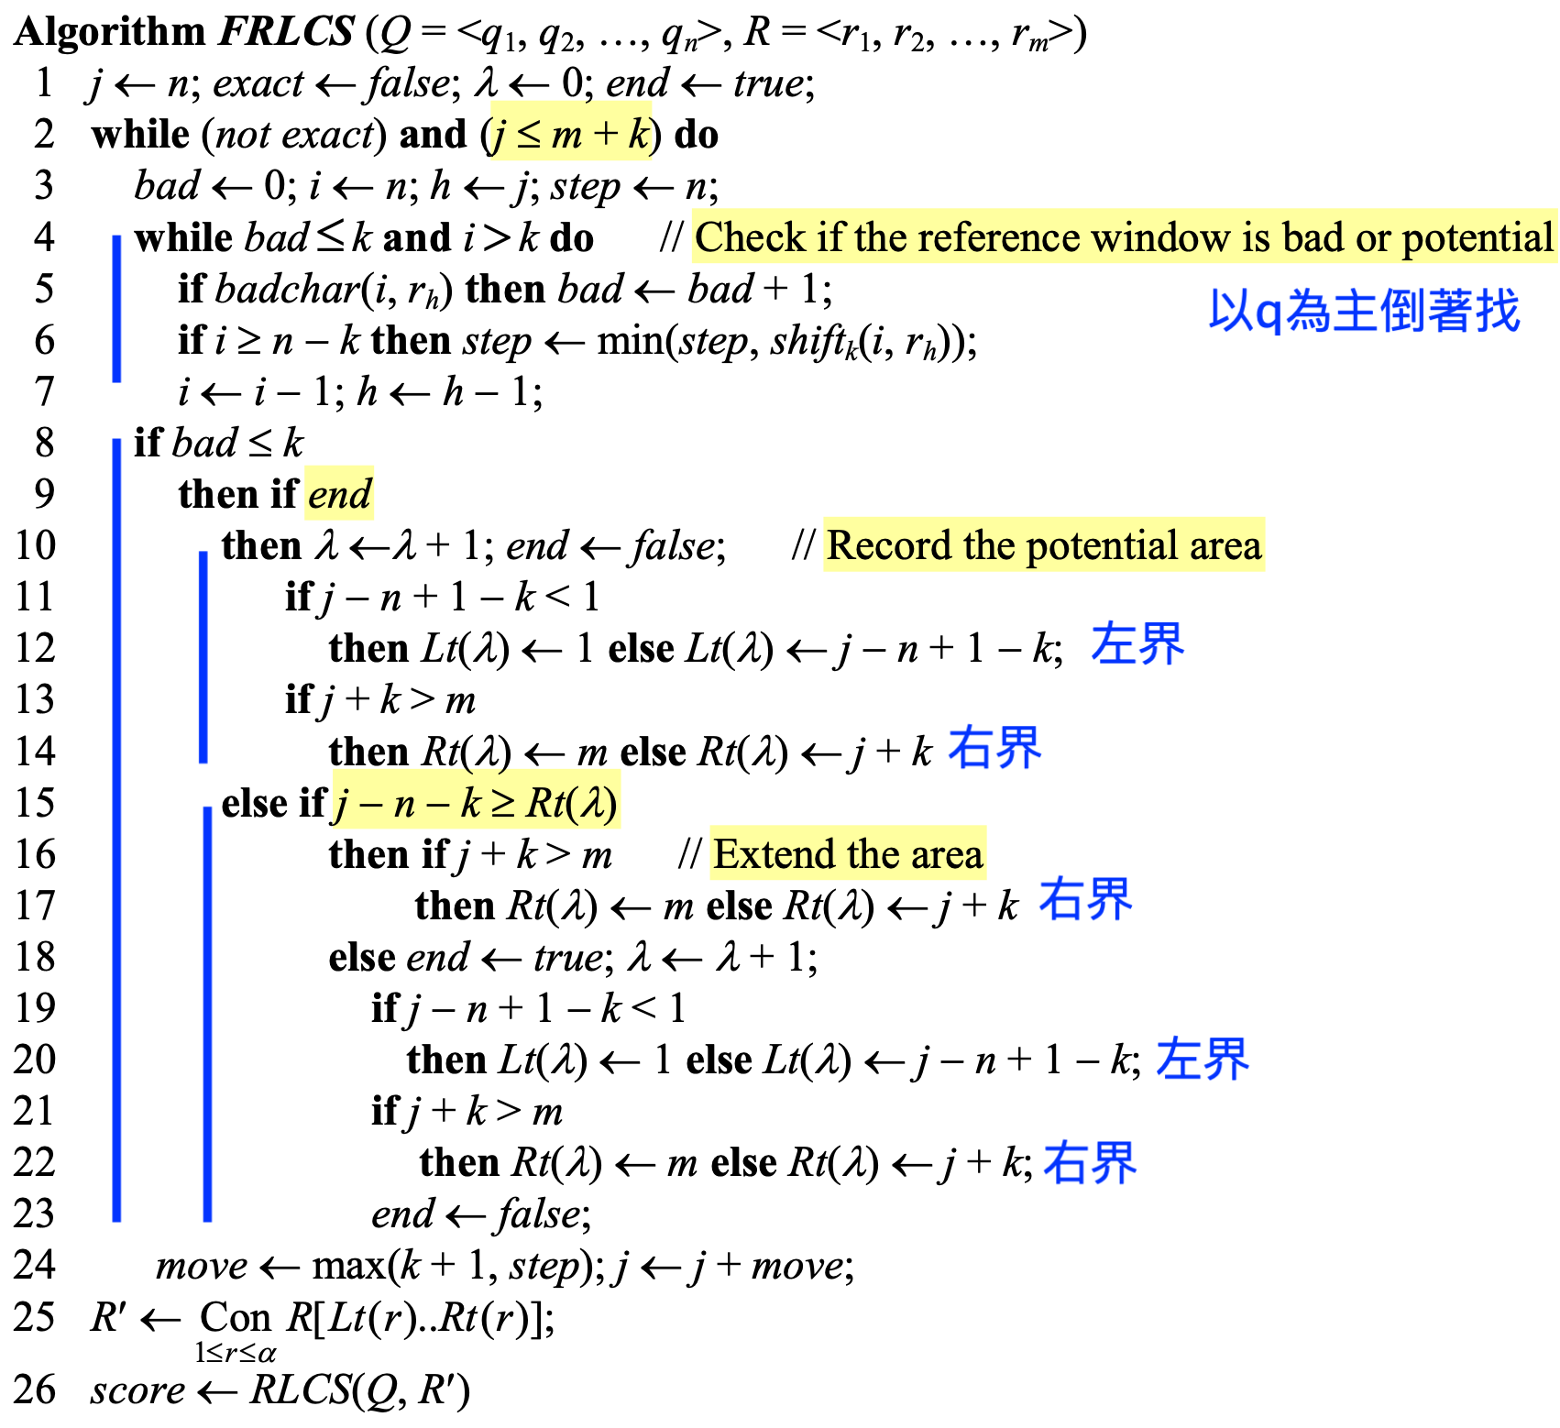
Filtering Algorithm (4/4)

Slide 18
Results (1/3)
A corpus of 3,497 pieces of music consisting of a total of 6,524,476 music notes.
Query A set : a set of 50 queries consisting of 10 to 36 music notes.
Query A set → query B set + query C set
Query set B has noise rates between 5% and 10%
Query set C has noise rates between 10% and 30%
Query set D was generated by the users
Name | Symbol | Value
The threshold value | T_{d} | 1.0
The threshold value | ρ | 0.7
A weight value | β | 0.5
A weight value | α | 0.76

Slide 19
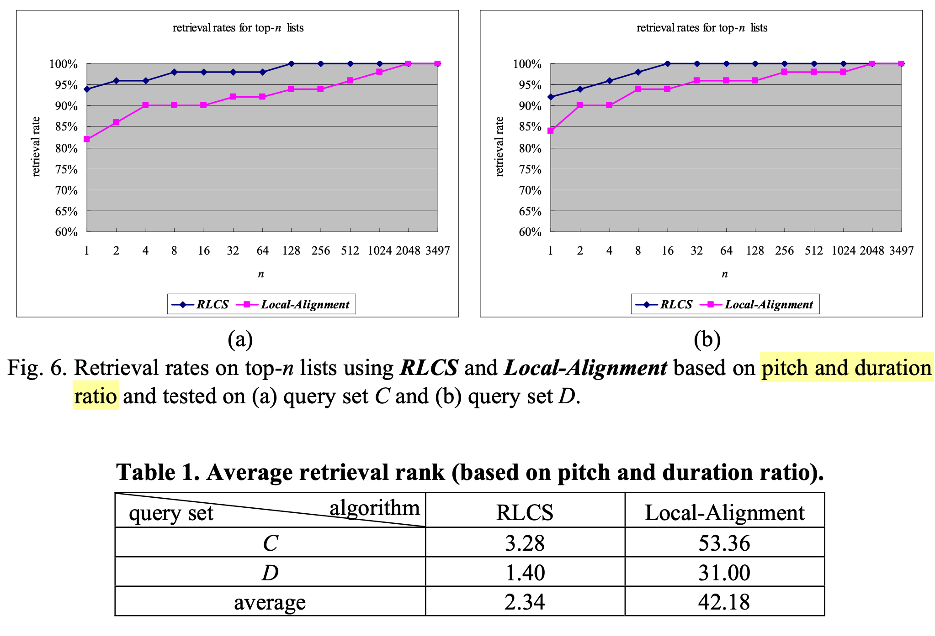
Results (2/3)

Slide 20
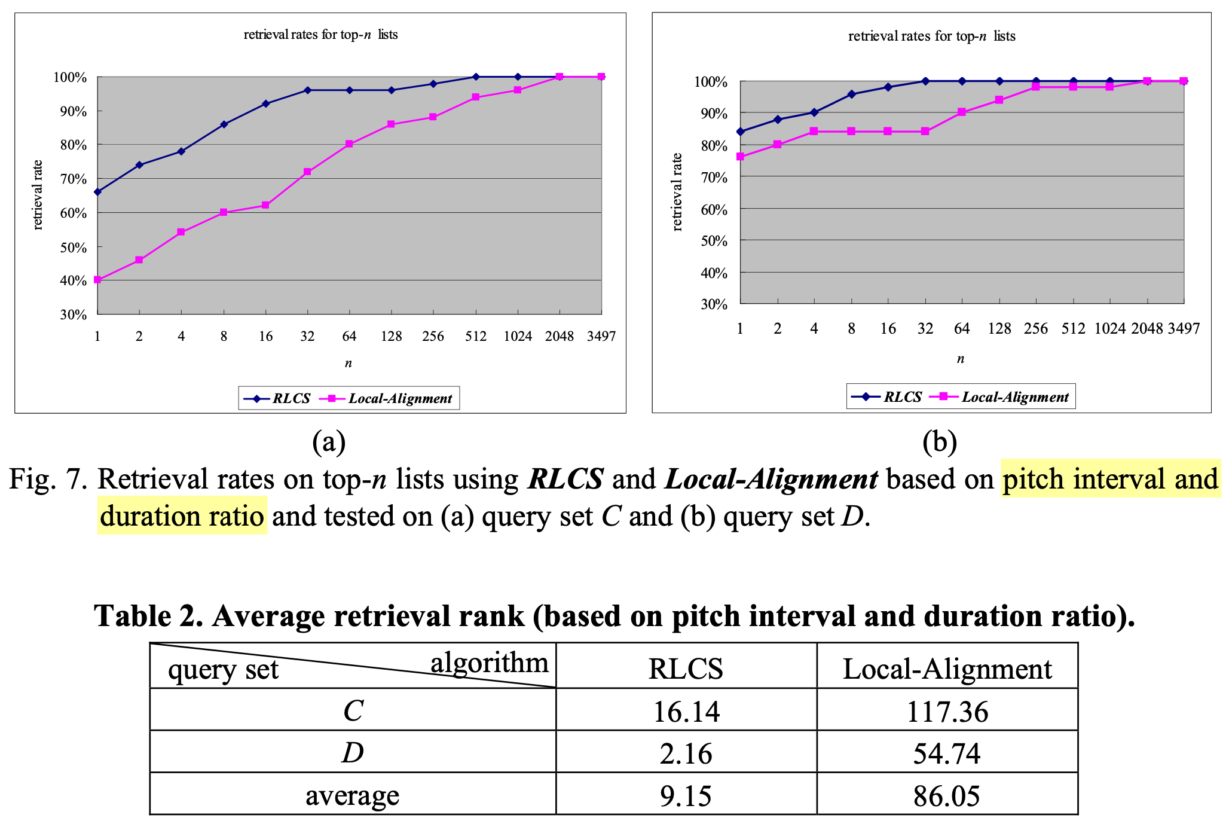
Results (3/3)

Slide 21
Thank you for listening

Slide 22
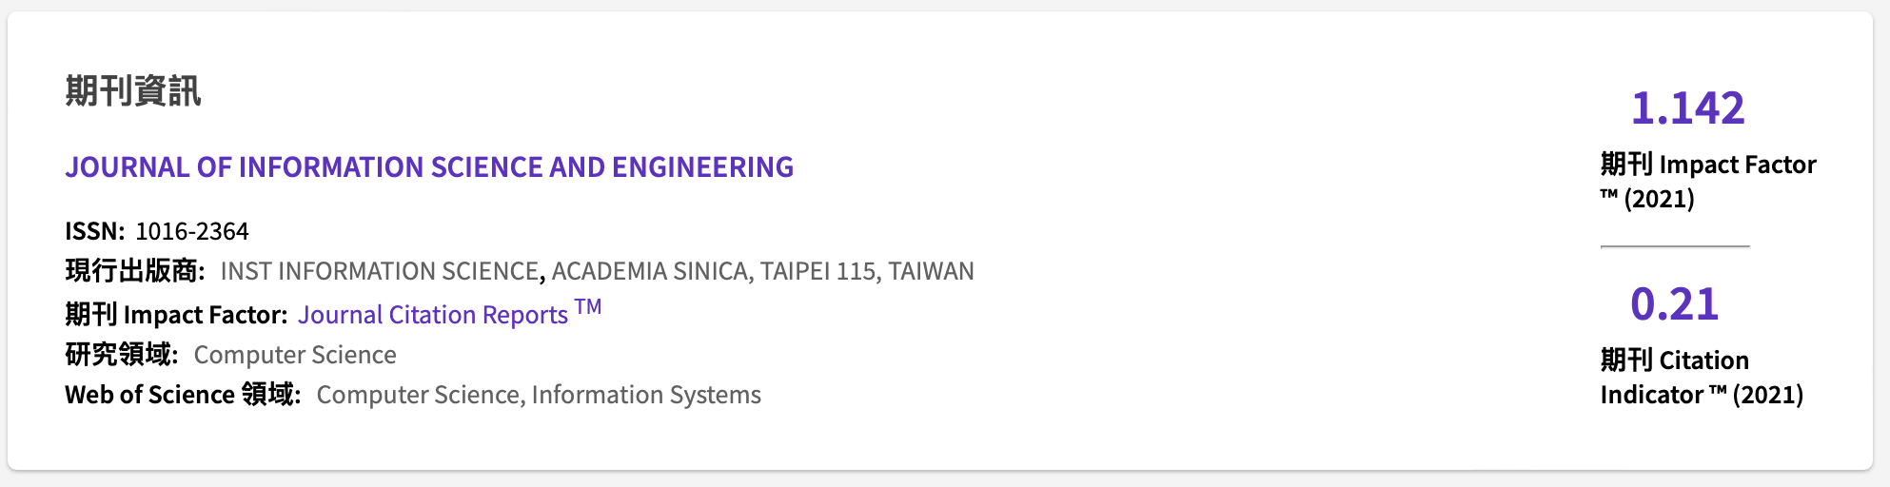
SCI Journal

Slide 23
老師回饋
Distance函數不連續，這樣的設計不是很理想。
應該可以使用反拋物線去設計Distance函數，但這樣原本的DP公式就必須更改成時間序列的公式。
時間序列很像是LCS，但它的符號是有值的，這很符合音樂序列的性質。

