Slide 1
Fast and Accurate Time Series Classification with WEASEL
Patrick Schäfer, Ulf Leser
arXiv:1701
Presenter : Shu-Kai Hung
Date : 2017/4/18

Slide 2
Abstract(1/2)
Time series (TS) occur in many scientific and commercial applications, ranging from earth surveillance to industry automation to the smart grids. An important type of TS analysis is classification, which can, for instance, improve energy load forecasting in smart grids by detecting the types of electronic devices based on their energy consumption profiles recorded by automatic sensors. Such sensor-driven applications are very often characterized by (a) very long TS and (b) very large TS datasets needing classification. However, current methods to time series classification (TSC) cannot cope with such data volumes at acceptable accuracy, they are either scalable but offer only inferior classification quality, or they achieve state-of-the-art classification quality but cannot scale to large data volumes.

Slide 3
Abstract(2/2)
In this paper, we present WEASEL (Word ExtrAction for time SEries cLassification), a novel TSC method which is both scalable and accurate. Like other state-of-the-art TSC methods, WEASEL transforms time series into feature vectors, using a sliding-window approach, which are then analyzed through a machine learning classifier. The novelty of WEASEL lies in its specific method for deriving features, resulting in a much smaller yet much more discriminative feature set. On the popular UCR benchmark of 85 TS datasets, WEASEL is more accurate than the best current non-ensemble algorithms at orders-of-magnitude lower classification and training times, and it is almost as accurate as ensemble classifiers, whose computational complexity makes them inapplicable even for midsize datasets. The outstanding robustness of WEASEL is also confirmed by experiments on two real smart grid datasets, where it out-of-the-box achieves almost the same accuracy as highly tuned, domain-specific methods.

Slide 4
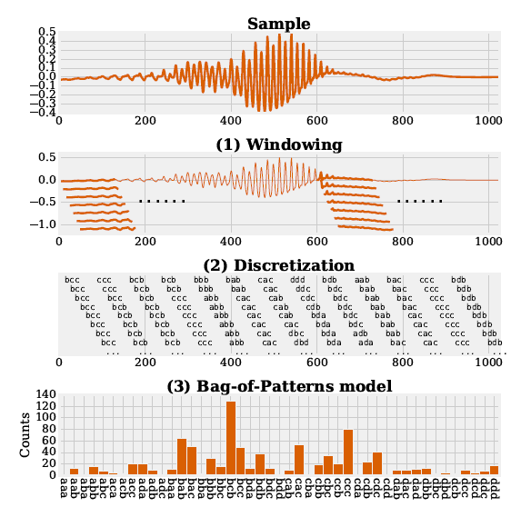
Bag-of-Pattern Symbolic Aggregate approXimation (BOP)
Sample => time series
Window => fixed length
Discretization 轉換成字母
Symbolic Aggregate approximation
(SAX )
Bag-of-Pattern model
Count 每個字母的數量做出的
長條圖

Slide 5
Symbolic Aggregate approximation(SAX )
1.0
c
c
c
0.5
b
b
0.0
a
a
-0.5

Slide 6
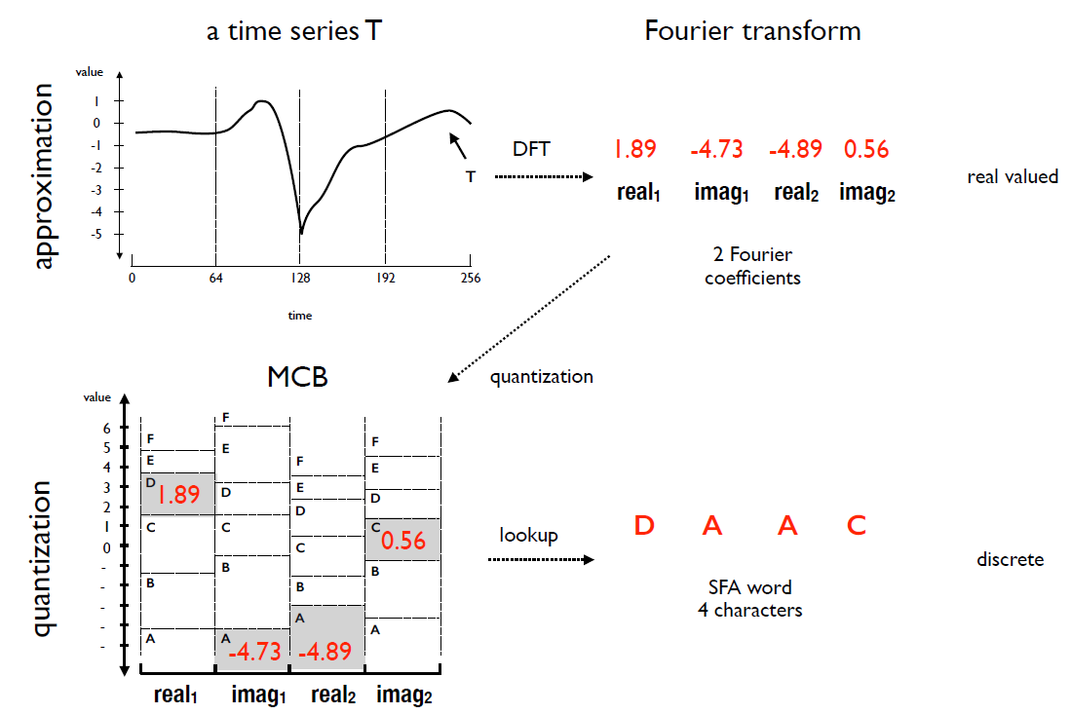
Symbolic Fourier Approximation(SFA )

Slide 7
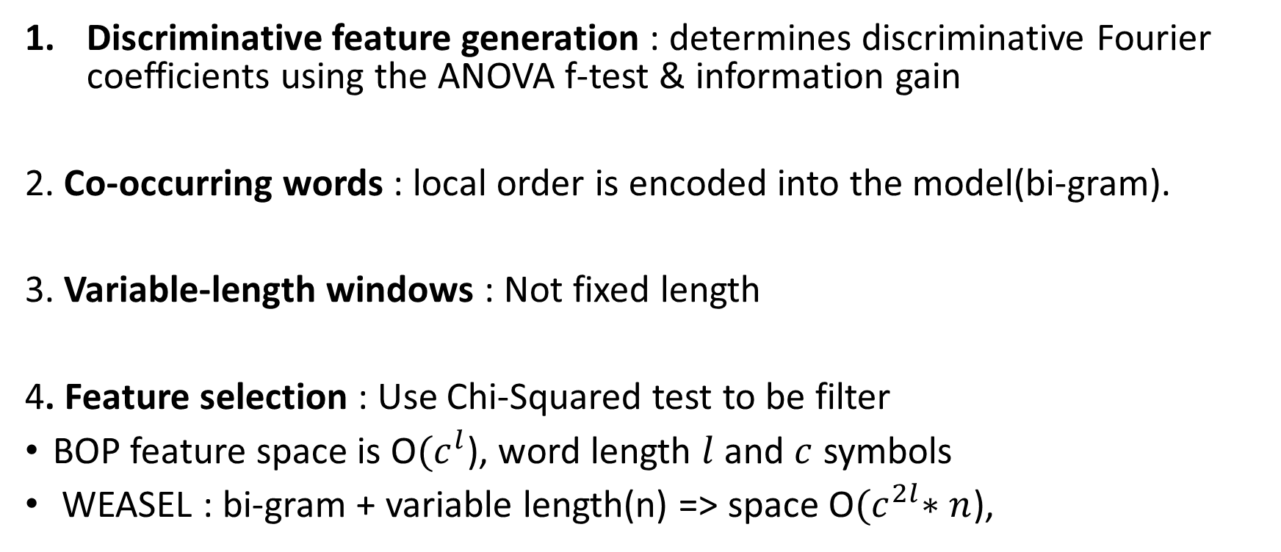
WEASEL(Word ExtrAction for time SEries cLassification)
Discriminative feature generation : determines discriminative Fourier coefficients using the ANOVA f-test & information gain
2. Co-occurring words : local order is encoded into the model(bi-gram).
3. Variable-length windows : Not fixed length
4. Feature selection : Use Chi-Squared test to be filter
BOP feature space is O${(c}^{l}$), word length $l$and $c$ symbols
WEASEL : bi-gram + variable length(n) => space O${(c}^{2l}∗n$),

Slide 8
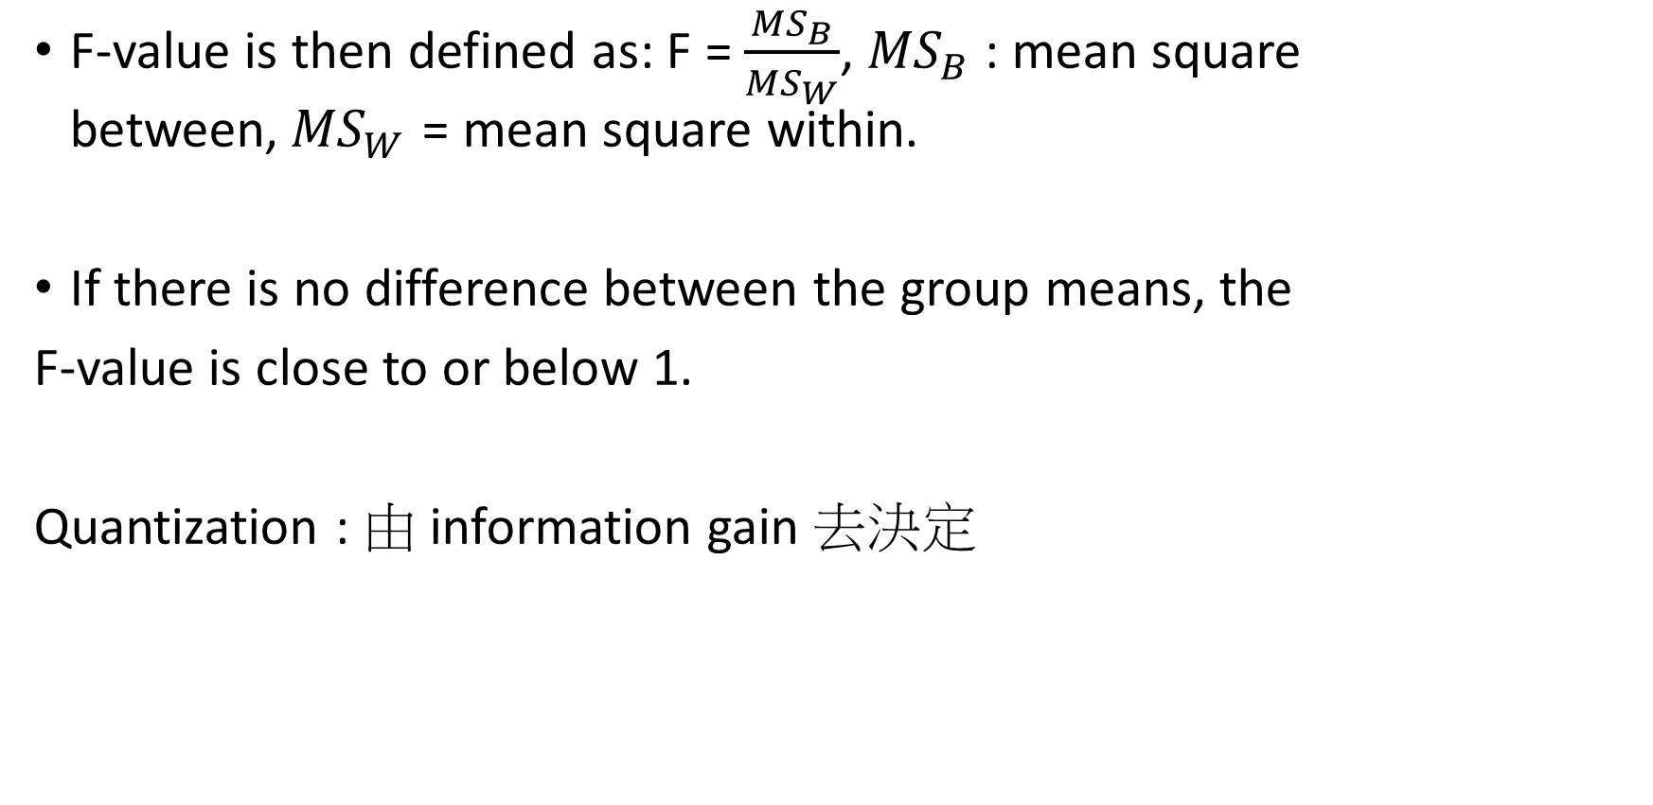
one-way ANOVA F-test
F-value is then defined as: F = $\frac{{MS}_{B}}{{MS}_{W}}$, ${MS}_{B}$ : mean square between,${ MS}_{W}$ = mean square within.
If there is no difference between the group means, the
F-value is close to or below 1.
Quantization : 由 information gain 去決定

Slide 9
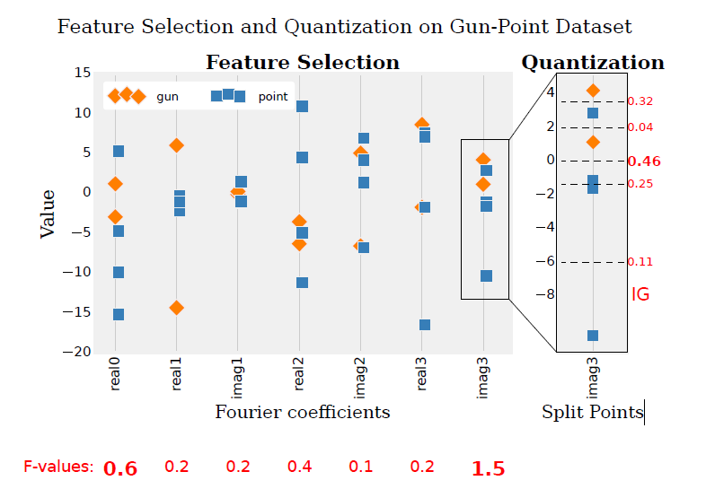

Slide 10
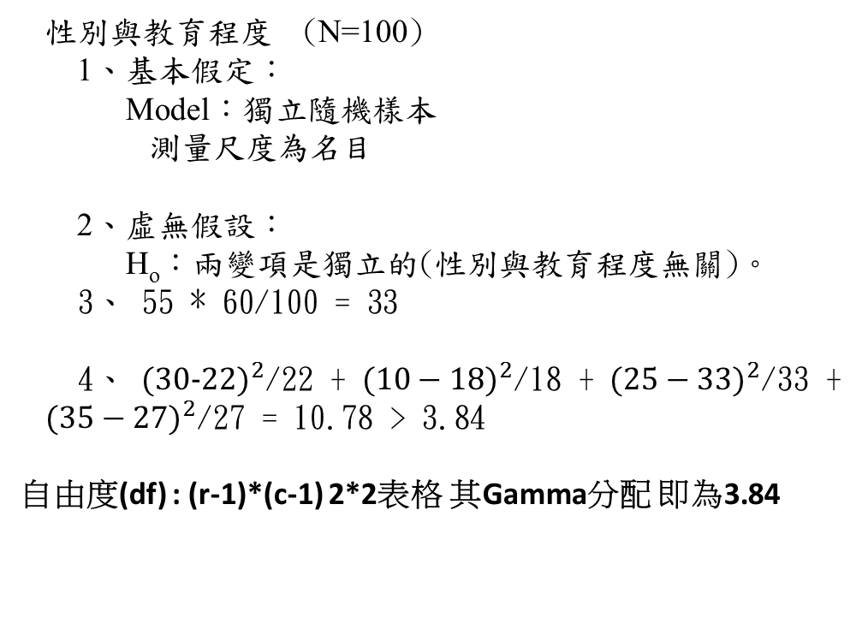
Chi-square
實際值
 | 性別
教育程度 | 男 | 女 | 合計
大 專 | 30 | 10 | 40
大專以下 | 25 | 35 | 60
合計 | 55 | 45 | 100
期待值
 | 性別
教育程度 | 男 | 女 | 合計
大 專 | 22 | 18 | 40
大專以下 | 33 | 27 | 60
合計 | 55 | 45 | 100
性別與教育程度 (N=100)
1、基本假定：
Model：獨立隨機樣本
測量尺度為名目
2、虛無假設：
H_{o}：兩變項是獨立的(性別與教育程度無關)。
3、 55 * 60/100 = 33
4、 ${(30−22)}^{2}$/22 + ${(10−18)}^{2}$/18 + ${(25−33)}^{2}$/33 +
${(35−27)}^{2}$/27 = 10.78 > 3.84
自由度(df) : (r-1)*(c-1) 2*2表格 其Gamma分配 即為3.84

Slide 11
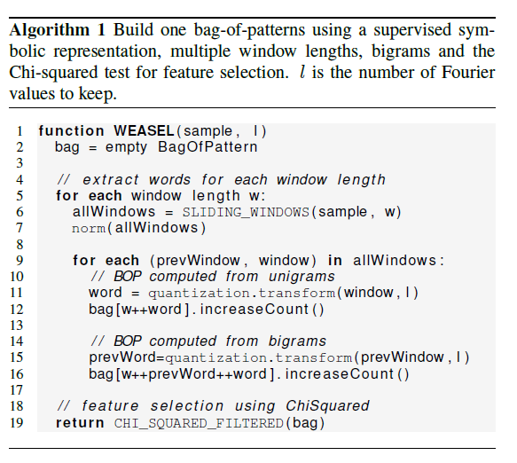

Slide 12
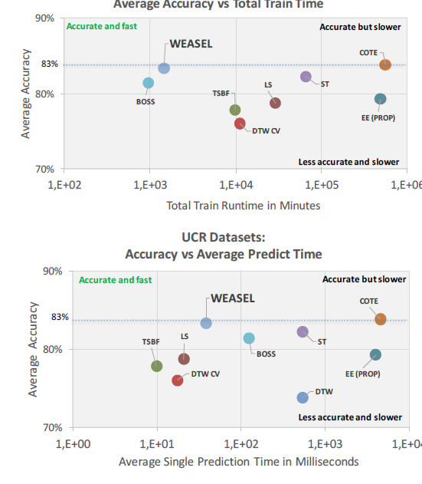
Experiment Result

Slide 13
