Slide 1
Locating Longest Common Subsequences with Limited Penalty
Bin Wang, Xiaochun Yang and Jinxu Li
22nd International Conference on Database Systems for Advanced Applications, Suzhou, China, 2017, pp. 187-201
Presenter: Bi-Shiang Lin
Date:2017/4/18

Slide 2
Abstract(1/3)
Locating longest common subsequences is a typical and important problem. The original version of locating longest common subsequences stretches a longer alignment between a query and a database sequence finds all alignments corresponding to the maximal length of common subsequences.

Slide 3
Abstract(2/3)
However, the original version produces a lot of results, some of which are meaningless in practical applications and rise to a lot of time overhead. In this paper, we firstly define longest common subsequences with limited penalty to compute the longest common subsequences whose penalty values are not larger than a threshold τ. This helps us to find answers with good locality.

Slide 4
Abstract(3/3)
We focus on the efficiency of this problem. We propose a basic approach for finding longest common subsequences with limited penalty. We further analyze features of longest common subsequences with limited penalty, and based on it we propose a filter-refine approach to reduce number of candidates. We also adopt suffix array to efficiently generate common substrings, which helps calculating the problem. Experimental results on three real data sets show the effectiveness and efficiency of our algorithms.

Slide 5
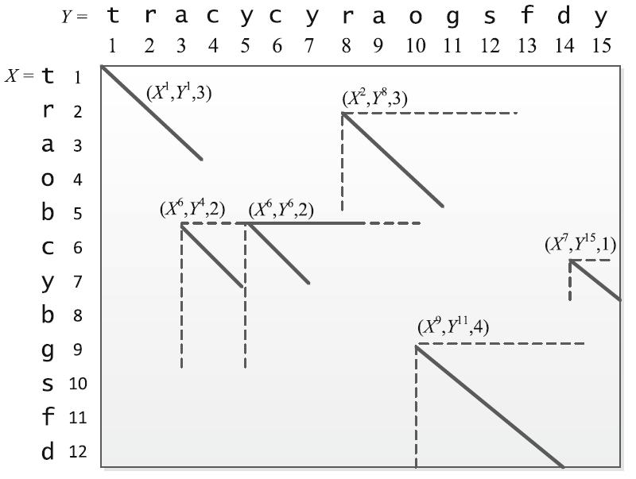

LCS with limited penalty (LCSp)
Find LCS with penalty $≤ τ$ (limited penalty)
Penalty of mismatch = $α$, space = $β$.
$$2β+(α+4β)$$
$$2α+\left(α+2β\right)$$

Slide 7
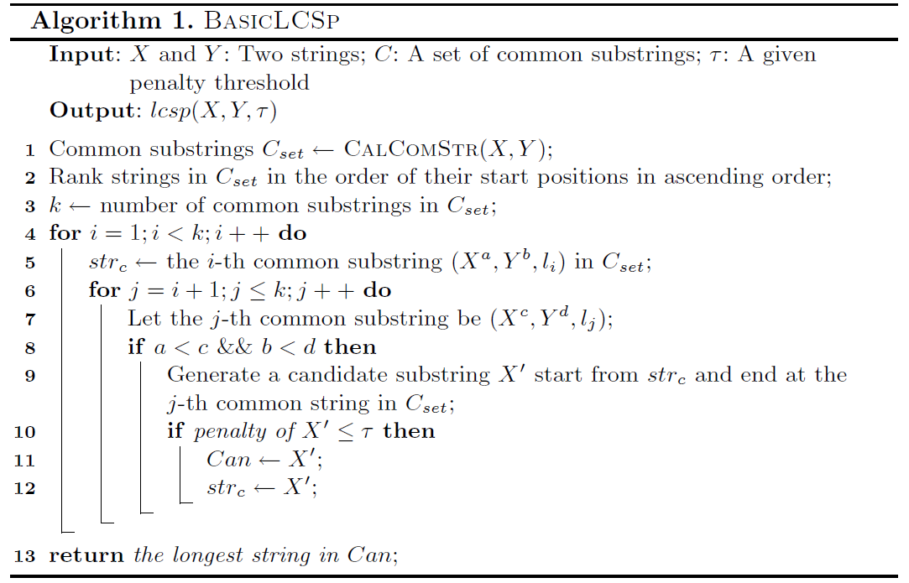
$$O\left(k^{2}\right) time? k=number of common substrings.$$

Slide 8

Pruning (useless concatenation)
if $τ$ = 4, not legal

Slide 9
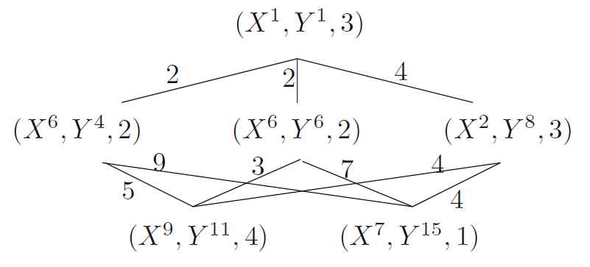

Pruning (early termination)
DFS
if $τ$ = 3

Slide 10
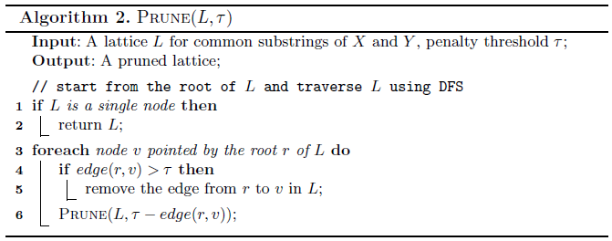

Slide 11
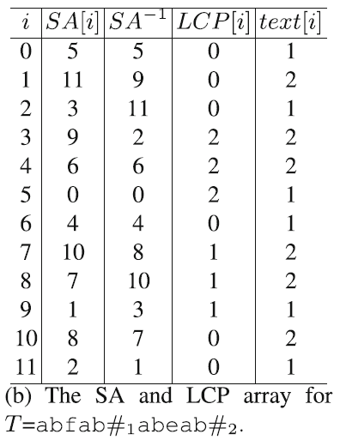

Find common substrings
With suffix array, common substrings can be found in linear time.

Slide 12
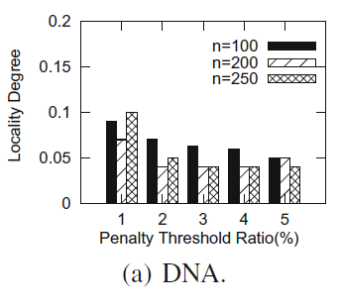

Experiments
$LD\left(locality degree\right)=\frac{avg(\sum{l\left({lcs}_{p}\right)})}{avg(\sum{l\left(lcs\right)}−\sum{l\left({lcs}_{p}\right)})}$

Slide 13
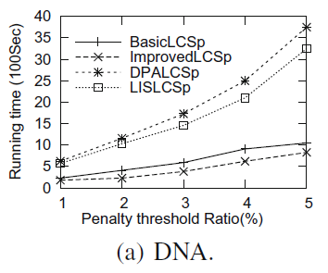
Experiments

