Slide 1
Stock trading with cycles A financial application of ANFIS and reinforcement learning
Expert Systems with Applications Volume 38, Issue 5, May 2011, Pages 4741–4755
Zhiyong Tan, Chai Quek, Philip Y.K. Cheng
Presenter：Jia-Hong Liu
Date：2017/3/6

Slide 2
Abstract(1/2)
Based on the principles of technical analysis, this paper proposes an artificial intelligence model, which employs the Adaptive Network Fuzzy Inference System (ANFIS) supplemented by the use of reinforcement learning (RL) as a non-arbitrage algorithmic trading system. The novel intelligent trading system is capable of identifying a change in a primary trend for trading and investment decisions. It dynamically determines the periods for momentum and moving averages using the RL paradigm and also appropriately shifting the cycle using ANFIS-RL to address the delay in the predicted cycle.

Slide 3
Abstract(2/2)
This is used as a proxy to determine the best point in time to go LONG and visa versa for SHORT. When this is coupled with a group of stocks, we derive a simple form of ‘‘riding the cycles – waves”. These are the derived features of the underlying stock movement. It provides a learning framework to trade on cycles. Initial experimental results are encouraging. Firstly, the proposed framework is able to outperform DENFIS and RSPOP in terms of true error and correlation. Secondly, based on the test trading with five US stocks, the proposed trading system is able to beat the market by about 50 percentage points over a period of 13 years.

Slide 4
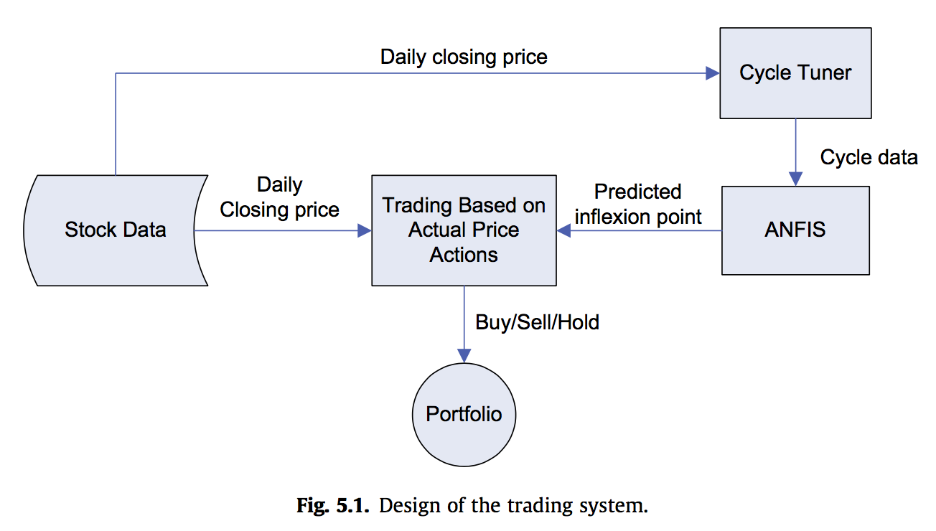
Design of the trading system

Slide 5


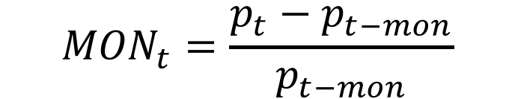
Cycle Tunner
$${MON}_{t}=\frac{p_{t}−p_{t−mon}}{p_{t−mon}}$$
$${Cycle}_{t}=\frac{{MON}_{t−ma+1}+{MON}_{t−ma+2}+…+{MON}_{t−1}+{MON}_{t}}{ma}$$

Slide 6


Cycle Tunner

Slide 7

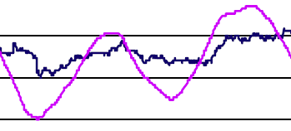
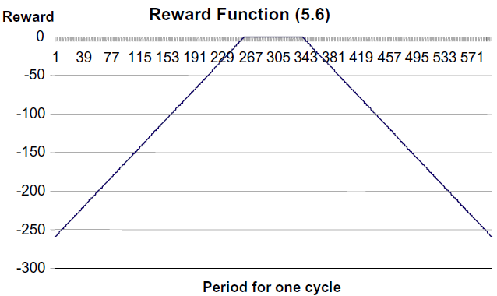
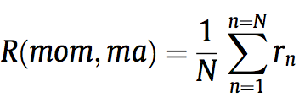
Cycle Tunner

Slide 8
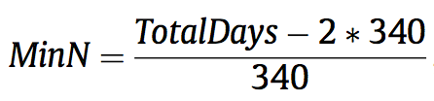
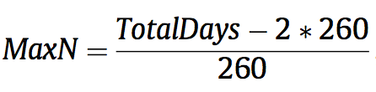
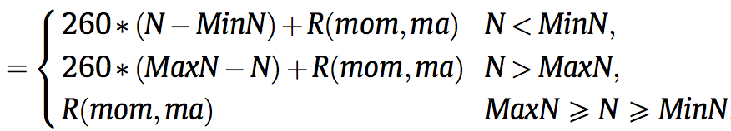


Slide 9
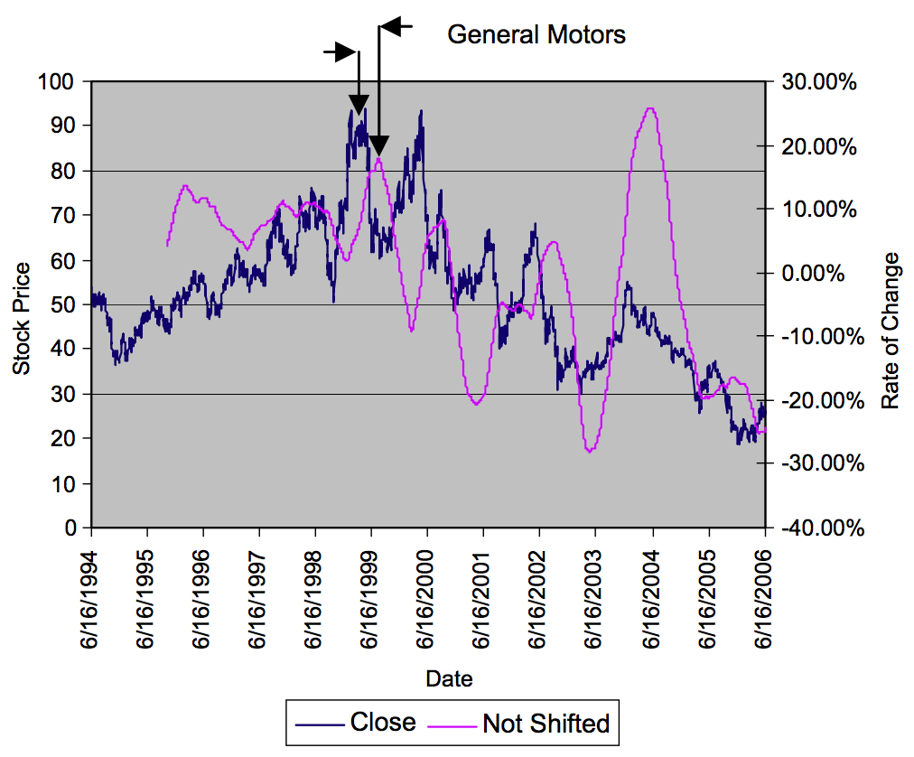
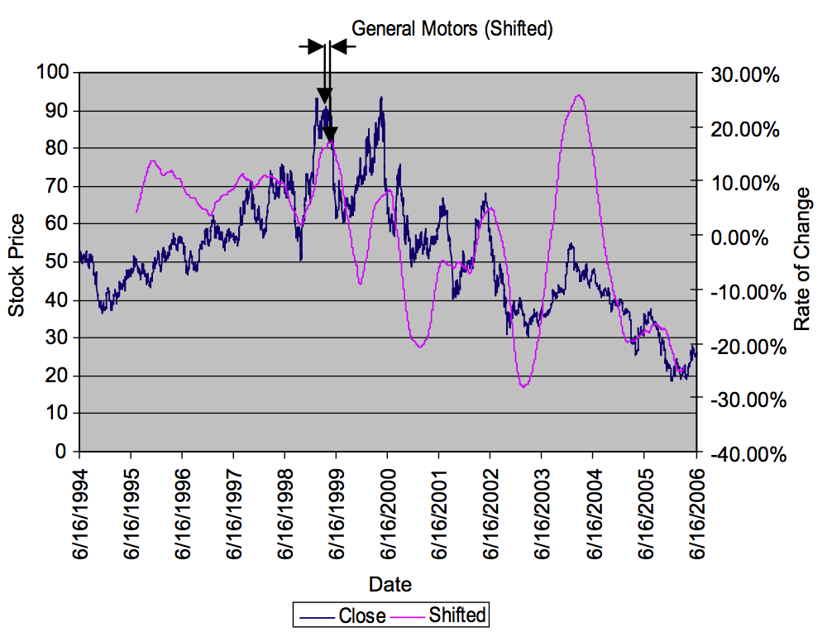
Cycle Shift

Slide 10
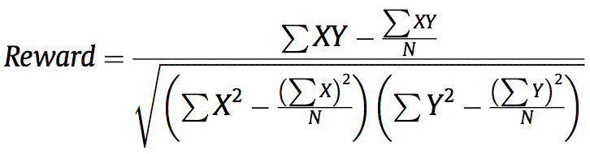
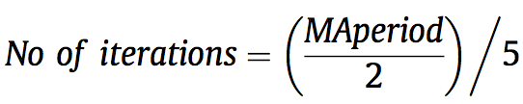
Cycle Shift

Slide 11


Adaptive Network Fuzzy Inference System (ANFIS)

Slide 12
Adaptive Network Fuzzy Inference System (ANFIS)

Slide 13
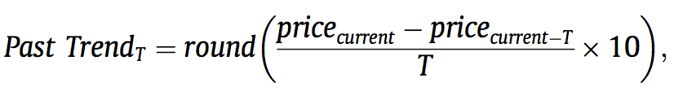

Learning to trade
Past Trend₉₀
Past Trend₇₀
Past Trend₃₀
State_{current}

Slide 14
Learning to buy
Bye
Bye
Bye
Sell
Bye
Sell

Slide 15
Learning to sell
Sell
Sell
Sell
Sell
Bye
Bye

Slide 16



Decision making process
Buy stopping criteria
Sell stopping criteria

Slide 17
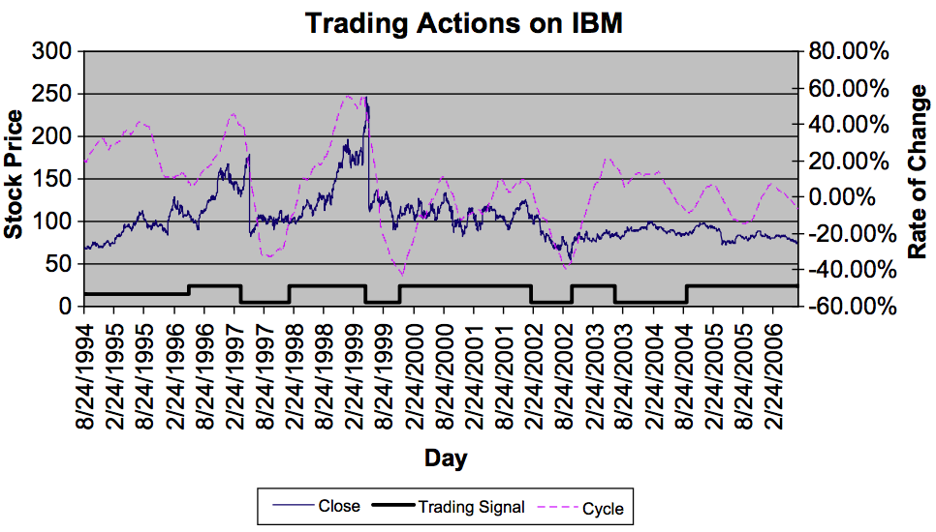
Result
Notes:
13年

Slide 18
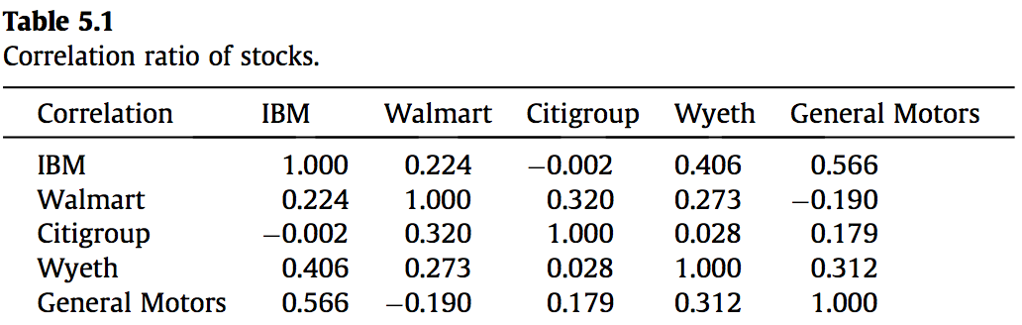
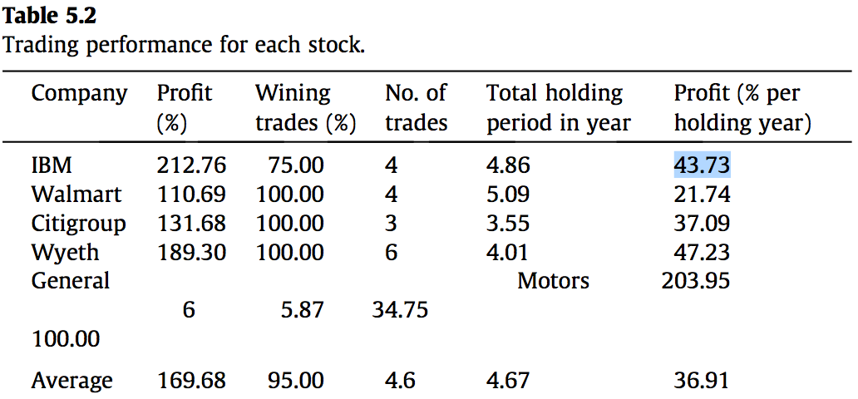
Result
Variety Stores
Finance
Healthcare
Automotive
General Motors 203.95 100.00 6 5.87 34.75
Notes:
Citigroup (Finance),
General Motors (Automotive), Wyeth (Healthcare), IBM (Information
Technology) and Walmart (Variety Stores)

Slide 19
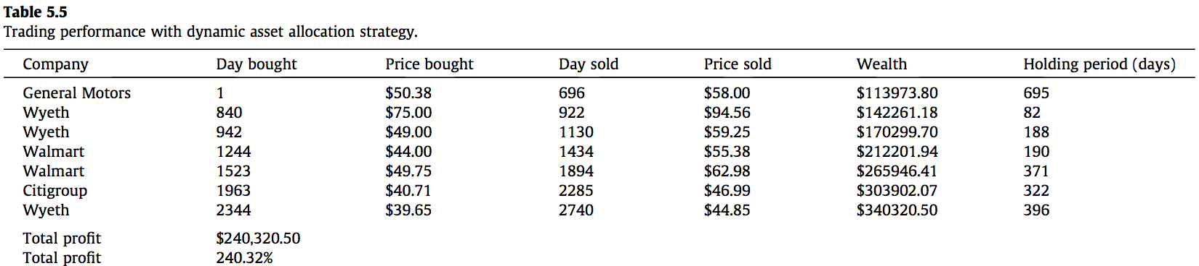
Trading with dynamic asset switching strategy

