Slide 1
Proceedings of the 8th international conference on machine learning and data mining in pattern recognition(MLDM), pages. 525–539, L. Moreira-Matias, J. Mendes-Moreira, J. Gama, and P. Brazdil(2012)
Text Categorization Using an Ensemble Classifier Based on a Mean Co-association Matrix
Presenter：Jyun-Hao Lai
Date：2017 / 06 / 13
Notes:
1

Slide 2
Abstract
Text Categorization (TC) has attracted the attention of the research community in the last decade. Algorithms like Support Vector Machines, Naïve Bayes or k Nearest Neighbors have been used with good performance, confirmed by several comparative studies. Recently, several ensemble classifiers were also introduced in TC. However, many of those can only provide a category for a given new sample. Instead, in this paper, we propose a methodology – MECAC – to build an ensemble of classifiers that has two advantages to other ensemble methods: 1) it can be run using parallel computing, saving processing time and 2) it can extract important statistics from the obtained clusters. It uses the mean co-association matrix to solve binary TC problems. Our experiments revealed that our framework performed, on average, 2.04% better than the best individual classifier on the tested datasets. These results were statistically validated for a significance level of 0.05 using the Friedman Test.

Slide 3
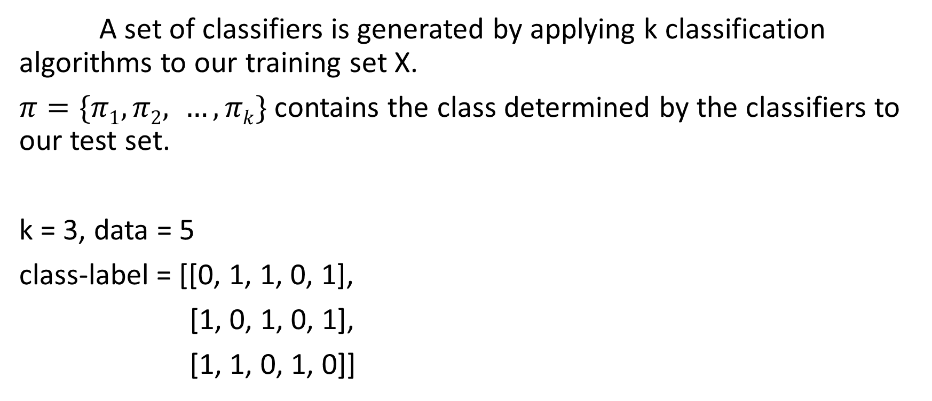
Step 1 The Classifiers Training
A set of classifiers is generated by applying k classification algorithms to our training set X.
$π=\{π1,π2, …,πk\}$ contains the class determined by the classifiers to our test set.
k = 3, data = 5
class-label = [[0, 1, 1, 0, 1],
[1, 0, 1, 0, 1],
[1, 1, 0, 1, 0]]

Slide 4
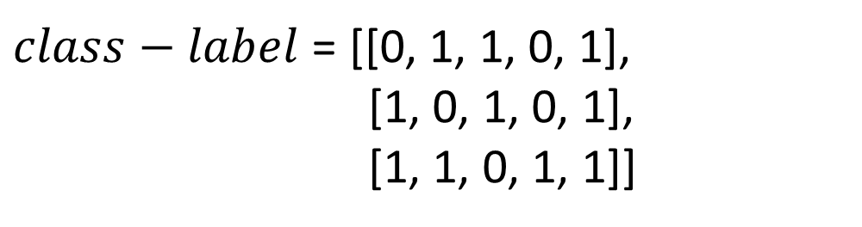
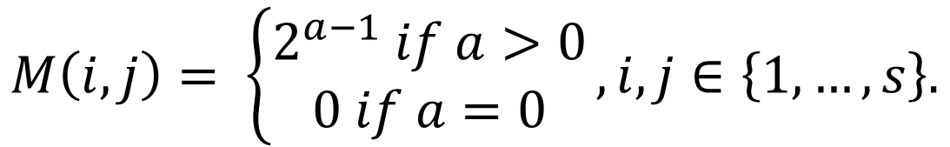
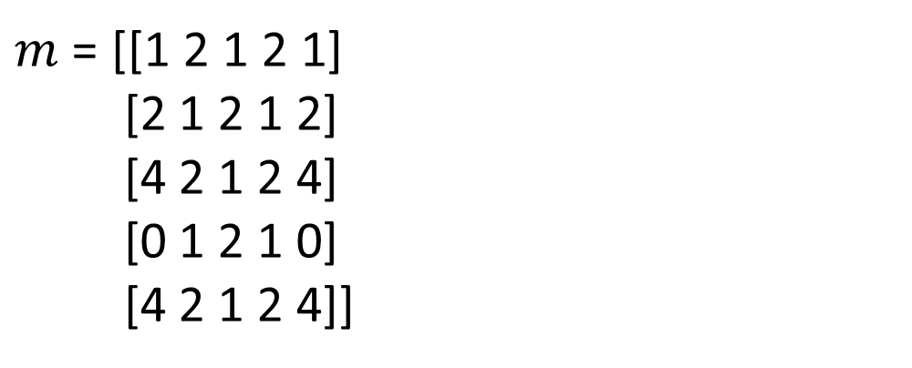
Step 2 The calculus of the Agreement Matrix
$$M\left(i, j\right)= \left\{\begin{aligned}2^{a−1} if a>0 \\ 0 if a=0\end{aligned}\right.,i, j∈\left\{1,…,s\right\}.$$
$m$ = [[1 2 1 2 1]
[2 1 2 1 2]
[4 2 1 2 4]
[0 1 2 1 0]
[4 2 1 2 4]]
$class−label$ = [[0, 1, 1, 0, 1],
[1, 0, 1, 0, 1],
[1, 1, 0, 1, 1]]

Slide 5
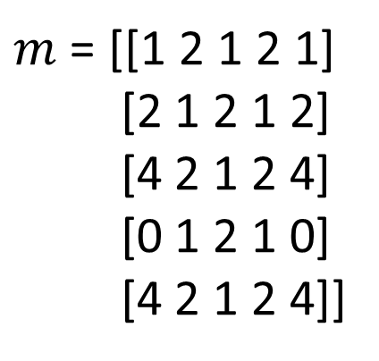
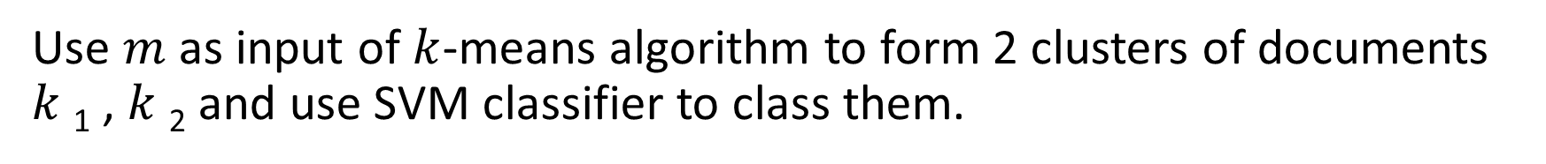
Step 3 The Document Clustering
Use $m$ as input of $k$-means algorithm to form 2 clusters of documents $k$₁ , $k$₂ and use SVM classifier to class them.
clusters = 2
$m$ = [[1 2 1 2 1]
[2 1 2 1 2]
[4 2 1 2 4]
[0 1 2 1 0]
[4 2 1 2 4]]
[0, 0, 1, 0, 1]

Slide 6
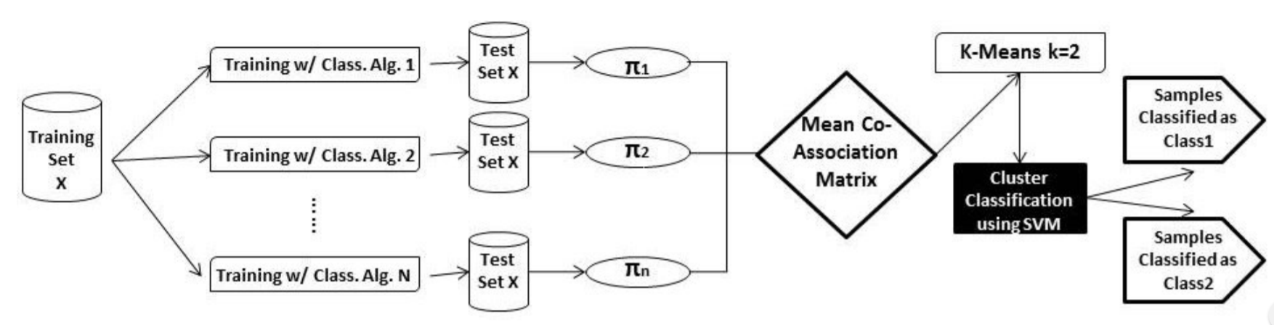
Architecture
主要是應用於文件的二元分類，例如：垃圾郵件判斷。

Slide 7
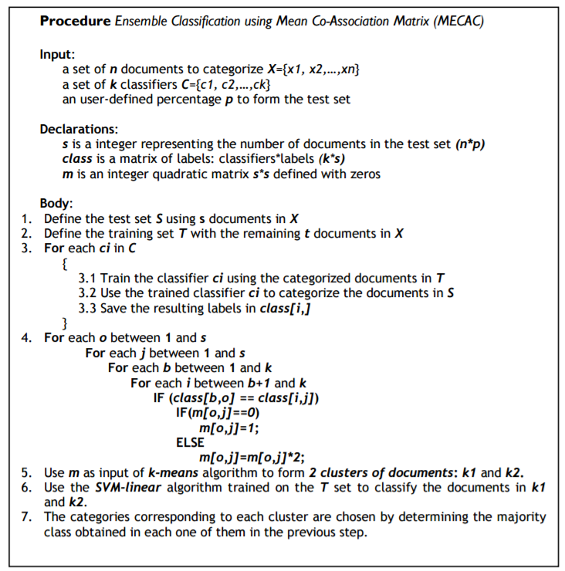
Algorithm
Step 1
The Classifiers Training
Step 2
The calculus of the Agreement Matrix
Step 3
The Document Clustering

Slide 8
from sklearn.cluster import KMeans
m = np.zeros((5,5), dtype=int)
class_label = [[0, 1, 1, 0, 1],
[1, 0, 1, 0, 1],
[1, 1, 0, 1, 1]]
for o in range(0, 5):
for j in range(0, 5):
for b in range(0, 3):
for i in range(b + 1, 3):
if class_label[b][o] == class_label[i][j]:
print('b = ', b, ' o = ', o, ' and i = ', i, ' j = ', j)
print(' before m[', o, '][', j, '] = ', m[o][j])
if m[o][j] == 0:
m[o][j] = 1
else:
m[o][j] = m[o][j] * 2
print(' after m[', o, '][', j, '] = ', m[o][j])
num_clusters = 2
km = KMeans(n_clusters=num_clusters)
km.fit(m)
print(km.labels_.tolist()) #[0, 0, 1, 0, 1]

Slide 9
Result
Dataset：路透社21578，自 1987 年 2 月 26 日到 1987 年 10 月
9 日所收集的新聞，共有 21,578 篇文件。
作者使用了135類中的其中7類作為實驗的材料，並分成5個資料集。
dataset | Class 1 | Class 2
DS1 | Wheat | Money-FX
DS2 | Sugar | Interest
DS3 | Sugar | Crude
DS4 | Interest | Coffee
DS5 | Grain | Crude

Slide 10
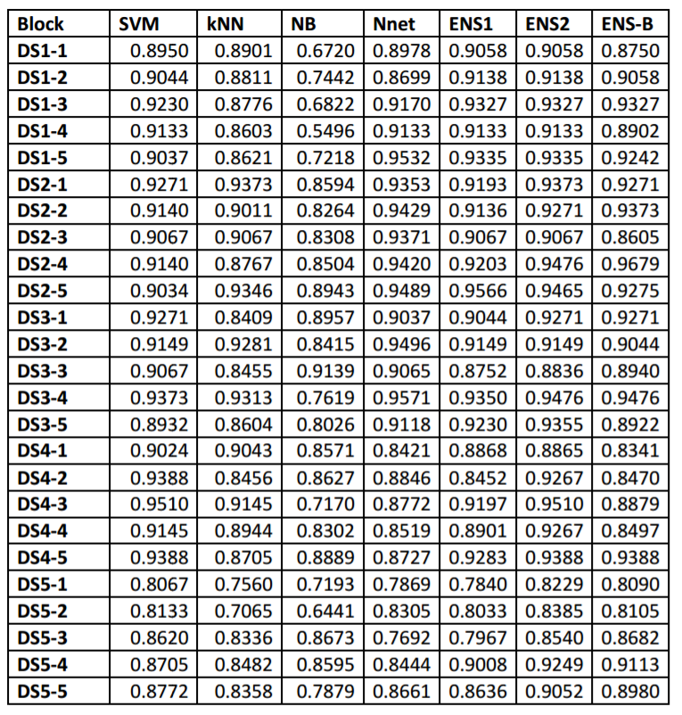
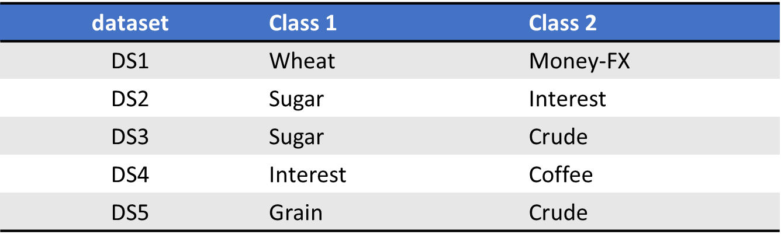
Result：
SVM： Support Vector Machines
KNN ：k Nearest Neighbors
NB ：Naïve Bayes
Nnet ： Neural Networks
EnsB ：使用上述4個分類器，並使用投票法。
Ens1 ：使用上述4個分類器，但加入了論文所提的分類架構。
Ens2 ：一樣使用了論文所提的分類架構，但是去除了Bayes分類器。

Slide 11
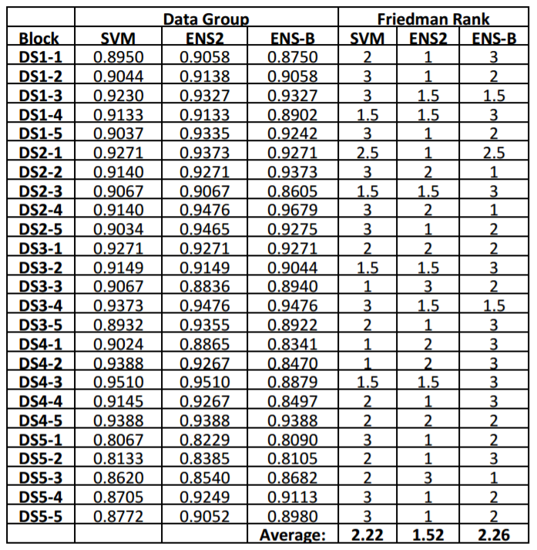

Result：
比較SVM，ENS2，ENSB的各個效能。
作者提出的ENS2的架構，在分類的效能上
較其他兩者佳。

