Slide 1
On the Constrained Longest Common Subsequence Problem
Anna Gorbenko
IAENG International Journal of Computer Science,
Vol. 40, Issue 4, pp. 266-273, 2013
Presenter: Shou-Fu Lo
Date:2017/06/13

Slide 2
Abstract
The problem of the longest common subsequence is a classical distance measure for strings. There have been several attempts to accommodate longest common subsequences along with some other distance measures. There are a large number of different variants of the problem. In this paper, we consider the constrained longest common subsequence problem for two strings and arbitrary number of constraints. In particular, we consider an explicit reduction from the problem to the satisfiability problem and present experimental results for different satisﬁability algorithms. It should be noted that different regularities in experimentally obtained data reveal important information about the underlying physical system. In this paper, we consider the problem of systematic monitoring of passenger ﬂows. In particular, we use constrained longest common subsequences for tracking the image features.

Slide 3
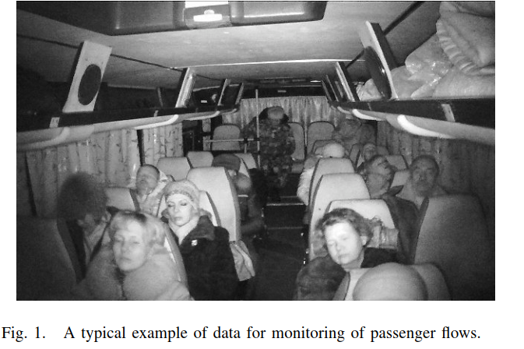
Systematic monitoring of passenger ﬂows
In general, we can apply various face and body detectors to images for solution of this problem. However, low quality of data (see e.g. Figure 1) makes this task very difﬁcult. To simplify this task, it is natural to use some method of tracking the image features. In particular, we can represent a sequence of features as a string.

Slide 4
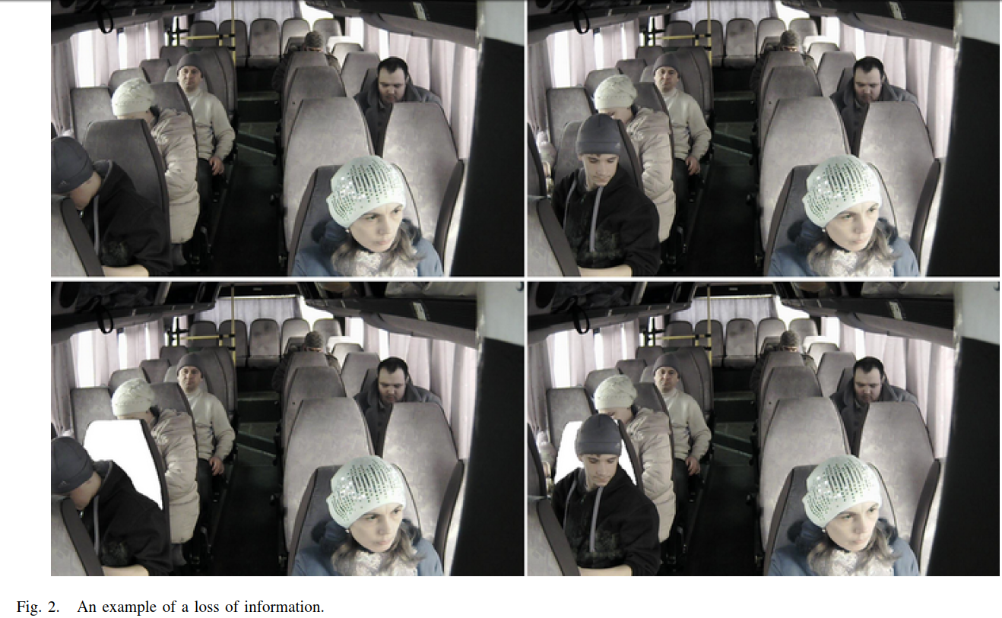
Systematic monitoring of passenger ﬂows
We can consider strings of features of current and previous images and use longest common subsequence to establish a feature correspondence.

Slide 5
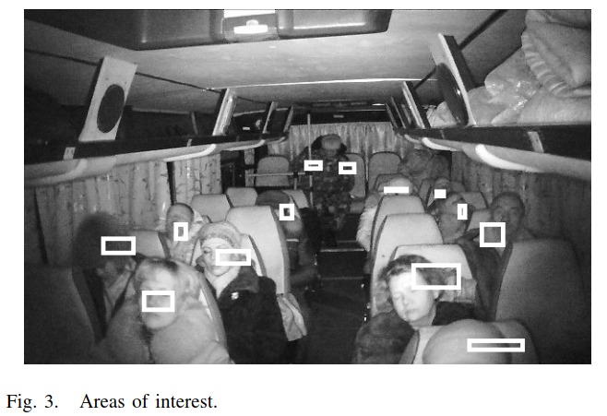
Systematic monitoring of passenger ﬂows
We use Haar cascades for initial detection of passengers. Haar cascades allow us to obtain a set of various features, parts of faces, parts of bodies, pieces of clothing and so on. We classify these features based on their motion.

Slide 6

Systematic monitoring of passenger ﬂows
Let f be a feature. The set of pixels of the feature f at
time t we denote by S_{f} (t).
Let f 〈x(t), y(t)〉 be a feature f with coordinates.
We assume that f₁〈x₁(t), y₁ (t)〉< f₂〈x₂(t), y₂ (t)〉
⇔ $\left\{\begin{aligned}\text{ (}\text{x}\text{1}\text{ (}\text{t}\text{ − 1) < }\text{x}\text{2}\text{ (}\text{t}\text{ − 1))∧ (}\text{x}\text{1}\text{(}\text{t}\text{) <} \text{x}\text{2}\text{(}\text{t}\text{) + }\text{ε}\text{), } \\ \text{((}\text{x}\text{1}\text{(}\text{t}\text{ − 1) =}\text{x}\text{2}\text{(}\text{t}\text{ − 1))∧ (}\text{y}\text{1 (}\text{t}\text{ − 1) > }\text{y}\text{2 (}\text{t}\text{ − 1)))∧ (}\text{x}\text{1}\text{(}\text{t}\text{) <}\text{x}\text{2}\text{(}\text{t}\text{) + }\text{ε}\text{), } \\ \text{(}\text{x}\text{2}\text{(}\text{t}\text{) ≥} \text{x}\text{1}\text{(}\text{t}\text{) + }\text{ε}\text{),} \end{aligned}\right.$
where ε is a constant that depends on the resolution of the images.

Slide 7

Systematic monitoring of passenger ﬂows
Under this assumption, we can construct the string
F (t) = f_{t,1}〈x_{t,1}(t), y_{t,1} (t)〉 f_{t,2}〈x_{t,2}(t), y_{t,2} (t)〉… f_{t,}$r_{t}$〈x_{t,}$r_{t}$(t),
y_{t,}$r_{t}$ (t)〉 of all features at time t.
We assume that
f₁〈x₁(t), y₁ (t)〉= f₂〈x₂(t), y₂ (t)〉
if and only if f₁ = f₂ . For feature tracking, we consider
strings F (t − 1) and F (t) and the set of constraints
{Z_{j} | 1 ≤ j ≤ α}.

Slide 8
Systematic monitoring of passenger ﬂows
We use constrained longest common subsequence to localize passengers. If we can not solve the problem, then we again use Haar cascades for initial detection of passengers and restart the process.
Usage of constrained longest common subsequences allows us to minimize number of runs of very complicated process of classiﬁcation.

Slide 9
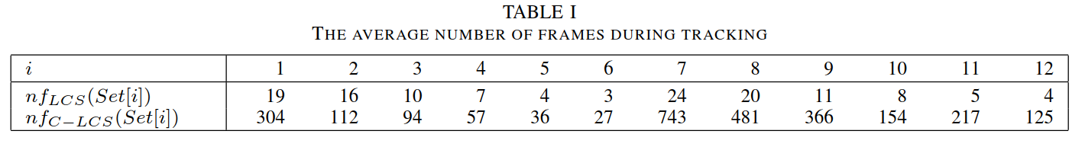
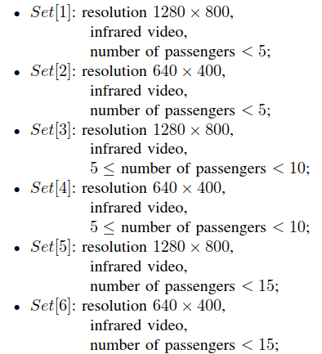
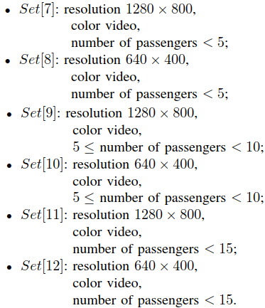
let nf_{LCS} (Set[i]) be the average number of frames before the loss of ﬁrst passenger during longest common subsequence tracking,
nf_{C −LC S} (Set[i]) be the average number of frames before the loss of ﬁrst passenger during constrained longest common subsequence tracking.

Slide 10
SAT solvers for C-LCS-D
We use genetic algorithms OA[1] (see [52]), OA[2] (see[53]), OA[3] (see [54]), OA[4] (see [55]), and OA[5] (see[56]) for the satisﬁability problem to obtain optimal solutions of C-LCS-D. Also, we have considered GSAT with adaptive score function (see [57]).
We have used heterogeneous cluster (500 calculation nodes, Intel Core i7). Each test was runned on a cluster of at least 100 nodes. Note that due to restrictions on computation time (20 hours) we used savepoints

Slide 11
