Slide 1
Basic Local Alignment Search Tool
Stephen F. Altschul
Warren Gish
Webb Miller
Eugene W. Myers
David J. Lipman
Journal of Molecular Biology, Volume 215, Issue 3, Pages 403-410, 1990
Presenter: Hsiu-Chieh Hung
Date: 2017/7/5

Slide 2
Abstract
A new approach to rapid sequence comparison, basic local alignment search tool (BLAST), directly approximates alignments that optimize a measure of local similarity, the maximal segment pair (MSP) score. Recent mathematical results on the stochastic properties of MSP scores allow an analysis of the performance of this method as well as the statistical significance of alignments it generates. The basic algorithm is simple and robust; it can be implemented in a number of ways and applied in a variety of contexts including straight-forward DNA and protein sequence database searches, motif searches, gene identification searches, and in the analysis of multiple regions of similarity in long DNA sequences. In addition to its flexibility and tractability to mathematical analysis, BLAST is an order of magnitude faster than existing sequence comparison tools of comparable sensitivity.

Slide 3
CATACTCGT
GCTACTGATC
G C T A C T G A T C
C
A
T
A
C
T
C
G
T
0 | 1 | 1 | 1 | 1 | 1 | 1 | 1 | 1 | 1
0 | 1 | 1 | 2 | 2 | 2 | 2 | 2 | 2 | 2
0 | 1 | 2 | 2 | 2 | 3 | 3 | 3 | 3 | 3
0 | 1 | 2 | 3 | 3 | 3 | 3 | 4 | 4 | 4
0 | 1 | 2 | 3 | 4 | 4 | 4 | 4 | 4 | 5
0 | 1 | 2 | 3 | 4 | 5 | 5 | 5 | 5 | 5
0 | 1 | 2 | 3 | 4 | 5 | 5 | 5 | 5 | 6
1 | 1 | 2 | 3 | 4 | 5 | 6 | 6 | 6 | 6
1 | 1 | 2 | 3 | 4 | 5 | 6 | 6 | 7 | 7
-CATACTCG-T-
GC-TACT-GATC

Slide 4
BLAST
A
B
C
.
.
.
query sequence：Q
sequence database

Slide 5
BLAST
-CATACTCG-T-
GC-TACT-GATC
Global alignment：
CATACTCGT
GCTACTGATC
Local alignment：

Slide 6

BLAST
Step 1：find words from query sequence
$$w=3$$
Q：CATACTCGT
……
CAT
ATA
TAC
ACT
CTC
TCG
CGT
words：
length of Q – w + 1 words

Slide 7
BLAST
Step 2：scan sequences in database to find hits (for DNA)
Q：CATACTCGT
A：GCTACTGATC
hit
CAT
ATA
TAC
ACT
CTC
TCG
CGT
words：

Slide 8


BLAST
Step 3：extend hits (for DNA)
$$S=16$$
Q：CATACTCGT
A：GCTACTGATC
$15−4+5=16≥S$
Match：+5
Mismatch：-4

Slide 9

BLAST
Step 3：extend hits (for DNA)
$$S=16$$
Q：CATACTCGT
A：GCTACTGATC
$15−4+5=16≥S$
Match：+5
Mismatch：-4
$$16−4−4=8<S$$

Slide 10
BLAST
Q：CATACTCGT
A：GCTACTGATC
Maximal segment pair (MSP)

Slide 11
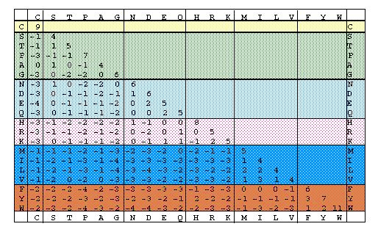


BLAST
Step 2：scan sequences in database to find hits (for protein)
PAM matrix
$$T=15$$
A： ---YPN---
word： YPD
$$7+7+1=15≥T$$
擷取自 https://www.ctu.edu.vn/~dvxe/Bioinformatic%20course/mod4/mod4_0.html

Slide 12
BLAST
Step 3：extend hits (for protein)
Use PAM matrix to calculate MSP score
擷取自 https://www.ctu.edu.vn/~dvxe/Bioinformatic%20course/mod4/mod4_0.html

Slide 13
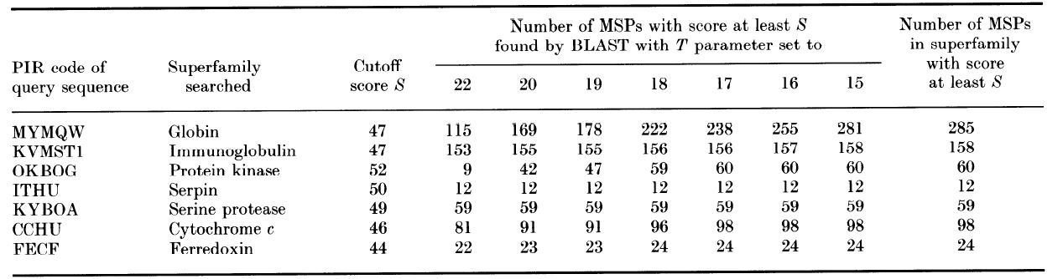
Experiment
protein

Slide 14
Experiment
Human β gene
Rabbit δ gene
w | Time (sec) | Words | Hits | Matches
8 | 15.9 | 44,587 | 118,941 | 130
9 | 6.8 | 44,586 | 39,218 | 123
10 | 4.3 | 44,585 | 15,321 | 114
11 | 3.5 | 44,584 | 7345 | 106
12 | 3.2 | 44,583 | 4197 | 98

