Slide 1
Highly Comparative Feature-Based Time-Series Classification
Ben D. Fulcher and Nick S. Jones
IEEE Transactions on Knowledge and Data Engineering,
Volume 26, Issue 12, Dec. 2014
Presenter : Bo-Xian Chen
Date : 2017/7/24

Slide 2
Abstract(1/2)
A highly comparative, feature-based approach to time series classification is introduced that uses an extensive database of algorithms to extract thousands of interpretable features from time series. These features are derived from across the scientific time-series analysis literature, and include summaries of time series in terms of their correlation structure, distribution, entropy, stationarity, scaling properties, and fits to a range of time-series models. After computing thousands of features for each time series in a training set, those that are most informative of the class structure are selected using greedy forward feature selection with a linear classifier. The resulting feature-based classifiers automatically learn the differences between classes using a reduced number of time-series properties, and circumvent the need to calculate distances between time series.

Slide 3
Abstract(2/2)
Representing time series in this way results in orders of magnitude of dimensionality reduction, allowing the method to perform well on very large data sets containing long time series or time series of different lengths. For many of the data sets studied, classification performance exceeded that of conventional instance-based classifiers, including one nearest neighbor classifiers using euclidean distances and dynamic time warping and, most importantly, the features selected provide an understanding of the properties of the data set, insight that can guide further scientific investigation.

Slide 4
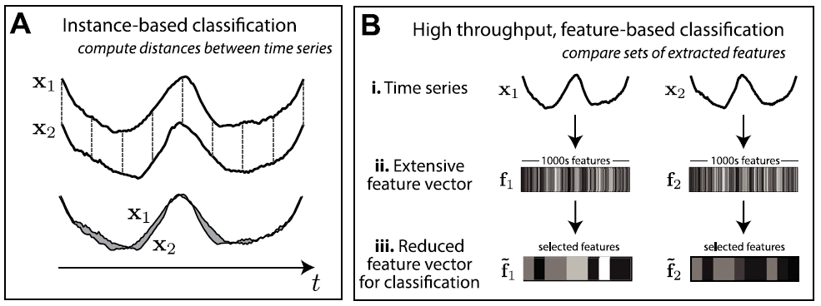
Feature class

Slide 5
Feature Selection
Greedy forward feature selection
Terminated
Adding an additional features drops below 3 percent.
Training set misclassification rate drops to 0.

Slide 6
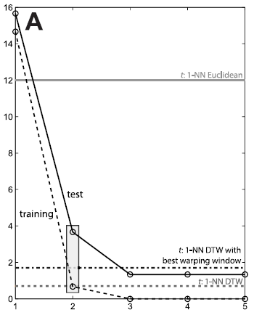
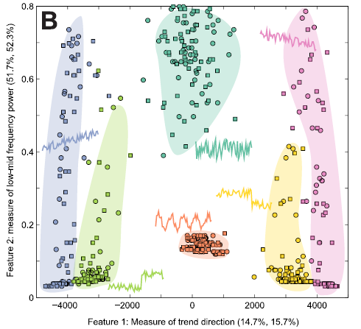
Greedy forward feature selection

Slide 7
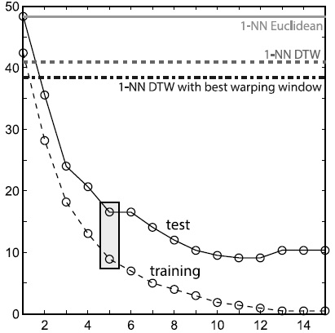
OSU Leaf data set

Slide 8
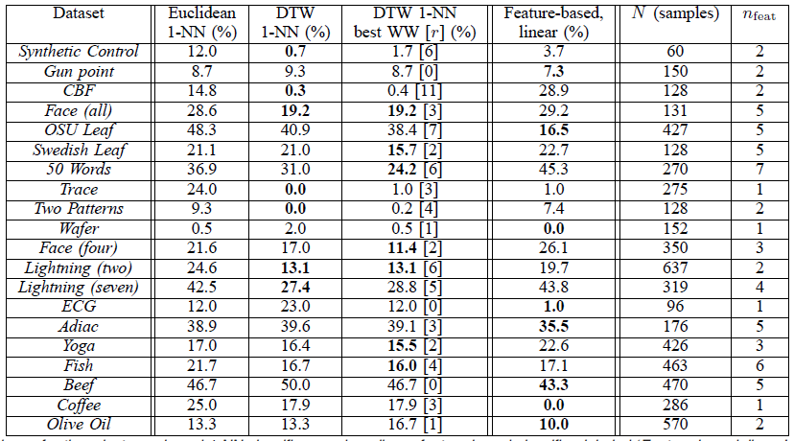
Experimental Result

