Slide 1
International Conference of the Biometrics Special Interest Group (BIOSIG), Darmstadt, Germany, 2015 N. Pattabhi Ramaiah, C. Krishna Mohan, and N. Srilatha
Sparsity-based Iris Classification using Iris Fiber Structures
Presenter：Wei-Hao Fu
Date：2017/07/25
Notes:
1

Slide 2
Abstract (1/2)
As there is a growing demand for biometrics usage
in e-Society, the biometric recognition system faces the scalability issue as the number of people to be enrolled into the system runs into billions. In this paper, we propose an approach for iris classification using three different iris classes based on iris fiber structures, namely, stream, flower, jewel and shaker for faster retrieval of identities in large scale biometric system.

Slide 3
Abstract (2/2)
A sparsity based on-line dictionary learning (ODL) algorithm is used in the proposed classification approach where dictionaries are developed for each class using log-Gabor wavelet features. Also, a method for iris adjudication process is illustrated using the iris classification to reduce the search space. The efficacy of the proposed classification approach is demonstrated on the standard UPOL iris database.

Slide 4
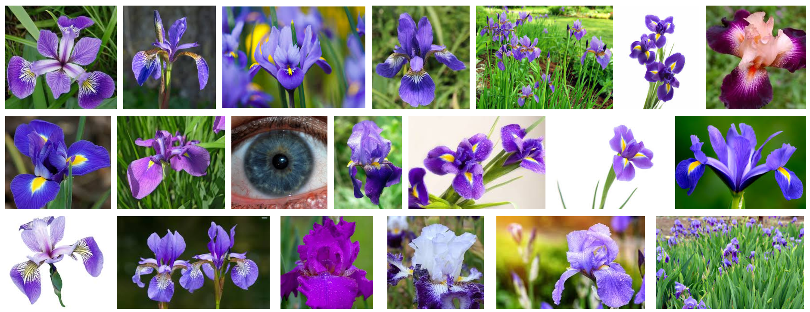
Introduction

Slide 5
Introduction

Slide 6
Proposed Method
Step 1. Iris Segmentation and normalization
Step 2. Feature extraction
Step 3. Iris classification using ODL
Step 4. Iris Adjudication

Slide 7
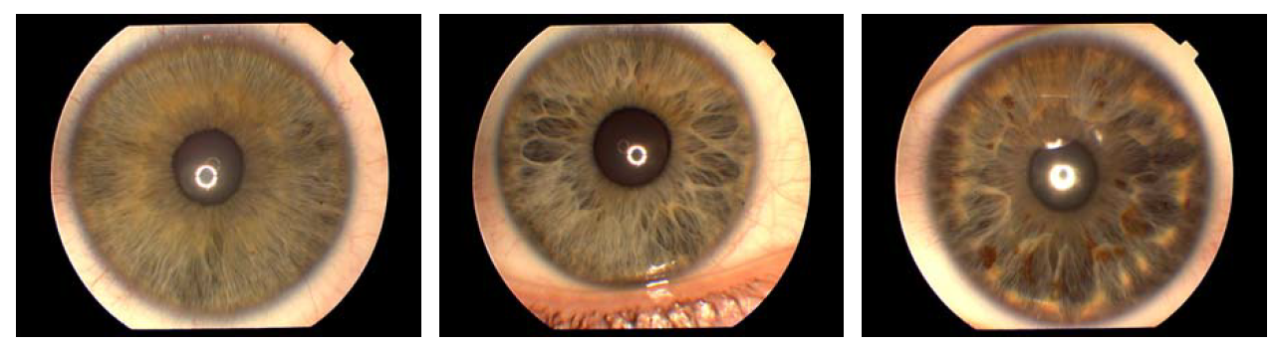

Proposed Method
Step 1. Iris Segmentation and normalization
$$\max\left(r, x_{0}, y_{0}\right)G_{σ}\left(r\right)∗\frac{δ}{δr}\int_{r, x_{0}, y_{0}}{\frac{I\left(x,y\right)}{2πr}ds}$$

Slide 8
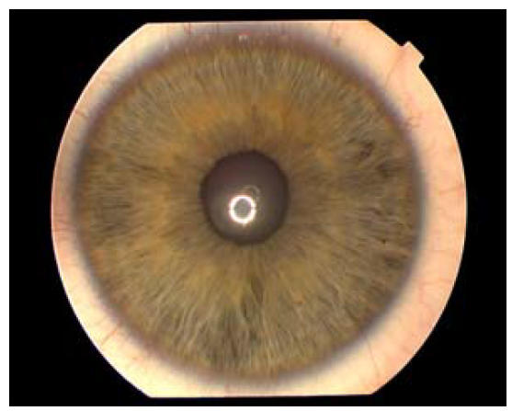
Proposed Method
Step 1. Iris Segmentation and normalization

Slide 9
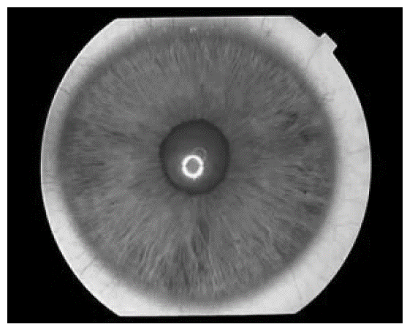
Proposed Method
Step 1. Iris Segmentation and normalization

Slide 10
Proposed Method
Step 1. Iris Segmentation and normalization

Slide 11
Proposed Method
Step 1. Iris Segmentation and normalization

Slide 12

Proposed Method
Step 1. Iris Segmentation and normalization

Slide 13
Proposed Method
Step 2. Feature extraction
The 2D normalized pattern is broken up into a number of 1D signals, and then these 1D signals are convolved with 1D signal, each row corresponds to a circular ring on the iris region.
Feature extraction by using Gabor filter.

Slide 14
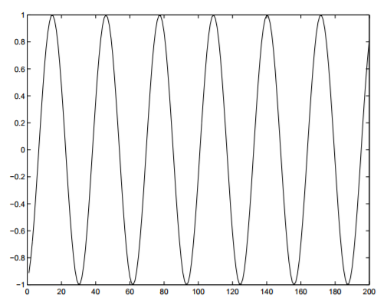
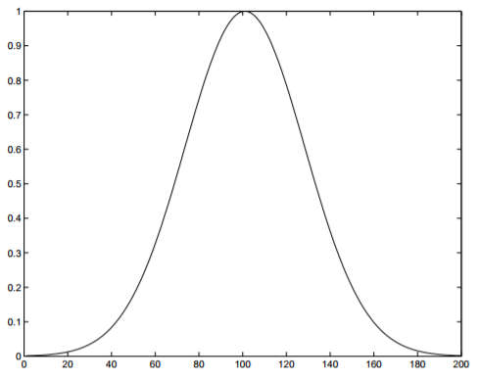
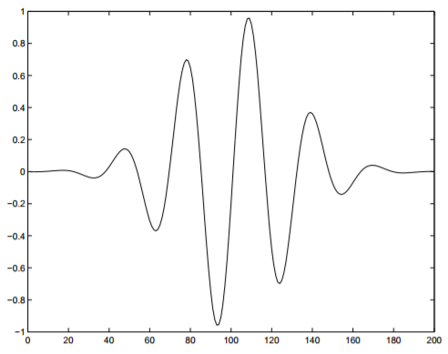
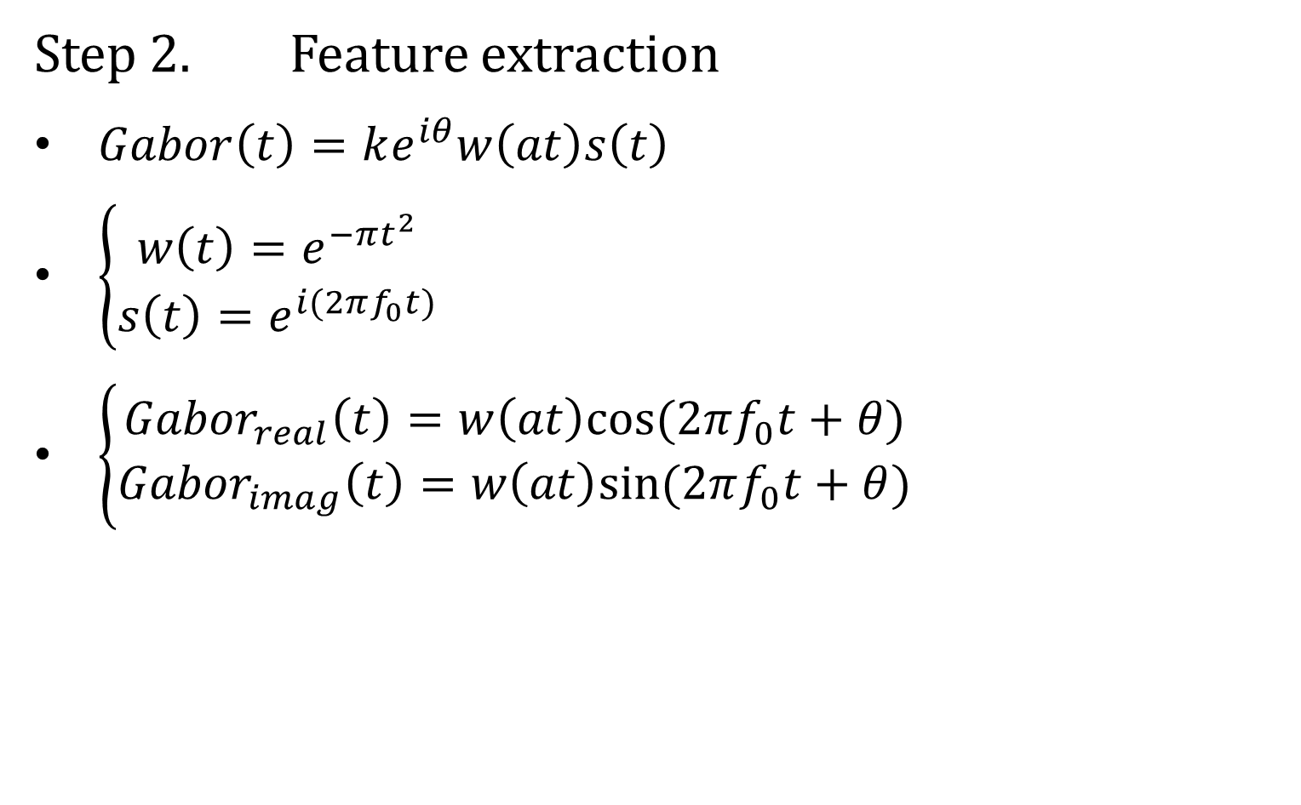
Proposed Method
Step 2. Feature extraction
$Gabor\left(t\right)=ke^{iθ}w\left(at\right)s\left(t\right)$
$\left\{\begin{aligned}w\left(t\right)=e^{−πt^{2}} \\ s\left(t\right)=e^{i(2πf_{0}t)}\end{aligned}\right.$
$\left\{\begin{aligned}{Gabor}_{real}\left(t\right)=w\left(at\right)cos⁡(2πf_{0}t+θ) \\ {Gabor}_{imag}\left(t\right)=w\left(at\right)sin⁡(2πf_{0}t+θ)\end{aligned}\right.$
Reference: Gabor Filter Visualization

Slide 15
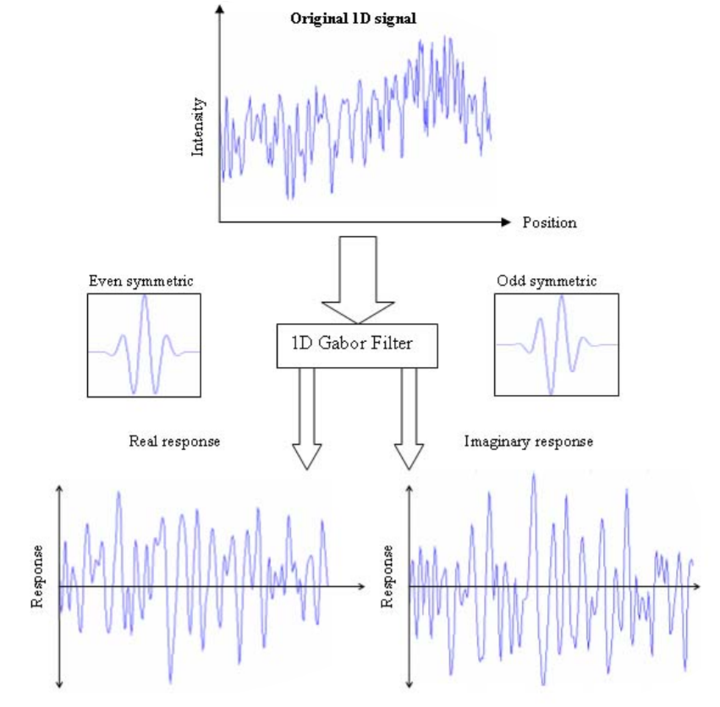
Proposed Method
Reference: Recognition of Human Iris Patterns for Biometric Identification

Slide 16
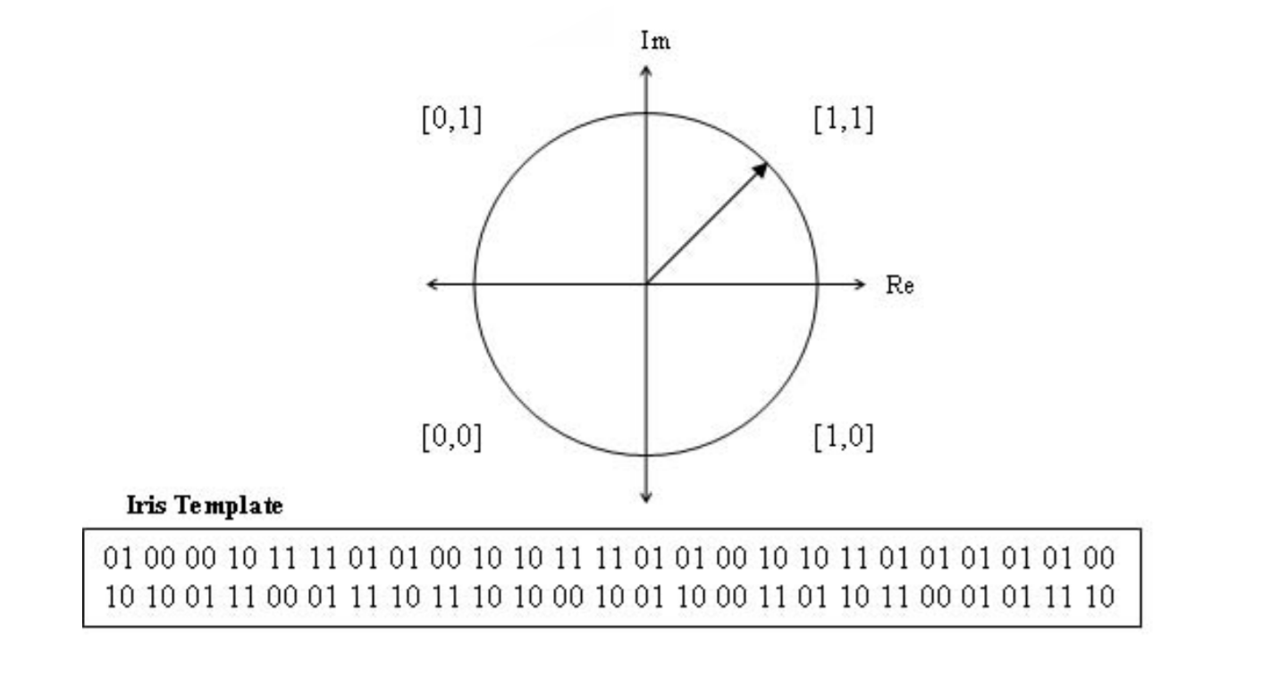
Proposed Method
Reference: Recognition of Human Iris Patterns for Biometric Identification

Slide 17
Proposed Method
Step 3. Iris classification using ODL
An on-line dictionary learning (ODL) algorithm is used to classify the iris data into three different classes to reduce the search space.
Sparse coding: A coding that is modelling data vectors as sparse linear combinations of basis elements.

Slide 18

Proposed Method
Step 3. Iris classification using ODL
$$C=[C_{1}, C_{2}, …, C_{N}]$$
$$original: \left\{y_{1}^{1}, y_{2}^{1}, …, y_{k}^{1}\right\}$$
$${approximation: \{D}^{1}φ_{1}^{1}, D^{1}φ_{2}^{1}, …, D^{1}φ_{k}^{1}\}$$

Slide 19
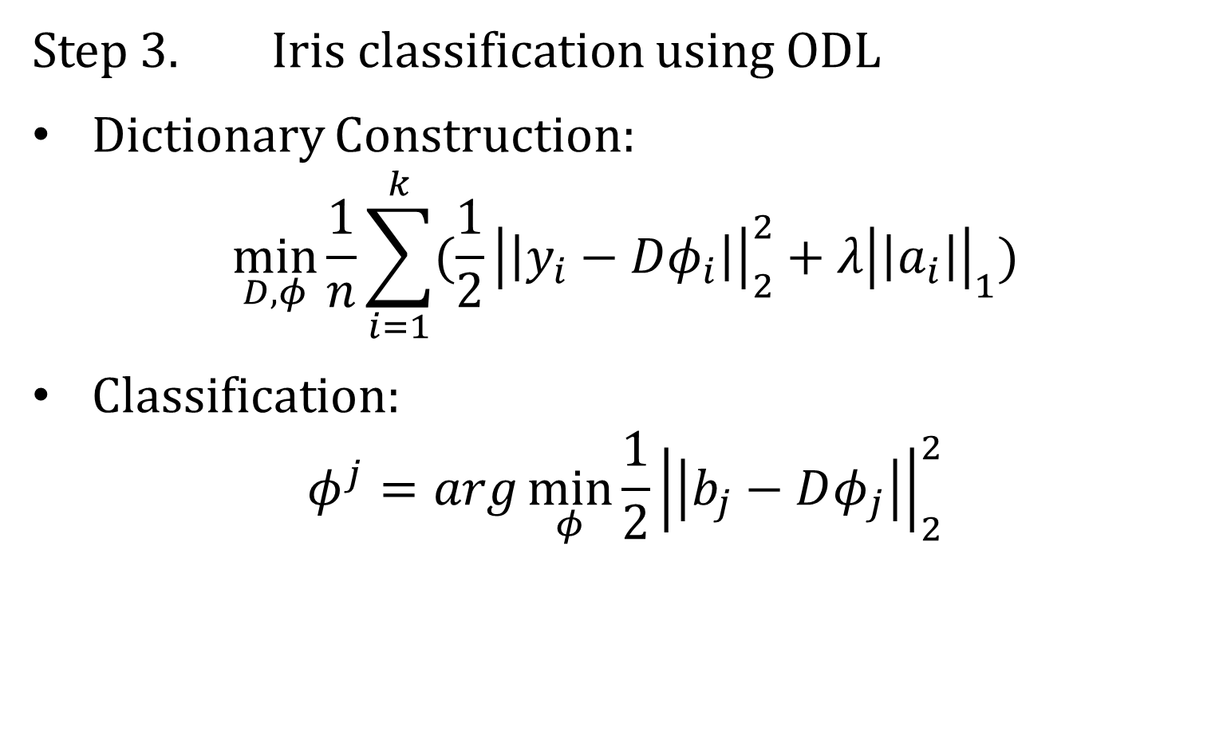
Proposed Method
Step 3. Iris classification using ODL
Dictionary Construction:
$$\min_{D, φ}{\frac{1}{n}\sum_{i=1}^{k}{(\frac{1}{2}{\left|\left|y_{i}−Dφ_{i}\right|\right|}_{2}^{2}+λ{\left|\left|a_{i}\right|\right|}_{1})}}$$
Classification:
$$φ^{j}=arg\min_{φ}{\frac{1}{2}{\left|\left|b_{j}−Dφ_{j}\right|\right|}_{2}^{2}}$$

Slide 20
Proposed Method
Step 4. Iris Adjudication
Use Hamming distance to adjudicate.
A=1001001100
B=0001011001
Hamming distance=4/10=0.4

Slide 21
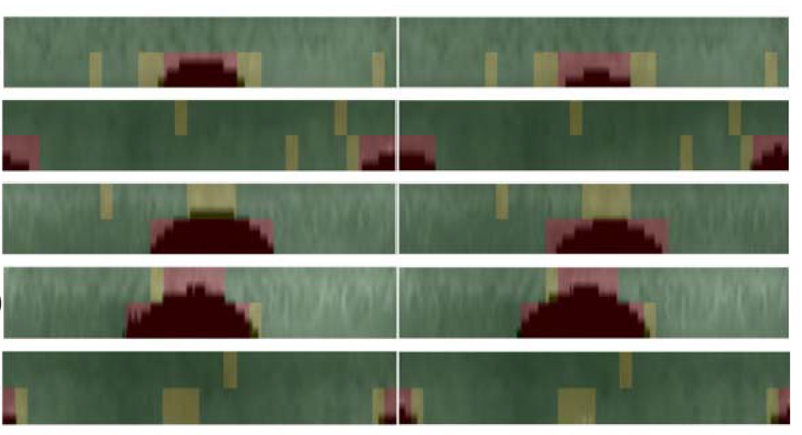
Proposed Method
Step 4. Iris Adjudication
Three colors: green, yellow, and red

Slide 22
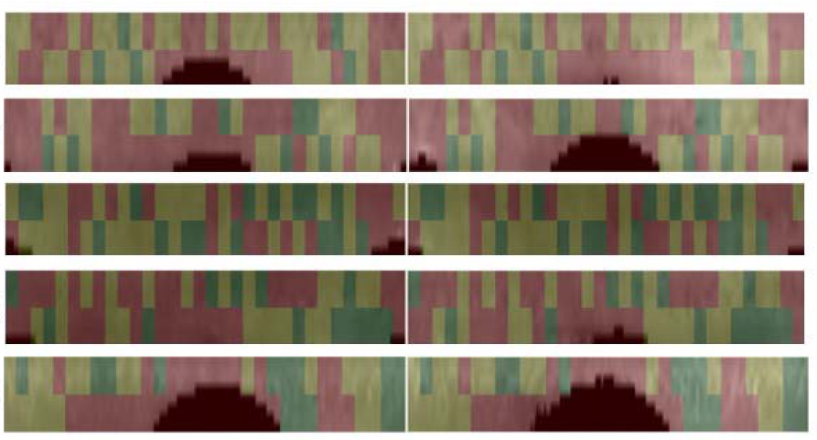
Proposed Method
Step 4. Iris Adjudication
Three colors: green, yellow, and red

Slide 23
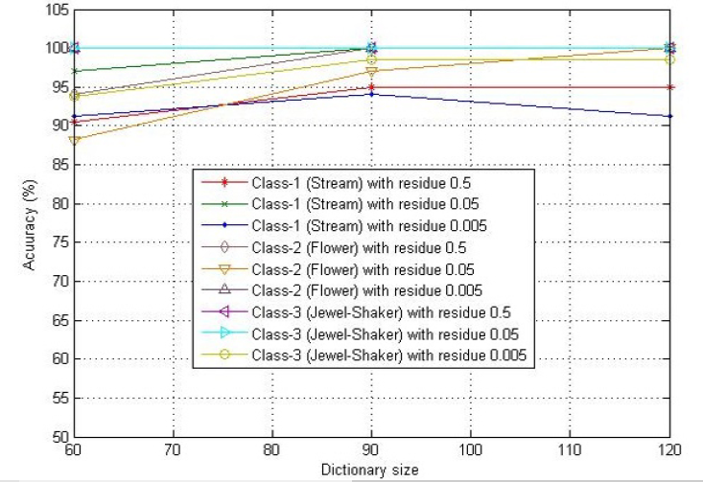
Experimental Result
UPOL iris database: 224 training data and 128 testing data

