Slide 1
Springer International Publishing Switzerland, Recent Advances in Swarm Intelligence and Evolutionary Computation, 2015, Douglas Rodrigues, Xin-She Yang, André Nunes de Souza and João Paulo Papa
Binary Flower Pollination Algorithm and Its Application to Feature Selection
Presenter：Wei-Hao Fu
Date：2017/08/08
Notes:
1

Slide 2
Abstract (1/2)
The problem of feature selection has been paramount in the last years, since it can be as important as the classiﬁcation step itself. The main goal of feature selection is to ﬁnd out the subset of features that optimize some ﬁtness function, often in terms of a classiﬁer’s accuracy or even the computational burden for extracting each feature. Therefore, the approaches to feature selection can be modeled as optimization tasks.

Slide 3
Abstract (2/2)
In this chapter, we evaluate a binary-constrained version of the Flower Pollination Algorithm (FPA) for feature selection, in which the search space is a boolean lattice where each possible solution, or a string of bits, denotes whether a feature will be used to compose the ﬁnal set. Numerical experiments over some public and private datasets have been carried out and comparison with Particle Swarm Optimization, Harmony Search and Fireﬂy Algorithm has demonstrated the suitability of the FPA for feature selection.

Slide 4
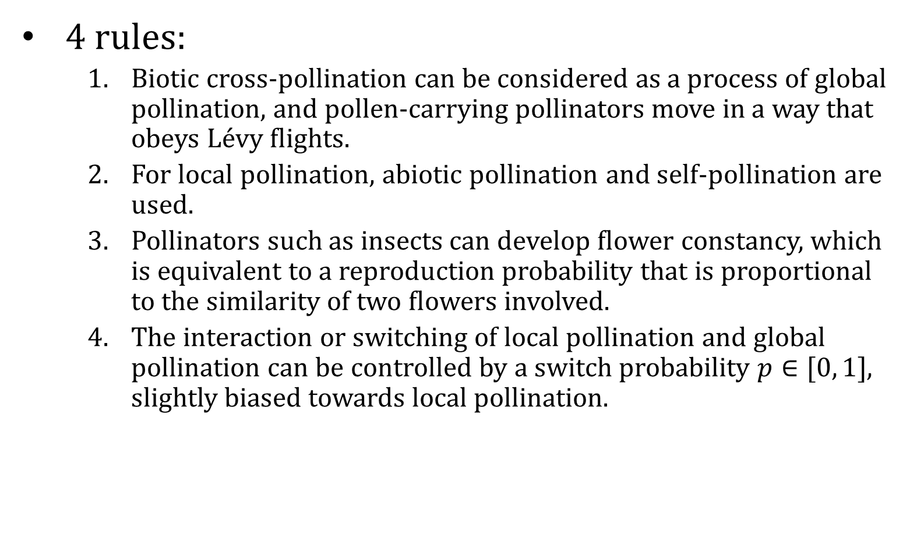
Flower Pollination Algorithm
4 rules:
Biotic cross-pollination can be considered as a process of global pollination, and pollen-carrying pollinators move in a way that obeys Lévy ﬂights.
For local pollination, abiotic pollination and self-pollination are used.
Pollinators such as insects can develop ﬂower constancy, which is equivalent to a reproduction probability that is proportional to the similarity of two ﬂowers involved.
The interaction or switching of local pollination and global pollination can be controlled by a switch probability $p∈[0, 1]$, slightly biased towards local pollination.

Slide 5
Binary Flower Pollination Algorithm

Slide 6
Binary Flower Pollination Algorithm
0 | 1 | 0 | 0 | 1 | 1 | 1
0 | 0 | 0 | 1 | 0 | 1 | 1
1 | 0 | 1 | 0 | 1 | 0 | 0
1 | 1 | 0 | 0 | 0 | 1 | 0
1 | 1 | 1 | 0 | 0 | 0 | 1
0 | 0 | 0 | 0 | 1 | 1 | 1
0 | 1 | 0 | 1 | 0 | 0 | 1
1 | 0 | 0 | 1 | 0 | 0 | 1

Slide 7
Binary Flower Pollination Algorithm
0 | 1 | 0 | 0 | 1 | 1 | 1
0 | 0 | 0 | 1 | 0 | 1 | 1
1 | 0 | 1 | 0 | 1 | 0 | 0
1 | 1 | 0 | 0 | 0 | 1 | 0
1 | 1 | 1 | 0 | 0 | 0 | 1
0 | 0 | 0 | 0 | 1 | 1 | 1
0 | 1 | 0 | 1 | 0 | 0 | 1
1 | 0 | 0 | 1 | 0 | 0 | 1

Slide 8
Binary Flower Pollination Algorithm
0 | 1 | 0 | 0 | 1 | 1 | 1
0 | 0 | 0 | 1 | 0 | 1 | 1
1 | 0 | 1 | 0 | 1 | 0 | 0
1 | 1 | 0 | 0 | 0 | 1 | 0
1 | 1 | 1 | 0 | 0 | 0 | 1
0 | 0 | 0 | 0 | 1 | 1 | 1
0 | 1 | 0 | 1 | 0 | 0 | 1
1 | 0 | 0 | 1 | 0 | 0 | 1
Training subset
Evaluating subset

Slide 9
Binary Flower Pollination Algorithm
0 | 1 | 0 | 0 | 1 | 1 | 1
0 | 0 | 0 | 1 | 0 | 1 | 1
1 | 0 | 1 | 0 | 1 | 0 | 0
1 | 1 | 0 | 0 | 0 | 1 | 0
1 | 1 | 1 | 0 | 0 | 0 | 1
0 | 0 | 0 | 0 | 1 | 1 | 1
0 | 1 | 0 | 1 | 0 | 0 | 1
1 | 0 | 0 | 1 | 0 | 0 | 1
Training subset
Evaluating subset
Train
Model
Result

Slide 10
Binary Flower Pollination Algorithm
0 | 1 | 0 | 0 | 1 | 1 | 1
0 | 0 | 0 | 1 | 0 | 1 | 1
1 | 0 | 1 | 0 | 1 | 0 | 0
1 | 1 | 0 | 0 | 0 | 1 | 0
1 | 1 | 1 | 0 | 0 | 0 | 1
0 | 0 | 0 | 0 | 1 | 1 | 1
0 | 1 | 0 | 1 | 0 | 0 | 1
1 | 0 | 0 | 1 | 0 | 0 | 1

Slide 11
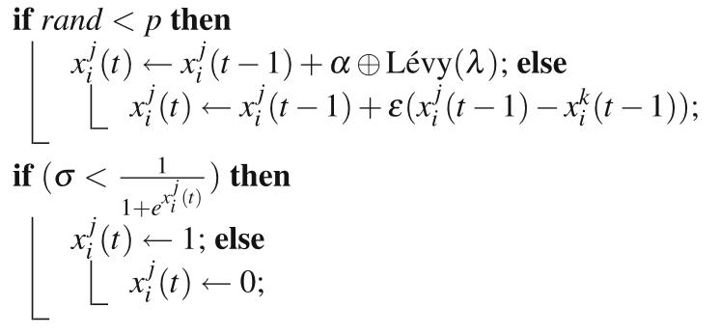
Binary Flower Pollination Algorithm
0 | 1 | 0 | 0 | 1 | 1 | 1
0 | 0 | 0 | 1 | 0 | 1 | 1
1 | 0 | 1 | 0 | 1 | 0 | 0
1 | 1 | 0 | 0 | 0 | 1 | 0
1 | 1 | 1 | 0 | 0 | 0 | 1
0 | 0 | 0 | 0 | 1 | 1 | 1
0 | 1 | 0 | 1 | 0 | 0 | 1
1 | 0 | 0 | 1 | 0 | 0 | 1

Slide 12
Binary Flower Pollination Algorithm
1 | 1 | 0 | 0 | 1 | 1 | 1
0 | 0 | 0 | 1 | 0 | 1 | 0
1 | 0 | 1 | 0 | 1 | 0 | 0
1 | 1 | 0 | 0 | 0 | 1 | 1
1 | 1 | 1 | 0 | 0 | 0 | 1
0 | 0 | 0 | 0 | 1 | 1 | 0
0 | 1 | 0 | 1 | 0 | 0 | 1
0 | 0 | 1 | 1 | 0 | 0 | 1
0 | 1 | 0 | 0 | 1 | 1 | 1
0 | 0 | 0 | 1 | 0 | 1 | 1
1 | 0 | 1 | 0 | 1 | 0 | 0
1 | 1 | 0 | 0 | 0 | 1 | 0
1 | 1 | 1 | 0 | 0 | 0 | 1
0 | 0 | 0 | 0 | 1 | 1 | 1
0 | 1 | 0 | 1 | 0 | 0 | 1
1 | 0 | 0 | 1 | 0 | 0 | 1

Slide 13
Binary Flower Pollination Algorithm
Goal:
1 | 1 | 0 | 0 | 1 | 0 | 1

Slide 14
Optimum-Path Forest Classifier

Slide 15
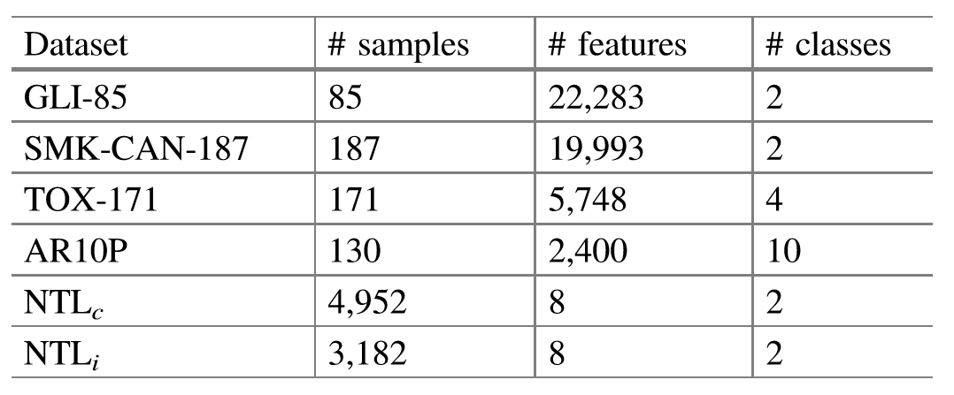
Experimental Result
Datasets

Slide 16
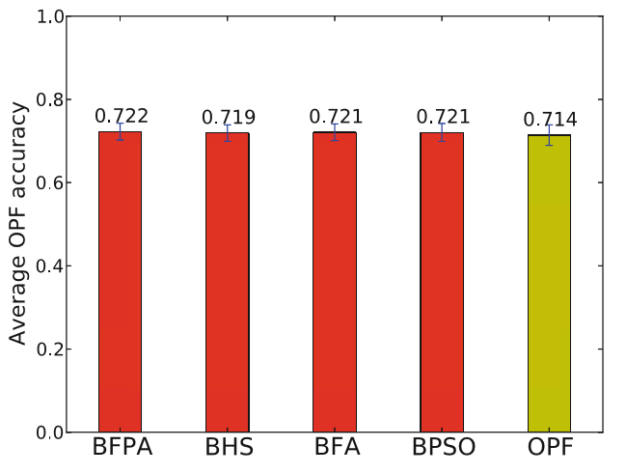
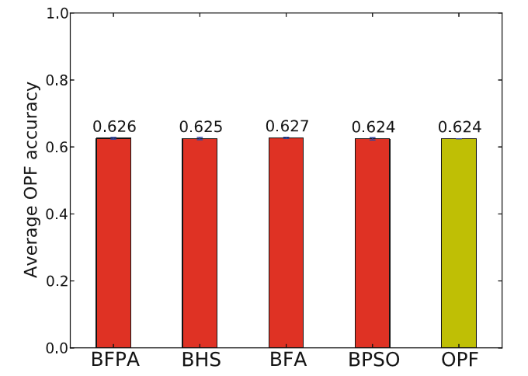
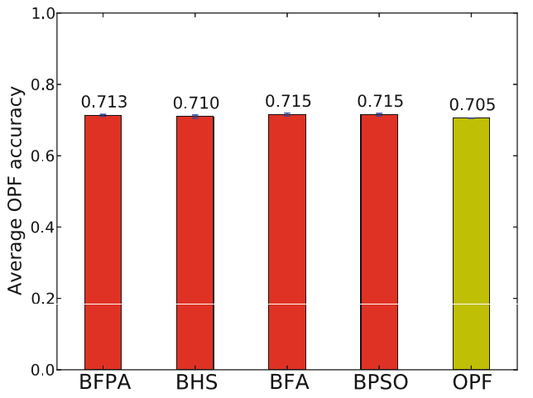
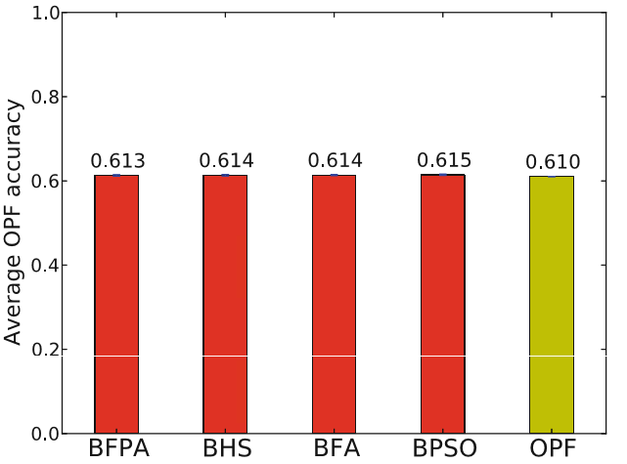
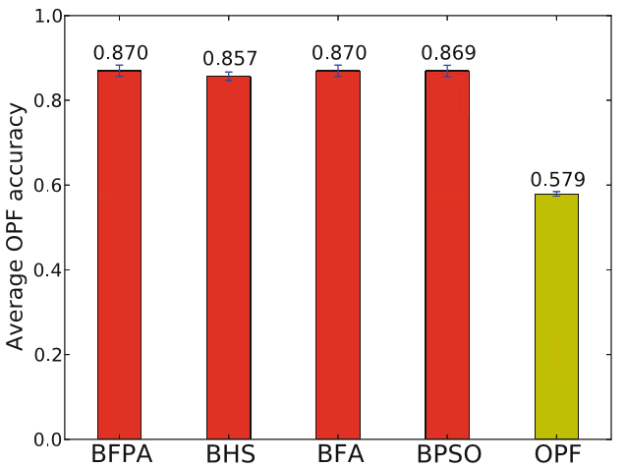
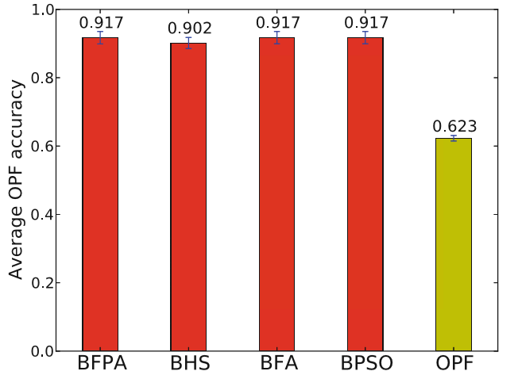
Experimental Result

