Slide 1
Introducing variable gap penalties into three-sequence alignment for protein sequences
Che-Lun Hung, Chun-Yuan Lin, Yeh-Ching Chung and Chuan Yi Tang
22nd International Conference on Advanced Information Networking and Applications – Workshops 2008, pp.726-731.
Presenter : Shie-Yan Lee
2017/9/5

Slide 2
Abstract
The common-use gap penalty strategies, constant penalty and affine gap penalty, have been adopted in the traditional three-sequence alignment algorithm which considers the insertion, deletion and substitution. However, these strategies are not suitable to protein sequence alignments. For the alignment accuracy of protein sequences, the gap penalty is a major determinant. Incorporating protein structure information to vary the gap penalties can lead to more biologically correct alignments. Here, we present an algorithm to find a global and optimal alignment among three protein sequences by using position specific gap penalties which allow gap penalties to be varied. Thus, residue-dependent information and protein structure information can be applied to the three-sequence alignment. The experimental results show that our algorithm achieves the significant improvement in the accuracy of alignments than the three-sequence alignment algorithm with the affine gap penalty for protein sequences.

Slide 3
Three-sequence alignment
Sequence :
Sequence A = ALPKTKAG
Sequence B = ALPKTKG
Sequence C = ALSAPATKAG
Alignment :
A | L | - | - | P | K | T | K | A | G
A | L | - | - | P | K | T | K | - | G
A | L | S | A | P | A | T | K | A | G

Slide 4
Three-sequence alignment
Sequence :
Sequence A = ALPKTKAG
Sequence B = ALPKTKG
Sequence C = ALSAPATKAG
Alignment :
A | L | - | - | P | K | T | K | A | G
A | L | - | - | P | K | T | K | - | G
A | L | S | A | P | A | T | K | A | G
2-gap
1-gap

Slide 5
Fixed gap penalty : constant gap
A | L | - | - | - | K | T | K
A | L | - | - | - | K | T | K
A | L | S | A | P | A | T | K
match : 1
gap : -1
Score of this alignment : 5 – 1 = 4

Slide 6
Fixed gap penalty : linear gap
A | L | - | - | - | K | T | K
A | L | - | - | - | K | T | K
A | L | S | A | P | A | T | K
match : 1
gap : -1
Score of this alignment : 5 – 3 = 2

Slide 7
Fixed gap penalty : affine gap
A | L | - | - | - | K | T | K
A | L | - | - | - | K | T | K
A | L | S | A | P | A | T | K
match : 1
gap opening penalty : -2 gap extension penalty : -1
Score of this alignment : 5 + (-2 + (-1)*2 ) = 1

Slide 8
Variable gap penalty
A | L | - | - | - | K | T | K
A | L | - | - | - | K | T | K
A | L | S | A | P | A | T | K
Gap penalties are calculated by gap penalty functions
instead of constant numbers.
gap opening penalty : GOP (i, j, k)
gap extension penalty : GEP (i, j, k)

Slide 9
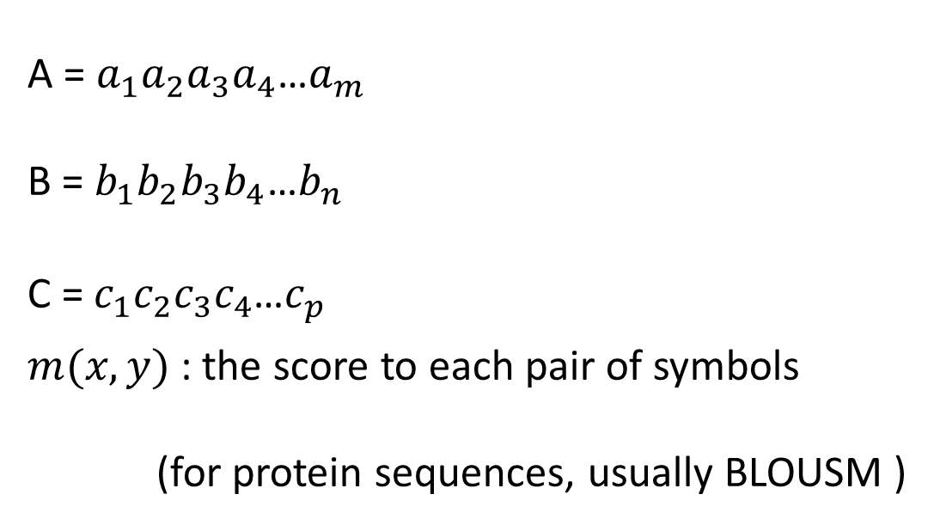
Definition
A = $a_{1}a_{2}a_{3}a_{4}$…$a_{m}$
B = $b_{1}b_{2}b_{3}b_{4}$…$b_{n}$
C = $c_{1}c_{2}c_{3}c_{4}$…$c_{p}$
$m(x,y)$ : the score to each pair of symbols
(for protein sequences, usually BLOUSM )

Slide 10
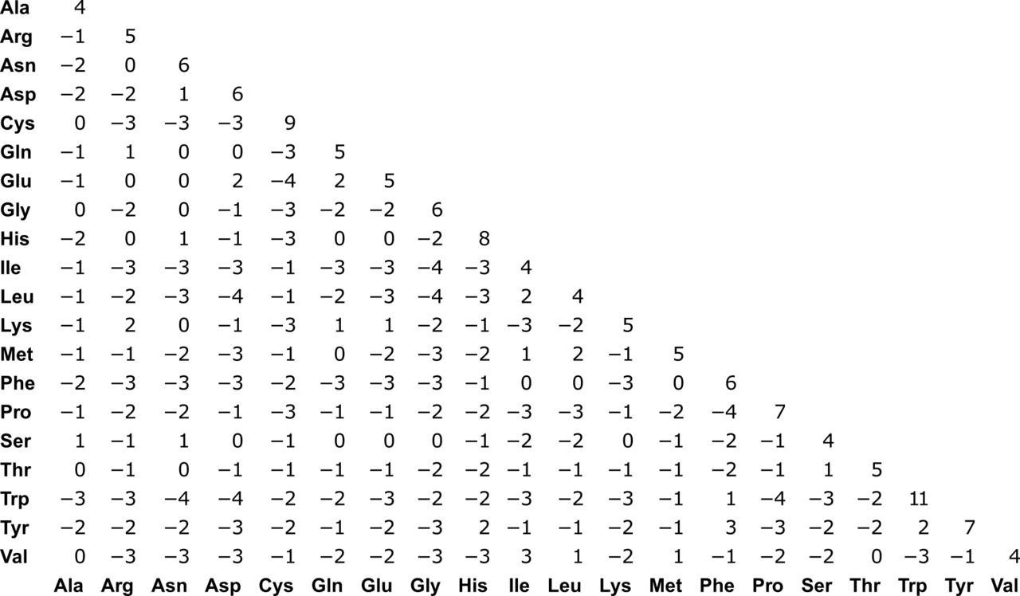
BLOSUM

Slide 11
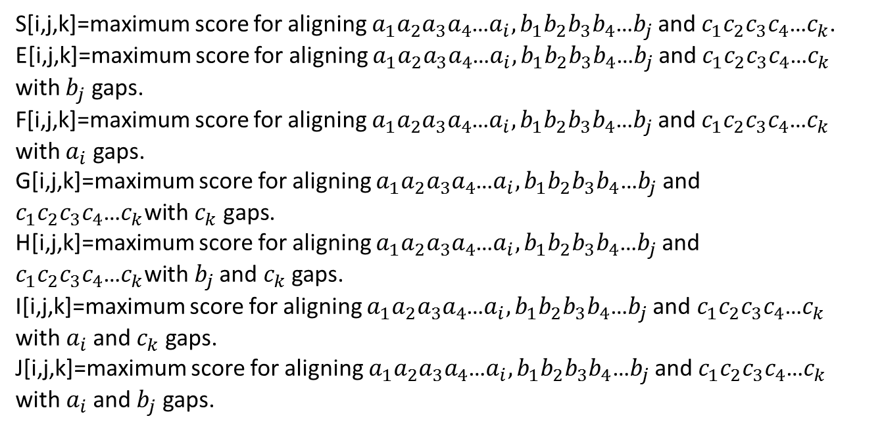
Three-sequence alignment with the dynamic programming
S[i,j,k]=maximum score for aligning $a_{1}a_{2}a_{3}a_{4}$…$a_{i}, b_{1}b_{2}b_{3}b_{4}\text{…}b_{j}$ and $c_{1}c_{2}c_{3}c_{4}$…$c_{k}$.
E[i,j,k]=maximum score for aligning $a_{1}a_{2}a_{3}a_{4}$…$a_{i}, b_{1}b_{2}b_{3}b_{4}\text{…}b_{j}$ and $c_{1}c_{2}c_{3}c_{4}$…$c_{k}$ with $b_{j}$ gaps.
F[i,j,k]=maximum score for aligning $a_{1}a_{2}a_{3}a_{4}$…$a_{i}, b_{1}b_{2}b_{3}b_{4}\text{…}b_{j}$ and $c_{1}c_{2}c_{3}c_{4}$…$c_{k}$ with $a_{i}$ gaps.
G[i,j,k]=maximum score for aligning $a_{1}a_{2}a_{3}a_{4}$…$a_{i}, b_{1}b_{2}b_{3}b_{4}\text{…}b_{j}$ and $c_{1}c_{2}c_{3}c_{4}$…$c_{k}\text{with} c_{k} \text{gaps}\text{.}$
H[i,j,k]=maximum score for aligning $a_{1}a_{2}a_{3}a_{4}$…$a_{i}, b_{1}b_{2}b_{3}b_{4}\text{…}b_{j}$ and $c_{1}c_{2}c_{3}c_{4}$…$c_{k}\text{with} b_{j}$ and $c_{k}$ gaps.
I[i,j,k]=maximum score for aligning $a_{1}a_{2}a_{3}a_{4}$…$a_{i}, b_{1}b_{2}b_{3}b_{4}\text{…}b_{j}$ and $c_{1}c_{2}c_{3}c_{4}$…$c_{k}$ $\text{with} a_{i}$ and $c_{k}$ gaps.
J[i,j,k]=maximum score for aligning $a_{1}a_{2}a_{3}a_{4}$…$a_{i}, b_{1}b_{2}b_{3}b_{4}\text{…}b_{j}$ and $c_{1}c_{2}c_{3}c_{4}$…$c_{k}$ $\text{with} a_{i}$ and $b_{j}$ gaps.

Slide 12
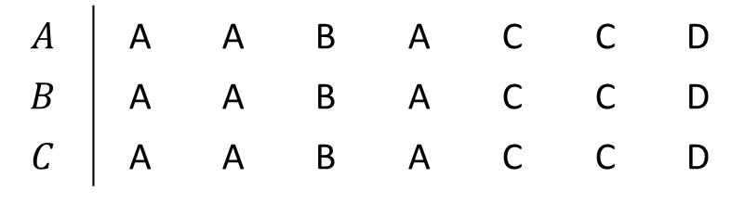
Three-sequence alignment with the dynamic programming
S[i,j,k]=maximum score for aligning $a_{1}a_{2}a_{3}a_{4}$…$a_{i}, b_{1}b_{2}b_{3}b_{4}\text{…}b_{j}$ and $c_{1}c_{2}c_{3}c_{4}$…$c_{k}$.
$$A$$ | A | A | B | A | C | C | D
$$B$$ | A | A | B | A | C | C | D
$$C$$ | A | A | B | A | C | C | D

Slide 13
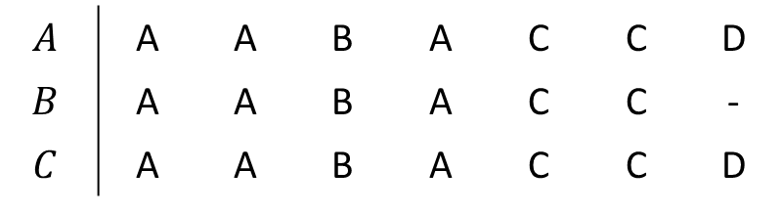

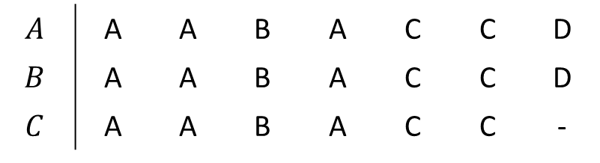
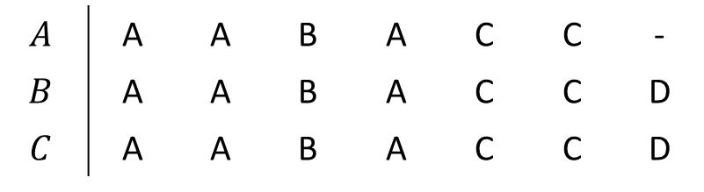
Three-sequence alignment with the dynamic programming
E[i,j,k]=maximum score for aligning $a_{1}a_{2}a_{3}a_{4}$…$a_{i}, b_{1}b_{2}b_{3}b_{4}\text{…}b_{j}$ and $c_{1}c_{2}c_{3}c_{4}$…$c_{k}$ with $b_{j}$ gaps.
F[i,j,k]=maximum score for aligning $a_{1}a_{2}a_{3}a_{4}$…$a_{i}, b_{1}b_{2}b_{3}b_{4}\text{…}b_{j}$ and $c_{1}c_{2}c_{3}c_{4}$…$c_{k}$ with $a_{i}$ gaps.
G[i,j,k]=maximum score for aligning $a_{1}a_{2}a_{3}a_{4}$…$a_{i}, b_{1}b_{2}b_{3}b_{4}\text{…}b_{j}$ and $c_{1}c_{2}c_{3}c_{4}$…$c_{k}\text{with} c_{k} \text{gaps}\text{.}$
$$A$$ | A | A | B | A | C | C | D
$$B$$ | A | A | B | A | C | C | -
$$C$$ | A | A | B | A | C | C | D
$$A$$ | A | A | B | A | C | C | -
$$B$$ | A | A | B | A | C | C | D
$$C$$ | A | A | B | A | C | C | D
$$A$$ | A | A | B | A | C | C | D
$$B$$ | A | A | B | A | C | C | D
$$C$$ | A | A | B | A | C | C | -

Slide 14
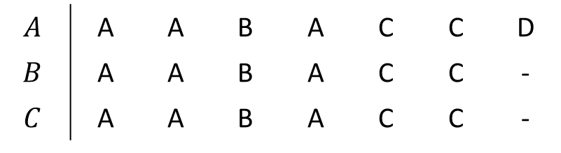

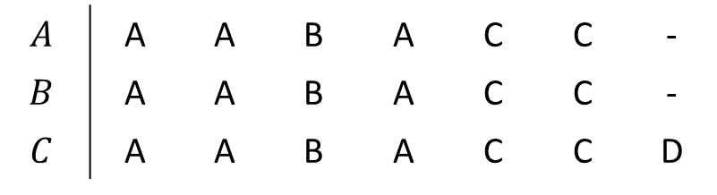
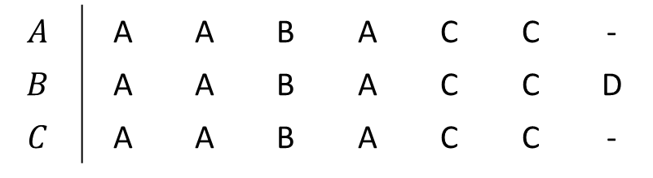
Three-sequence alignment with the dynamic programming
H[i,j,k]=maximum score for aligning $a_{1}a_{2}a_{3}a_{4}$…$a_{i}, b_{1}b_{2}b_{3}b_{4}\text{…}b_{j}$ and $c_{1}c_{2}c_{3}c_{4}$…$c_{k}\text{with} b_{j}$ and $c_{k}$ gaps.
I[i,j,k]=maximum score for aligning $a_{1}a_{2}a_{3}a_{4}$…$a_{i}, b_{1}b_{2}b_{3}b_{4}\text{…}b_{j}$ and $c_{1}c_{2}c_{3}c_{4}$…$c_{k}$ $\text{with} a_{i}$ and $c_{k}$ gaps.
J[i,j,k]=maximum score for aligning $a_{1}a_{2}a_{3}a_{4}$…$a_{i}, b_{1}b_{2}b_{3}b_{4}\text{…}b_{j}$ and $c_{1}c_{2}c_{3}c_{4}$…$c_{k}$ $\text{with} a_{i}$ and $b_{j}$ gaps.
$$A$$ | A | A | B | A | C | C | D
$$B$$ | A | A | B | A | C | C | -
$$C$$ | A | A | B | A | C | C | -
$$A$$ | A | A | B | A | C | C | -
$$B$$ | A | A | B | A | C | C | D
$$C$$ | A | A | B | A | C | C | -
$$A$$ | A | A | B | A | C | C | -
$$B$$ | A | A | B | A | C | C | -
$$C$$ | A | A | B | A | C | C | D

Slide 15
Variable gap penalties
Gap penalties are calculated by gap penalty functions instead of constant numbers.
GOP : the gap opening penalty function
GEP : the gap extension penalty function
i, j, k : indices of the sequence A, B and C ,respectively
Gap penalty : GOP+GEP*(gap length-1)

Slide 16
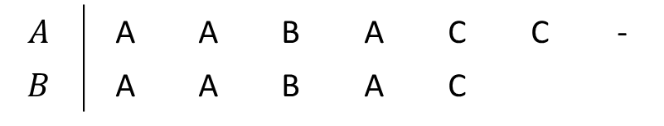
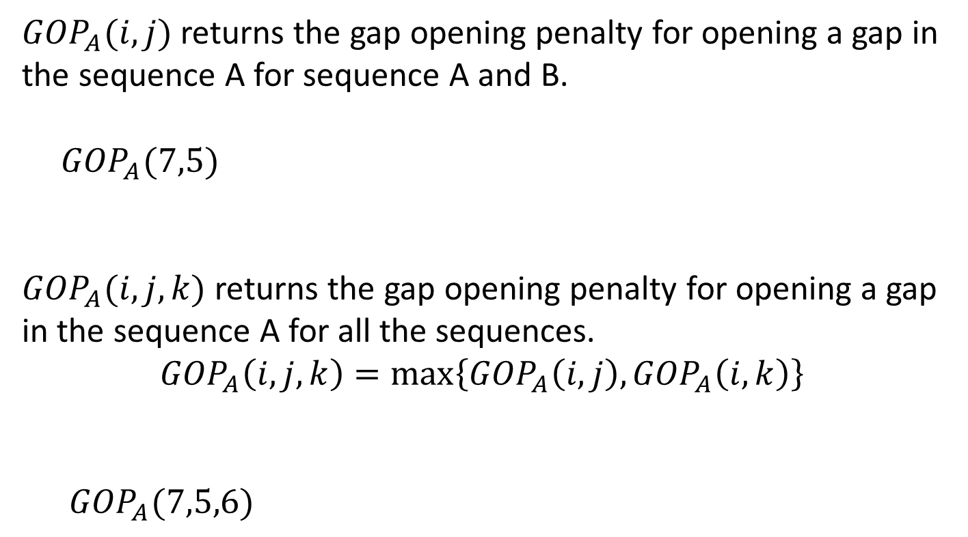
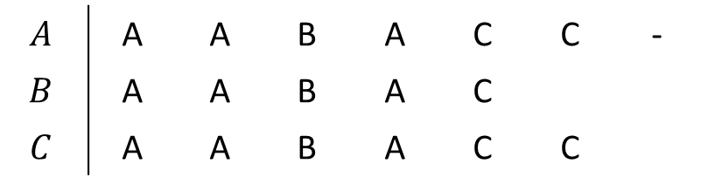
Gap opening penalty function : 1-gap
${GOP}_{A}(i,j)$ returns the gap opening penalty for opening a gap in the sequence A for sequence A and B.
${GOP}_{A}(7,5)$
${GOP}_{A}(i,j,k)$ returns the gap opening penalty for opening a gap in the sequence A for all the sequences.
$${GOP}_{A}\left(i,j,k\right)=max\left\{{GOP}_{A}\left(i,j\right),{GOP}_{A}\left(i,k\right)\right\}$$
${GOP}_{A}(7,5,6)$
$$A$$ | A | A | B | A | C | C | -
$$B$$ | A | A | B | A | C
$$A$$ | A | A | B | A | C | C | -
$$B$$ | A | A | B | A | C
$$C$$ | A | A | B | A | C | C

Slide 17
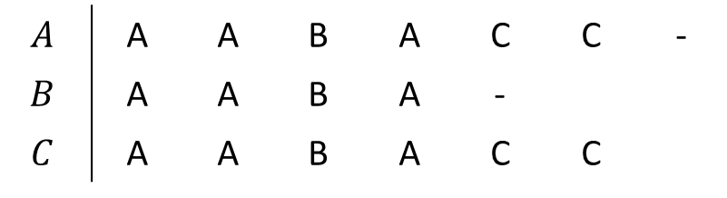
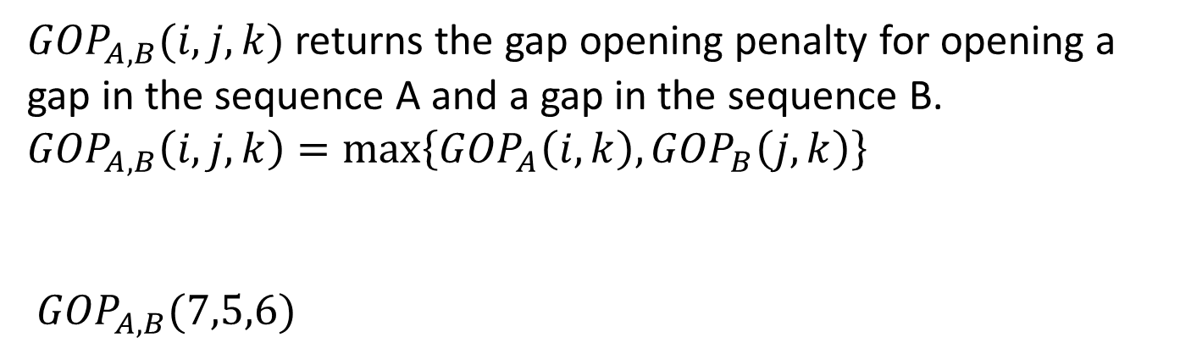
Gap opening penalty function : 2-gap
${GOP}_{A,B}(i,j,k)$ returns the gap opening penalty for opening a gap in the sequence A and a gap in the sequence B. ${GOP}_{A,B}\left(i,j,k\right)=max\left\{{GOP}_{A}\left(i,k\right),{GOP}_{B}\left(j,k\right)\right\}$
${GOP}_{A,B}(7,5,6)$
$$A$$ | A | A | B | A | C | C | -
$$B$$ | A | A | B | A | -
$$C$$ | A | A | B | A | C | C

Slide 18
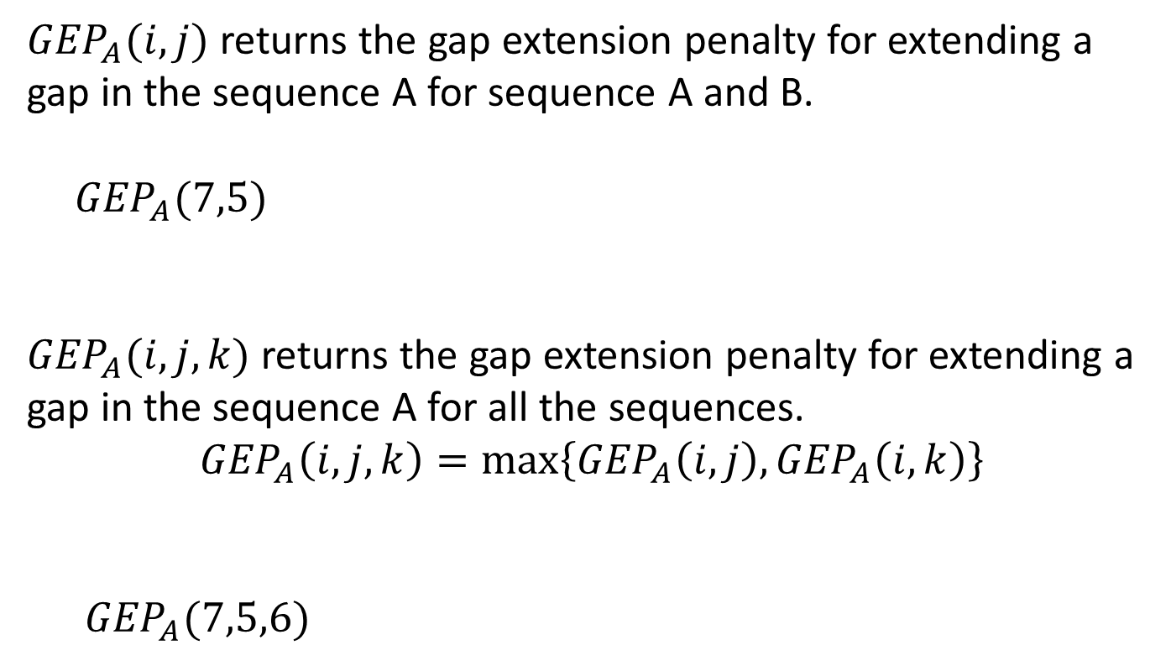
Gap extension penalty function : 1-gap
${GEP}_{A}(i,j)$ returns the gap extension penalty for extending a gap in the sequence A for sequence A and B.
${GEP}_{A}(7,5)$
${GEP}_{A}(i,j,k)$ returns the gap extension penalty for extending a gap in the sequence A for all the sequences.
$${GEP}_{A}\left(i,j,k\right)=max\left\{{GEP}_{A}\left(i,j\right),{GEP}_{A}\left(i,k\right)\right\}$$
${GEP}_{A}(7,5,6)$
$$A$$ | A | A | B | A | C | C | -
$$B$$ | A | A | B | A | C
$$A$$ | A | A | B | A | C | C | -
$$B$$ | A | A | B | A | C
$$C$$ | A | A | B | A | C | C

Slide 19
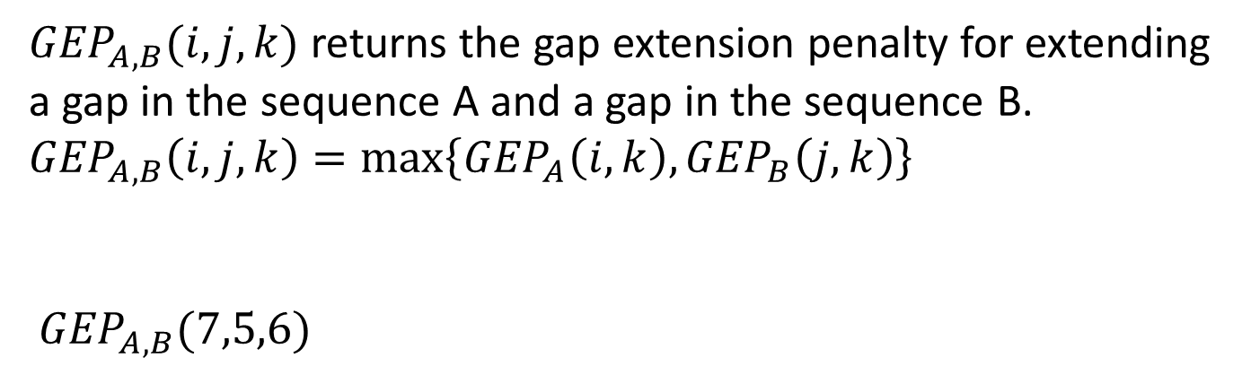
Gap extension penalty function : 2-gap
${GEP}_{A,B}(i,j,k)$ returns the gap extension penalty for extending a gap in the sequence A and a gap in the sequence B. ${GEP}_{A,B}\left(i,j,k\right)=max\left\{{GEP}_{A}\left(i,k\right),{GEP}_{B}\left(j,k\right)\right\}$
${GEP}_{A,B}(7,5,6)$
$$A$$ | A | A | B | A | C | C | -
$$B$$ | A | A | B | A | -
$$C$$ | A | A | B | A | C | C

Slide 20
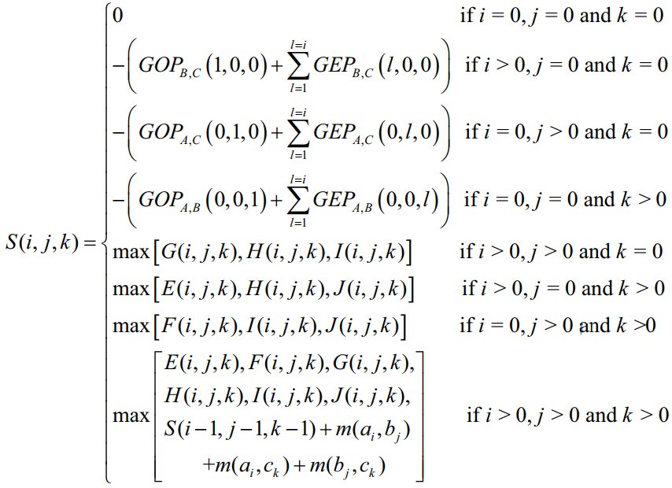
Three-sequence alignment with the dynamic programming

Slide 21
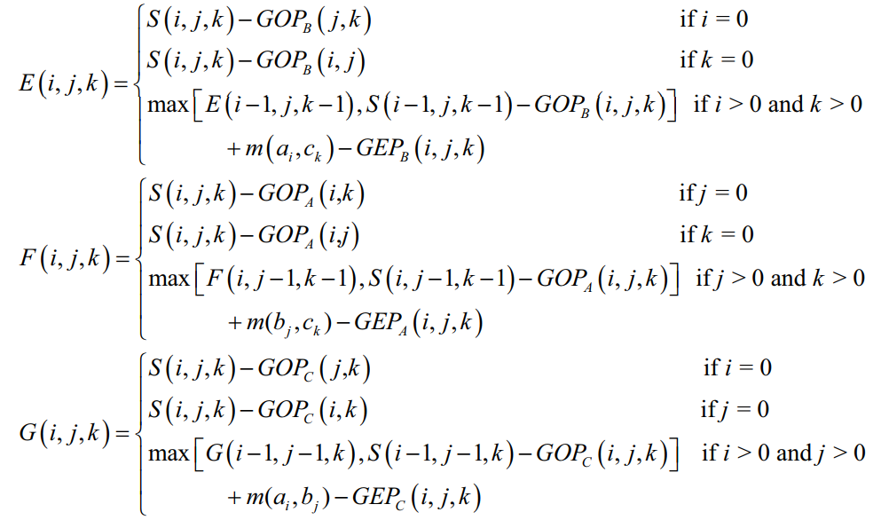



Three-sequence alignment with the dynamic programming
Gap : $b_{j}$
Gap : $a_{i}$
Gap : $c_{k}$

Slide 22
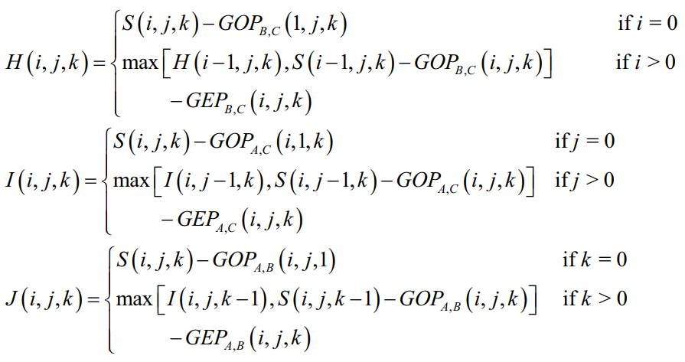



Three-sequence alignment with the dynamic programming
Gap : $b_{j} ,c_{k}$
Gap : $a_{i} ,c_{k}$
Gap : $a_{i} ,b_{j}$

Slide 23
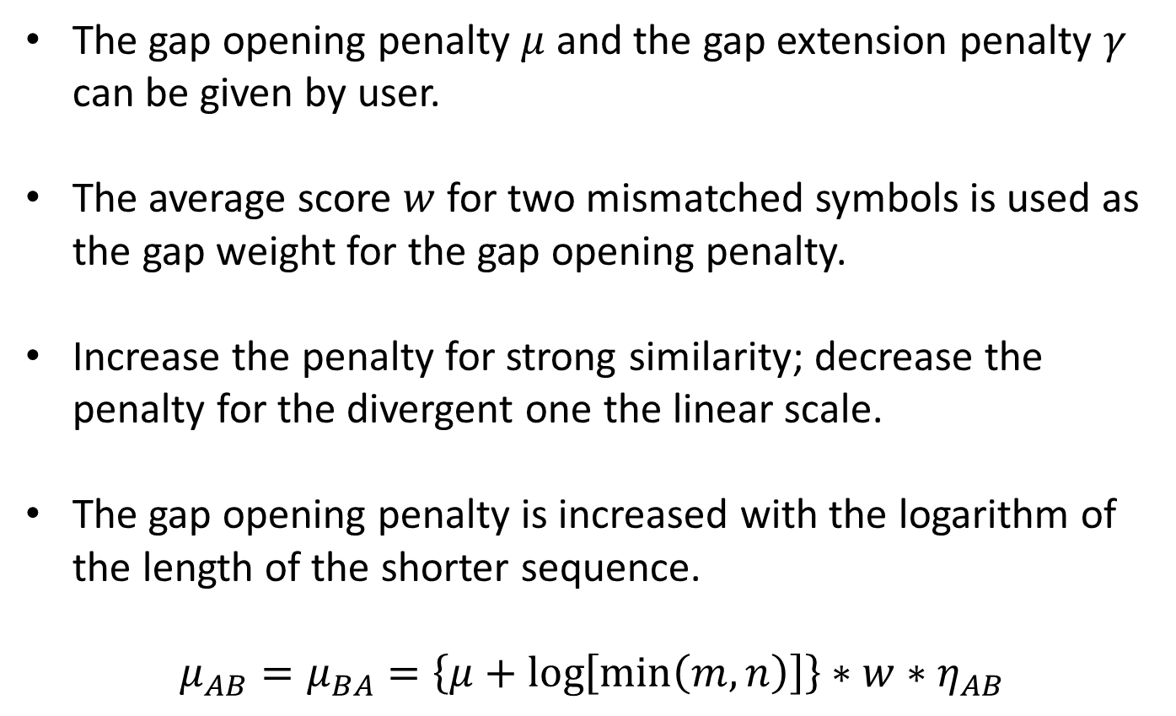
Factors for the gap opening penalty
The gap opening penalty $μ$ and the gap extension penalty $γ$ can be given by user.
The average score $w$ for two mismatched symbols is used as the gap weight for the gap opening penalty.
Increase the penalty for strong similarity; decrease the penalty for the divergent one the linear scale.
The gap opening penalty is increased with the logarithm of the length of the shorter sequence.
$$μ_{AB}=μ_{BA}=\left\{μ+\log\left[\min\left(m,n\right)\right]\right\}∗w∗η_{AB}$$

Slide 24
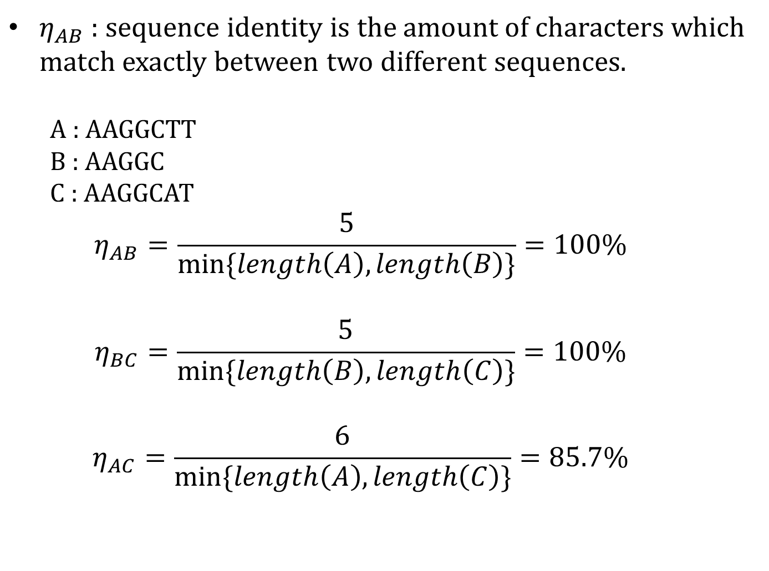
Sequence identity
$η_{AB}$ : sequence identity is the amount of characters which match exactly between two different sequences.
A : AAGGCTT
B : AAGGC
C : AAGGCAT
$$η_{AB}=\frac{5}{\min{\{length\left(A\right),length\left(B\right)\}}}=100\%$$
$$η_{BC}=\frac{5}{\min{\{length\left(B\right),length\left(C\right)\}}}=100\%$$
$$η_{AC}=\frac{6}{\min{\{length\left(A\right),length\left(C\right)\}}}=85.7\%$$

Slide 25
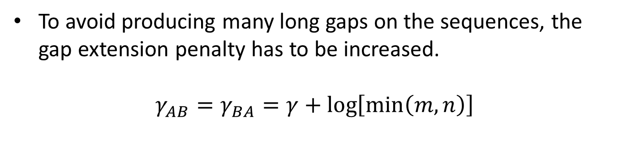
Factors for the gap extension penalty
To avoid producing many long gaps on the sequences, the gap extension penalty has to be increased.
$$γ_{AB}=γ_{BA}=γ+\log\left[\min\left(m,n\right)\right]$$

Slide 26
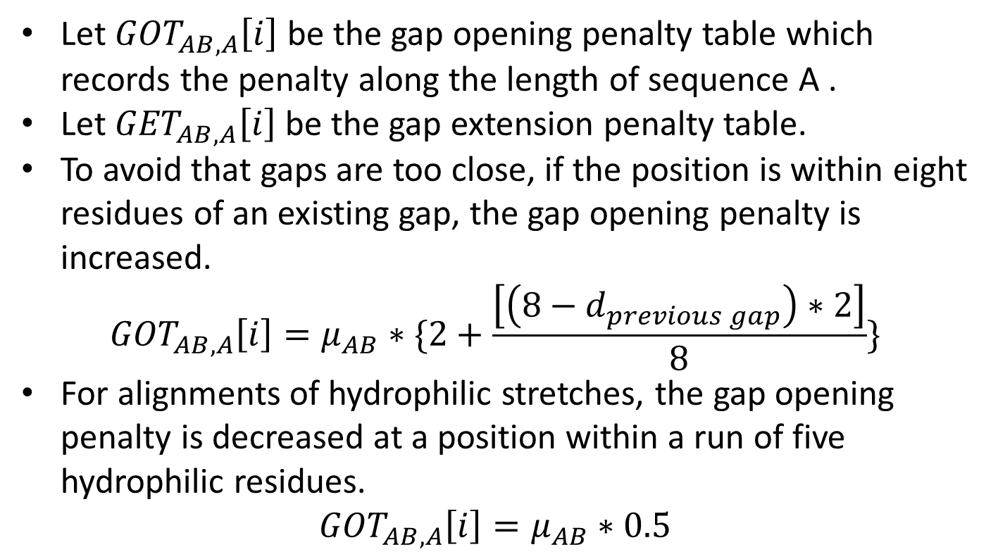
Other concerns for protein sequences
Let ${GOT}_{AB,A}\left[i\right]$ be the gap opening penalty table which records the penalty along the length of sequence A .
Let ${GET}_{AB,A}\left[i\right]$ be the gap extension penalty table.
To avoid that gaps are too close, if the position is within eight residues of an existing gap, the gap opening penalty is increased.
$${GOT}_{AB,A}\left[i\right]=μ_{AB}∗\{2+\frac{\left[\left(8−d_{previous gap}\right)∗2\right]}{8}\}$$
For alignments of hydrophilic stretches, the gap opening penalty is decreased at a position within a run of five hydrophilic residues.
$${GOT}_{AB,A}\left[i\right]=μ_{AB}∗0.5$$

Slide 27
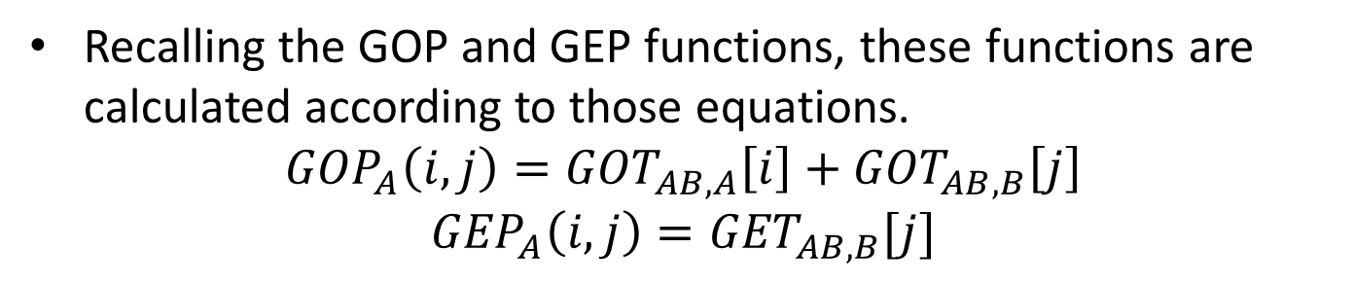
Other concerns for protein sequences
Recalling the GOP and GEP functions, these functions are calculated according to those equations.
$${{GOP}_{A}\left(i,j\right)=GOT}_{AB,A}\left[i\right]+{GOT}_{AB,B}\left[j\right]$$
$${{GEP}_{A}\left(i,j\right)=GET}_{AB,B}[j]$$

Slide 28
Experiments
Three different percent identity ranges
<=25% , 20-40%, >35%
The accuracy is evaluated by two different scoring functions
Sum of pair :
the number of correctly aligned residue
pairs found in the test alignment divided by the total
number of aligned residue pairs in the reference
alignment.
Total column score :
the number of correctly aligned columns
found in the test alignment divided by the total number
of aligned columns in the reference alignment.

Slide 29
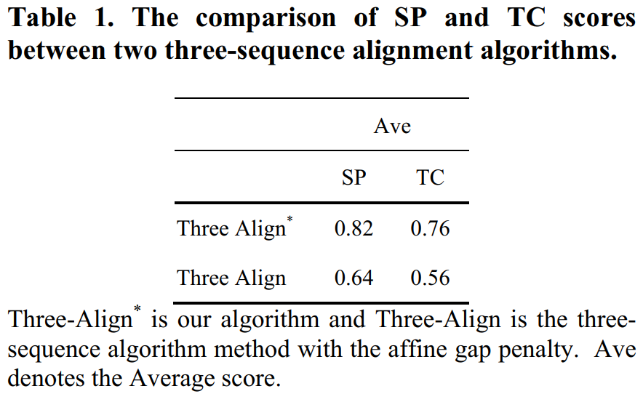
Experiments

Slide 30
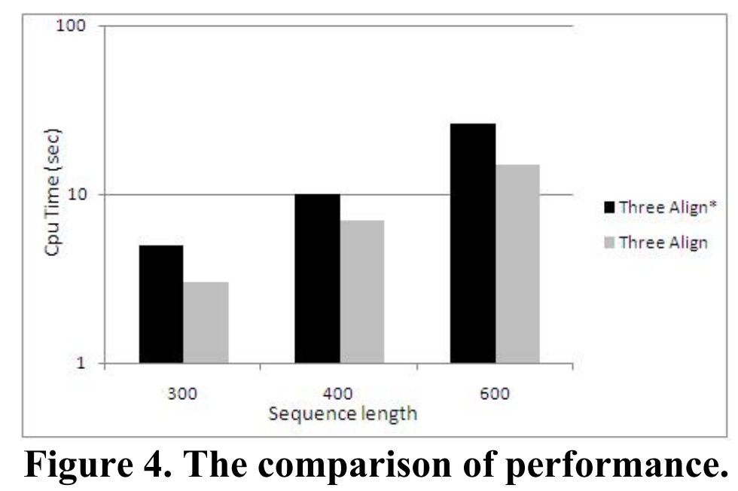
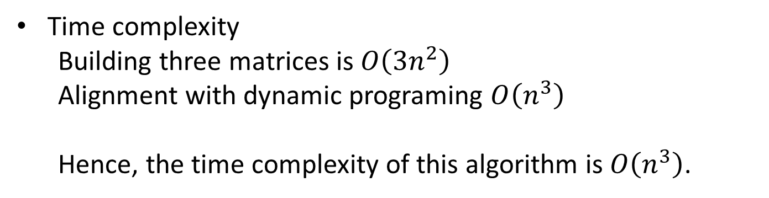
Experiments
Time complexity
Building three matrices is $O\left(3n^{2}\right)$
Alignment with dynamic programing $O\left(n^{3}\right)$
Hence, the time complexity of this algorithm is $O\left(n^{3}\right)$.

