Slide 1
Effective Sparse Dynamic Programming Algorithms for Merged and Block Merged LCS Problems
AHM Mahfuzur Rahman, M. Sohel Rahman
Journal of Computers, Vol. 9, no. 8, August 2014, Page 1743-1754
Presenter: Chien-Ting Lee
Date: Mar. 13, 2023

Slide 2
Abstract(1/3)
The longest common subsequence problem has been widely studied and used to find out the relationship between sequences. In this paper, we study the interleaving relationship between sequences, that is, we measure the relationship among three sequences, where two of those are interleaved in different ways and then the interleaved sequences are subsequently matched with the third remaining sequence, as pairwise longest common subsequence problems. Given a target sequence T and two other sequences A and B, we need to find out the LCS between M(A, B) and T, where M(A,B) denotes the merged-sequence which consists of A and B.

Slide 3
Abstract(2/3)
We first present an improved O((Rr + Pm)loglogr) time algorithm, where we consider only the matches between sequences; here |T| = n, |A| = m and |B| = r (m≥r); R is the total number of ordered pairs of positions at which the two strings A and T match and P denotes the total number of ordered pairs of positions at which the two strings B and T match. Basing on the same idea, we also propose an improved algorithm to solve a block constrained variation of the problem. Running time of the blocked version is O(max{Rβloglog r, Pαloglogr}), where α denotes the number of blocks in A and β denotes the number of blocks in B.

Slide 4
Abstract(3/3)
However, these improved algorithms do not provide best output in every cases. Therefore we finally fabricate a hybrid algorithm which utilizes the advantages of our proposed algorithms and previous state of the arts algorithms to provide best output in every possible cases, from both time efficiency and space efficiency.

Slide 5
Merged LCS
A = a₁a₂a₃a₄ = actt, B = b₁b₂b₃ = ctg , T = tcatcg
M₁(A, B) = a₁b₁a₂b₂b₃a₃a₄ = acctgtt
M₂(A, B) = a₁a₂a₃a₄b₁b₂b₃ = acttctg
M₃(A, B) = b₁a₁b₂a₂b₃a₃a₄ = catcgtt
MLCS(A, B, T) = LCS (M₃(A, B), T) = catcg

Slide 6
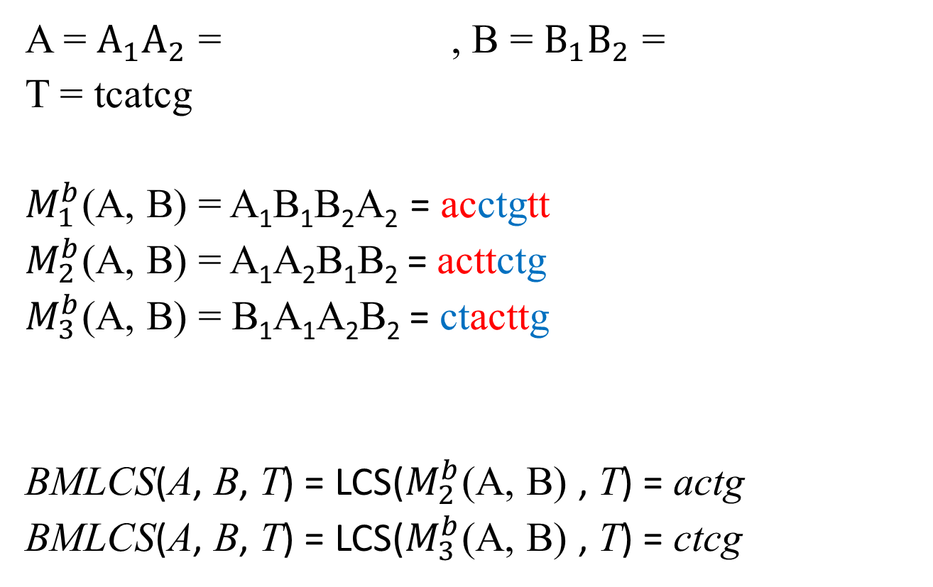
Block Merged LCS
ac | tt
ct | g
A = $A_{1}A_{2}$ = , B = $B_{1}B_{2}$ =
T = tcatcg
$M_{1}^{b}$(A, B) = A₁B₁B₂A₂ = acctgtt
$M_{2}^{b}$(A, B) = A₁A₂B₁B₂ = acttctg
$M_{3}^{b}$(A, B) = B₁A₁A₂B₂ = ctacttg
BMLCS(A, B, T) = LCS($M_{2}^{b}$(A, B) , T) = actg
BMLCS(A, B, T) = LCS($M_{3}^{b}$(A, B) , T) = ctcg

Slide 7
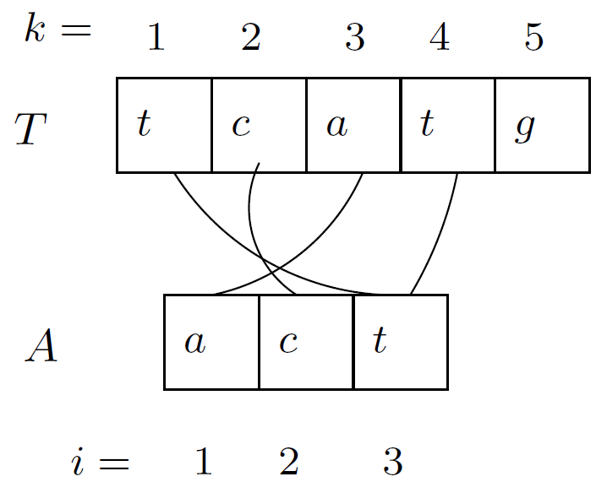
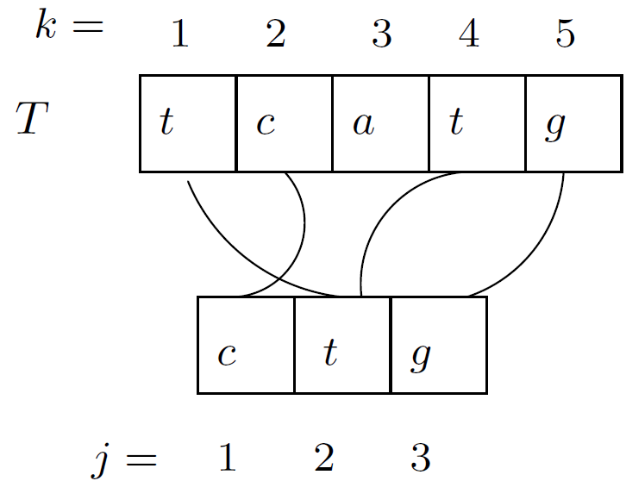
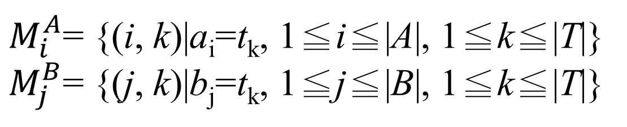
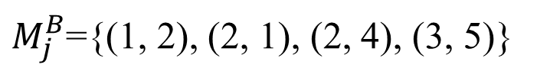
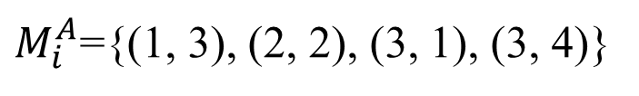
Match pair
|A| = m , |B| = r , |T| = n
$M_{i}^{A}$= {(i, k)|a_{i}=t_{k}, 1≦i≦|A|, 1≦k≦|T|}
$M_{j}^{B}$= {(j, k)|b_{j}=t_{k}, 1≦j≦|B|, 1≦k≦|T|}
B
$M_{i}^{A}$={(1, 3), (2, 2), (3, 1), (3, 4)}
$M_{j}^{B}$={(1, 2), (2, 1), (2, 4), (3, 5)}

Slide 8
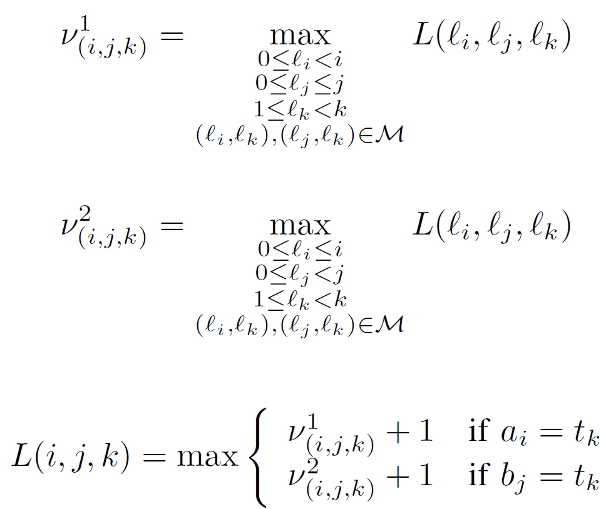
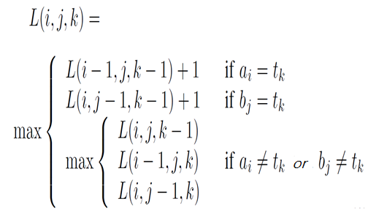
Algorithm for Merged LCS Problem

Slide 9
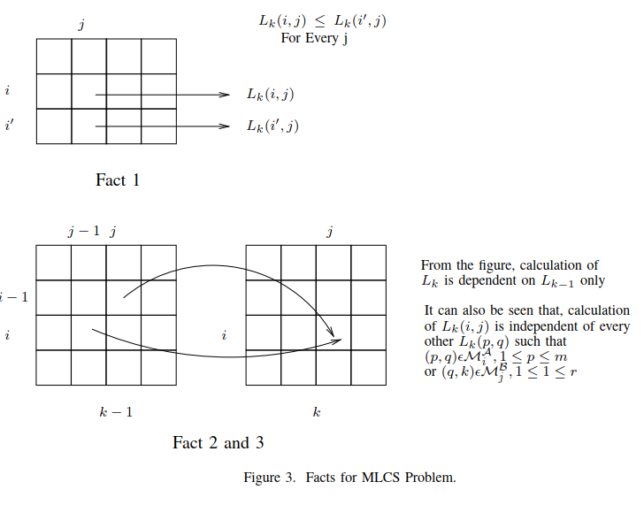

Algorithm for Merged LCS Problem
L(i, j, k) = $L_{k}$(i, j)
0 ≤ i ≤m,
0 ≤ j ≤ r,
1 ≤ k ≤ n

Slide 10
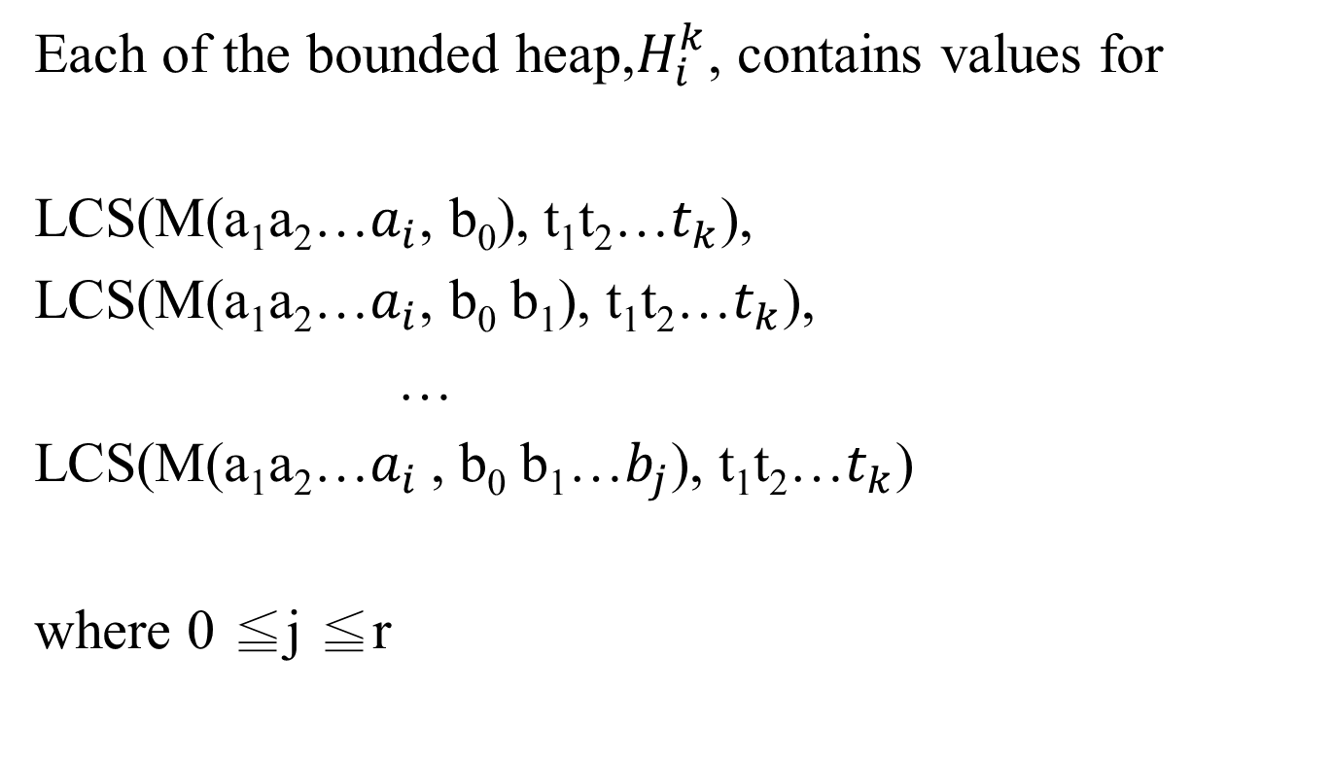
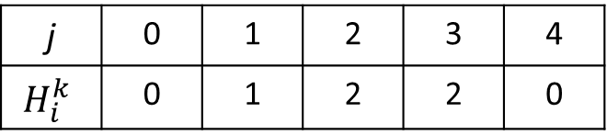
Bounded Heap data structure
Each of the bounded heap,$H_{i}^{k}$, contains values for
LCS(M(a₁a₂…$a_{i}$, b₀), t₁t₂…$t_{k}$),
LCS(M(a₁a₂…$a_{i}$, b₀ b₁), t₁t₂…$t_{k}$),
…
LCS(M(a₁a₂…$a_{i}$ , b₀ b₁…$b_{j}$), t₁t₂…$t_{k}$)
where 0 ≦j ≦r
j | 0 | 1 | 2 | 3 | 4
$$H_{i}^{k}$$ | 0 | 1 | 2 | 2 | 0

Slide 11
Bounded Heap data structure
Insert(H, pos, val, data)
IncVal(H, pos, val, data)
BoundedMax(H, pos)
above operations in O(loglogn) amortized time.
Using van Emde Boas tree (vEB tree).
 | 0 | 1 | 2 | 3 | 4
H | 0 | 1 | 2 | 2 | 0

Slide 12
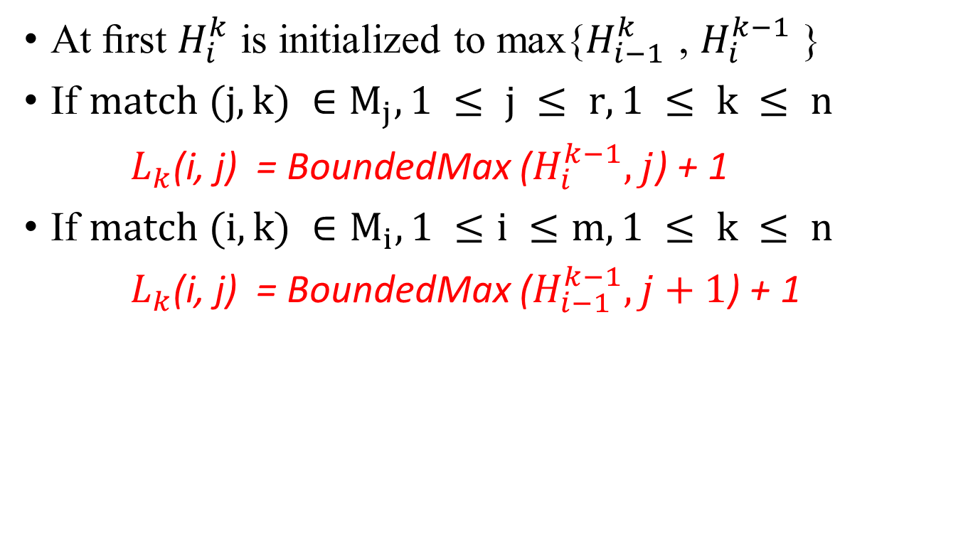
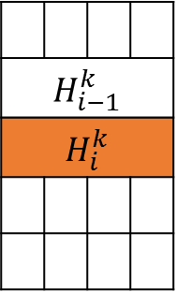
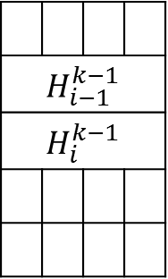
Algorithm MLCS(A, B, T)
At ﬁrst $H_{i}^{k}$ is initialized to max{$H_{i−1}^{k}$ , $H_{i}^{k−1}$ }
If $match (j, k) ∈M_{j}, 1 ≤ j ≤ r, 1 ≤ k ≤ n$
$L_{k}$(i, j) = BoundedMax ($H_{i}^{k−1},j$) + 1
If $match (i, k) ∈M_{i}, 1 ≤i ≤m, 1 ≤ k ≤ n$
$L_{k}$(i, j) = BoundedMax ($H_{i−1}^{k−1},j+1$) + 1
j
j
$$H_{i−1}^{k−1}$$
$$H_{i}^{k−1}$$
$$H_{i−1}^{k}$$
$$H_{i}^{k}$$
i-1
i
k -1 k

Slide 13

Algorithm MLCS(A, B, T)
A = actt, B = ctg, T = tcatcg
$M_{i}^{A}$={ (1, 3), (2, 2), (2, 5), (3, 1), (3, 4), (4, 1), (4, 4)}
$M_{j}^{B}$={(1, 2), (1, 5), (2, 1), (2, 4), (3, 6)}

Slide 14
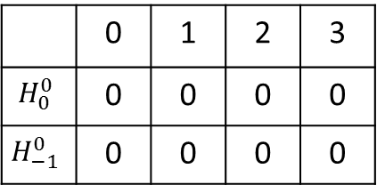

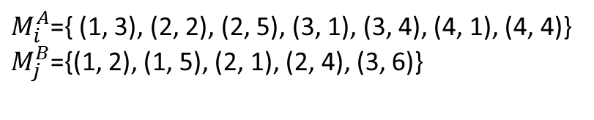
j
0 | 1 | 2 | 3
0 | 1 | 2 | 3
0 | 1 | 2 | 3
0 | 1 | 2 | 3
0 | 1 | 2 | 3
0 | 1 | 2 | 3
0
1
2
3
4
i
k = 1 2 3 4 5 6
 | 0 | 1 | 2 | 3
$$H_{0}^{0}$$ | 0 | 0 | 0 | 0
$$H_{−1}^{0}$$ | 0 | 0 | 0 | 0
$M_{i}^{A}$={ (1, 3), (2, 2), (2, 5), (3, 1), (3, 4), (4, 1), (4, 4)}
$M_{j}^{B}$={(1, 2), (1, 5), (2, 1), (2, 4), (3, 6)}
$$H_{−1}^{1}$$ | 0 | 0 | 0 | 0

Slide 15
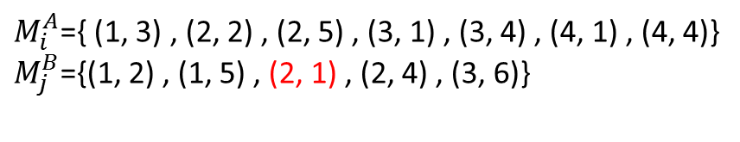
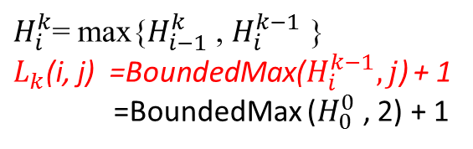
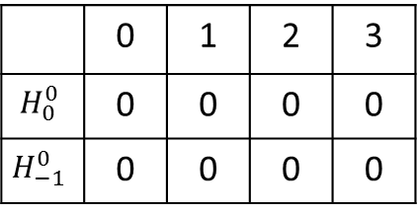


j
0 | 1 | 2 | 3
0 | 1 | 2 | 3
0 | 1 | 2 | 3
0 | 1 | 2 | 3
0 | 1 | 2 | 3
0 | 1 | 2 | 3
0
1
2
3
4
 |  | 1
i
k = 1 2 3 4 5 6
 | 0 | 1 | 2 | 3
$$H_{0}^{0}$$ | 0 | 0 | 0 | 0
$$H_{−1}^{0}$$ | 0 | 0 | 0 | 0
$M_{i}^{A}$={ (1, 3) , (2, 2) , (2, 5) , (3, 1) , (3, 4) , (4, 1) , (4, 4)}
$M_{j}^{B}$={(1, 2) , (1, 5) , (2, 1) , (2, 4) , (3, 6)}
i = 0 , k = 1
$$H_{−1}^{1}$$ | 0 | 0 | 0 | 0
$$H_{0}^{1}$$ | 0 | 0 | 1 | 0
$H_{i}^{k}$= max{$H_{i−1}^{k}$ , $H_{i}^{k−1}$ }
$L_{k}$(i, j) =BoundedMax($H_{i}^{k−1},j$) + 1
=BoundedMax ($H_{0}^{0}$ , 2) + 1

Slide 16
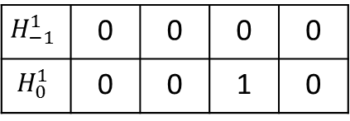
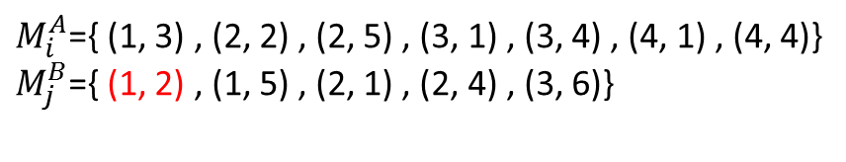

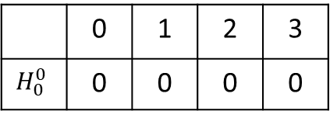

j
0 | 1 | 2 | 3
0 | 1 | 2 | 3
0 | 1 | 2 | 3
0 | 1 | 2 | 3
0 | 1 | 2 | 3
0 | 1 | 2 | 3
0
1
2
3
4
 |  | 1
 | 1
i
k = 1 2 3 4 5 6
 | 0 | 1 | 2 | 3
$$H_{0}^{0}$$ | 0 | 0 | 0 | 0
$M_{i}^{A}$={ (1, 3) , (2, 2) , (2, 5) , (3, 1) , (3, 4) , (4, 1) , (4, 4)}
$M_{j}^{B}$={ (1, 2) , (1, 5) , (2, 1) , (2, 4) , (3, 6)}
i = 0 , k = 2
$$H_{−1}^{1}$$ | 0 | 0 | 0 | 0
$$H_{0}^{1}$$ | 0 | 0 | 1 | 0
$$H_{0}^{2}$$ | 0 | 1 | 1 | 0
$H_{i}^{k}$= max{$H_{i−1}^{k}$ , $H_{i}^{k−1}$ }
$L_{k}$(i, j) =BoundedMax($H_{i}^{k−1},j$) + 1
=BoundedMax ($H_{0}^{1}$ , 1) + 1

Slide 17


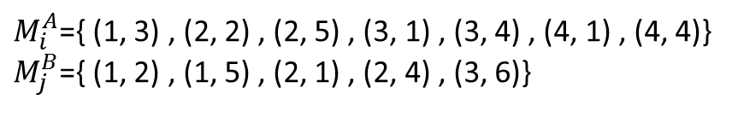

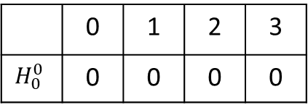

j
0 | 1 | 2 | 3
0 | 1 | 2 | 3
0 | 1 | 2 | 3
0 | 1 | 2 | 3
0 | 1 | 2 | 3
0 | 1 | 2 | 3
0
1
2
3
4
 |  | 1
 | 1
i
k = 1 2 3 4 5 6
 | 0 | 1 | 2 | 3
$$H_{0}^{0}$$ | 0 | 0 | 0 | 0
$M_{i}^{A}$={ (1, 3) , (2, 2) , (2, 5) , (3, 1) , (3, 4) , (4, 1) , (4, 4)}
$M_{j}^{B}$={ (1, 2) , (1, 5) , (2, 1) , (2, 4) , (3, 6)}
i = 0 , k = 3
$$H_{0}^{1}$$ | 0 | 0 | 1 | 0
$$H_{0}^{3}$$ | 0 | 1 | 1 | 0
$$H_{0}^{2}$$ | 0 | 1 | 1 | 0
$H_{i}^{k}$= max{$H_{i−1}^{k}$ , $H_{i}^{k−1}$ }

Slide 18



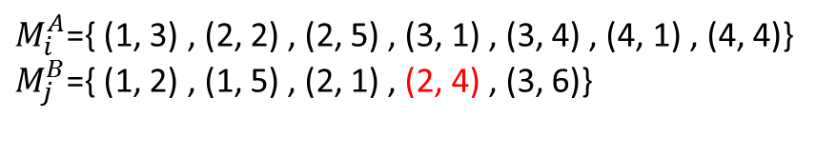

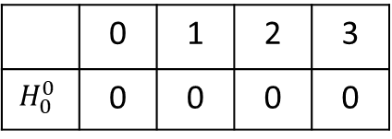

j
0 | 1 | 2 | 3
0 | 1 | 2 | 3
0 | 1 | 2 | 3
0 | 1 | 2 | 3
0 | 1 | 2 | 3
0 | 1 | 2 | 3
0
1
2
3
4
 |  | 1
 | 1
 |  | 2
i
k = 1 2 3 4 5 6
 | 0 | 1 | 2 | 3
$$H_{0}^{0}$$ | 0 | 0 | 0 | 0
$M_{i}^{A}$={ (1, 3) , (2, 2) , (2, 5) , (3, 1) , (3, 4) , (4, 1) , (4, 4)}
$M_{j}^{B}$={ (1, 2) , (1, 5) , (2, 1) , (2, 4) , (3, 6)}
i = 0 , k = 4
$$H_{0}^{1}$$ | 0 | 0 | 1 | 0
$$H_{0}^{4}$$ | 0 | 1 | 2 | 0
$$H_{0}^{2}$$ | 0 | 1 | 1 | 0
$H_{i}^{k}$= max{$H_{i−1}^{k}$ , $H_{i}^{k−1}$ }
$L_{k}$(i, j) =BoundedMax($H_{i}^{k−1},j$) + 1
=BoundedMax ($H_{0}^{3}$ , 2) + 1
$$H_{0}^{3}$$ | 0 | 1 | 1 | 0

Slide 19



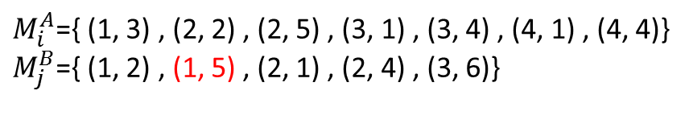

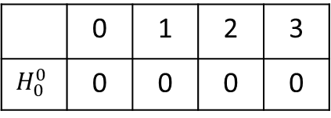


j
0 | 1 | 2 | 3
0 | 1 | 2 | 3
0 | 1 | 2 | 3
0 | 1 | 2 | 3
0 | 1 | 2 | 3
0 | 1 | 2 | 3
0
1
2
3
4
 |  | 1
 | 1
 |  | 2
 | 1
i
k = 1 2 3 4 5 6
 | 0 | 1 | 2 | 3
$$H_{0}^{0}$$ | 0 | 0 | 0 | 0
$M_{i}^{A}$={ (1, 3) , (2, 2) , (2, 5) , (3, 1) , (3, 4) , (4, 1) , (4, 4)}
$M_{j}^{B}$={ (1, 2) , (1, 5) , (2, 1) , (2, 4) , (3, 6)}
i = 0 , k = 5
$$H_{0}^{1}$$ | 0 | 0 | 1 | 0
$$H_{0}^{5}$$ | 0 | 1 | 2 | 0
$$H_{0}^{2}$$ | 0 | 1 | 1 | 0
$H_{i}^{k}$= max{$H_{i−1}^{k}$ , $H_{i}^{k−1}$ }
$L_{k}$(i, j) =BoundedMax($H_{i}^{k−1},j$) + 1
=BoundedMax ($H_{0}^{4}$ , 1) + 1
$$H_{0}^{3}$$ | 0 | 1 | 1 | 0
$$H_{0}^{4}$$ | 0 | 1 | 2 | 0

Slide 20

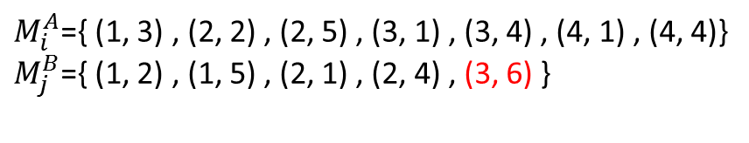




j
0 | 1 | 2 | 3
0 | 1 | 2 | 3
0 | 1 | 2 | 3
0 | 1 | 2 | 3
0 | 1 | 2 | 3
0 | 1 | 2 | 3
0
1
2
3
4
 |  | 1
 | 1
 |  | 2
 | 1
 |  |  | 3
i
k = 1 2 3 4 5 6
 | 0 | 1 | 2 | 3
$$H_{0}^{0}$$ | 0 | 0 | 0 | 0
$M_{i}^{A}$={ (1, 3) , (2, 2) , (2, 5) , (3, 1) , (3, 4) , (4, 1) , (4, 4)}
$M_{j}^{B}$={ (1, 2) , (1, 5) , (2, 1) , (2, 4) , (3, 6) }
i = 0 , k = 6
$$H_{0}^{1}$$ | 0 | 0 | 1 | 0
$$H_{0}^{5}$$ | 0 | 1 | 2 | 0
$$H_{0}^{6}$$ | 0 | 1 | 2 | 0
$$H_{0}^{6}$$ | 0 | 1 | 2 | 3
$$H_{0}^{2}$$ | 0 | 1 | 1 | 0
$H_{i}^{k}$= max{$H_{i−1}^{k}$ , $H_{i}^{k−1}$ }
$L_{k}$(i, j) =BoundedMax($H_{i}^{k−1},j$) + 1
=BoundedMax ($H_{0}^{5}$ , 3) + 1
$$H_{0}^{3}$$ | 0 | 1 | 1 | 0
$$H_{0}^{4}$$ | 0 | 1 | 2 | 0

Slide 21
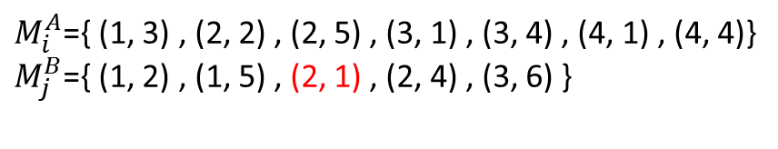



j
0 | 1 | 2 | 3
0 | 1 | 2 | 3
0 | 1 | 2 | 3
0 | 1 | 2 | 3
0 | 1 | 2 | 3
0 | 1 | 2 | 3
0
1
2
3
4
 |  | 1
 |  | 1
 | 1
 |  | 2
 | 1
 |  |  | 3
i
k = 1 2 3 4 5 6
 | 0 | 1 | 2 | 3
$$H_{0}^{0}$$ | 0 | 0 | 0 | 0
$M_{i}^{A}$={ (1, 3) , (2, 2) , (2, 5) , (3, 1) , (3, 4) , (4, 1) , (4, 4)}
$M_{j}^{B}$={ (1, 2) , (1, 5) , (2, 1) , (2, 4) , (3, 6) }
i = 1 , k = 1
$$H_{0}^{1}$$ | 0 | 0 | 1 | 0
$$H_{0}^{5}$$ | 0 | 1 | 2 | 0
$$H_{0}^{6}$$ | 0 | 1 | 2 | 3
$$H_{0}^{2}$$ | 0 | 1 | 1 | 0
$$H_{1}^{1}$$ | 0 | 0 | 1 | 0
$H_{i}^{k}$= max{$H_{i−1}^{k}$ , $H_{i}^{k−1}$ }
$L_{k}$(i, j) =BoundedMax($H_{i}^{k−1},j$) + 1
=BoundedMax ($H_{1}^{0}$ , 2) + 1
$$H_{0}^{3}$$ | 0 | 1 | 1 | 0
$$H_{0}^{4}$$ | 0 | 1 | 2 | 0

Slide 22

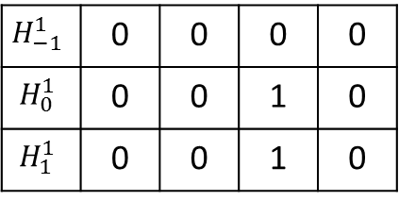







j
0 | 1 | 2 | 3
0 | 1 | 2 | 3
0 | 1 | 2 | 3
0 | 1 | 2 | 3
0 | 1 | 2 | 3
0 | 1 | 2 | 3
0
1
2
3
4
 |  | 1
 |  | 1
 | 1
 | 1
 |  | 2
 | 1
 |  |  | 3
i
k = 1 2 3 4 5 6
$M_{i}^{A}$={ (1, 3) , (2, 2) , (2, 5) , (3, 1) , (3, 4) , (4, 1) , (4, 4)}
$M_{j}^{B}$={ (1, 2) , (1, 5) , (2, 1) , (2, 4) , (3, 6) }
i = 1 , k = 2
$$H_{−1}^{1}$$ | 0 | 0 | 0 | 0
$$H_{0}^{1}$$ | 0 | 0 | 1 | 0
$$H_{1}^{1}$$ | 0 | 0 | 1 | 0
$$H_{0}^{5}$$ | 0 | 1 | 2 | 0
$$H_{0}^{6}$$ | 0 | 1 | 2 | 3
$$H_{0}^{2}$$ | 0 | 1 | 1 | 0
$H_{i}^{k}$= max{$H_{i−1}^{k}$ , $H_{i}^{k−1}$ }
$L_{k}$(i, j) =BoundedMax($H_{i}^{k−1},j$) + 1
=BoundedMax ($H_{1}^{1}$ , 1) + 1
$$H_{1}^{2}$$ | 0 | 1 | 1 | 0
$$H_{0}^{3}$$ | 0 | 1 | 1 | 0
$$H_{0}^{4}$$ | 0 | 1 | 2 | 0

Slide 23


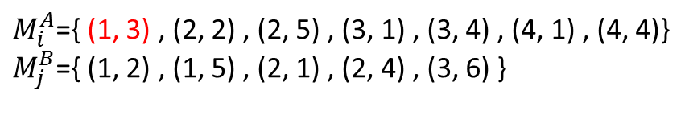
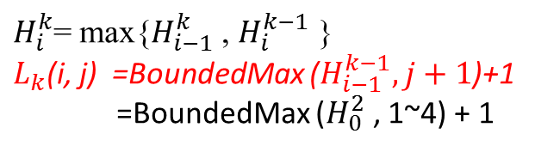


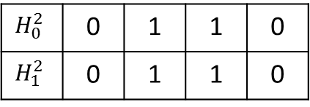

j
0 | 1 | 2 | 3
0 | 1 | 2 | 3
0 | 1 | 2 | 3
0 | 1 | 2 | 3
0 | 1 | 2 | 3
0 | 1 | 2 | 3
0
1
2
3
4
 |  | 1
 |  | 1
 | 1
 | 1
1 | 2 | 2 | 2
 |  | 2
 | 1
 |  |  | 3
i
k = 1 2 3 4 5 6
$M_{i}^{A}$={ (1, 3) , (2, 2) , (2, 5) , (3, 1) , (3, 4) , (4, 1) , (4, 4)}
$M_{j}^{B}$={ (1, 2) , (1, 5) , (2, 1) , (2, 4) , (3, 6) }
i = 1 , k = 3
$$H_{1}^{1}$$ | 0 | 0 | 1 | 0
$$H_{0}^{5}$$ | 0 | 1 | 2 | 0
$$H_{0}^{6}$$ | 0 | 1 | 2 | 3
$$H_{0}^{2}$$ | 0 | 1 | 1 | 0
$$H_{1}^{2}$$ | 0 | 1 | 1 | 0
$$H_{1}^{3}$$ | 1 | 2 | 2 | 2
$H_{i}^{k}$= max{$H_{i−1}^{k}$ , $H_{i}^{k−1}$ }
$L_{k}$(i, j) =BoundedMax ($H_{i−1}^{k−1},j+1$)+1
=BoundedMax ($H_{0}^{2}$ , 1~4) + 1
$$H_{0}^{3}$$ | 0 | 1 | 1 | 0
$$H_{0}^{4}$$ | 0 | 1 | 2 | 0

Slide 24


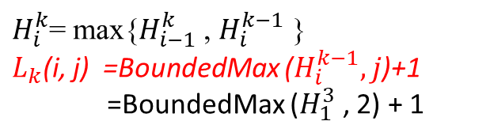



j
0 | 1 | 2 | 3
0 | 1 | 2 | 3
0 | 1 | 2 | 3
0 | 1 | 2 | 3
0 | 1 | 2 | 3
0 | 1 | 2 | 3
0
1
2
3
4
 |  | 1
 |  | 1
 | 1
 | 1
1 | 2 | 2 | 2
 |  | 2
 |  | 3
 | 1
 |  |  | 3
i
k = 1 2 3 4 5 6
$M_{i}^{A}$={ (1, 3) , (2, 2) , (2, 5) , (3, 1) , (3, 4) , (4, 1) , (4, 4)}
$M_{j}^{B}$={ (1, 2) , (1, 5) , (2, 1) , (2, 4) , (3, 6) }
i = 1 , k = 4
$$H_{1}^{1}$$ | 0 | 0 | 1 | 0
$$H_{0}^{5}$$ | 0 | 1 | 2 | 0
$$H_{1}^{2}$$ | 0 | 1 | 1 | 0
$$H_{0}^{6}$$ | 0 | 1 | 2 | 3
$$H_{0}^{3}$$ | 0 | 1 | 1 | 0
$$H_{1}^{3}$$ | 1 | 2 | 2 | 2
$$H_{1}^{4}$$ | 1 | 2 | 3 | 2
$H_{i}^{k}$= max{$H_{i−1}^{k}$ , $H_{i}^{k−1}$ }
$L_{k}$(i, j) =BoundedMax ($H_{i}^{k−1},j$)+1
=BoundedMax ($H_{1}^{3}$ , 2) + 1
$$H_{0}^{4}$$ | 0 | 1 | 2 | 0

Slide 25


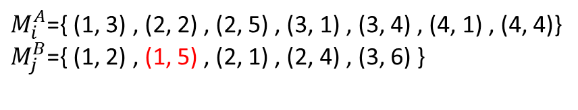



j
0 | 1 | 2 | 3
0 | 1 | 2 | 3
0 | 1 | 2 | 3
0 | 1 | 2 | 3
0 | 1 | 2 | 3
0 | 1 | 2 | 3
0
1
2
3
4
 |  | 1
 |  | 1
 | 1
 | 1
1 | 2 | 2 | 2
 |  | 2
 |  | 3
 | 1
 | 2
 |  |  | 3
i
k = 1 2 3 4 5 6
$M_{i}^{A}$={ (1, 3) , (2, 2) , (2, 5) , (3, 1) , (3, 4) , (4, 1) , (4, 4)}
$M_{j}^{B}$={ (1, 2) , (1, 5) , (2, 1) , (2, 4) , (3, 6) }
i = 1 , k = 5
$$H_{1}^{1}$$ | 0 | 0 | 1 | 0
$$H_{0}^{5}$$ | 0 | 1 | 2 | 0
$$H_{1}^{2}$$ | 0 | 1 | 1 | 0
$$H_{0}^{6}$$ | 0 | 1 | 2 | 3
$$H_{1}^{3}$$ | 1 | 2 | 2 | 2
$$H_{1}^{5}$$ | 1 | 2 | 3 | 2
$H_{i}^{k}$= max{$H_{i−1}^{k}$ , $H_{i}^{k−1}$ }
$L_{k}$(i, j) =BoundedMax ($H_{i}^{k−1},j$)+1
=BoundedMax ($H_{1}^{4}$ , 1) + 1
$$H_{0}^{4}$$ | 0 | 1 | 2 | 0
$$H_{1}^{4}$$ | 1 | 2 | 3 | 2

Slide 26

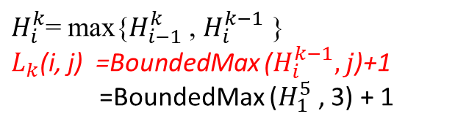




j
0 | 1 | 2 | 3
0 | 1 | 2 | 3
0 | 1 | 2 | 3
0 | 1 | 2 | 3
0 | 1 | 2 | 3
0 | 1 | 2 | 3
0
1
2
3
4
 |  | 1
 |  | 1
 | 1
 | 1
1 | 2 | 2 | 2
 |  | 2
 |  | 3
 | 1
 | 2
 |  |  | 3
 |  |  | 4
i
k = 1 2 3 4 5 6
$M_{i}^{A}$={ (1, 3) , (2, 2) , (2, 5) , (3, 1) , (3, 4) , (4, 1) , (4, 4)}
$M_{j}^{B}$={ (1, 2) , (1, 5) , (2, 1) , (2, 4) , (3, 6) }
i = 1 , k = 6
$$H_{1}^{1}$$ | 0 | 0 | 1 | 0
$$H_{1}^{5}$$ | 1 | 2 | 3 | 2
$$H_{1}^{2}$$ | 0 | 1 | 1 | 0
$$H_{0}^{6}$$ | 0 | 1 | 2 | 3
$$H_{1}^{3}$$ | 1 | 2 | 2 | 2
$$H_{1}^{6}$$ | 1 | 2 | 3 | 4
$$H_{1}^{4}$$ | 1 | 2 | 3 | 2
$H_{i}^{k}$= max{$H_{i−1}^{k}$ , $H_{i}^{k−1}$ }
$L_{k}$(i, j) =BoundedMax ($H_{i}^{k−1},j$)+1
=BoundedMax ($H_{1}^{5}$ , 3) + 1

Slide 27



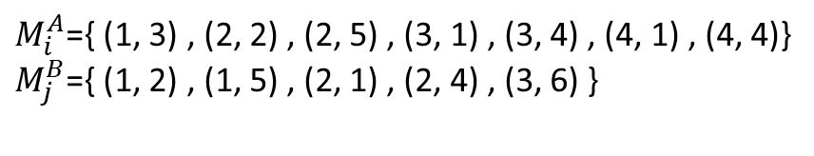




j
0 | 1 | 2 | 3
0 | 1 | 2 | 3
0 | 1 | 2 | 3
0 | 1 | 2 | 3
0 | 1 | 2 | 3
0 | 1 | 2 | 3
0
1
2
3
4
 |  | 1
 |  | 1
 |  | 1
 | 1
 | 1
1 | 1 | 2 | 2
1 | 2 | 2 | 2
 |  | 2
 |  | 3
 |  | 3
 | 1
 | 2
2 | 3 | 4 | 4
 |  |  | 3
 |  |  | 4
 |  |  | 5
i
k = 1 2 3 4 5 6
$M_{i}^{A}$={ (1, 3) , (2, 2) , (2, 5) , (3, 1) , (3, 4) , (4, 1) , (4, 4)}
$M_{j}^{B}$={ (1, 2) , (1, 5) , (2, 1) , (2, 4) , (3, 6) }
i = 2 , k = 3
$$H_{2}^{3}$$ | 1 | 2 | 2 | 2
$$H_{1}^{1}$$ | 0 | 0 | 1 | 0
$$H_{1}^{5}$$ | 1 | 2 | 3 | 2
i = 2 , k = 4
$$H_{1}^{2}$$ | 0 | 1 | 1 | 0
$$H_{1}^{6}$$ | 1 | 2 | 3 | 4
$$H_{2}^{4}$$ | 1 | 2 | 3 | 2
i = 2 , k = 1
i = 2 , k = 5
$$H_{1}^{3}$$ | 1 | 2 | 2 | 2
$$H_{2}^{1}$$ | 0 | 0 | 1 | 0
$$H_{2}^{5}$$ | 2 | 3 | 4 | 4
$$H_{1}^{4}$$ | 1 | 2 | 3 | 2
i = 2 , k = 6
i = 2 , k = 2
$$H_{2}^{6}$$ | 2 | 3 | 4 | 5
$$H_{2}^{2}$$ | 1 | 1 | 2 | 2

Slide 28












j
0 | 1 | 2 | 3
0 | 1 | 2 | 3
0 | 1 | 2 | 3
0 | 1 | 2 | 3
0 | 1 | 2 | 3
0 | 1 | 2 | 3
0
1
2
3
4
 |  | 1
 |  | 1
 |  | 1
1 | 1 | 1 | 1
 | 1
 | 1
1 | 1 | 2 | 2
 | 2
1 | 2 | 2 | 2
 |  | 2
 |  | 3
 |  | 3
2 | 3 | 3 | 3
 | 1
 | 2
2 | 3 | 4 | 4
 | 3
 |  |  | 3
 |  |  | 4
 |  |  | 5
 |  |  | 5
i
k = 1 2 3 4 5 6
$M_{i}^{A}$={ (1, 3) , (2, 2) , (2, 5) , (3, 1) , (3, 4) , (4, 1) , (4, 4)}
$M_{j}^{B}$={ (1, 2) , (1, 5) , (2, 1) , (2, 4) , (3, 6) }
i = 3 , k = 3
$$H_{3}^{3}$$ | 1 | 2 | 2 | 2
$$H_{2}^{1}$$ | 0 | 0 | 1 | 0
$$H_{2}^{5}$$ | 2 | 3 | 4 | 4
i = 3 , k = 4
$$H_{2}^{2}$$ | 1 | 1 | 2 | 2
$$H_{2}^{6}$$ | 2 | 3 | 4 | 5
$$H_{3}^{4}$$ | 2 | 3 | 3 | 3
i = 3 , k = 1
i = 3 , k = 5
$$H_{2}^{3}$$ | 1 | 2 | 2 | 2
$$H_{3}^{1}$$ | 1 | 1 | 1 | 1
$$H_{3}^{5}$$ | 2 | 3 | 4 | 4
$$H_{2}^{4}$$ | 1 | 2 | 3 | 2
i = 3 , k = 6
i = 3 , k = 2
$$H_{3}^{6}$$ | 2 | 3 | 4 | 5
$$H_{3}^{2}$$ | 1 | 2 | 2 | 2

Slide 29












j
0 | 1 | 2 | 3
0 | 1 | 2 | 3
0 | 1 | 2 | 3
0 | 1 | 2 | 3
0 | 1 | 2 | 3
0 | 1 | 2 | 3
0
1
2
3
4
 |  | 1
 |  | 1
 |  | 1
1 | 1 | 1 | 1
1 | 1 | 1 | 1
 | 1
 | 1
1 | 1 | 2 | 2
 | 2
 | 2
1 | 2 | 2 | 2
 |  | 2
 |  | 3
 |  | 3
2 | 3 | 3 | 3
2 | 3 | 3 | 3
 | 1
 | 2
2 | 3 | 4 | 4
 | 3
 | 3
 |  |  | 3
 |  |  | 4
 |  |  | 5
 |  |  | 5
 |  |  | 5
i
k = 1 2 3 4 5 6
$M_{i}^{A}$={ (1, 3) , (2, 2) , (2, 5) , (3, 1) , (3, 4) , (4, 1) , (4, 4)}
$M_{j}^{B}$={ (1, 2) , (1, 5) , (2, 1) , (2, 4) , (3, 6) }
i = 4 , k = 3
$$H_{4}^{3}$$ | 1 | 2 | 2 | 2
$$H_{3}^{1}$$ | 1 | 1 | 1 | 1
$$H_{3}^{5}$$ | 2 | 3 | 4 | 4
i = 4 , k = 4
$$H_{3}^{2}$$ | 1 | 2 | 2 | 2
$$H_{3}^{6}$$ | 2 | 3 | 4 | 5
$$H_{4}^{4}$$ | 2 | 3 | 3 | 3
i = 4 , k = 1
i =4, k = 5
$$H_{3}^{3}$$ | 1 | 2 | 2 | 2
$$H_{4}^{1}$$ | 1 | 1 | 1 | 1
$$H_{4}^{5}$$ | 2 | 3 | 4 | 4
$$H_{3}^{4}$$ | 2 | 3 | 3 | 3
i =4, k = 6
i = 4 , k = 2
$$H_{4}^{6}$$ | 2 | 3 | 4 | 5
$$H_{4}^{2}$$ | 1 | 2 | 2 | 2

Slide 30
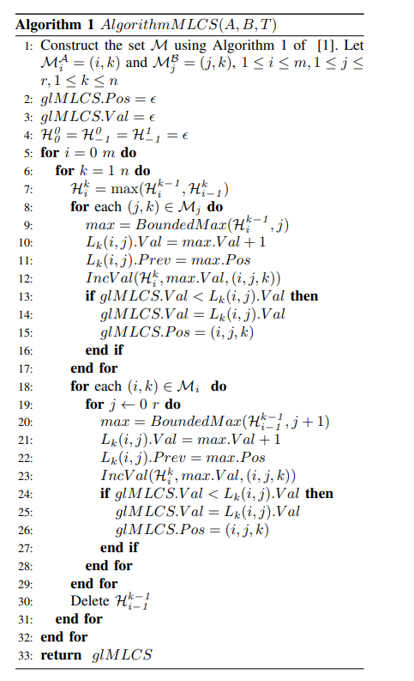




Slide 31
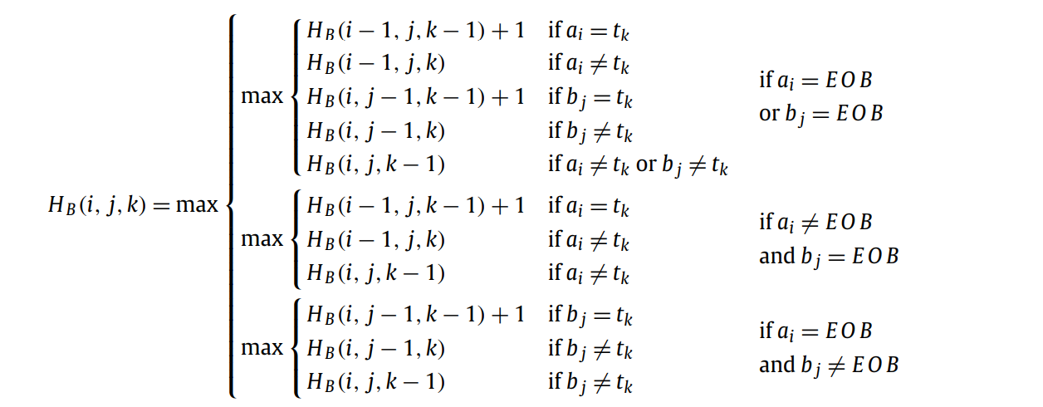

Algorithm for Block Merged LCS Problem

Slide 32
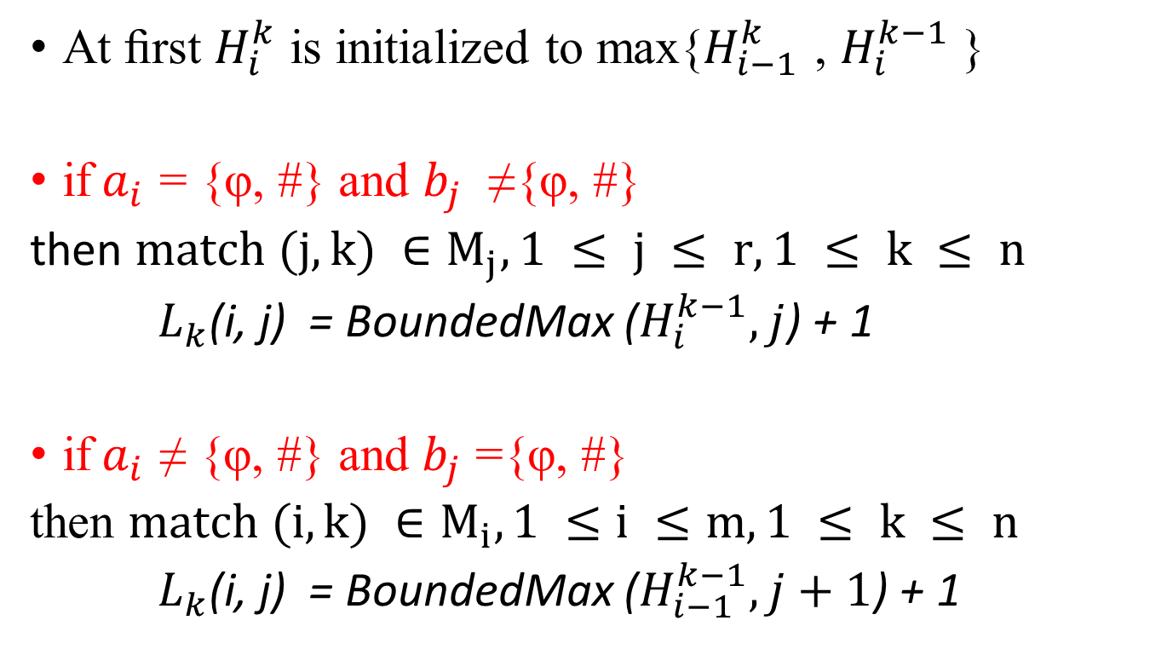
Algorithm BMLCS(A, B, T)
At ﬁrst $H_{i}^{k}$ is initialized to max{$H_{i−1}^{k}$ , $H_{i}^{k−1}$ }
if${ a}_{i}$ = {φ, #} and $b_{j}$ ≠{φ, #}
then $match (j, k) ∈M_{j}, 1 ≤ j ≤ r, 1 ≤ k ≤ n$
$L_{k}$(i, j) = BoundedMax ($H_{i}^{k−1},j$) + 1
if${ a}_{i}$ ≠ {φ, #} and $b_{j}$ ={φ, #}
then $match (i, k) ∈M_{i}, 1 ≤i ≤m, 1 ≤ k ≤ n$
$L_{k}$(i, j) = BoundedMax ($H_{i−1}^{k−1},j+1$) + 1

Slide 33
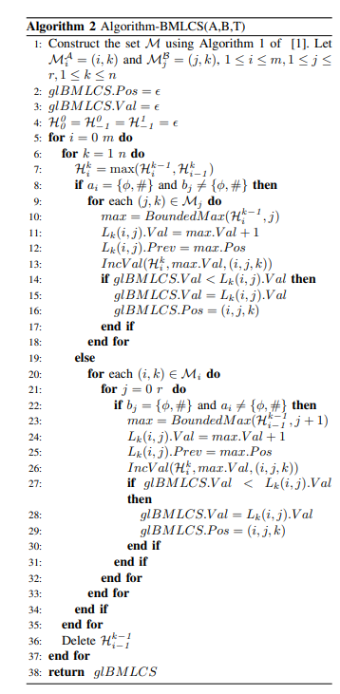

Slide 34
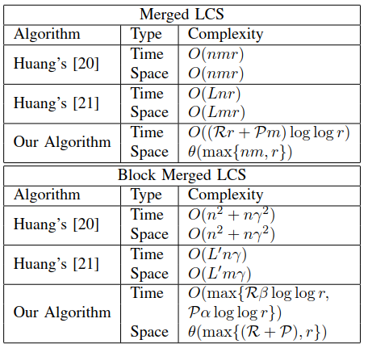
Comparison of algorithms

Slide 35
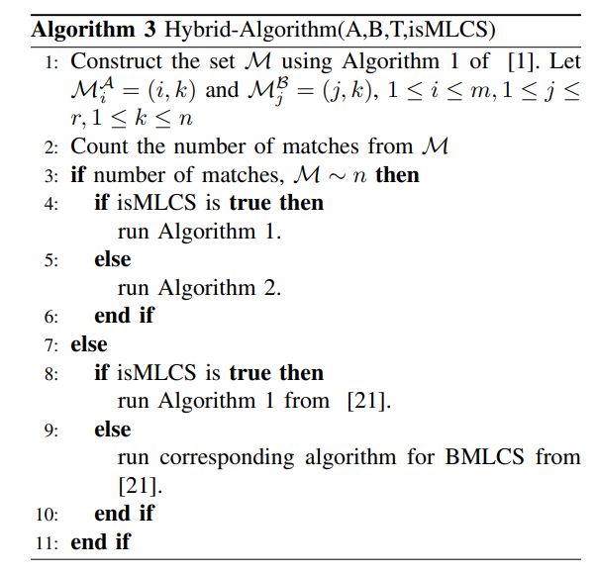
Hybrid-Algorithm

Slide 36
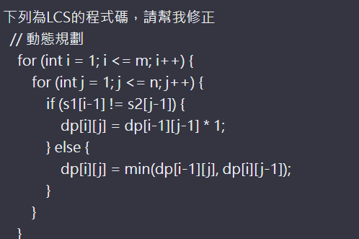

Slide 37
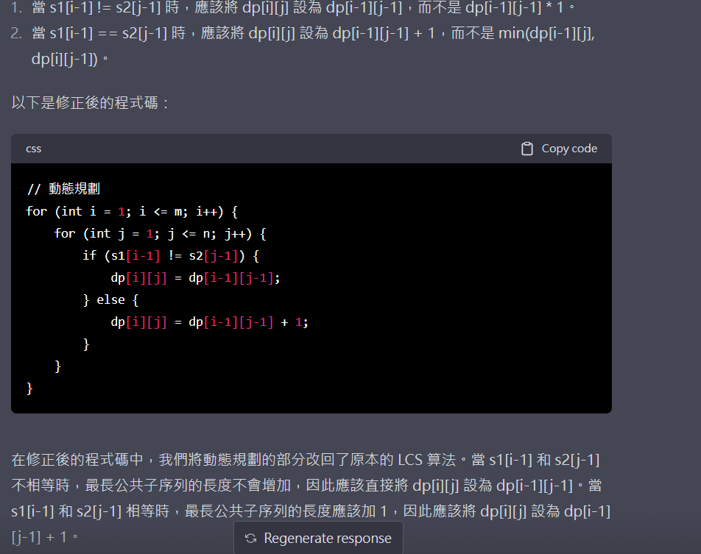

Slide 38
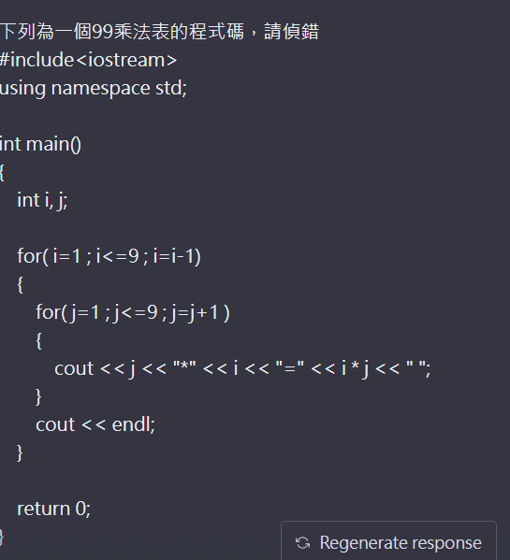

Slide 39
