Slide 1
Order-Preserving Pattern Matching with Scaling
Youngho Kim, Munseong Kang, Joong Chae Na, Jeong Seop Sim,
Information Processing Letters, Volume 180, 2023
Presenter: Wen-Wen Liao
Date: Apr. 11, 2023

Slide 2
Abstract
Given a text T and a pattern P, the order-preserving pattern matching (OPPM for short) problem is to find all substrings of T which have the same relative orders as P. Recently, approximate OPPM that allows errors have been studied such as OPPM with k-mismatches. In this paper we define the OPPM with scaling which is a novel criteria for approximate OPPM by considering the relative orders of cusps and the scale of lengths of strings between them. Also we present an algorithm to solve the OPPM problem with scaling in O(n + m logm) time, which is the same time bound as the best known exact OPPM algorithm.

Slide 3
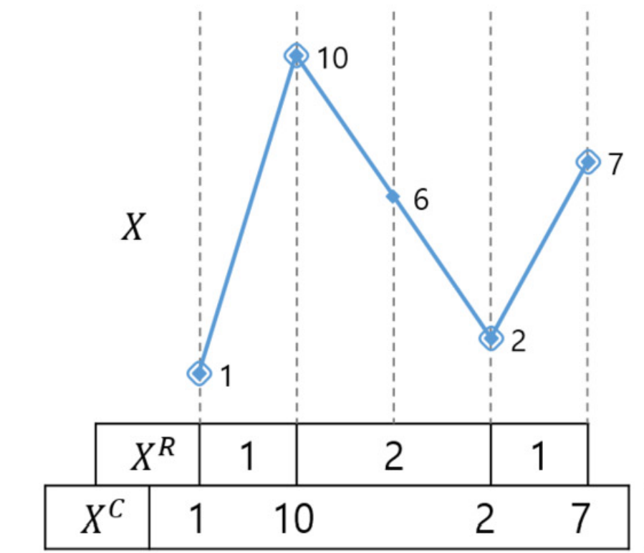

Scaled order-isomorphism
run-length
cusp
$X$ = (1, 10, 6, 2, 7)
$X^{C}$= (1, 10, 2, 7)
$X^{R}$= (1, 2, 1)
cusp

Slide 4

K-scaled order-isomorphic
$X≌^{k}Y$
$Condition 1: |X^{R}|=|Y^{R}| and k × X^{R}[i] = Y^{R}[i] for all 0≤i≤|X^{R}|$
$Condition 2:X^{C} \text{≈} Y^{C}$

Slide 5
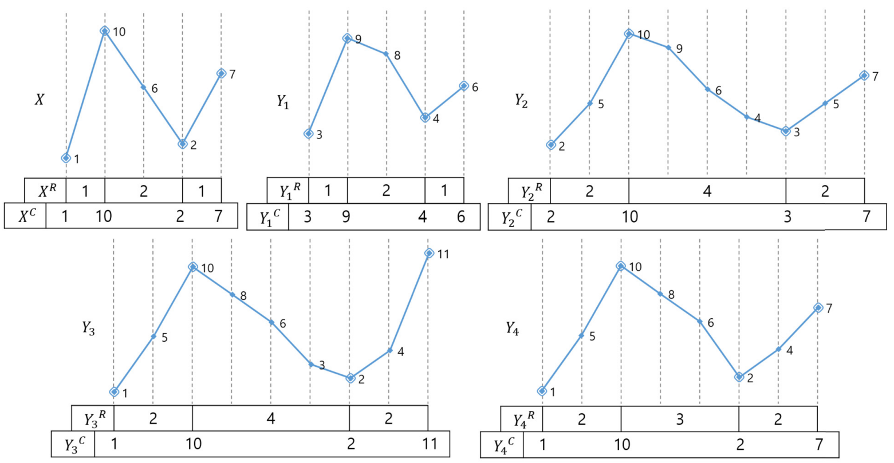





K-scaled order-isomorphic
$X$ = (1, 10, 6, 2, 7)
$Y_{1}$ = (3, 9, 8, 4, 6)
$Y_{2}$ = (2, 5, 10, 9, 6, 4, 3, 5, 7)
$$√$$
$$X ≅^{1}Y_{1}$$
$$√$$
$$X ≅^{2}Y_{2}$$

Slide 6



K-scaled order-isomorphic
$X$ = (1, 10, 6, 2, 7)
$Y_{3}$ = (1, 5, 10, 8, 6, 3, 2, 4, 11)
$Y_{4}$ = (1, 5, 10, 8, 6, 2, 4, 7)

Slide 7
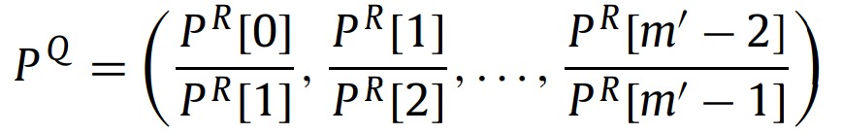

Algorithm for the OPPM problem with scaling
Quotient string ($P^{Q}$)
$X^{R}$ = (1, 2, 1, 2)
$Y^{R}$ = (2, 4, 2, 4)
→ $X^{Q}$ = (1/2, 2/1, 1/2)
→ $Y^{Q}$ = (2/4, 4/2, 2/4)
same

Slide 8

Algorithm for the OPPM problem with scaling
Step 1: find candidate substring $w$
$J_{1}$: position in $T^{R}$ that satisfies Condition 1
$J_{2}$: position in $T^{R}$ that satisfies Condition 2

Slide 9
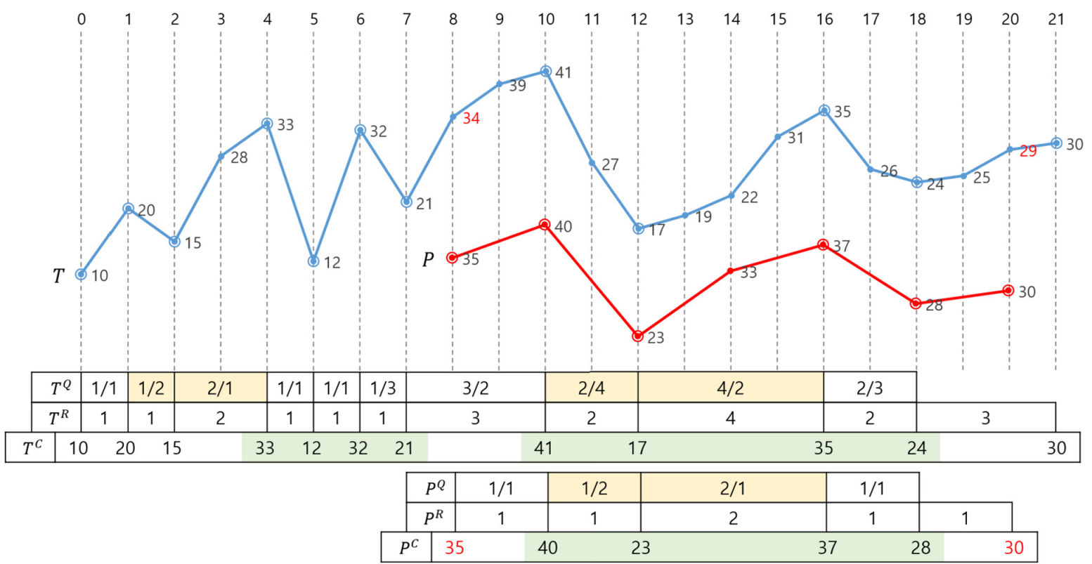

Algorithm for the OPPM problem with scaling
$P^{Q}[1..2]$ = (1/2, 2/1)
$T^{Q}[1..2]$ ($k$ = 1)
$T^{Q}[7..8]$ ($k$ = 2)
$J_{1}$ = {1, 7}
0 1 2 3 4 5 6 7 8 9

Slide 10

Algorithm for the OPPM problem with scaling
$P^{C}[1..4]$: order = (4, 1, 3, 2)
$T^{Q}[3..6]$
$T^{Q}[7..10]$
$J_{2}$ = {3, 7}
0 1 2 3 4 5 6 7 8 9 10 11

Slide 11

Algorithm for the OPPM problem with scaling
$j$ = $J_{1}$ ∩ $J_{2}$ = {1, 7} ∩ {3, 7} = {7}
$k$ = $T^{R}[7]$ / $P^{R}[1]$ = 2
$s=∑_{q=0}^{6}T^{R}\left[q\right]−2P^{R}\left[0\right]=10−2=8$
$e=8+2×6=20$
candidate: $T[8..20]$

Slide 12

Algorithm for the OPPM problem with scaling
Step 2: verify each candidate $w=T\left[s..e\right]$
If Condition 1 is satisfied for $w^{R}$ and $P^{R}$
If Condition 2 is satisfied for $w^{C}$ and $P^{C}$

Slide 13

Algorithm for the OPPM problem with scaling
Check whether $T^{R}\left[j−1\right]≥kP^{R}\left[0\right]$ and $T^{R}\left[j+m^{′}−2\right]≥kP^{R}\left[m^{′}−1\right]$
$T\left[8..20\right]\left(j=7, k=2, and m^{′}=5\right)$
$T^{R}\left[6\right] \left(=3\right)≥kP^{R}\left[0\right] \left(=2\right)$
$T^{R}\left[10\right] \left(=3\right)≥kP^{R}\left[4\right] \left(=2\right)$
satisfy Condition 1

Slide 14

Algorithm for the OPPM problem with scaling
Check $P^{C}\left[0\right]$ and $P^{C}\left[m^{′}\right]$
$T^{C}\left[j..j+m^{′}−2\right]\text{◦} T\left[e\right]\text{◦} T\left[s\right]$= (41, 17, 35, 24, 29, 34) => order = (6, 1, 5, 2, 3, 4)
$P^{C}\left[1..m^{′}−1\right]\text{◦}P^{C}\left[m^{′}\right]\text{◦}P^{C}\left[0\right]$= (40, 23, 37, 28, 30, 35) => order = (6, 1, 5, 2, 3, 4)
satisfy Condition 2

Slide 15

Conclusion
Time complexity: $O(n + m logm)$

Slide 16
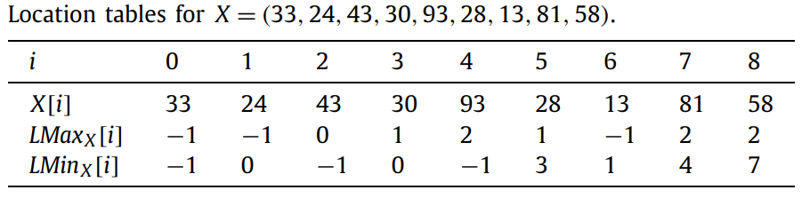

Preliminaries
${LMax}_{X}[i]$: 比$X[i]$小之中最大的index
${LMin}_{X}[i]$: 比$X[i]大$之中最小的index

