Slide 1
Simple is Better: Training an End-to-end Contract Bridge Bidding Agent without Human Knowledge
Qucheng Gong, Tina Jiang, Yuandong Tian
ICLR 2020 Conference Blind Submission, September 26, 2019,
Addis Ababa, Ethiopia
Presenter: Ying-Yu Lin
Date: Apr. 11, 2023

Slide 2
Abstract (1/2)
Contract bridge is a multi-player imperfect information game where one partnership collaborate with each other to compete against the other partnership. The game consists of two phases: bidding and playing. While playing is relatively easy for modern software, bidding is challenging and requires agents to learn a communication protocol to reach the optimal contract jointly, with their own private information. The agents need to exchange information to their partners, and interfere opponents, through a sequence of actions. In this work, we train a strong agent to bid competitive bridge purely through self-play, outperforming WBridge5, a championship-winning software.

Slide 3
Abstract (2/2)
Furthermore, we show that explicitly modeling belief is not necessary in boosting the performance. To our knowledge, this is the first competitive bridge agent that is trained with no domain knowledge. It outperforms previous state-of-the-art that use human replays with 70x fewer number of parameters.

Slide 4
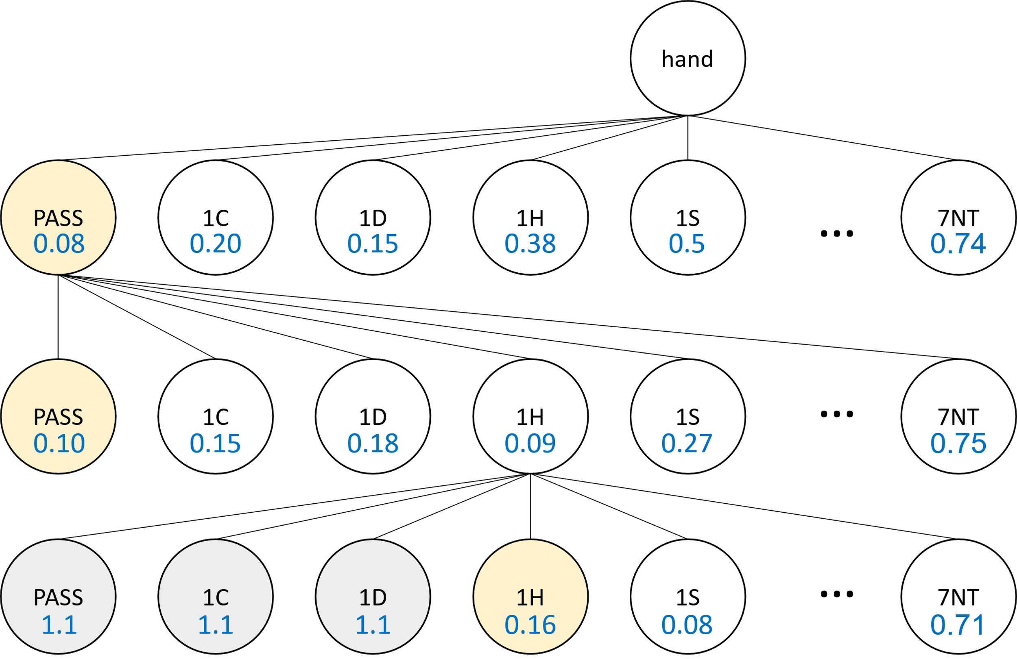
Baseline 16
min
Hand of player1
Hand of player2
Bid1
DNN layer 1
Output layer
Bid2
DNN layer 2
Output layer
Continue until PASS occurs
DNN layer 3
Reference: Chih-Kuan Yeh, Cheng-Yu Hsieh , and Hsuan-Tien Lin , “Automatic Bridge Bidding Using Deep Reinforcement Learning “, IEEE transactions on games, vol. 10, no. 4, December 2018

Slide 5
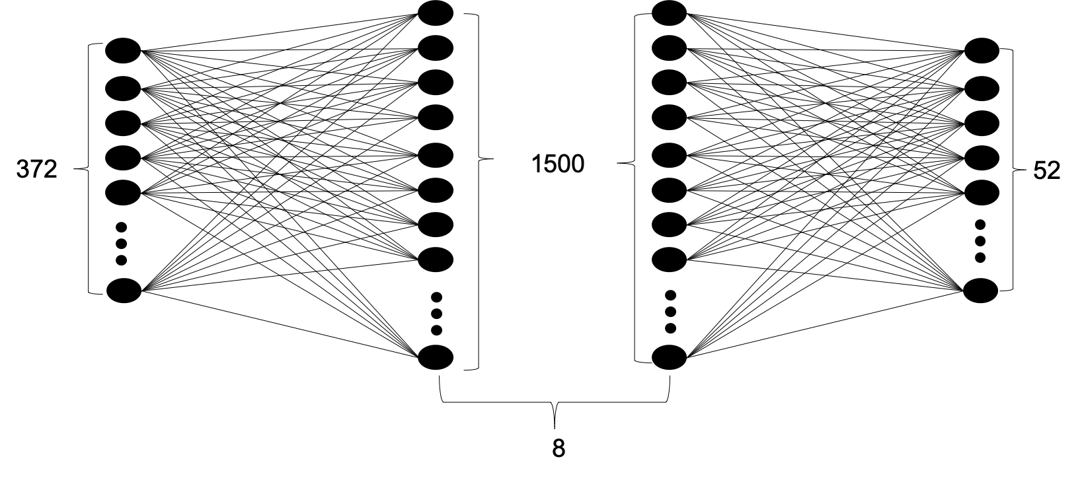
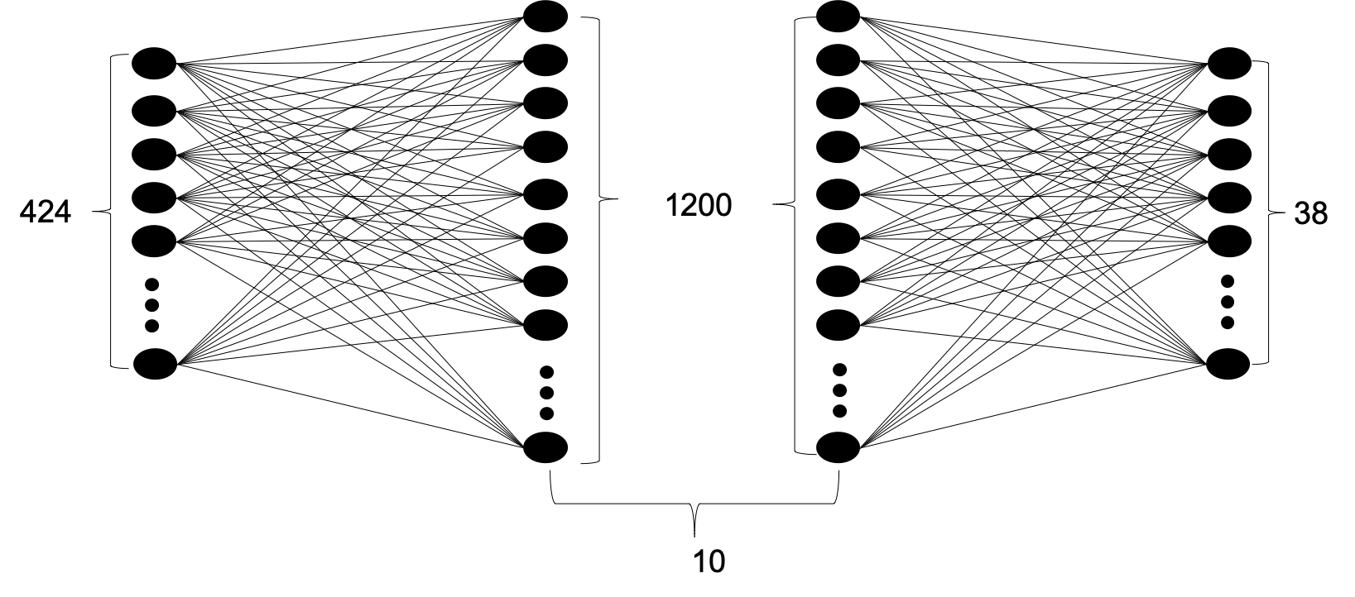
Baseline 19
$φ_{ω}:C×V×H→{\left[0,1\right]}^{52}$ , $σ_{θ}:C×V×H×{\left[0, 1\right]}^{52}→{\left[0,1\right]}^{38}$
52 bits | 2 bits | 318 bits
cards | vulnerability | sequence
Pass |  |  | 9 bits for 1♣ |  |  |  |  |  |  |  |  | 9 bits for 1♦ |  |  |  |  |  |  |  |  | 9 bits for 1♥ |  |  |  |  |  |  |  |  | 32*9 bits
1 | 1 | 0 | 1 | 0 | 0 | 1 | 0 | 0 | 1 | 1 | 0 | 0 | 0 | 0 | 0 | 0 | 0 | 0 | 0 | 0 | 1 | 1 | 1 | 0 | 0 | 0 | 0 | 0 | 0 | All zero
P | P |  | 1♣,Double,Redouble,Pass |  |  |  |  |  |  |  |  |  |  |  |  |  |  |  |  |  | 1♥,Pass,Pass,Pass
Estimation Neural Network (ENN)
Policy Neural Network (PNN)
Reference: Jiang Rong, Tao Qin and Bo An, “Competitive Bridge Bidding with Deep Neural Networks,“18th International Conference on Autonomous Agents and Multiagent Systems, AAMAS '19, Montreal, QC, Canada, May 13-17, 2019

Slide 6
Problem Setup
Training dataset: randomly generated 2,500,000 hands
Evaluation dataset: 100,000 hands
Each hand is played twice
The final reward is the difference in the results of the two tables
The difference in scores is then converted to IMPs scale, and then normalized to [-1, 1].

Slide 7
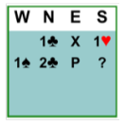
Input Representation
267 bit vector
Own cards | Bid history, multi-hot of contract bids |  |  |  |  | Vulnerability | Available Action
 | Own | Partner | Left Opp | Right Opp | Double Indicator
52 | 35 | 35 | 35 | 35 | 35 | 2 | 38
 | 1C | 1D | 1H | 1S | 1N | 2C | 2D | 2H | 2S | 2N | 3C | 3D | 3H | 3S | 3N |  | 7N
Own | 0 | 0 | 1 | 0 | 0 | 0 | 0 | 0 | 0 | 0 | 0 | 0 | 0 | 0 | 0 | … | 0
Partner | 1 | 0 | 0 | 0 | 0 | 1 | 0 | 0 | 0 | 0 | 0 | 0 | 0 | 0 | 0 | … | 0
Left Opp | 0 | 0 | 0 | 1 | 0 | 0 | 0 | 0 | 0 | 0 | 0 | 0 | 0 | 0 | 0 | … | 0
Right Opp | 0 | 0 | 0 | 0 | 0 | 0 | 0 | 0 | 0 | 0 | 0 | 0 | 0 | 0 | 0 | … | 0
Double Indicator | 1 | 0 | 0 | 0 | 0 | 0 | 0 | 0 | 0 | 0 | 0 | 0 | 0 | 0 | 0 | … | 0

Slide 8
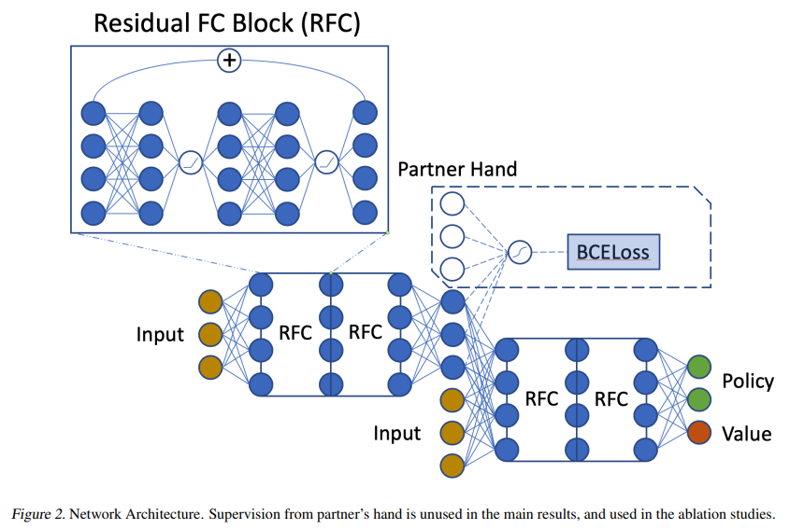
Network
The network consists of an initial fully connected layer, then 4 fully connected layer with skip connections added every 2 layers to get a latent representation.
We use 200 neurons at each hidden layer, about 1/70 in parameter size compared with baseline19.

Slide 9
Reinforcement Learning -A3C
Policy head:
38 output neurons
Masking out illegal actions
Value head:
1 neuron
The whole training process takes roughly 4-5 hours to converge on a single GPU.

Slide 10
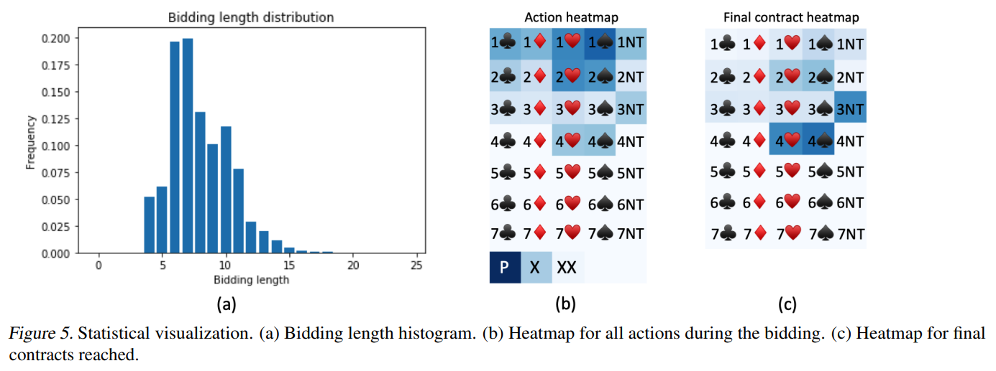
Visualization

Slide 11
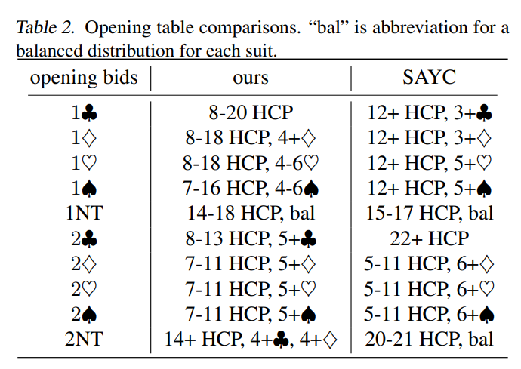
Opening Table

Slide 12
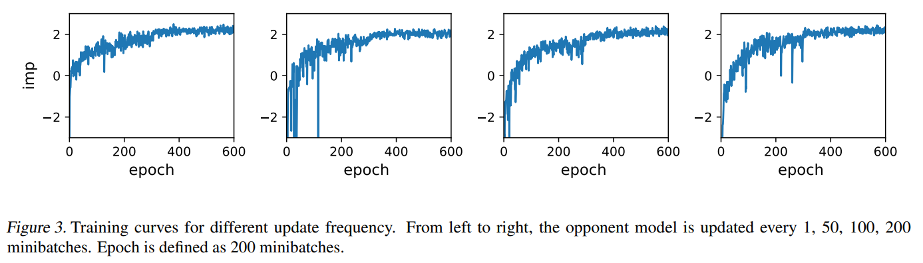
Experiments
We significantly beat baseline16 2.31 IMPs per board.
Baseline 16 can only handle a fixed length of bids.

Slide 13
Experiments
We beat Wbridge5 0.41 IMPs per board in 64 board tournament.
Baseline19 outperforms Wbridge5 by 0.25 IMPs per board.
We outperform baseline19 mainly due to a better history encoding and not to model belief explicitly
52 bits | 2 bits | 318 bits
cards | vulnerability | sequence
52 bits | 2 bits | 318 bits | 52 bits
cards | vulnerability | sequence | Partner’s card
Own cards | Bid history, multi-hot of contract bids |  |  |  |  | Vulnerability | Available Action
 | Own | Partner | Left Opp | Right Opp | Double Indicator
52 | 35 | 35 | 35 | 35 | 35 | 2 | 38

Slide 14
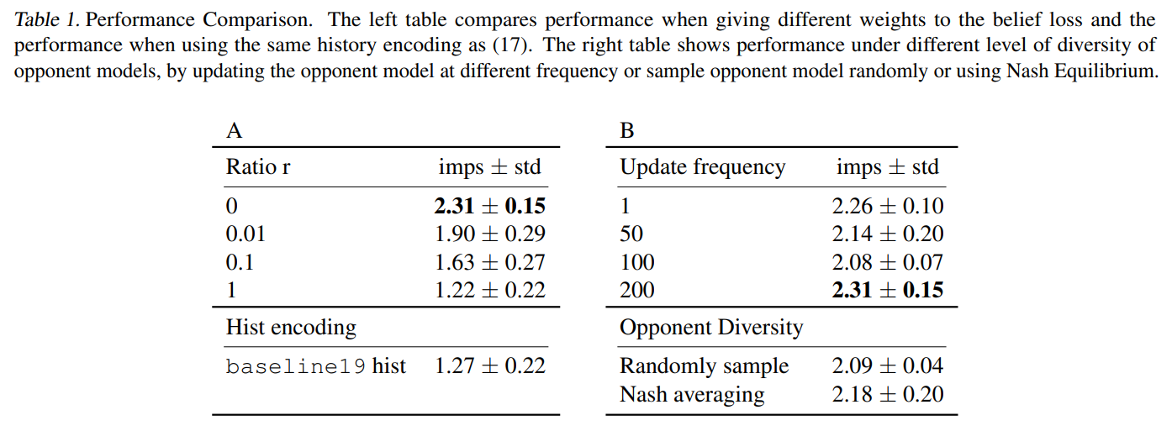
Experiments
final loss: L = r ．L_{belief}+ L_{A3C} .

