Slide 1
Benchmark Instances and Branch-and-Cut Algorithm for the Hashiwokakero Puzzle
Leandro C. Coelho, Gilbert Laporte, Arinei Lindbeck, Thibaut Vidal
arXiv, 2019
Presenter: Yu-Yen, Chu
Date: Apr. 25, 2023

Slide 2
Abstract
Hashiwokakero, or simply Hashi, is a Japanese single-player puzzle played on a rectangular grid with no standard size. Some cells of the grid contain a circle, called island, with a number inside it ranging from one to eight. The remaining positions of the grid are empty. The player must connect all of the islands by drawing a series of horizontal or vertical bridges between them, respecting a series of rules: the number of bridges incident to an island equals the number indicated in the circle, at most two bridges are incident to any side of an island, bridges cannot cross each other or pass through islands, and each island must eventually be reachable from any other island.

Slide 3
Abstract (Cont.)
In this paper, we present some complexity results and relationships between Hashi and well-known graph theory problems. We give a formulation of the problem by means of an integer linear mathematical programming model, and apply a branch-and-cut algorithm to solve the model in which connectivity constraints are dynamically generated. We also develop a puzzle generator. Our experiments on 1440 Hashi puzzles show that the algorithm can consistently solve hard puzzles with up to 400 islands.

Slide 4
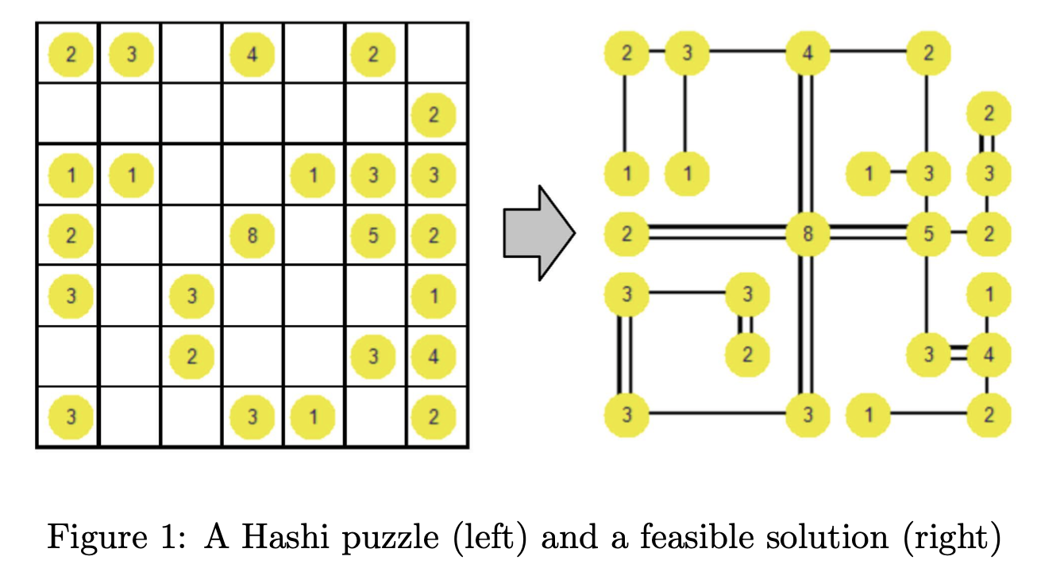
Hashi Puzzle
The bridges must begin and end at distinct islands.
They must not cross any other bridges or islands.
They may only run horizontally or vertically.
At most two bridges may connect any pair of islands.
The number of bridges connected to each island must be equal to the number inscribed in the circle.
Each island must be reachable from any other island.

Slide 5
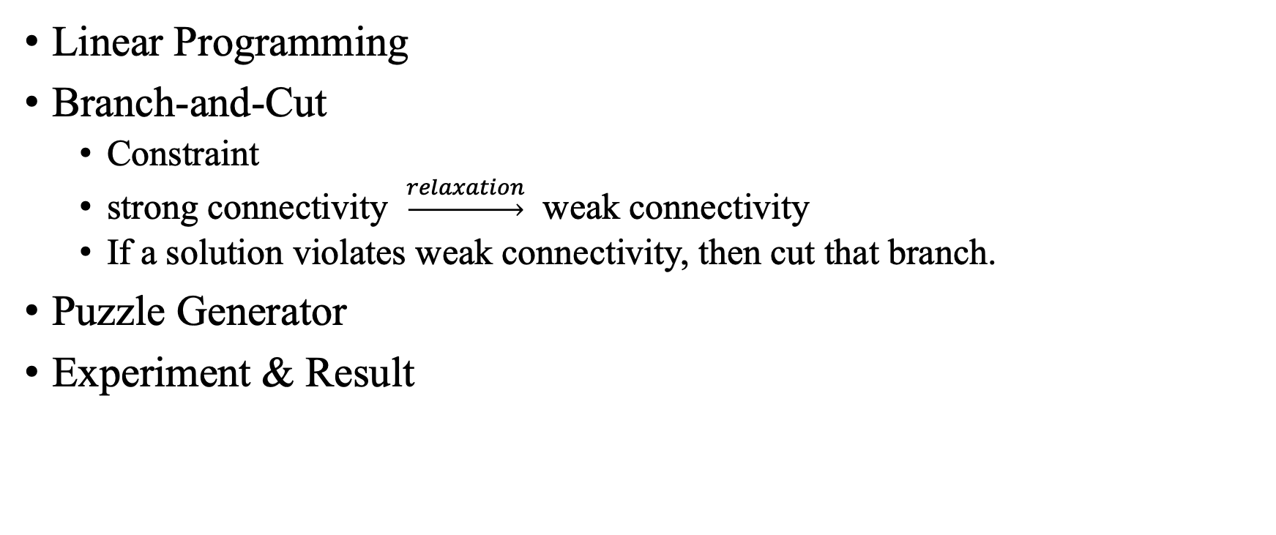
Problem Setup
Linear Programming
Branch-and-Cut
Constraint
strong connectivity $\underset{→}{relaxation}$ weak connectivity
If a solution violates weak connectivity, then cut that branch.
Puzzle Generator
Experiment & Result

Slide 6
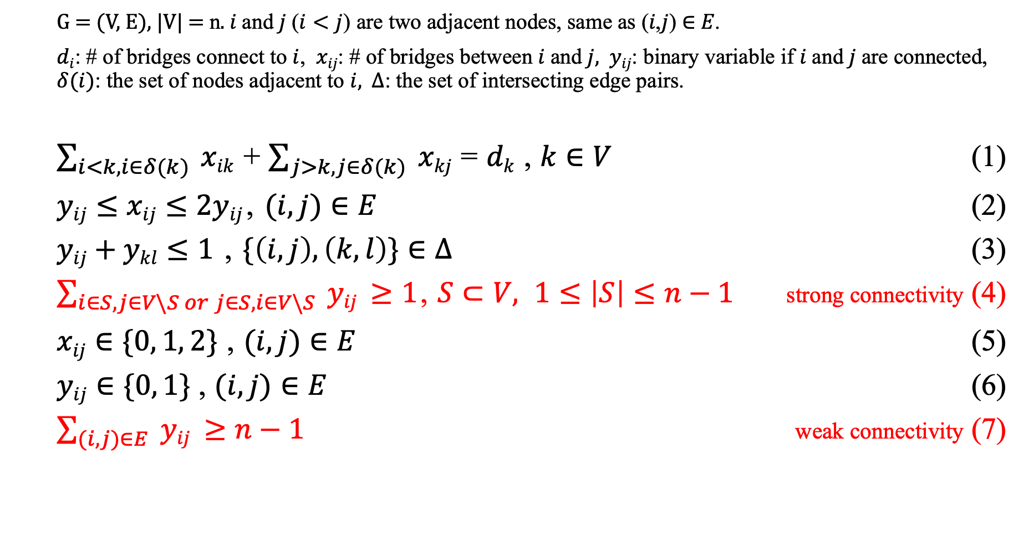
Constraint
G = (V, E), |V| = n. $i$ and $j$ ($i<j$) are two adjacent nodes, same as (𝑖,𝑗) ∈ 𝐸.
$di$: # of bridges connect to $i$, $xij$: # of bridges between $i$ and $j$, $yij$: binary variable if $i$ and $j$ are connected, $δ(i)$: the set of nodes adjacent to $i$, $∆$: the set of intersecting edge pairs.
$\sum_{i<k,i∈δ(k)}{ xik}$ + $\sum_{j>k,j∈δ(k)}{ xkj}$ = $dk$ , $k∈V$ (1)
$yij≤xij≤2yij$, $(i,j)∈E$ (2)
$yij+ykl≤1$ , $\{\left(i,j\right),\left(k,l\right)\}∈∆$ (3)
$\sum_{i∈S,j∈V\backslash S or j∈S,i∈V\backslash S}{ yij} ≥1$, $S⊂V, 1≤\left|S\right|≤n−1$ strong connectivity (4)
$xij∈\{0, 1, 2\}$ , $(i,j)∈E$ (5)
$yij∈\{0, 1\}$ , $(i,j)∈E$ (6)
$\sum_{(i,j)∈E}{ yij} ≥n−1$ weak connectivity (7)

Slide 7



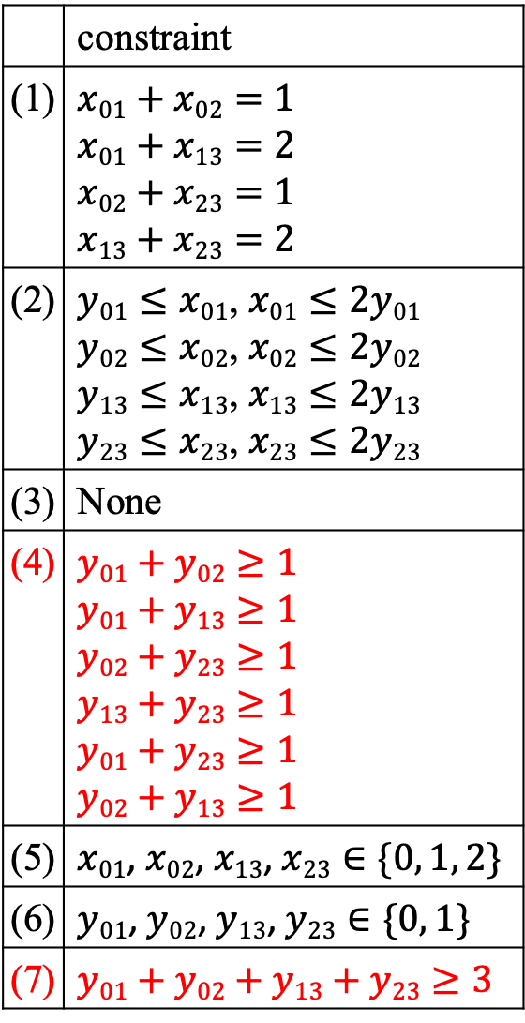





Branch-and-Cut
 | constraint
(1) | $$x01+x02=1$$ $$x01+x13=2$$ $$x02+x23=1$$ $$x13+x23=2$$
(2) | $y01≤x01$, $x01≤2y01$ $y02≤x02$, $x02≤2y02$ $y13≤x13$, $x13≤2y13$ $y23≤x23$, $x23≤2y23$
(3) | None
(4) | $$y01+y02≥1$$ $$y01+y13≥1$$ $$y02+y23≥1$$ $$y13+y23≥1$$ $$y01+y23≥1$$ $$y02+y13≥1$$
(5) | $x01$, $x02$, $x13$, $x23∈\{0, 1, 2\}$
(6) | $y01$, $y02$, $y13$, $y23∈\{0, 1\}$
(7) | $$y01+y02+y13+y23≥3$$
1
2
0
1
1
2
2
3
based on constraint (6) & (7)
violate constraint (7)
(weak connectivity)
$$\left\{y01, y02,y13,y23\right\}$$
other
solutions
$$\left\{1,1,1,1\right\}$$
$$\left\{0,1,1,1\right\}$$
$$\left\{1,0,1,1\right\}$$
$$\left\{1,1,0,1\right\}$$
$$\left\{1,1,1,0\right\}$$
based on constraint
(1) & (2) & (5)
violate
constraint (1)
violate
constraint (1)
violate
constraint (1)
violate
constraint (1)
$$\left\{x01, x02,x13,x23\right\}$$
all solutions
all solutions
$$\left\{1,0,1,1\right\}$$
all
solutions
all solutions
feasible solution

Slide 8
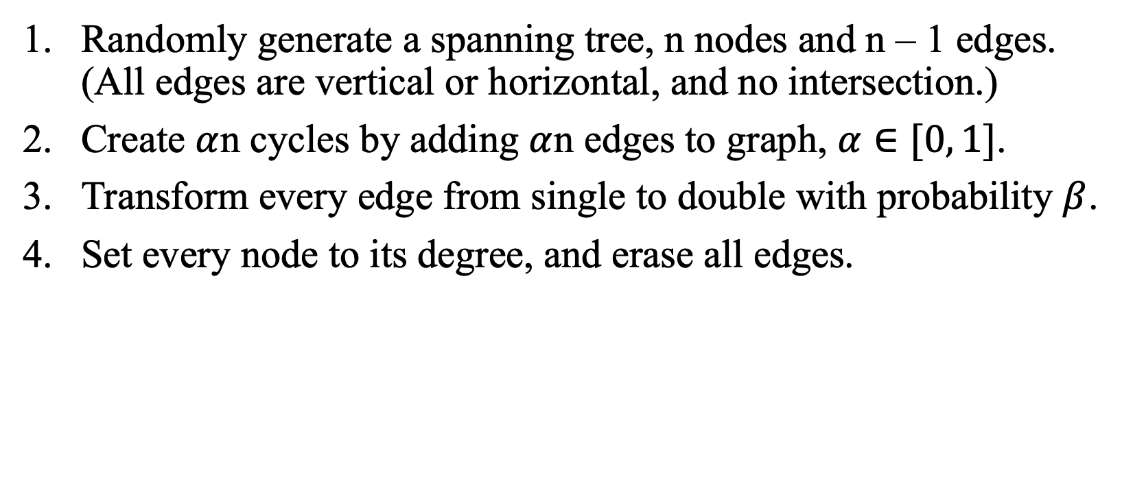
Puzzle Generator
Randomly generate a spanning tree, n nodes and n – 1 edges. (All edges are vertical or horizontal, and no intersection.)
Create $α$n cycles by adding $α$n edges to graph, $α∈[0, 1]$.
Transform every edge from single to double with probability $β$.
Set every node to its degree, and erase all edges.

Slide 9
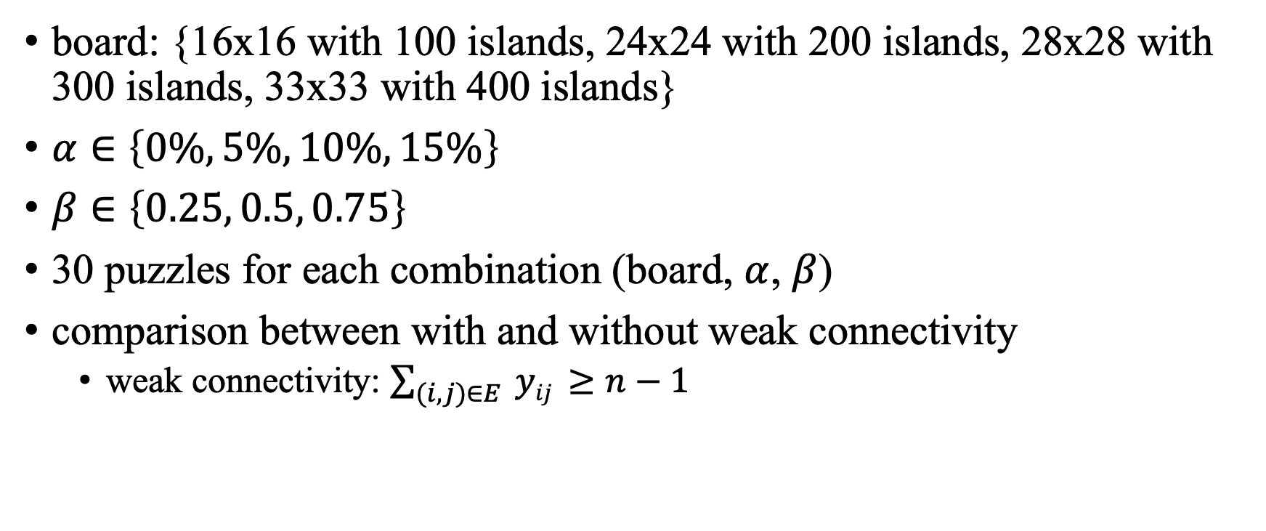
Experiment
board: {16x16 with 100 islands, 24x24 with 200 islands, 28x28 with 300 islands, 33x33 with 400 islands}
$α∈\left\{0\%, 5\%, 10\%, 15\%\right\}$
$β∈\left\{0.25, 0.5, 0.75\right\}$
30 puzzles for each combination (board, $α$, $β$)
comparison between with and without weak connectivity
weak connectivity: $\sum_{(i,j)∈E}{ yij} ≥n−1$

Slide 10
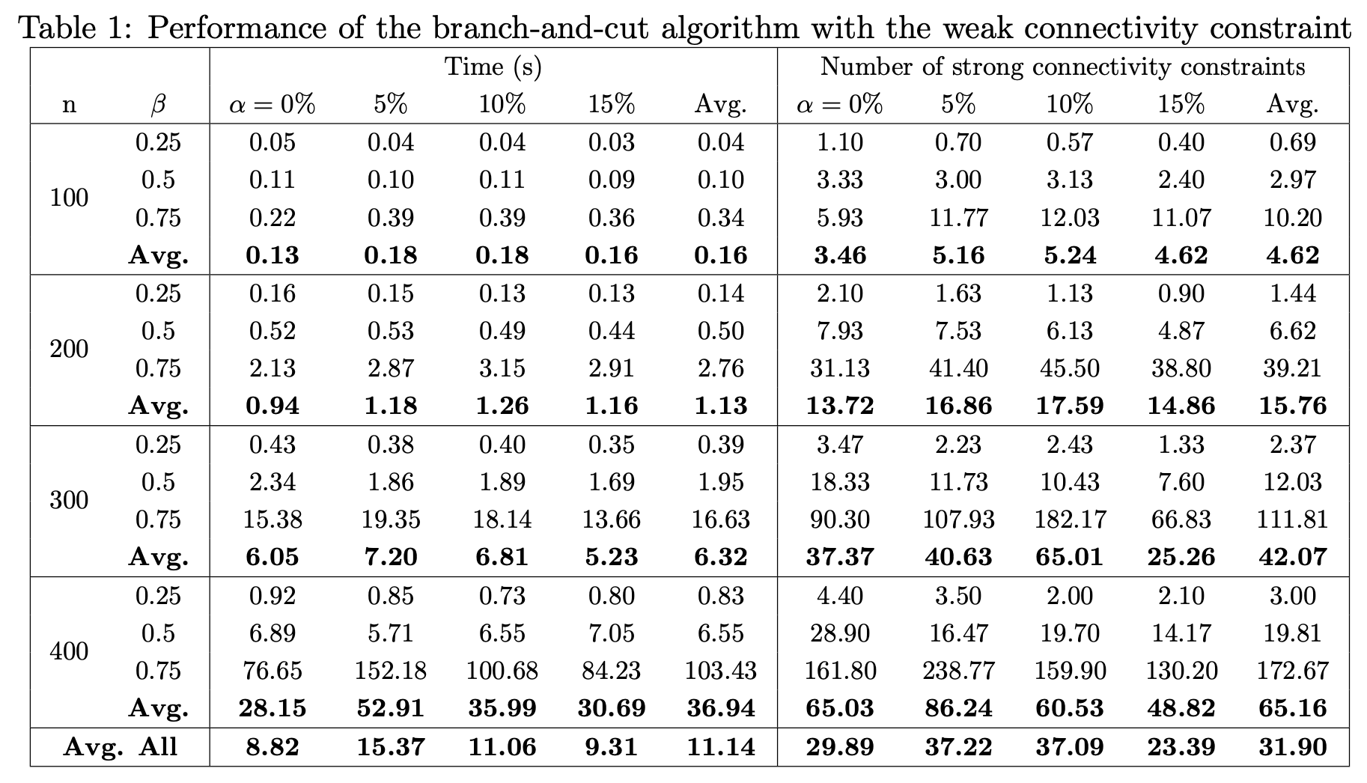
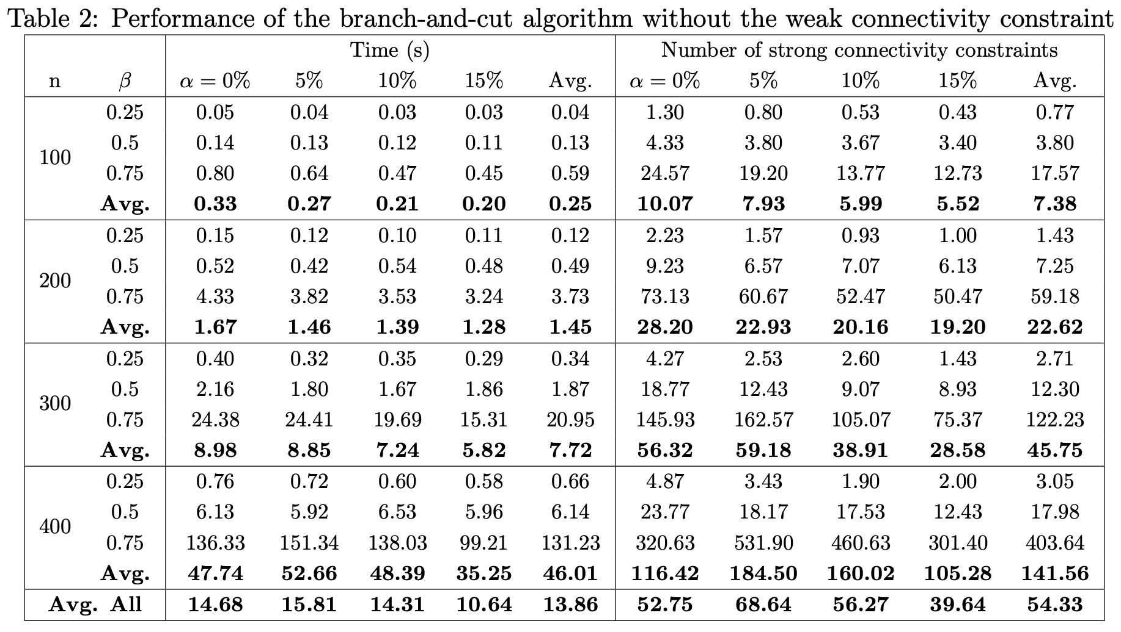
Result

