Slide 1
The Synergy of Double Neural Networks for Bridge Bidding
X. Zhang, R. Lin, Y. Bo, and F. Yang,
Mathematics 2022, 10, 3187.
Presenter: Yu-Yen Chu
Date: May 24, 2023

Slide 2
Abstract
Artificial intelligence (AI) has made many breakthroughs in the perfect information game. Nevertheless, Bridge, a multiplayer imperfect information game, is still quite challenging. Bridge consists of two parts: bidding and playing. Bidding accounts for about 75% of the game and playing for about 25%. Expert-level teams are generally indistinguishable at the playing level, so bidding is the more decisive factor in winning or losing. The two teams can communicate using different systems during the bidding phase. However, existing bridge bidding models focus on at most one bidding system, which does not conform to the real game rules.

Slide 3
Abstract (Cont.)
This paper proposes a deep reinforcement learning model that supports multiple bidding systems, which can compete with players using different bidding systems and exchange hand information normally. The model mainly comprises two deep neural networks: a bid selection network and a state evaluation network. The bid selection network can predict the probabilities of all bids, and the state evaluation network can directly evaluate the optional bids and make decisions based on the evaluation results. Experiments show that the bidding model is not limited by a single bidding system and has superior bidding performance.

Slide 4
Preliminary
Previous researches can be divided into two categories: human-based bidding system and non-human-based bidding system. Because bridge needs to explain the meaning of bids to opponents, the application of non-human-based bidding system is narrow.
Previous researches focused on single bidding system. When opponents use a different bidding system, it may cause error. (The bidding system cannot understand the bids of opponents correctly.)

Slide 5
Problem Setup
Train a bidding model with competition.
Use Chinese Bridge Association(CCBA) bidding system, and compete against opponents using any bidding systems.
Two parts of the model:
bid selection
bid evaluation
Do feature extraction, and use these features as input of the model.

Slide 6
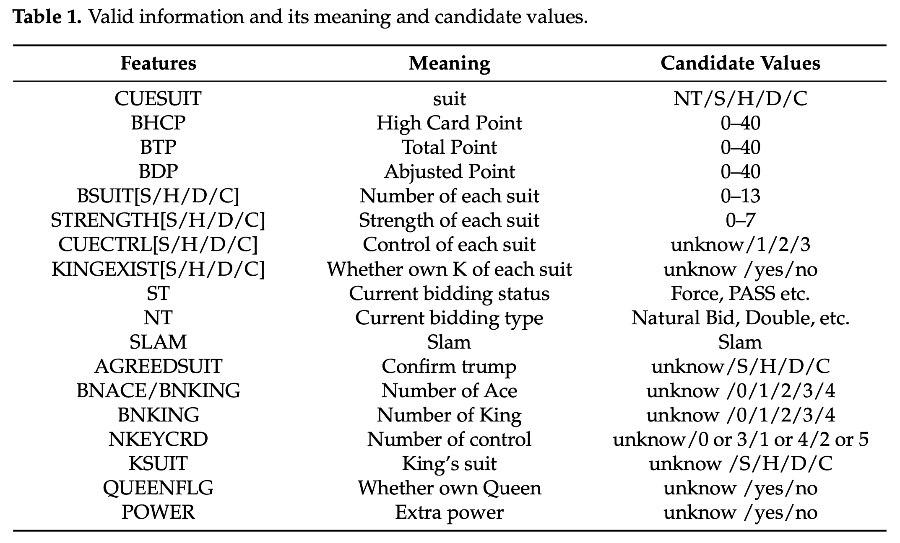
Feature Extraction
Convert bidding sequences to general features by fixed logic.
Design two feature extraction algorithms.
CCBA bidding system
precision bidding system
30 common features selected by the analysis of 2,500,000 instances of bidding.

Slide 7
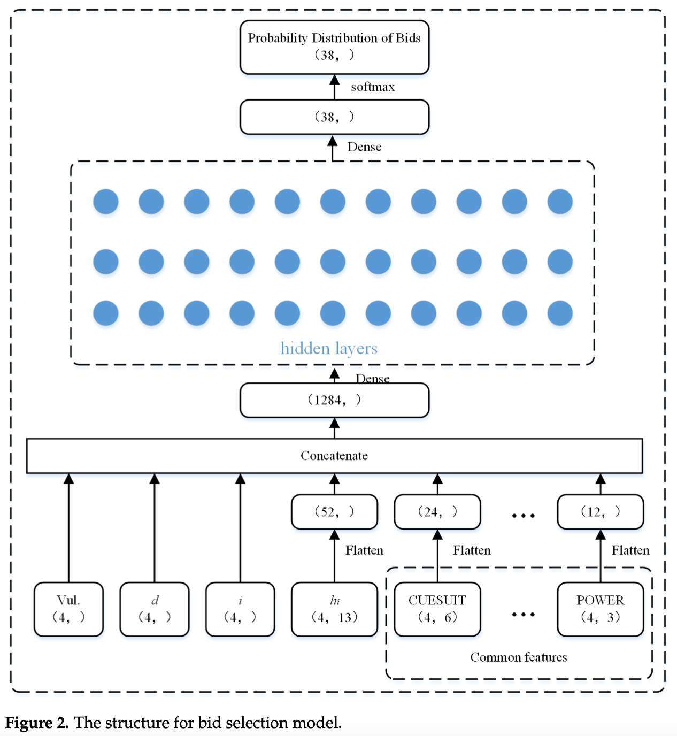
Bid Selection Model
Use Mini-batch Gradient Descent for training.
Input:
vulnerability v
opener d
player i
hand cards h_{i}
features of bidding sequence L
Output:
probability of choosing bid b

Slide 8
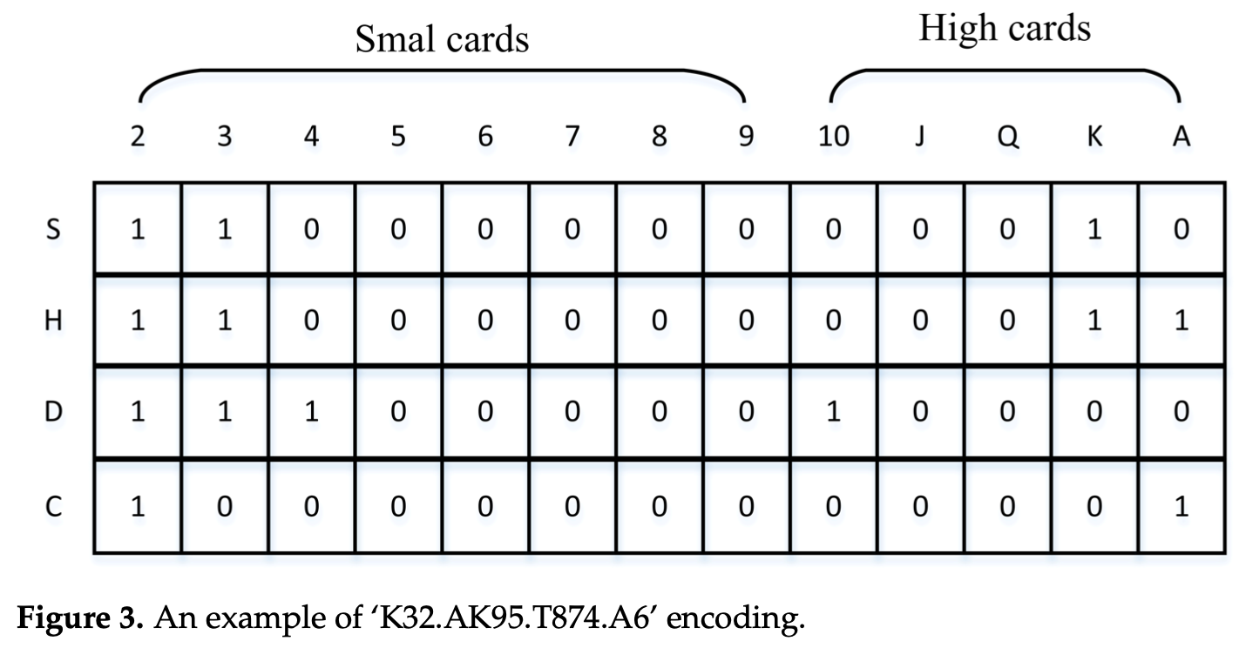
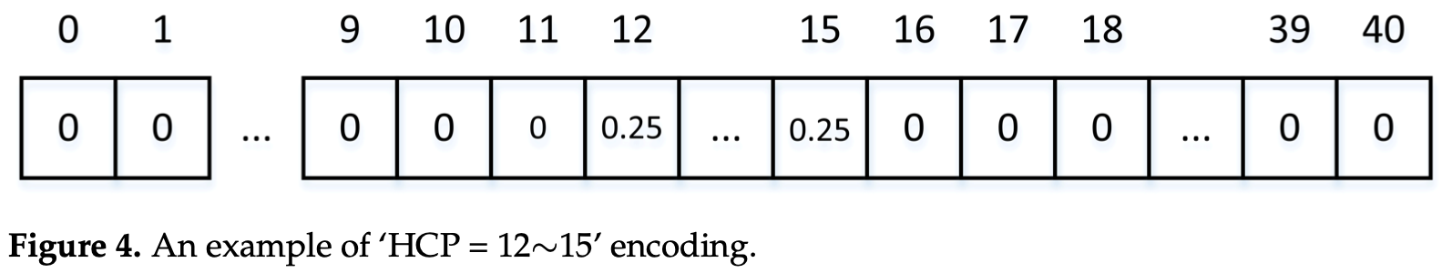
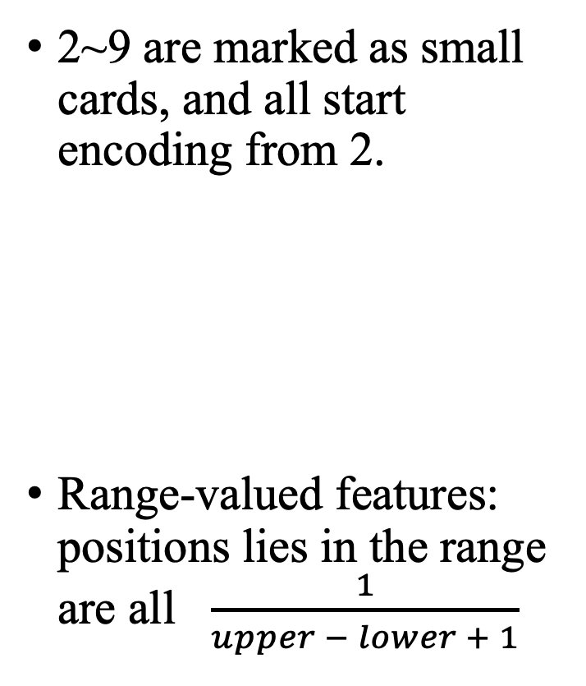
Encoding of input
2~9 are marked as small cards, and all start encoding from 2.
Range-valued features: positions lies in the range are all $\frac{1}{upper − lower + 1}$

Slide 9
Evaluation Model
Use Gradient Descent with Reinforcement Learning for training.
Input:
vulnerability v
opener d
player i
hand cards h_{i}
features of bidding sequence L (including the predicted bid b from bid selection model)
Output:
Evaluation of IMP at the situation after choosing bid b.

Slide 10
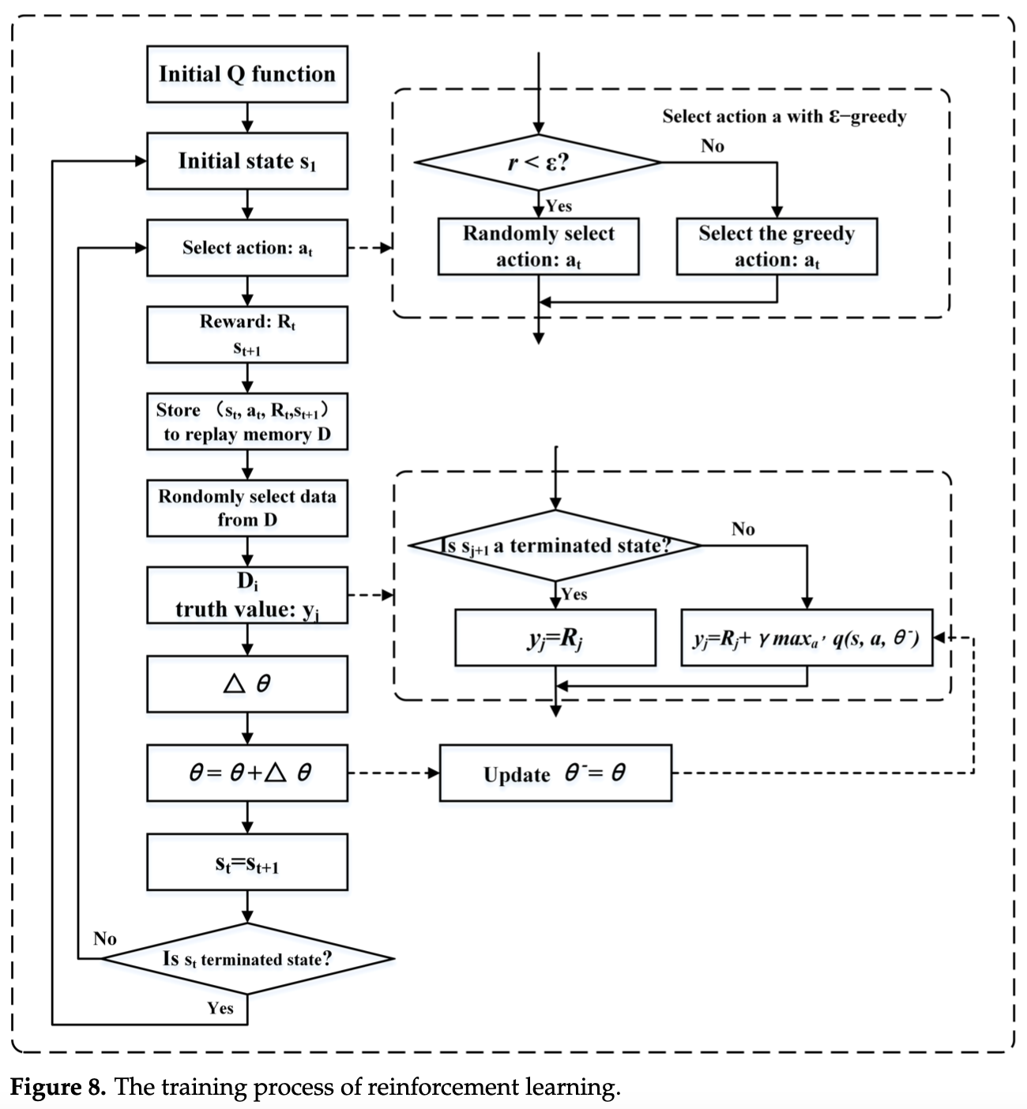
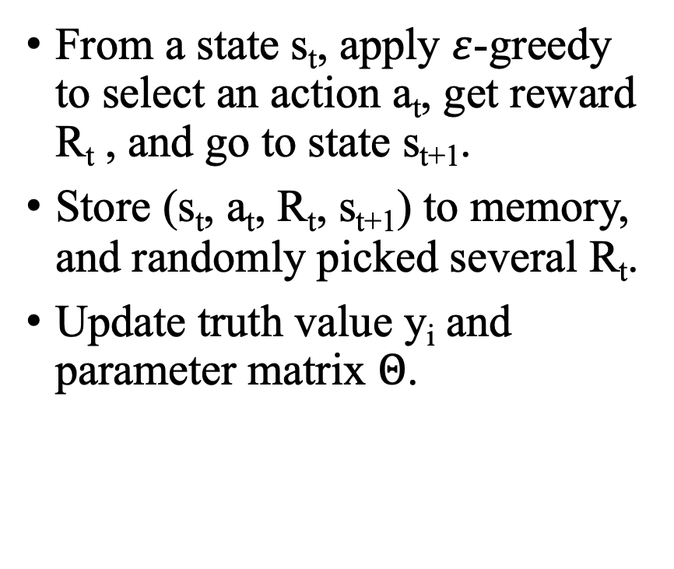
Evaluation Model
From a state s_{t}, apply $ε$-greedy to select an action a_{t}, get reward R_{t} , and go to state s_{t+1}.
Store (s_{t}, a_{t}, R_{t}, s_{t+1}) to memory, and randomly picked several R_{t}.
Update truth value y_{i} and parameter matrix $Θ$.

Slide 11
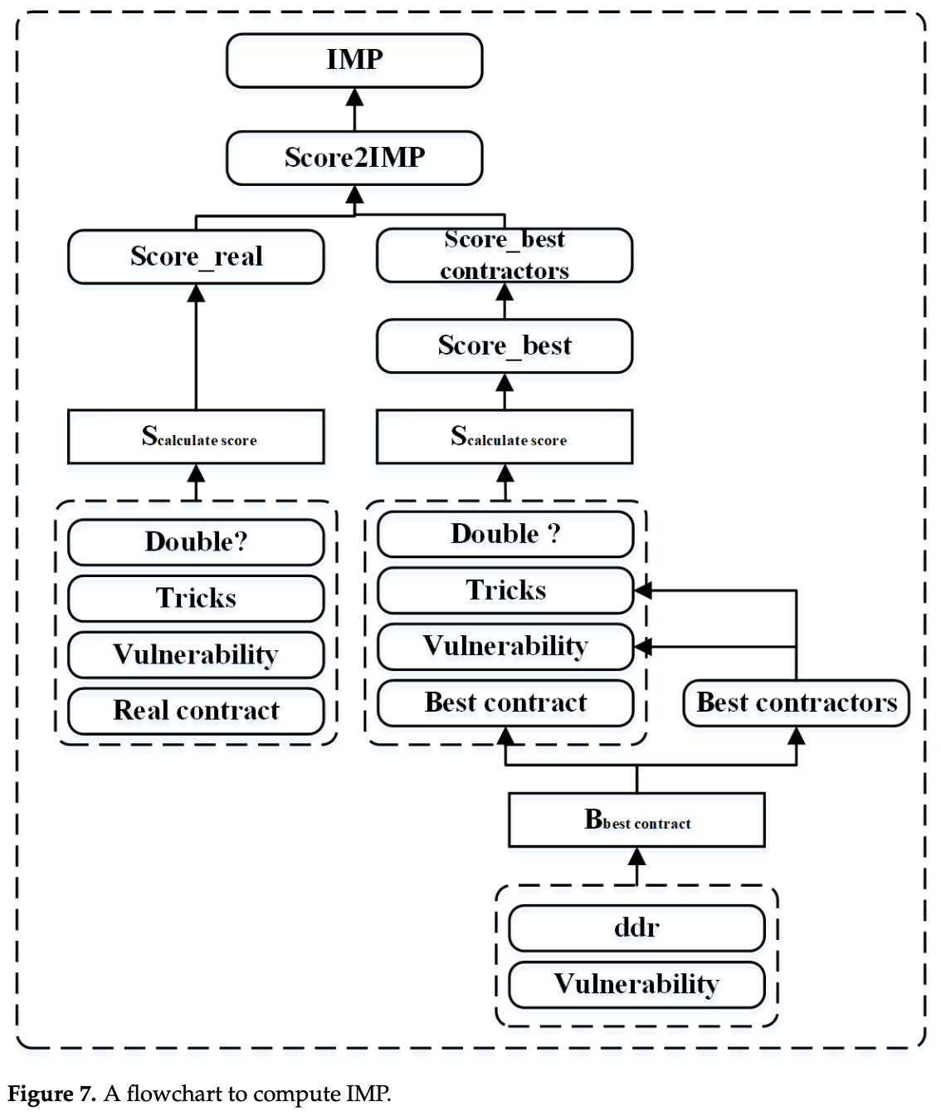
Evaluation Model
Reward: IMP of choose the action (bid), and the difference between 2 scores, converted to IMP.
2 scores
Actual score: the score of the last bid.
Best score: the score of contract at balanced point (winner cannot get higher score and loser cannot get lower score), and applied from double dummy results.

Slide 12
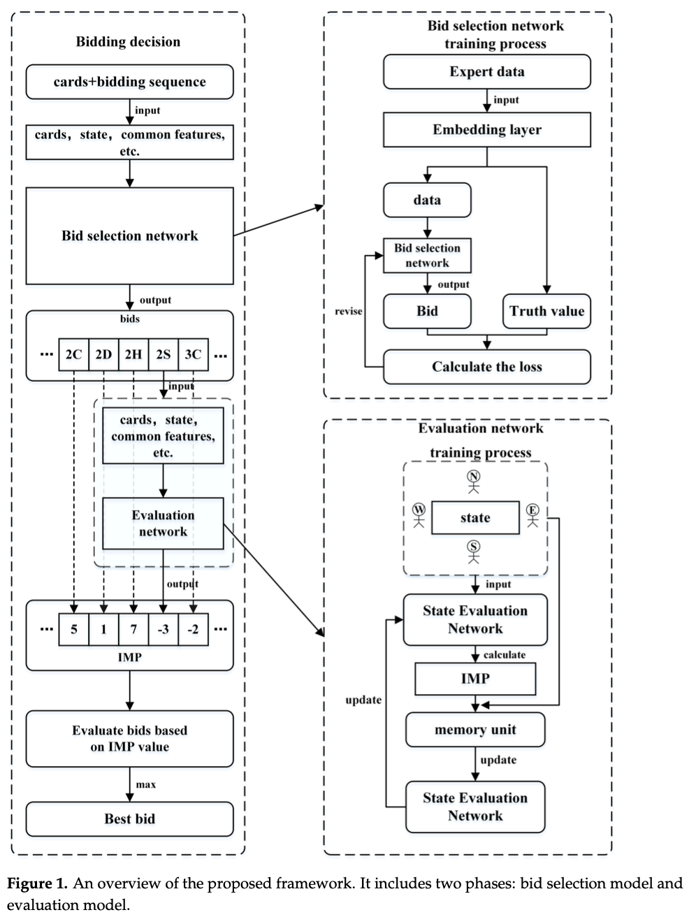
Flow Chart

Slide 13
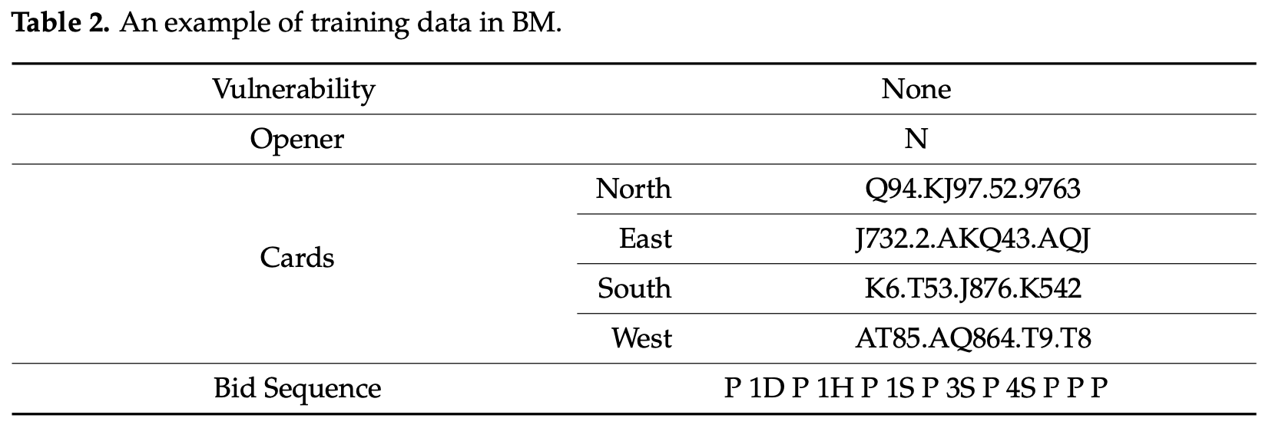
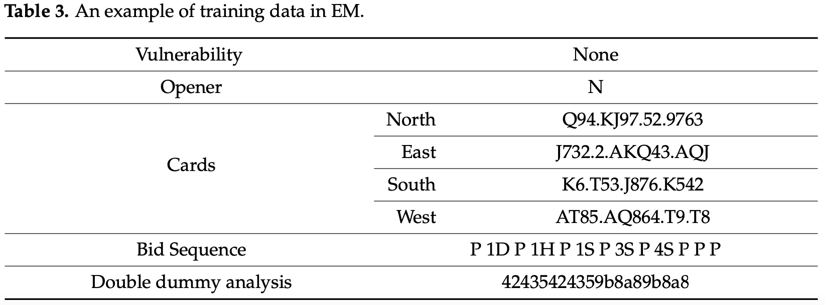
Dataset
About 500,000,000 bidding sequences by Snyrey platform.
Random select 8,000,000 instances, 80% training, 20% testing.

Slide 14
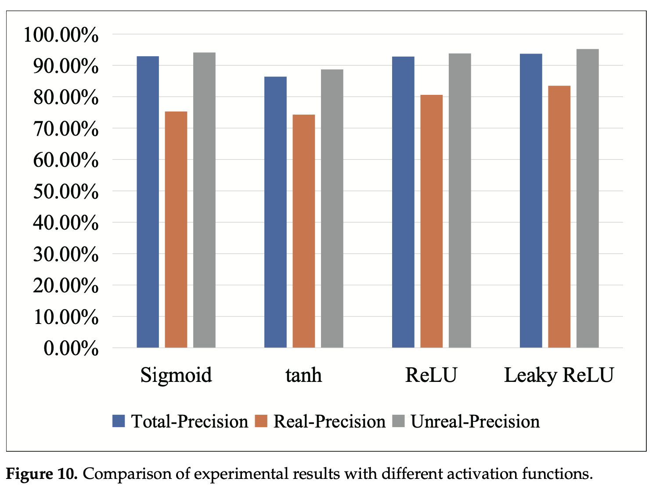
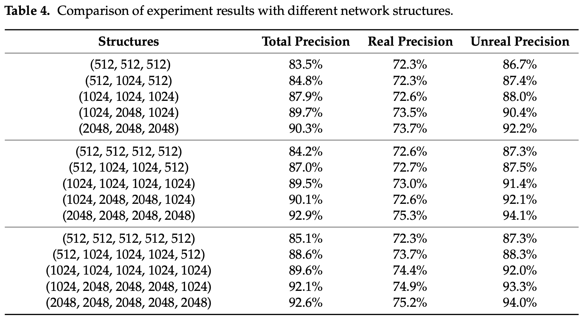
Evaluation of Bid Selection Model
Precision (auctions made from model compare with real bidding sequence)
Total-Precision (overall precision)
Real-Precision (precision of 1C~7NT)
Unreal-Precision (precision of P, X, and XX)
Epoch: 30
Batch size: 512

Slide 15
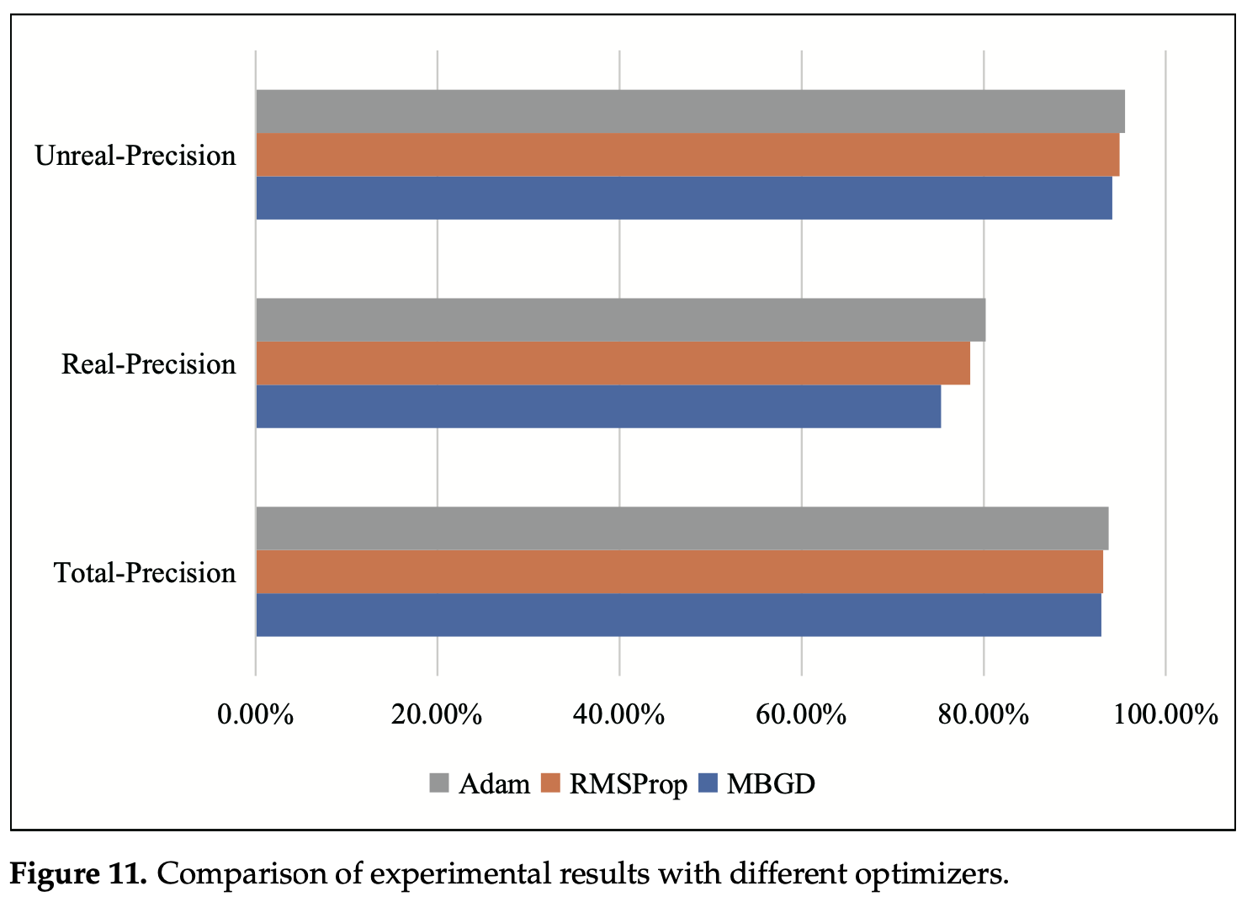
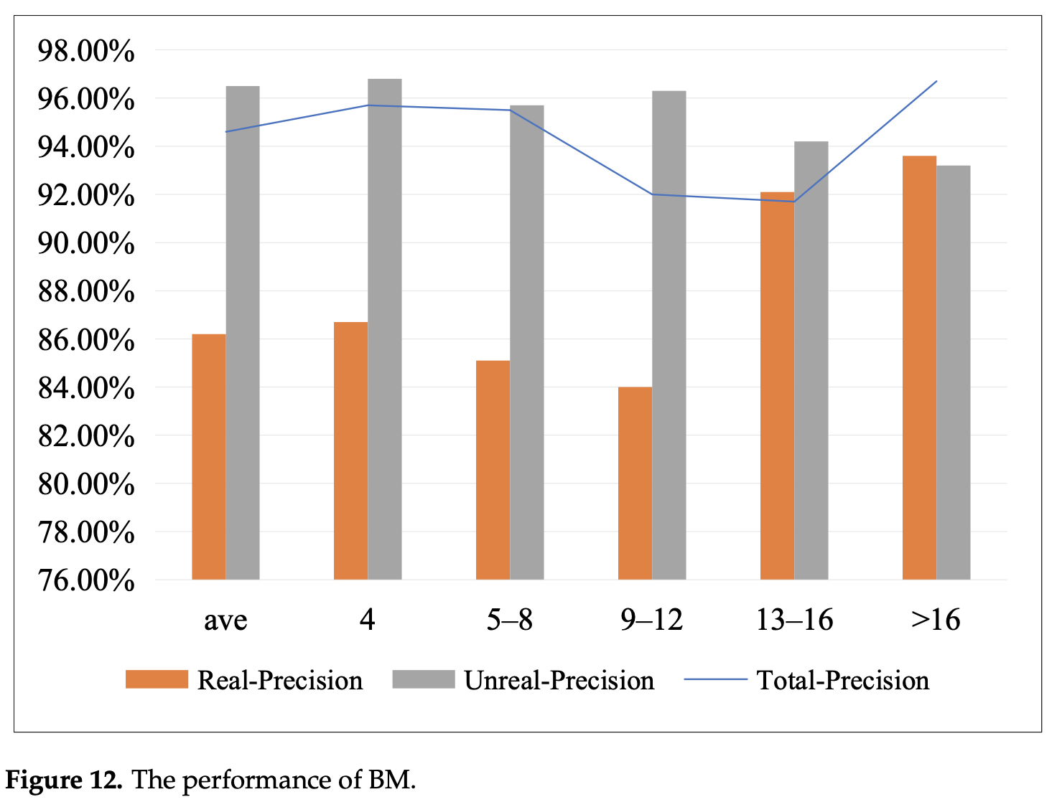
Evaluation of Bid Selection Model
Select Leaky ReLU and Adam.

Slide 16
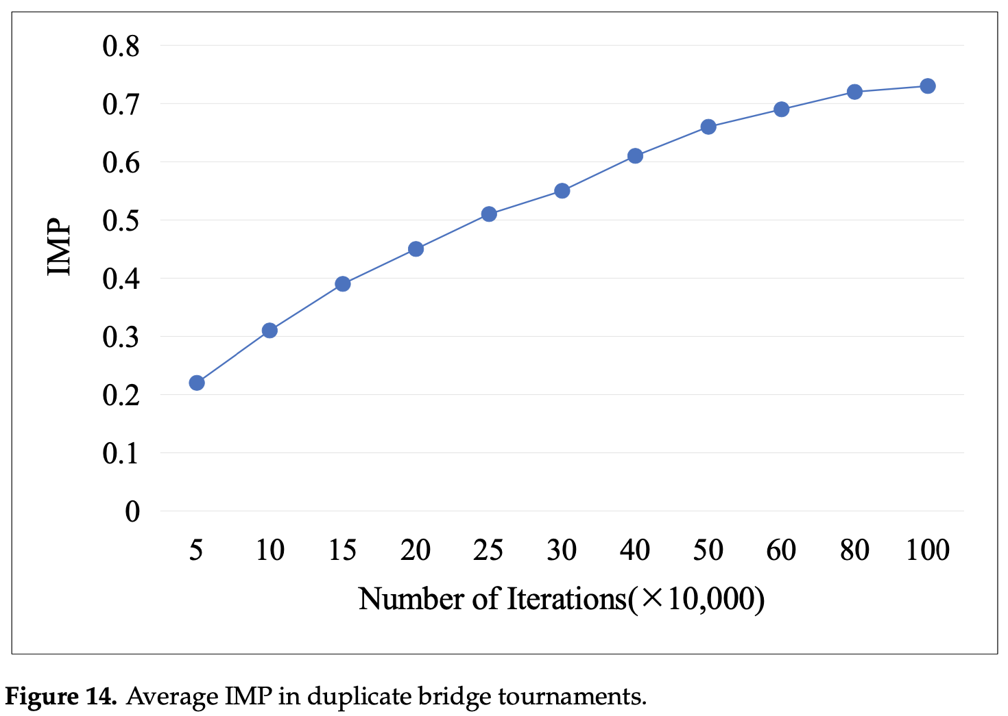
Evaluation of Evaluation Model
2,500,000 training data to pre-train the parameters before reinforcement learning stage.
Compare the results of trained model and untrained model.

Slide 17
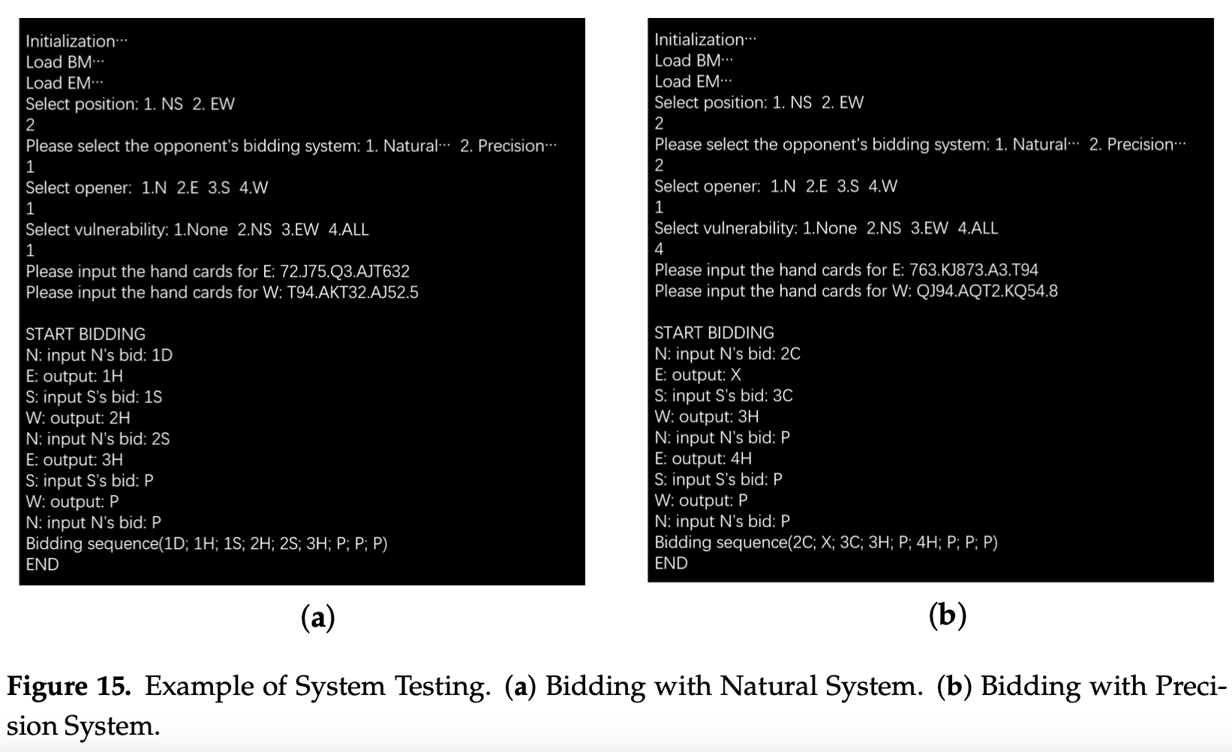
Multi-System Bidding
Model play against human players.

