Slide 1
A Filtration Method for Order-Preserving Matching
Tamanna Chhabra, Jorma Tarhio,
Information Processing Letters, Volume 116, Issue 2, February 2016, Pages 71-74
Presenter: Wen-Wen Liao
Date: May 24, 2023

Slide 2
Abstract
The problem of order-preserving matching has gained attention lately. The text and the pattern consist of numbers. The task is to find all the substrings in the text which have the same length and relative order as the pattern. The problem has applications in analysis of time series. We present a new sublinear solution based on filtration. Any algorithm for exact string matching can be used as a filtering method. If the filtration algorithm is sublinear, the total method is sublinear on average. We show by practical experiments that the new solution is more efficient than earlier algorithms.

Slide 3
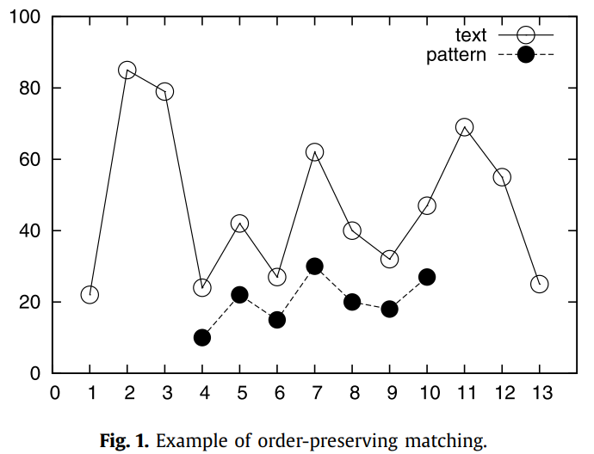
Order Preserving Pattern Matching
P = (10, 22, 15, 30, 20, 18, 27)
T = (22, 85, 79, 24, 42, 27, 62, 40, 32, 47, 69, 55, 25)
=> u =(24, 42, 27, 62, 40, 32, 47)

Slide 4
Preprocessing
P[i] < P[i+1] => P’[i] =1
else => P’[i] = 0
i | 1 | 2 | 3 | 4 | 5 | 6 | 7
P | 10 | 22 | 15 | 30 | 20 | 18 | 27
P’ | 1 | 0 | 1 | 0 | 0 | 1
i | 1 | 2 | 3 | 4 | 5 | 6 | 7 | 8 | 9 | 10 | 11 | 12 | 13
T | 22 | 85 | 79 | 24 | 42 | 27 | 62 | 40 | 32 | 47 | 69 | 55 | 25
T’ | 1 | 0 | 0 | 1 | 0 | 1 | 0 | 0 | 1 | 1 | 0 | 0

Slide 5
Filtration
use exact string matching
i | 1 | 2 | 3 | 4 | 5 | 6 | 7 | 8 | 9 | 10 | 11 | 12 | 13
T | 22 | 85 | 79 | 24 | 42 | 27 | 62 | 40 | 32 | 47 | 69 | 55 | 25
T’ | 1 | 0 | 0 | 1 | 0 | 1 | 0 | 0 | 1 | 1 | 0 | 0
i | 1 | 2 | 3 | 4 | 5 | 6 | 7
P | 10 | 22 | 15 | 30 | 20 | 18 | 27
P’ | 1 | 0 | 1 | 0 | 0 | 1

Slide 6
Verification
P = (10, 22, 15, 30, 20, 18, 27)
T = (22, 85, 79, 24, 42, 27, 62, 40, 32, 47, 69, 55, 25)
auxiliary table r
equality table E
check if there are the same elements
i | 1 | 2 | 3 | 4 | 5 | 6 | 7
p[i] | 10 | 15 | 18 | 20 | 22 | 27 | 30
r | 1 | 3 | 6 | 5 | 2 | 7 | 4
i | 1 | 2 | 3 | 4 | 5 | 6 | 7
p[i] | 10 | 15 | 18 | 20 | 22 | 27 | 30
E | 0 | 0 | 0 | 0 | 0 | 0

Slide 7
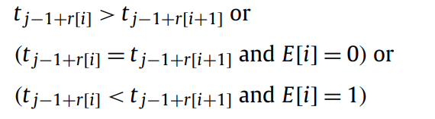
Verification
traversed in accordance with the table r and E
i | 1 | 2 | 3 | 4 | 5 | 6 | 7 | 8 | 9 | 10 | 11 | 12 | 13
T | 22 | 85 | 79 | 24 | 42 | 27 | 62 | 40 | 32 | 47 | 69 | 55 | 25
T’ | 1 | 0 | 0 | 1 | 0 | 1 | 0 | 0 | 1 | 1 | 0 | 0
T | 24 | 27 | 32 | 30 | 42 | 47 | 62
r | 1 | 3 | 6 | 5 | 2 | 7 | 4
E | 0 | 0 | 0 | 0 | 0 | 0
=> delete candidate

Slide 8
Exact string matching
SBNDM2
SBNDM4
Fast Shift-Or (FSO)
KMP algorithm

Slide 9
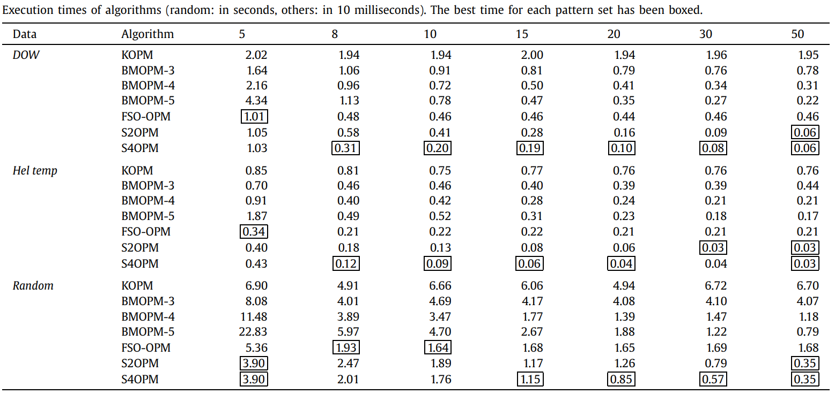
Experiments

Slide 10

Conclusion
Preprocessing
Time complexity: $O\left(mlogm\right)$
Space complexity: $O(m)$
Filtration
Time complexity: sublinear
Total
Time complexity: sublinear

