Slide 1
Who should bid higher, NS or WE, in a given Bridge deal.
Mańdziuk Jacek and Jakub Suchan.
IEEE International Joint Conference on Neural Networks (IJCNN). Budapest, Hungary, 2019.
Presenter: Yun-An Chen
Date: Feb. 14, 2023

Slide 2
Abstract(1/2)
The paper proposes a neural model for a direct comparison of the two so-called Double Dummy Bridge Problem (DDBP) instances, along with a practical use-case for determining which pair, NS or WE, should propose the higher deal during a bidding phase in a Bridge game. The proposed system is composed of two identical subnetworks combined by a comparator layer placed on top of them. The base of each subnetwork is a shallow autoencoder (AE) which is further connected with a Multilayer Perceptron. The system is trained in two phases - an unsupervised one - used to create a meaningful feature-based input representation in AE compression layer, and a supervised one - meant for fine-tuning of the whole model.

Slide 3
Abstract(2/2)
Training and test data are composed of pairs of Bridge deals in which the second deal in a pair is the first one rotated by 90 degrees. Since the task is to point which of the two deals promise a higher contract for the NS pair, due to deal rotation within a pair, the system effectively answers the title question “Who should bid higher, NS or WE, in a given deal?”. The proposed approach is experimentally compared with two other methods: one relying on a neural system solving the DDBP and the other one employing several estimators of hand strength used by experienced players. The results clearly indicate that both neural network approaches outperform the usage of human-scoring systems by a large margin, most notably in the trump (suit) contract.

Slide 4
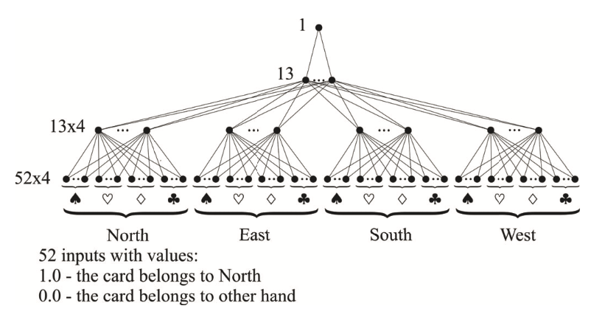
Experimental setup
Training set
No trump: 800000 deals
Trump: 800000 deals
Testing set
No trump: 400000 deals
Trump: 800000 deals
Training phase
Autoencoder
Fine-tuning of classifier

Slide 5
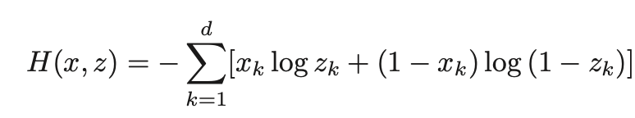
Autoencoder
Input
Encoder
Compressed
representation
Decoder
Output
208
104 / 156
208

Slide 6
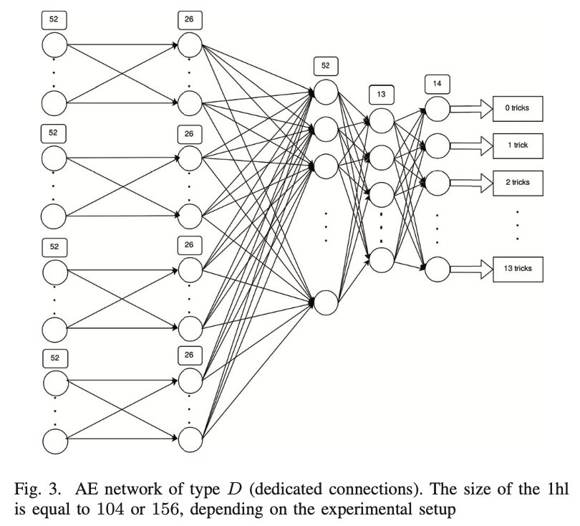
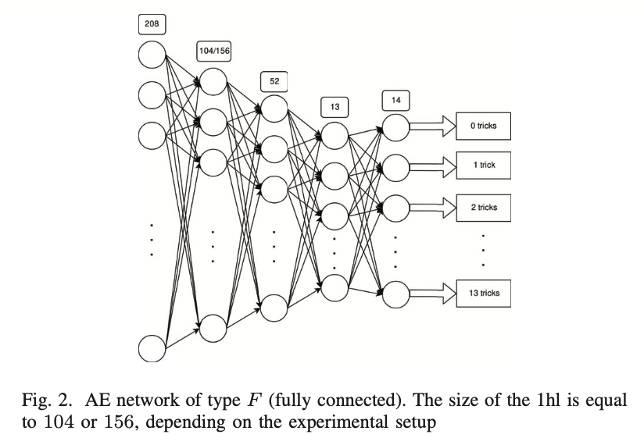
AE networks

Slide 7
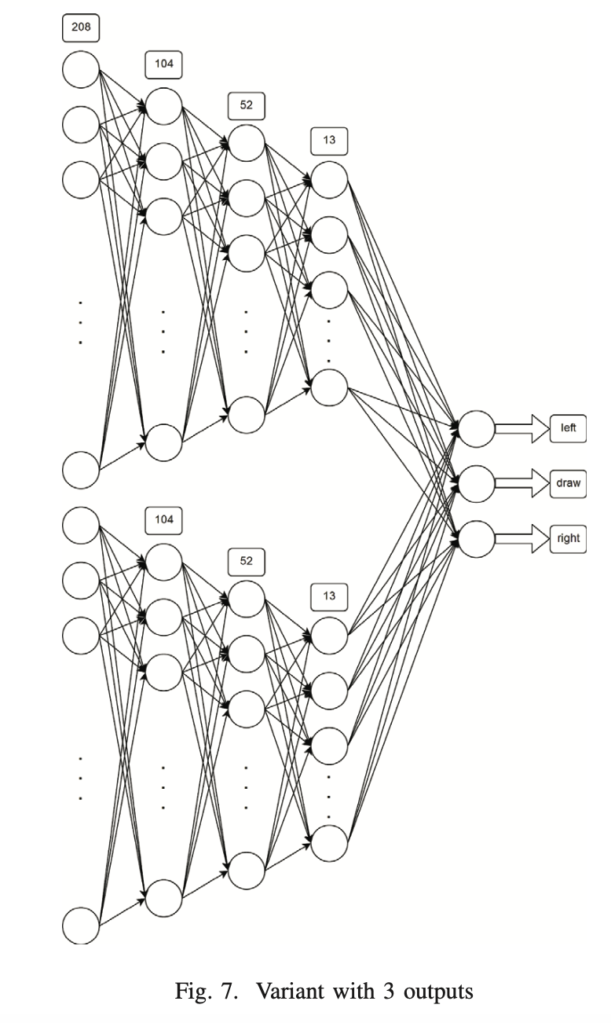
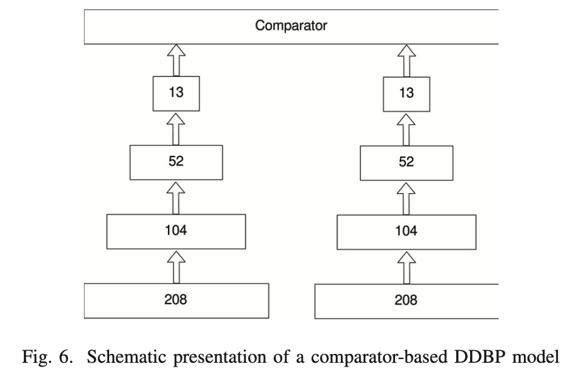
DeepChess approach

Slide 8
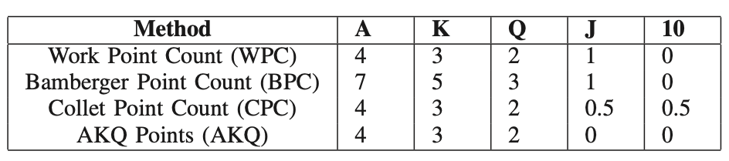
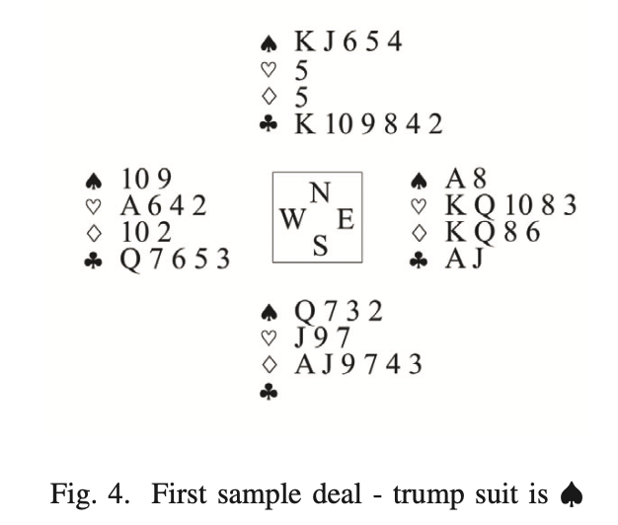
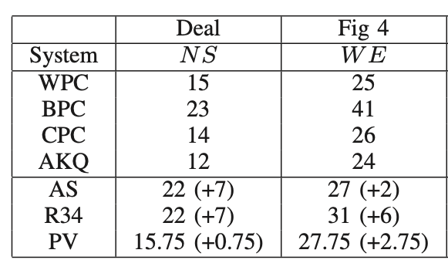
Points based methods

Slide 9
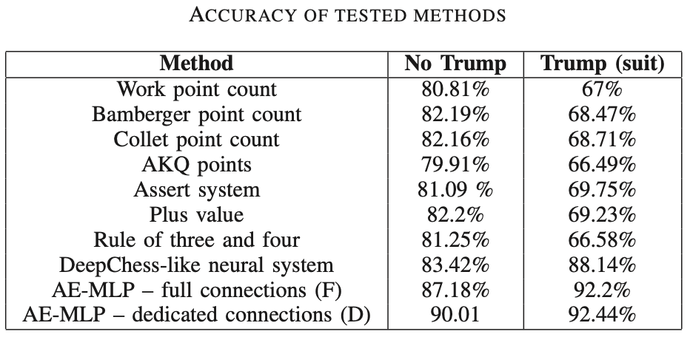
Experimental results

