Slide 1
Finding the gapped longest common subsequence by incremental suffix maximum queries
Yung-Hsing Peng, Chang-Biau Yang
Information and Computation, Volume 237, October 2014, Pages 95-100
Presenter: Guan-Jie Chen
Date: Feb. 14, 2023

Slide 2
Abstract (1 / 2)
The longest common subsequence (LCS) problem with gap constraints (or the gapped LCS), which has applications to genetics and molecular biology, is an interesting and useful variant to the LCS problem. In previous work, this problem is solved in O(nm) time when the gap constraints are fixed to a single integer, where n and m denote the lengths of the two input sequences A and B, respectively. In this paper, we first generalize the problem from fixed gaps to variable gap constraints.

Slide 3
Abstract (2 / 2)
Then, we devise an optimal approach for the incremental suffix maximum query (ISMQ), which helps us obtain an efficient algorithm with O(nm) time for finding LCS with variable gap constraints. In addition, our technique for ISMQ can be applied to solve one of the block edit problems on strings, reducing the time complexity from O(nm logm + m²) to O(nm + m²). Hence, the result of this paper is beneficial to related research on sequence analysis and stringology.

Slide 4
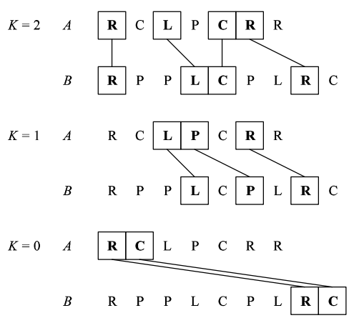
Fixed Gap LCS
i_{x} − i_{x−1} ≤ K + 1, for 2 ≤ x ≤ p
Notes:
同一條序列中的兩個連續match距離要小於等於K + 1
x: 第x個match
p: match總長度

Slide 5
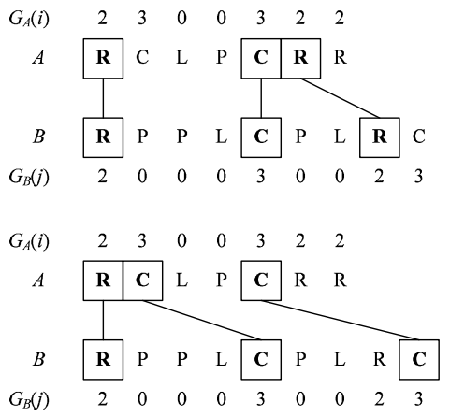
Variable Gap LCS
G_{A} = [2, 3, 0, 0, 3, 2, 2]
G_{B} = [2, 0, 0, 0, 3, 0, 0, 2, 3]
i_{x} − i_{x−1} ≤ G_{S} (i_{x}) + 1, for 2 ≤ x ≤ p
Notes:
某match與他前一個match的距離要小於等於G + 1
G_{S}: gap function

Slide 6
VGLCS to FGLCS
G_{A}(i) = k, for 2 ≤ i ≤ n
G_{B}(j) = k, for 2 ≤ j ≤ m
Notes:
n: A的長度
m: B的長度

Slide 7
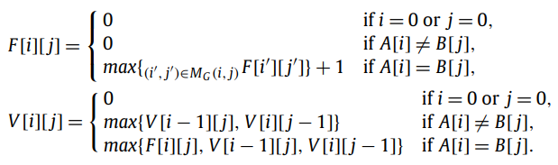
Preliminaries
F[i][j]: A[1, i]與B[1, j]的VGCS
V[i][j]: A[1, i]與B[1, j]的VGLCS
Notes:
MG: 紅色長方形內的match

Slide 8
F[i][j]
 | B₁ | … | B_{j-1-GB(j)} | … | B_{j-1} | B_{j} | …
A₁
…
A_{i-1-GA(i)}
…
A_{i-1}
A_{i} |  |  |  |  |  | ★
…
Notes:
i’的範圍

Slide 9
Time Complexity
O(nm) for F[i][j]
O(nm) for V[i][j]
O(n²m²)

Slide 10
VGLCS (Improved)

Slide 11
F | B₁ | … | B_{j-1-GB(j)} | … | B_{j-1} | B_{j} | …
A₁
…
A_{i-1-GA(i)}
…
A_{i-1}
A_{i} |  |  |  |  |  | ★
…

Slide 12
Col | B₁ | … | B_{j-1-GB(j)} | … | B_{j-1} | B_{j} | …
A₁
…
A_{i-1-GA(i)}
…
A_{i-1}
A_{i} |  |  |  |  |  | ★
…

Slide 13
F | B₁ | … | B_{j-1-GB(j)} | … | B_{j-1} | B_{j} | …
A₁
…
A_{i-1-GA(i)}
…
A_{i-1}
A_{i} |  |  |  |  |  | ★
…

Slide 14
Col | B₁ | … | B_{j-1-GB(j)} | … | B_{j-1} | B_{j} | …
A₁
…
A_{i-1-GA(i)}
…
A_{i-1}
A_{i} |  |  |  |  |  | ★
…

Slide 15
Col | B₁ | … | B_{j-1-GB(j)} | … | B_{j-1} | B_{j} | …
A₁
…
A_{i-1-GA(i)}
…
A_{i-1}
A_{i} |  |  |  |  |  | ★
…

Slide 16
Col | B₁ | … | B_{j-1-GB(j)} | … | B_{j-1} | B_{j} | …
A₁
…
A_{i-1-GA(i)}
…
A_{i-1}
A_{i} |  |  |  |  |  | ★
…

Slide 17
All | B₁ | … | B_{j-1-GB(j)} | … | B_{j-1} | B_{j} | …
A₁
…
A_{i-1-GA(i)}
…
A_{i-1}
A_{i} |  |  |  |  |  | ★
…

Slide 18
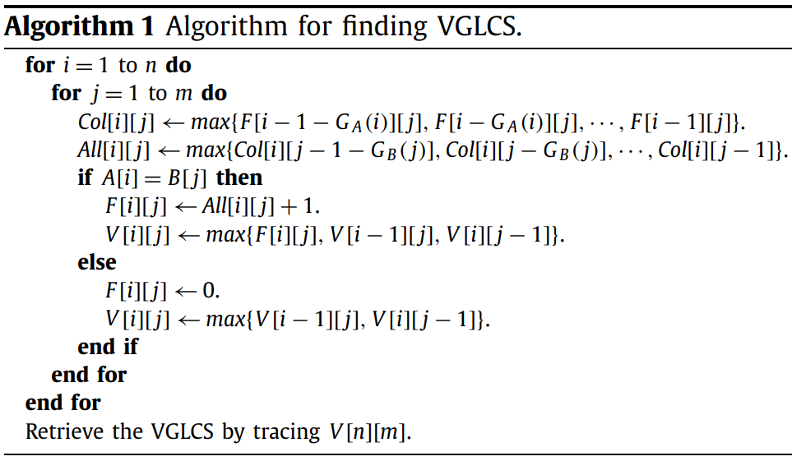
Notes:
F拿到的是左上角紅色長方形的max

Slide 19
Time Complexity
O(αnm)
α: each Col[i][j] and All[i][j]

Slide 20
SMQ (1 / 2)
D = [10, 3, 7, 2]
SMQ_{D} = [10, 7, 7, 2]
Notes:
從第i個到尾巴誰最大

Slide 21
SMQ (2 / 2)
D = [10, 3, 7, 2, 5, 8]
SMQ_{D} = [10, 8, 8, 8, 8, 8]

Slide 22
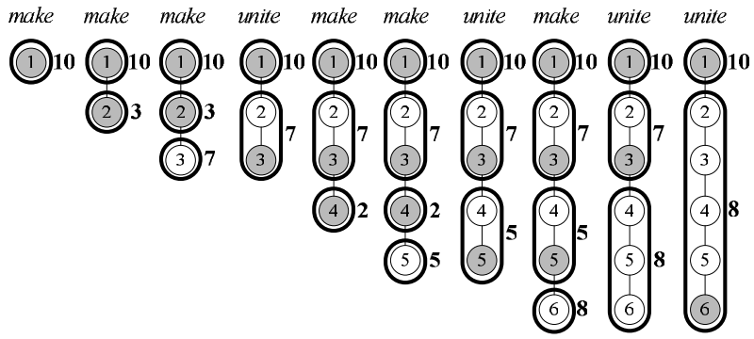
ISMQ Reduced to Union-Find
D = [10, 3, 7, 2, 5, 8]
Notes:
SMQ_{D} = [10, 8, 8, 8, 8, 8]
解釋一下W = [1, 3], [1, 3, 5], [1, 6]

Slide 23
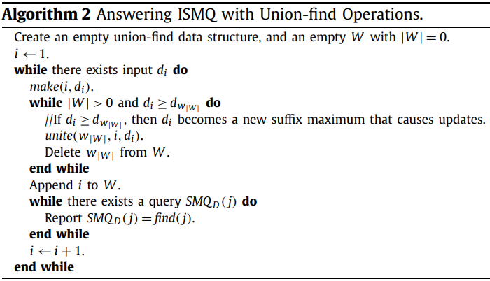

Slide 24
find(1 - G_{S}(1))
find(3 - G_{S}(3))
1 | 10 | 10 | 10 | 10 | 10 | 10
2 |  | 3 | 3 7 | 3 7 | 3 7 | 3 7
3
4 |  |  |  | 2 | 2 5 | 2 5 8
5
6
find(2 - G_{S}(2))
Notes:
find是找括號中元素所在set的老大
花O(n)解掉O(n)

Slide 25
Time Complexity (1 / 2)
O(β(|D| + |Q|))
β: required time of one union-find operation
D: the length of the input string
Q: the number of ISMQs
Notes:
Q就是|W|

Slide 26
Time Complexity (2 / 2)
The factor β can be reduced to O(1) by incremental tree set union
No more than O(nm) makes and unites
O(nm)
Notes:
Q就是|W|

Slide 27
Thanks for your patience

