Slide 1
SCOUT: A Simple Game-Searching Algorithm with Proven Optimal Properties
Judea Pearl
Association for the Advancement of Artificial Intelligence, August 18–21, 1980, Stanford, California
Presenter: Ying-Yu Lin
Date: Feb.14, 2023

Slide 2
Abstract
This paper describes a new algorithm for searching games which is conceptually simple, space efficient, and analytically tractable. It possesses optimal asymptotic properties and may offer practical advantages over 𝛼𝛽 for deep searches.

Slide 3
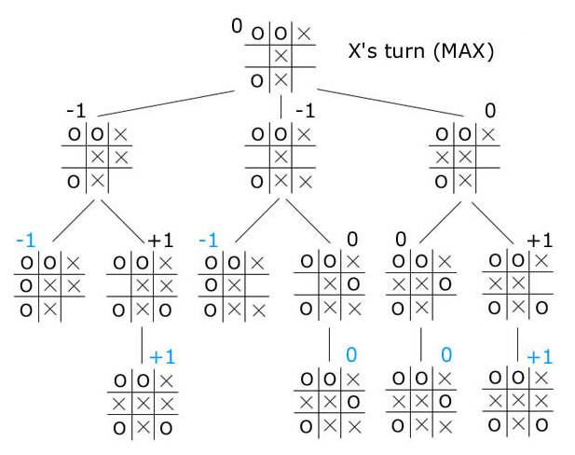
Mini-Max Algorithm
O’s turn
X’s turn

Slide 4
Mini-Max Algorithm
O’s turn
X’s turn

Slide 5
Mini-Max Algorithm
Player
Opponent
8
7
3
9
9
8
2
4
1
8
8
9
9
9
3
4

Slide 6
Mini-Max Algorithm
Player
Opponent
7
3
8
2
1
8
9
3
8
7
3
9
9
8
2
4
1
8
8
9
9
9
3
4

Slide 7
Mini-Max Algorithm
Player
Opponent
7
8
8
9
7
3
8
2
1
8
9
3
8
7
3
9
9
8
2
4
1
8
8
9
9
9
3
4

Slide 8
Mini-Max Algorithm
Player
Opponent
7
8
7
8
8
9
7
3
8
2
1
8
9
3
8
7
3
9
9
8
2
4
1
8
8
9
9
9
3
4

Slide 9
Mini-Max Algorithm
Player
Opponent
8
7
8
7
8
8
9
7
3
8
2
1
8
9
3
8
7
3
9
9
8
2
4
1
8
8
9
9
9
3
4

Slide 10
α - β pruning
Player
Opponent
7
8
7
3
9
9
8
2
4
1
8
8
9
9
9
3
4

Slide 11
α - β pruning
Player
Opponent
≥7
7
8
7
3
9
9
8
2
4
1
8
8
9
9
9
3
4

Slide 12
α - β pruning
Player
Opponent
≥7
7
≤3
8
7
3
9
9
8
2
4
1
8
8
9
9
9
3
4

Slide 13
α - β pruning
Player
Opponent
≤7
≥7
7
≤3
8
7
3
9
9
8
2
4
1
8
8
9
9
9
3
4

Slide 14
α - β pruning
Player
Opponent
≤7
≥7
7
≤3
8
8
7
3
9
9
8
2
4
1
8
8
9
9
9
3
4

Slide 15
α - β pruning
Player
Opponent
≤7
≥7
≥8
7
≤3
8
8
7
3
9
9
8
2
4
1
8
8
9
9
9
3
4

Slide 16
α - β pruning
Player
Opponent
≤7
7
≥8
7
≤3
8
8
7
3
9
9
8
2
4
1
8
8
9
9
9
3
4

Slide 17
α - β pruning
Player
Opponent
≥7
7
7
≥8
7
≤3
8
8
7
3
9
9
8
2
4
1
8
8
9
9
9
3
4

Slide 18
α - β pruning
Player
Opponent
≥7
7
7
≥8
7
≤3
8
1
8
7
3
9
9
8
2
4
1
8
8
9
9
9
3
4

Slide 19
α - β pruning
Player
Opponent
≥7
7
7
≥8
≥1
7
≤3
8
1
8
7
3
9
9
8
2
4
1
8
8
9
9
9
3
4

Slide 20
α - β pruning
Player
Opponent
≥7
7
7
≥8
≥1
7
≤3
8
1
8
8
7
3
9
9
8
2
4
1
8
8
9
9
9
3
4

Slide 21
α - β pruning
Player
Opponent
≥7
7
7
≥8
8
7
≤3
8
1
8
8
7
3
9
9
8
2
4
1
8
8
9
9
9
3
4

Slide 22
α - β pruning
Player
Opponent
≥7
7
≤8
7
≥8
8
7
≤3
8
1
8
8
7
3
9
9
8
2
4
1
8
8
9
9
9
3
4

Slide 23
α - β pruning
Player
Opponent
≥7
7
≤8
7
≥8
8
7
≤3
8
1
8
8
7
3
9
9
8
2
4
1
8
8
9
9
9
3
4

Slide 24
α - β pruning
Player
Opponent
8
7
≤8
7
≥8
8
7
≤3
8
1
8
8
7
3
9
9
8
2
4
1
8
8
9
9
9
3
4

Slide 25
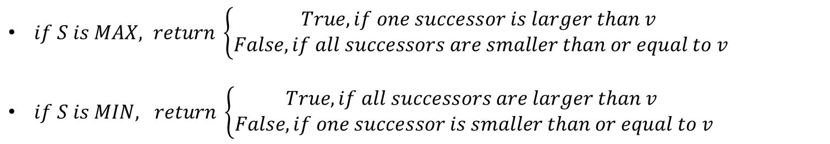
SCOUT Algorithm
TEST( S, v, > ) : V(S) > v ?
EVAL(S)
$if S is MAX, return \left\{\begin{aligned}True, if one successor is larger than v \\ False, if all successors are smaller than or equal to v\end{aligned}\right.$
$if S is MIN, return \left\{\begin{aligned}True, if all successors are larger than v \\ False, if one successor is smaller than or equal to v\end{aligned}\right.$

Slide 26
SCOUT Algorithm
Player (OR)
Opponent (AND)
EVAL(S) = [0,13]
8
7
3
9
9
8
2
4
1
8
8
9
9
9
3
4

Slide 27
SCOUT Algorithm
Player (OR)
Opponent (AND)
TEST(S,8,>)
TEST(S,8,>)
TEST(S,8,>)
TEST(S,8,>)
8
7
3
9
9
8
2
4
1
8
8
9
9
9
3
4

Slide 28
SCOUT Algorithm
Player (OR)
Opponent (AND)
TEST(S,8,>)
TEST(S,8,>)
TEST(S,8,>)
False
8
7
3
9
9
8
2
4
1
8
8
9
9
9
3
4

Slide 29
SCOUT Algorithm
Player (OR)
Opponent (AND)
TEST(S,8,>)
TEST(S,8,>)
TEST(S,8,>)
False
TEST(S,8,>)
8
7
3
9
9
8
2
4
1
8
8
9
9
9
3
4

Slide 30
SCOUT Algorithm
Player (OR)
Opponent (AND)
TEST(S,8,>)
TEST(S,8,>)
TEST(S,8,>)
False
False
8
7
3
9
9
8
2
4
1
8
8
9
9
9
3
4

Slide 31
SCOUT Algorithm
Player (OR)
Opponent (AND)
TEST(S,8,>)
TEST(S,8,>)
False
False
False
8
7
3
9
9
8
2
4
1
8
8
9
9
9
3
4

Slide 32
SCOUT Algorithm
Player (OR)
Opponent (AND)
TEST(S,8,>)
False
False
False
False
8
7
3
9
9
8
2
4
1
8
8
9
9
9
3
4

Slide 33
SCOUT Algorithm
Player (OR)
Opponent (AND)
TEST(S,8,>)
False
TEST(S,8,>)
False
TEST(S,8,>)
False
False
TEST(S,8,>)
8
7
3
9
9
8
2
4
1
8
8
9
9
9
3
4

Slide 34
SCOUT Algorithm
Player (OR)
Opponent (AND)
TEST(S,8,>)
False
TEST(S,8,>)
False
TEST(S,8,>)
False
False
False
8
7
3
9
9
8
2
4
1
8
8
9
9
9
3
4

Slide 35
SCOUT Algorithm
Player (OR)
Opponent (AND)
TEST(S,8,>)
False
TEST(S,8,>)
False
TEST(S,8,>)
False
False
False
TEST(S,8,>)
8
7
3
9
9
8
2
4
1
8
8
9
9
9
3
4

Slide 36
SCOUT Algorithm
Player (OR)
Opponent (AND)
TEST(S,8,>)
False
TEST(S,8,>)
False
TEST(S,8,>)
False
False
False
False
8
7
3
9
9
8
2
4
1
8
8
9
9
9
3
4

Slide 37
SCOUT Algorithm
Player (OR)
Opponent (AND)
TEST(S,8,>)
False
TEST(S,8,>)
False
False
False
False
False
False
8
7
3
9
9
8
2
4
1
8
8
9
9
9
3
4

Slide 38
SCOUT Algorithm
Player (OR)
Opponent (AND)
TEST(S,8,>)
False
False
False
False
False
False
False
False
8
7
3
9
9
8
2
4
1
8
8
9
9
9
3
4

Slide 39
SCOUT Algorithm
Player (OR)
Opponent (AND)
TEST(S,8,>)
False
False
False
False
False
False
False
False
False
8
7
3
9
9
8
2
4
1
8
8
9
9
9
3
4

Slide 40
SCOUT Algorithm
Player (OR)
Opponent (AND)
EVAL(S) = [0,8]
8
7
3
9
9
8
2
4
1
8
8
9
9
9
3
4

Slide 41
SCOUT Algorithm
Player (OR)
Opponent (AND)
TEST(S,7,>)
TEST(S,7,>)
TEST(S,7,>)
TEST(S,7,>)
8
7
3
9
9
8
2
4
1
8
8
9
9
9
3
4

Slide 42
SCOUT Algorithm
Player (OR)
Opponent (AND)
TEST(S,7,>)
TEST(S,7,>)
TEST(S,7,>)
False
TEST(S,7,>)
8
7
3
9
9
8
2
4
1
8
8
9
9
9
3
4

Slide 43
SCOUT Algorithm
Player (OR)
Opponent (AND)
TEST(S,7,>)
TEST(S,7,>)
TEST(S,7,>)
False
False
8
7
3
9
9
8
2
4
1
8
8
9
9
9
3
4

Slide 44
SCOUT Algorithm
Player (OR)
Opponent (AND)
TEST(S,7,>)
TEST(S,7,>)
False
False
False
8
7
3
9
9
8
2
4
1
8
8
9
9
9
3
4

Slide 45
SCOUT Algorithm
Player (OR)
Opponent (AND)
TEST(S,7,>)
False
False
False
False
8
7
3
9
9
8
2
4
1
8
8
9
9
9
3
4

Slide 46
SCOUT Algorithm
Player (OR)
Opponent (AND)
TEST(S,7,>)
False
TEST(S,7,>)
False
TEST(S,7,>)
False
False
TEST(S,7,>)
8
7
3
9
9
8
2
4
1
8
8
9
9
9
3
4

Slide 47
SCOUT Algorithm
Player (OR)
Opponent (AND)
TEST(S,7,>)
False
TEST(S,7,>)
False
TEST(S,7,>)
False
False
False
8
7
3
9
9
8
2
4
1
8
8
9
9
9
3
4

Slide 48
SCOUT Algorithm
Player (OR)
Opponent (AND)
TEST(S,7,>)
False
TEST(S,7,>)
False
TEST(S,7,>)
False
False
False
TEST(S,7,>)
8
7
3
9
9
8
2
4
1
8
8
9
9
9
3
4

Slide 49
SCOUT Algorithm
Player (OR)
Opponent (AND)
TEST(S,7,>)
False
TEST(S,7,>)
False
TEST(S,7,>)
False
False
False
True
8
7
3
9
9
8
2
4
1
8
8
9
9
9
3
4

Slide 50
SCOUT Algorithm
Player (OR)
Opponent (AND)
TEST(S,7,>)
False
TEST(S,7,>)
False
True
False
False
False
True
8
7
3
9
9
8
2
4
1
8
8
9
9
9
3
4

Slide 51
SCOUT Algorithm
Player (OR)
Opponent (AND)
TEST(S,7,>)
False
TEST(S,7,>)
False
True
TEST(S,7,>)
False
False
False
True
TEST(S,7,>)
8
7
3
9
9
8
2
4
1
8
8
9
9
9
3
4

Slide 52
SCOUT Algorithm
Player (OR)
Opponent (AND)
TEST(S,7,>)
False
TEST(S,7,>)
False
True
TEST(S,7,>)
False
False
False
True
True
8
7
3
9
9
8
2
4
1
8
8
9
9
9
3
4

Slide 53
SCOUT Algorithm
Player (OR)
Opponent (AND)
TEST(S,7,>)
False
TEST(S,7,>)
False
True
True
False
False
False
True
True
8
7
3
9
9
8
2
4
1
8
8
9
9
9
3
4

Slide 54
SCOUT Algorithm
Player (OR)
Opponent (AND)
TEST(S,7,>)
False
True
False
True
True
False
False
False
True
True
8
7
3
9
9
8
2
4
1
8
8
9
9
9
3
4

Slide 55
SCOUT Algorithm
Player (OR)
Opponent (AND)
TEST(S,7,>)
True
False
True
False
True
True
False
False
False
True
True
8
7
3
9
9
8
2
4
1
8
8
9
9
9
3
4

Slide 56
SCOUT Algorithm
Player (OR)
Opponent (AND)
EVAL(S) = (7,8]
8
7
3
9
9
8
2
4
1
8
8
9
9
9
3
4

Slide 57
Kalah (美國播棋)
4
4
4
4
4
4
4
4
4
4
4
4

Slide 58
Kalah – free move
4
4
4
4
4
4
1
1
4
4
0
5
5
5

Slide 59
Kalah – Capture
1
0
4
5
5
5
2
3
6
1
2
6
0
8

Slide 60
Kalah – Capture
1
0
4
5
5
5
2
3
6
1
2
6
0
8

Slide 61
Kalah – Capture
1
0
4
5
0
5
2
9
6
1
2
7
0
8

Slide 62
Experience Result
Search depth | Random Ordering |  |  | Dynamic Ordering
 | SCOUT | α - β | Improvement | SCOUT | α - β | Improvement
2 | 82 | 70 | -17.0 | 39 | 37 | -5.4
3 | 394 | 380 | -3.7 | 62 | 61 | -1.6
4 | 1173 | 1322 | +11.3 | 91 | 96 | -1.1
5 | 2514 | 4198 | +40.1 | 279 | 336 | +17.0
6 | 5111 | 6944 | +26.4 | 371 | 440 | +15.7

