Slide 1
An Improved Order-Preserving Pattern Matching Algorithm Using Fingerprints
Youngjoon Kim, Youngho Kim, Jeong Seop Sim
Mathematics, vol. 10, no. 12, 2022
Presenter: Guan-Ting Chen
Date: Feb. 16, 2022

Slide 2
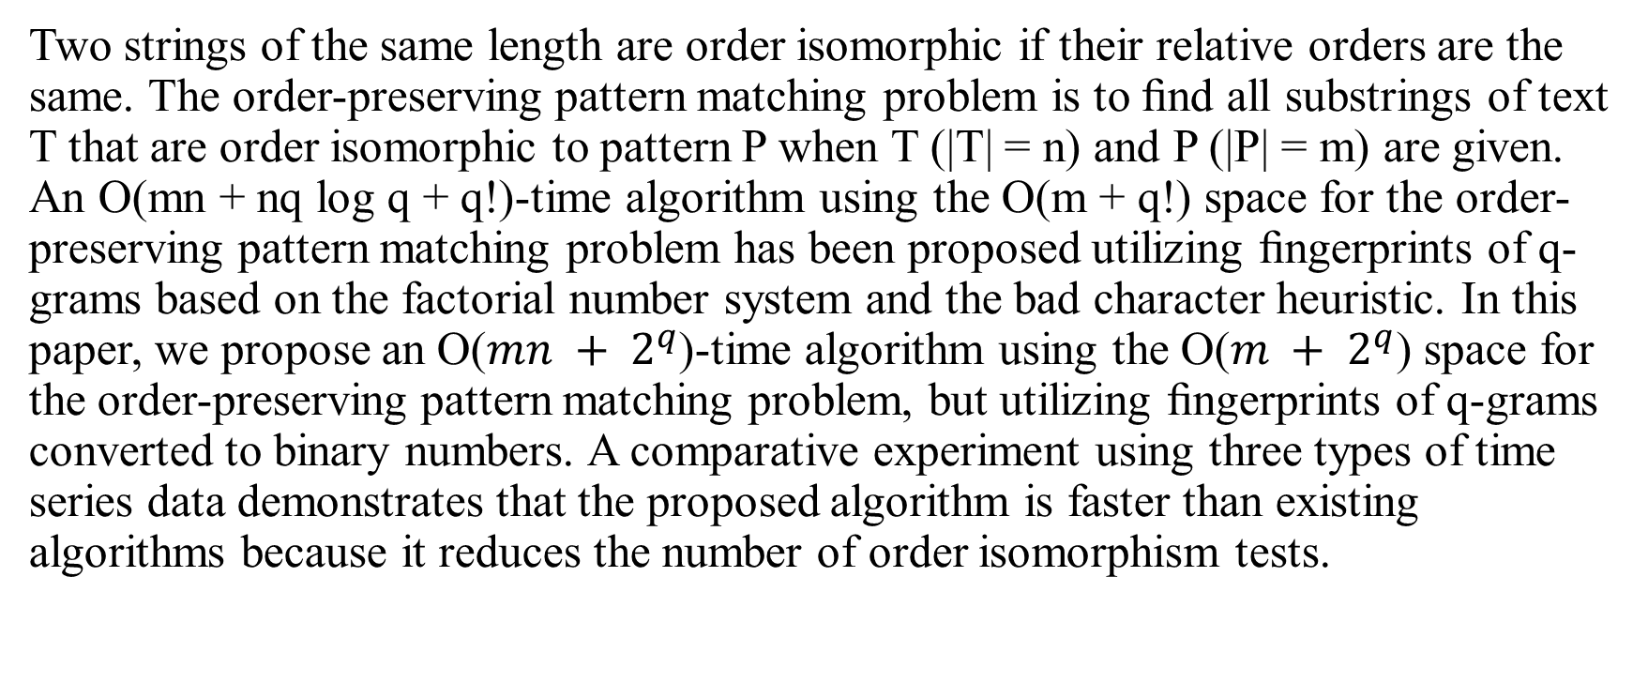
Abstract
Two strings of the same length are order isomorphic if their relative orders are the same. The order-preserving pattern matching problem is to ﬁnd all substrings of text T that are order isomorphic to pattern P when T (|T| = n) and P (|P| = m) are given. An O(mn + nq log q + q!)-time algorithm using the O(m + q!) space for the order-preserving pattern matching problem has been proposed utilizing ﬁngerprints of q-grams based on the factorial number system and the bad character heuristic. In this paper, we propose an O($mn + 2^{q}$)-time algorithm using the O($m + 2^{q}$) space for the order-preserving pattern matching problem, but utilizing ﬁngerprints of q-grams converted to binary numbers. A comparative experiment using three types of time series data demonstrates that the proposed algorithm is faster than existing algorithms because it reduces the number of order isomorphism tests.

Slide 3
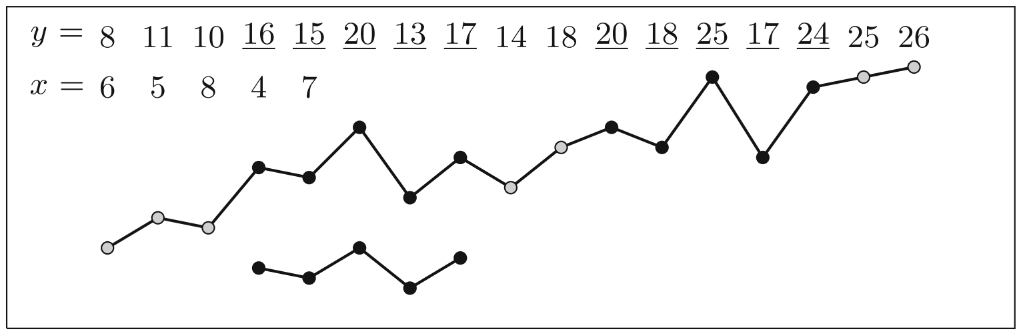
Order Preserving Pattern Matching

Slide 4
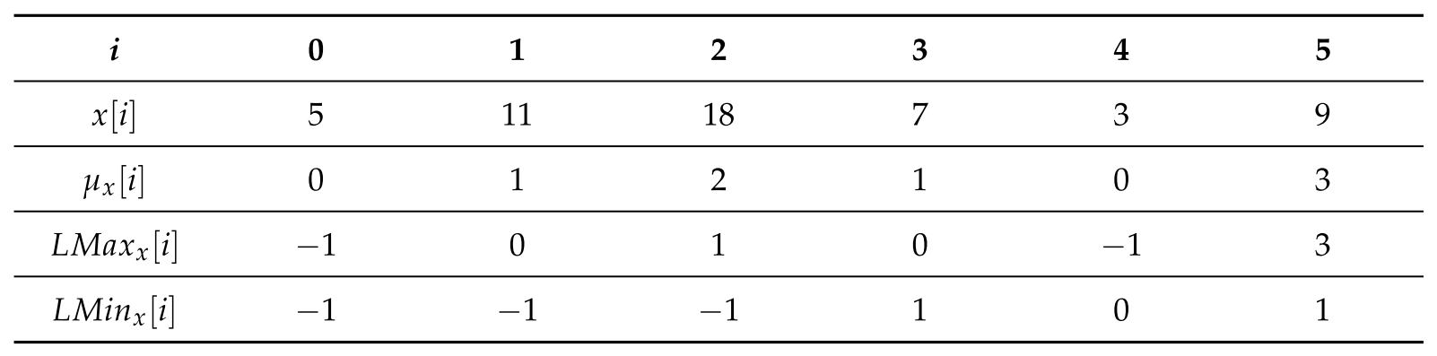
Relative Table

Slide 5
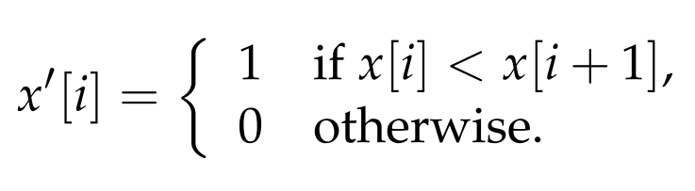
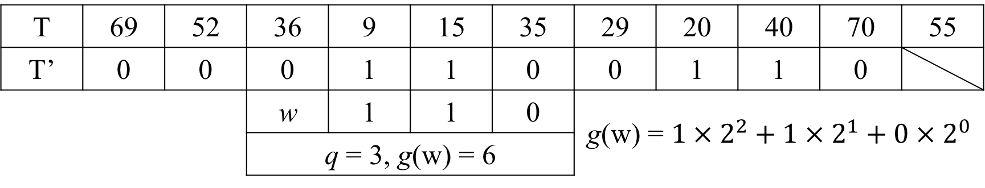
Preprocessing (1 / 3)
T | 69 | 52 | 36 | 9 | 15 | 35 | 29 | 20 | 40 | 70 | 55
T’ | 0 | 0 | 0 | 1 | 1 | 0 | 0 | 1 | 1 | 0
 |  |  | w | 1 | 1 | 0 | g(w) = ${1×2}^{2}+1×2^{1}+0×2^{0}$
 |  |  | q = 3, g(w) = 6

Slide 6
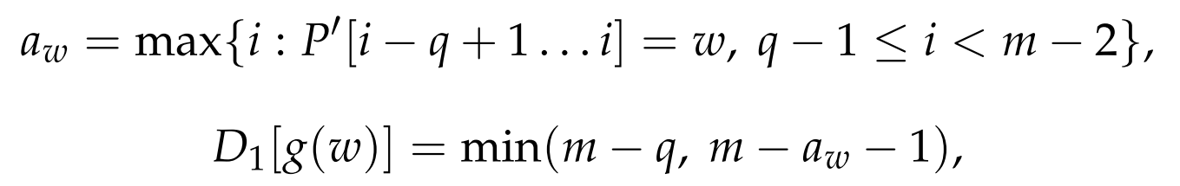

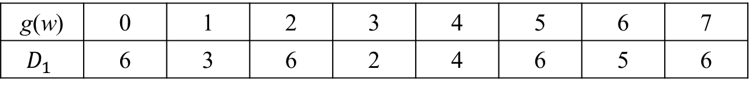
Preprocessing (2 / 3)
Shift Tables
$D_{1}$
i | 0 | 1 | 2 | 3 | 4 | 5 | 6 | 7 | 8
P | 30 | 4 | 12 | 27 | 25 | 16 | 32 | 60 | 49
P’ | 0 | 1 | 1 | 0 | 0 | 1 | 1 | 0
g(w) | 0 | 1 | 2 | 3 | 4 | 5 | 6 | 7
$$D_{1}$$ | 6 | 3 | 6 | 2 | 4 | 6 | 5 | 6

Slide 7
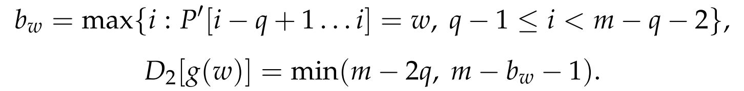
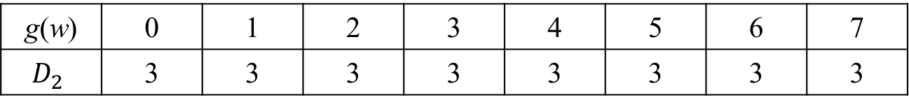

Preprocessing (3 / 3)
Shift Tables
$D_{2}$
i | 0 | 1 | 2 | 3 | 4 | 5 | 6 | 7 | 8
P | 30 | 4 | 12 | 27 | 25 | 16 | 32 | 60 | 49
P’ | 0 | 1 | 1 | 0 | 0 | 1 | 1 | 0
g(w) | 0 | 1 | 2 | 3 | 4 | 5 | 6 | 7
$$D_{2}$$ | 3 | 3 | 3 | 3 | 3 | 3 | 3 | 3

Slide 8
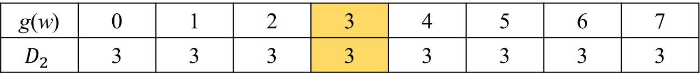
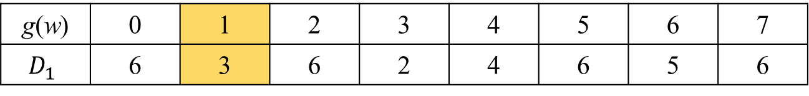
Example (1 / 2)
g(w) | 0 | 1 | 2 | 3 | 4 | 5 | 6 | 7
$$D_{1}$$ | 6 | 3 | 6 | 2 | 4 | 6 | 5 | 6
g(w) | 0 | 1 | 2 | 3 | 4 | 5 | 6 | 7
$$D_{2}$$ | 3 | 3 | 3 | 3 | 3 | 3 | 3 | 3
i | 0 | 1 | 2 | 3 | 4 | 5 | 6 | 7 | 8 | 9 | 10
T | 69 | 52 | 36 | 9 | 15 | 35 | 29 | 20 | 40 | 70 | 55
T’ | 0 | 0 | 0 | 1 | 1 | 0 | 0 | 1 | 1 | 0
P | 30 | 4 | 12 | 27 | 25 | 16 | 32 | 60 | 49
P’ | 0 | 1 | 1 | 0 | 0 | 1 | 1 | 0

Slide 9
Example (2 / 2)
Make sure 2 q-gram are match
Check the order by LMax, LMin
i | 0 | 1 | 2 | 3 | 4 | 5 | 6 | 7 | 8 | 9 | 10
T | 69 | 52 | 36 | 9 | 15 | 35 | 29 | 20 | 40 | 70 | 55
T’ | 0 | 0 | 0 | 1 | 1 | 0 | 0 | 1 | 1 | 0
 |  | P | 30 | 4 | 12 | 27 | 25 | 16 | 32 | 60 | 49
 |  | P’ | 0 | 1 | 1 | 0 | 0 | 1 | 1 | 0

Slide 10

Time Complexity
Preprocessing
LMax, LMin
O($m\log{m}$)
Shift Table
O($2^{q}+m$)
Search
O($mn$)
Total
O($2^{q}+mn$)

Slide 11
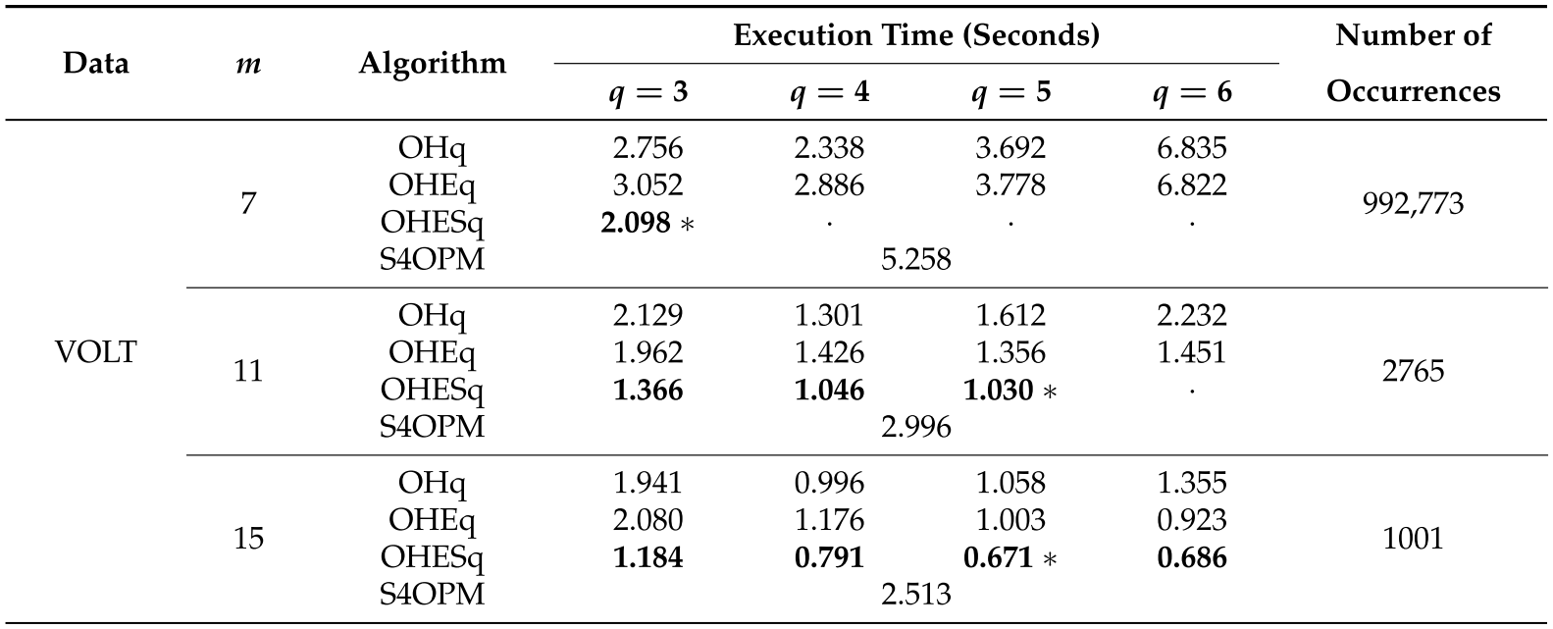
Experiment (1 / 2)

Slide 12
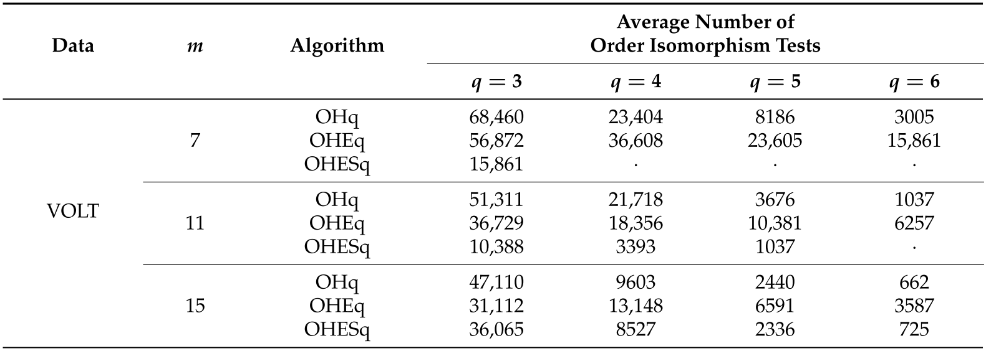
Experiment (2 / 2)

