Slide 1
AI Enabled Bridge Bidding Supporting Interactive Visualization
Xiaoyu Zhang, Wei Liu, Linhui Lou, and Fangchun Yang
Sensors(published by MDPI), 2022
Presenter: Yu-Yen Chu
Date: Feb. 21, 2023

Slide 2
Abstract
With the fast progress in perfect information game problems such as AI chess and AI Go, researchers have turned to imperfect information game problems, including Texas Hold’em and Bridge. Bridge is one of the most challenging card games that have significant research value. Bridge playing is divided into two phases: bidding and playing. This paper focuses on bridge bidding and proposes a bridge bidding service framework using deep neural networks, and supports bidding visualization for the first time. The framework consists of two parts: the bidding model (BM) with a multilayer neural network, and a visualization system. The framework predicts not only reasonable bids from the existing bidding system of humans, but also provides intuitive explanations for decisions to enable human–computer information interaction. Experimental results show that this bidding AI outperforms majority of existing systems.

Slide 3
Problem Setup
Train a bridge bidding model (with competition).
Using RNN and MLP(multi-layer perceptron).
A visualization system for human-machine competition.

Slide 4
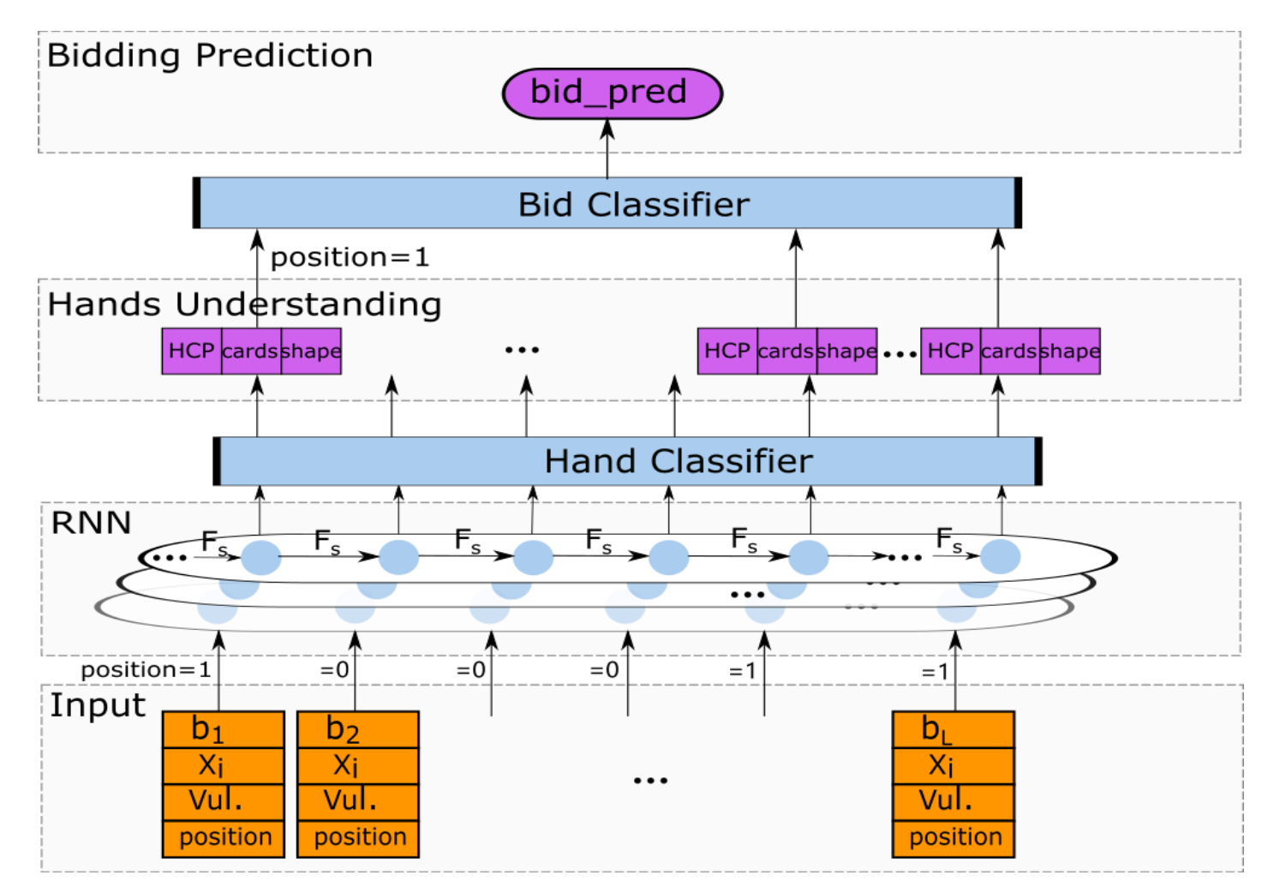
Bidding Model
RNN
3 hidden layers
input: bidding action, hand,
vulnerability, position
Multi-Layer Perceptron (MLP)
a classifier with multi-layer
4 kinds of MLP (to find the probability distribution)
MLP of HCP (take RNN’s output as input)
MLP of card amount of each suit (take RNN’s output as input)
MLP of each cards (take RNN’s output as input)
MLP of next bidding action (take RNN’s output and above 3 MLPs as input)

Slide 5
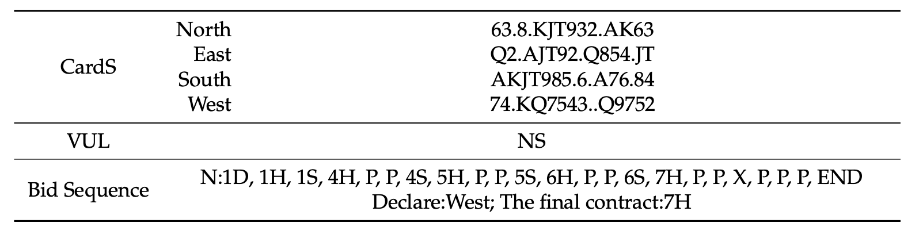
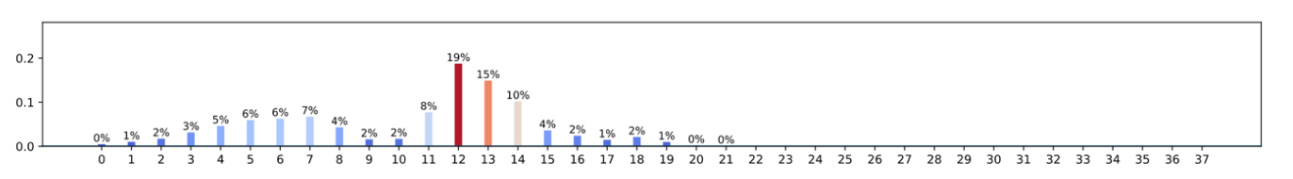
Visualization System
Represent the prediction results of bidding model.
Let human know what a bidding action means to bidding model.

Slide 6
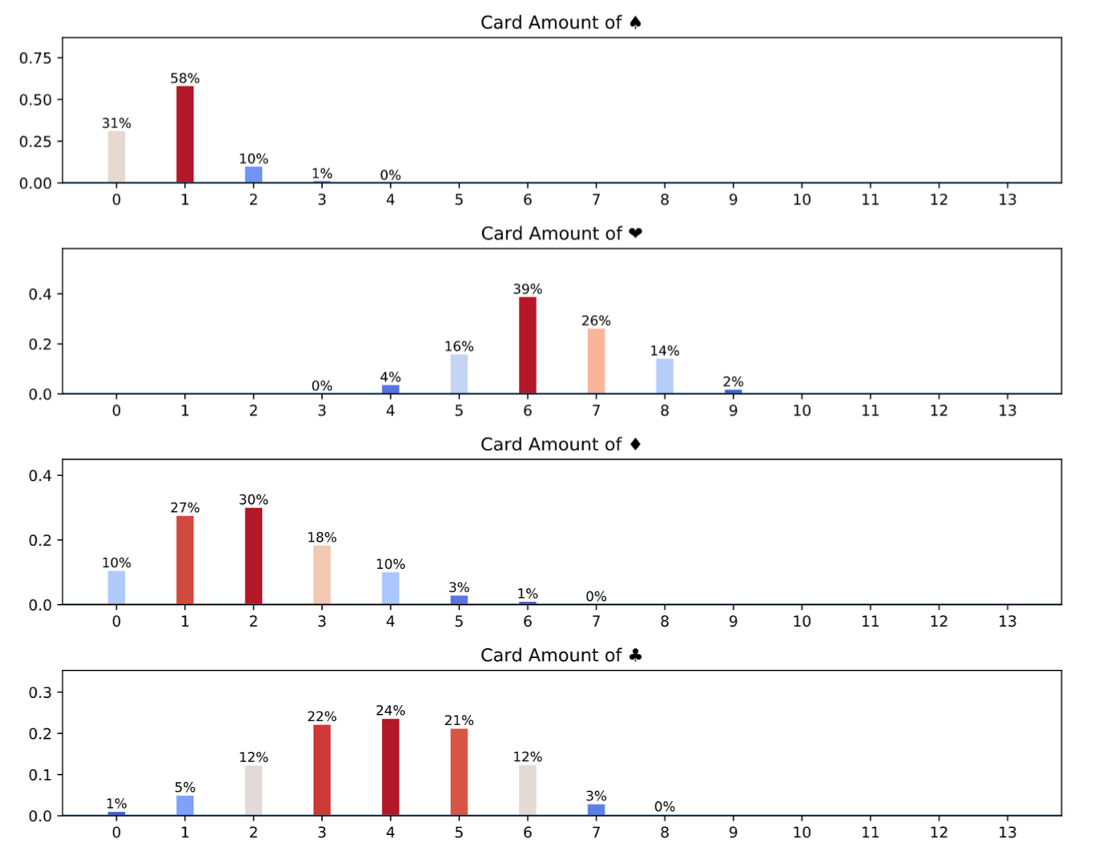

Slide 7
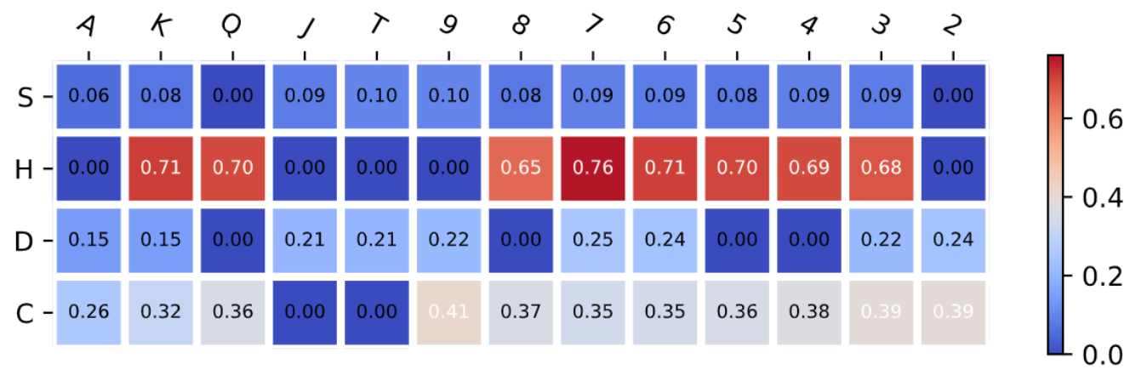

Slide 8
Experiment
data
Snyrey platform
4,000,000 data with bidding sequence and double dummy result.
70% training, 20% validation, 10% testing.
bid and non-bid
Large passes in a bidding sequence will overestimate the accuracy.
bid: only compare bidding actions without pass.
non-bid: compare all bidding actions.
rule of rationality
to check if a bidding action is rational or not

Slide 9
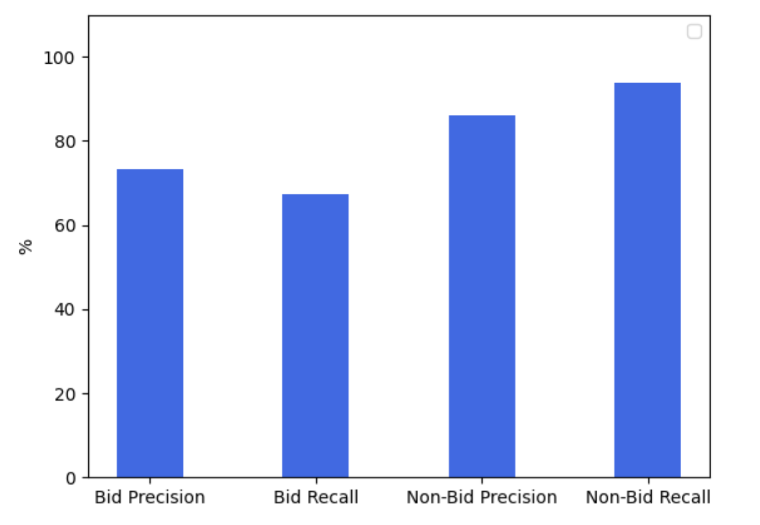
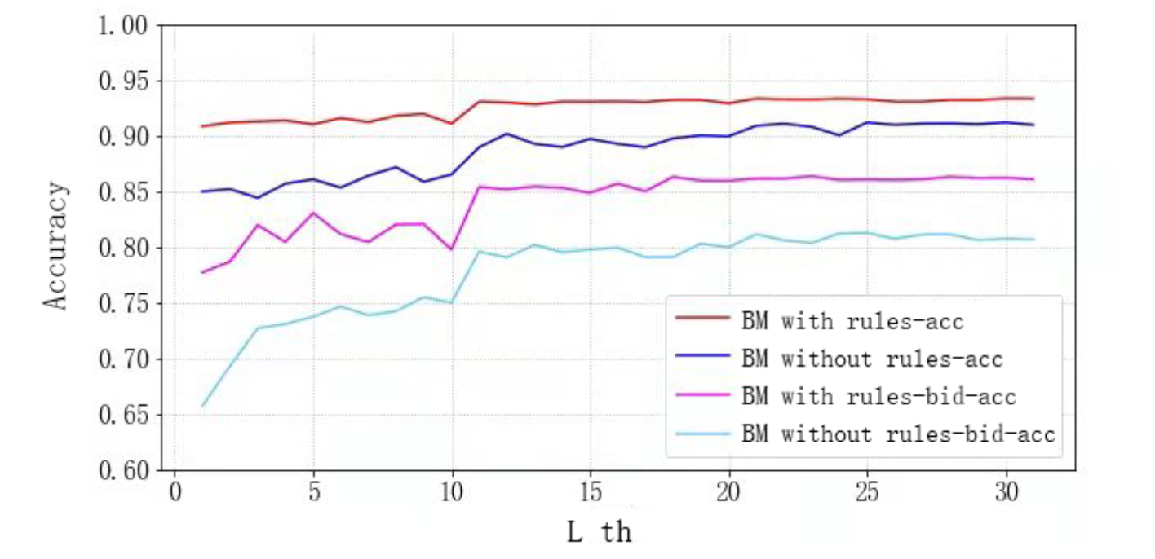
Result

Slide 10
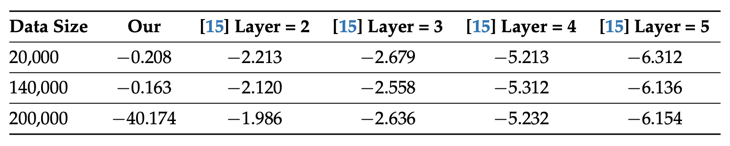
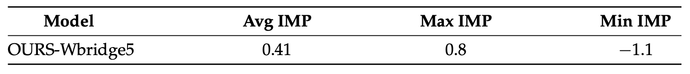
Result
Compare with the result in “Automatic Bridge Bidding Using Deep Reinforcement Learning, Yeh, Hsieh, and Lin, 2018”.
Compare with Wbridge5.

