Slide 1
Road Network Optimization of Intelligent Warehouse Picking Systems Based on Improved Genetic Algorithm
Ruiping Yuan, Luke Pan, Juntao Li, Zhixin Chen
2021 IEEE 7th International Conference on Cloud Computing and Intelligent Systems (CCIS), November 2021, Xi'an, China
Presenter: Yu-Chen Lin
Date: Feb. 21, 2023

Slide 2
Abstract
Intelligent Warehouse Picking System based on logistics robots is a new type of parts-to-picker order picking system, where robots carry mobile shelves to stationary pickers. The new picking mode puts forward higher requirements for the layout and design of warehousing network. In the existing few research on the path network optimization under the intelligent warehouse picking mode, the turning factors which obviously affects the picking efficiency, are seldom considered. In this paper, a mathematical model minimizing the total travel distance of logistics robots to complete all picking tasks is established, where the turning of robots is transformed into travel distance by cost function. Then an improved genetic algorithm with temperature parameter T and Metropolis acceptance criterion is proposed to solve the road network planning model. Finally, MATLAB is used to simulate and compare different road network layout strategies and algorithms from the total picking distance and total picking time to verify the effectiveness of the proposed method.

Slide 3
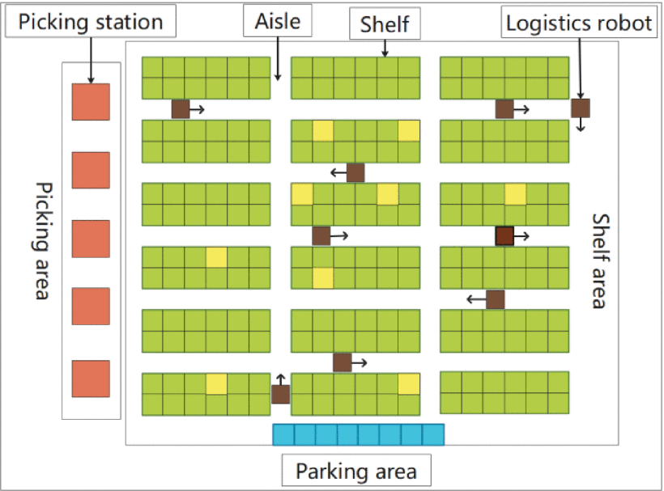
Intelligent Warehouse Picking System
Notes:
智能倉儲揀選系統的路徑網絡優化問題可以概括為：給定係統的引導路徑網絡，給定搬運任務，需要確定各引導路徑段的方向，保證設計的單向強連通性引導路徑網絡，優化系統的一定性能

Slide 4
Genetic Algorithm
Notes:
基因演算法是一種受到自然選擇(natural selection)機制所啟發的演算法。自然選擇解釋生物如何適應環境，基於生物中個體的某種優勢或劣勢，導致生存能力存在差異，進而影響繁殖能力，使得特徵逐漸被保存或者淘汰。基因演算法便是在模擬自然選擇的機制，將解比擬成一條染色體(chromosome)，模仿生物學中交配(crossover)、突變(mutation)等現象，並根據適應度(fitness)的高低，決定染色體的去留，達到去蕪存菁的效果。
基因演算法就是在特定大小的解集合中，透過增添亂數、兩兩排列組合等操作來改變/產生新的解，並從中挑選較好的解保留到下個世代中，以確保解變異的方向能夠逐漸收斂
GA主要步驟為，Initialization、Evaluation、Selection、Crossover & Mutation；不斷的演算迭代基本上就是以 Evaluation、Selection、Crossover & Mutation 為核心下去循環得到的結果

Slide 5
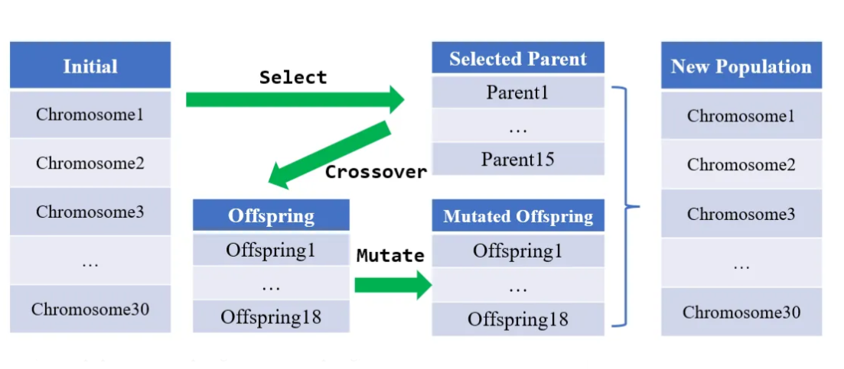
Notes:
最初從population中根據適應值大小挑選染色體成為父母(parent)，parent會隨機兩兩交配(crossover)產生後代(offspring)，offspring再進行突變(mutation)，此時挑選中的parent會與mutate後的offspring成為下一個代次新的population，因此菁英挑選策略最大優點是可以盡量維持住優秀染色體，不進行任何的突變，但也容易陷入局部最佳解

Slide 6



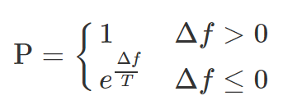
Improved Genetic Algorithm
Temperature parameter T:
control the iteration times of genetic algorithm
&& if terminate the iteration
Metropolis acceptance criteria:
If the fitness of the offspring is greater than that of the parent, the offspring is retained.
Otherwise, it is retained with a certain probability according to the metropolis acceptance criteria
Notes:
遺傳算法具有更強的全局搜索能力，但遺傳算法具有早熟收斂的特點。針對遺傳算法的這一缺陷，在其迭代過程中加入了溫度參數T和城市驗收準則。
採用metropolis接受準則可以保留一定概率的後代的較差解，從而在一定程度上避免遺傳算法的早熟收斂

Slide 7

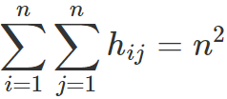
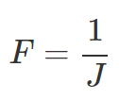

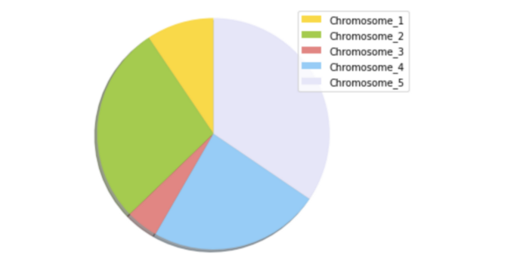
Step 1:Chromosome coding design.
Step 2:Initial population generation. Check strongly connected.
Step 3:Fitness function calculation.
Step 4:Choice. The initial population is selected by roulette.

Slide 8


Step 5:Cross. Two-point crossing method is adopted.
Step 6:Variation. The mutation probability is
Two positions are randomly selected in the individual chromosome coding. The genes at these two positions are reversed.
Step 7:Metropolis acceptance criteria.
Step 8:Niche elimination calculation.
The top N optimal individuals are selected to enter the next generation.
Step 9:Termination conditions.
Judge whether the current temperature T is less than

Slide 9
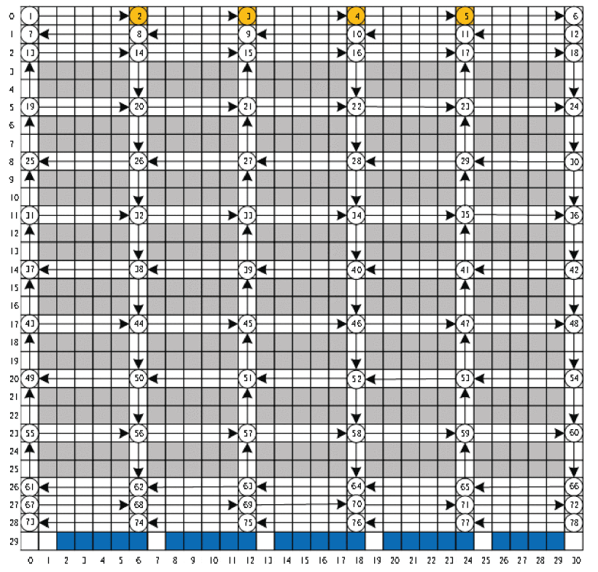
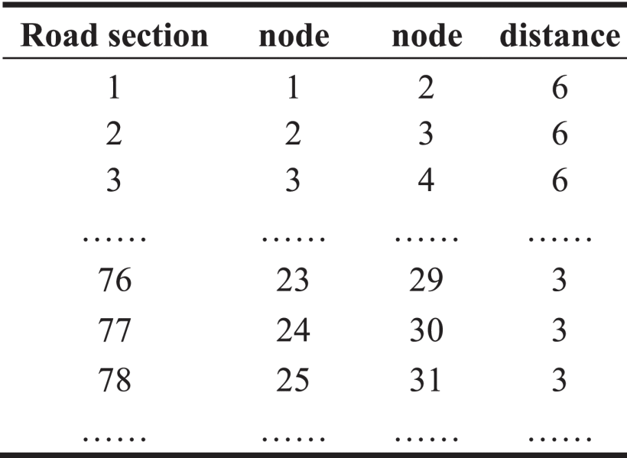
Simulation Analysis

Slide 10
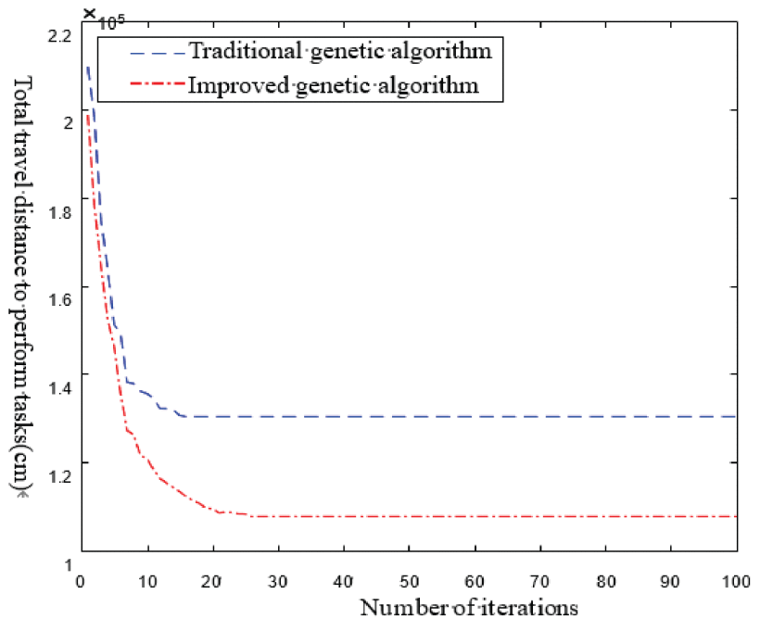
Under the scale of 1000 orders, the improved genetic algorithm reaches equilibrium at the 25th iteration, and the traditional genetic algorithm reaches equilibrium at the 16th iteration.

Slide 11
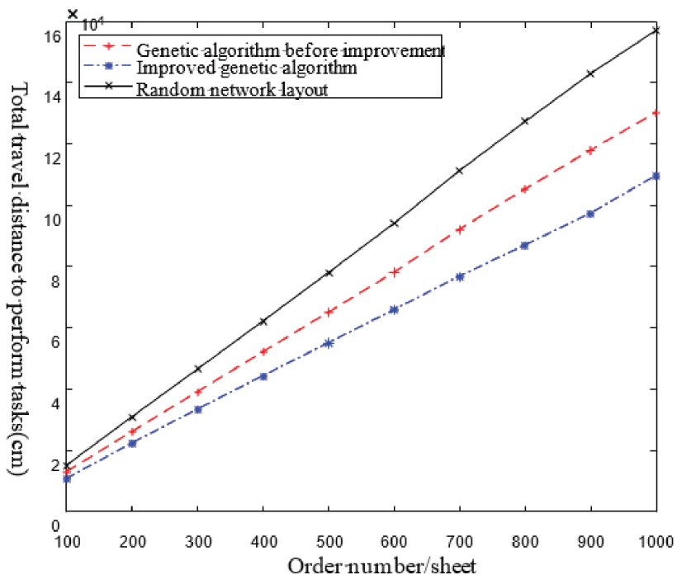
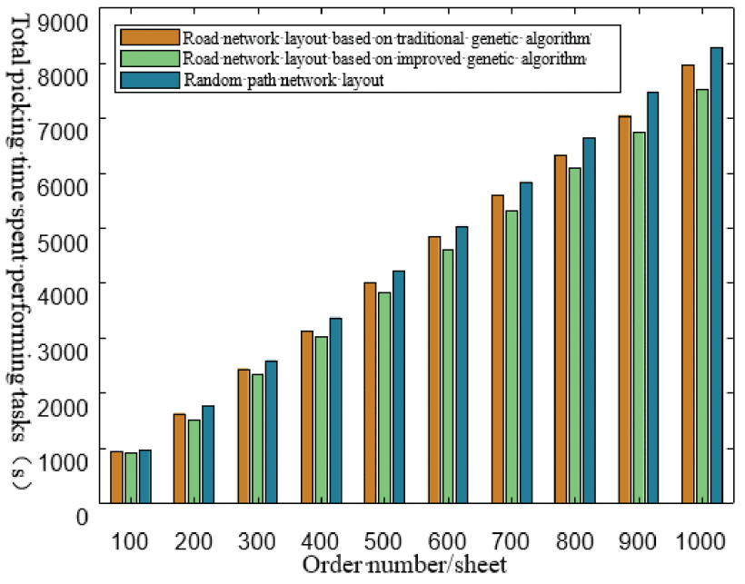
Notes:
物流機器人在基於改進遺傳算法的路網佈局中執行任務的總行駛距離和總揀選時間均小於其他路網佈局，因此本文提出的方法可以有效節省揀選時間，提高揀選效率.

Slide 12
Conclusion
Although the number of iterations of the improved genetic algorithm has increased in the running process, it can overcome the premature convergence characteristic of the traditional genetic algorithm, and has good optimization ability.
The total travel distance and total picking time of tasks performed by logistics robots in road network layout based on improved genetic algorithm is less than that in other road network layout Therefore, the method proposed in this paper can effectively save picking time and improve picking efficiency.
The calculation of the travel distance of logistics robots in this paper not considers the influence of dynamic factors on the travel distance in the real scenario.
Notes:
改進後的遺傳算法雖然在運行過程中迭代次數有所增加，但可以克服傳統遺傳算法早熟收斂的特點，具有良好的尋優能力。
隨著訂單數量的增加，物流機器人執行所有揀選任務的總行程距離和總揀選時間逐漸增加。但物流機器人在基於改進遺傳算法的路網佈局中執行任務的總行駛距離和總揀選時間均小於其他路網佈局，因此本文提出的方法可以有效節省揀選時間，提高揀選效率.
本文對物流機器人行走距離的計算沒有考慮實際場景中動態因素對行走距離的影響。例如物流機器人的損壞、物流機器人之間的相互影響、物流機器人搬運過程中的急停或故障等

