Slide 1
Order-Preserving Pattern Matching Indeterminate Strings
Luís M.S. Russo, Diogo Costa, Rui Henriques,
Hideo Bannai, Alexandre P. Francisco
Information and Computation, Volume 289, November 2022
Presenter: Wen-Wen Liao
Date: Mar. 7, 2023

Slide 2
Abstract
Given a pattern p of size m and a text t, the problem of order-preserving pattern matching (OPPM) is to find all substrings of t that satisfy one of the orderings defined by p. This problem has applications on time series analysis. However given its strict nature this model is unable to deal with indetermination, thus limiting its application to noisy time series. In this paper we introduce indeterminate characters to alleviate this limitation. We then propose two polynomial time algorithms. If the indetermination is limited to p confirming one occurrence can be computed in O(rm lg r) time, where r is a bound on the number of uncertain characters per position. If the indetermination alternates, but does not occur at the same position in t and p, we present an algorithm that requires O(rm(m + lg r)) time. We also show that the general problem is NP-hard and provide a polynomial size boolean formula.

Slide 3
Indeterminate Order Preserving Pattern Matching (μOPPM)
p = (1, 2|5, 3, 3)
t = (5, 0, 1, 2|1, 2, 5, 2|3, 3|4)
μOPPM
t[1..4] (p[0] < p[1] < p[2] = p[3]) => (0, 1, 2, 2)
t[4..7] (p[0] < p[2] = p[3] < p[1]) => (2, 5, 3, 3)

Slide 4
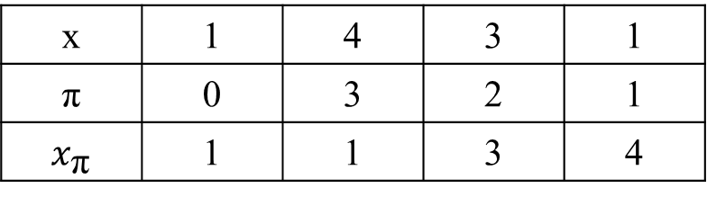
μOPPM with One Determinate String
x = (1, 4, 3, 1)
y = (2, 5, 4, 3)
y[0] < y[3] < y[2] < y[1]
x | 1 | 4 | 3 | 1
π | 0 | 3 | 2 | 1
$x_{\text{π}}$ | 1 | 1 | 3 | 4
x[0] = x[3] < x[2] < x[1]
≠

Slide 5
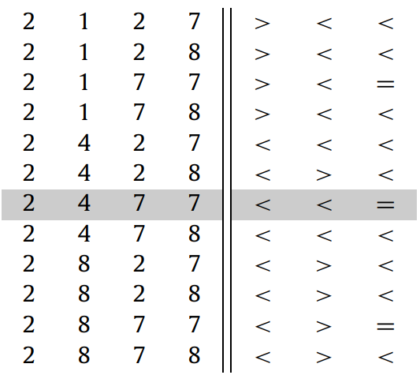

μOPPM with One Determinate String
x = (4, 1, 4, 2)
π = (1, 3, 0, 2)
$x_{\text{π}}$ = (1, 2, 4, 4)
order sequence for $x_{\text{π}}$ = (<, <, =)
y = (2|7, 2, 7|8, 1|4|8)
$y_{\text{π}}$ = (2, 1|4|8, 2|7, 7|8)
Notes:
xπ 的階序列僅包含等於或小於關係的關係。

Slide 6

μOPPM with One Determinate String
$y_{\text{π}}$ = (2, 1|4|8, 2|7, 7|8)
simplify the problem
${y^{′}}_{\text{π}}$[2] = $y_{\text{π}}$ [2] ∩ $y_{\text{π}}$ [3] = {2, 7} ∩ {7, 8} = {7}
${y^{′}}_{\text{π}}$ = (2, 1|4|8, 7)
=> find increasing sequence

Slide 7
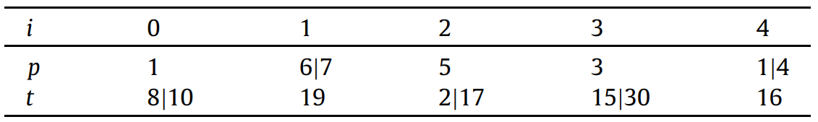

Alternate-μOPPM
size of both strings are $m$
both strings have indeterminate characters, but never in the same position

Slide 8
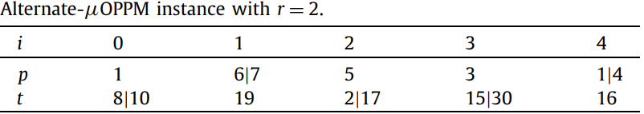
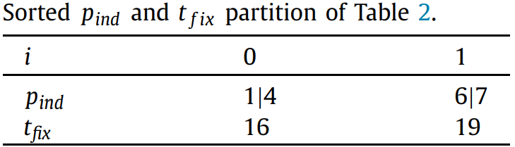
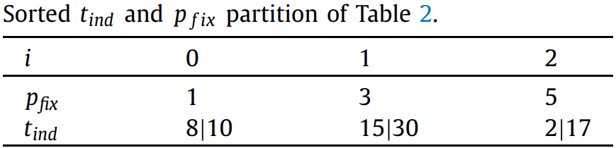
Alternate-μOPPM
Notes:
這裡也要先處理相等的情況

Slide 9

Alternate-μOPPM
$m_{p}$ = |$p_{ind}$|, $m_{t}$ = |$t_{ind}$|
table T = T[mp + 1, mt + 1, r, 2]
whether a match of length i + j exists, where the first i positions of $p_{ind}$ and the first j positions of $t_{ind}$ have been chosen

Slide 10




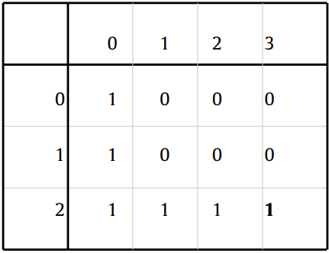
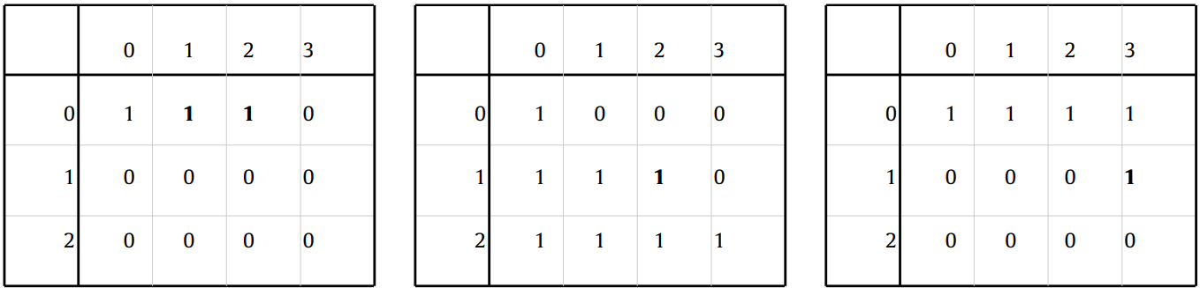
Alternate-μOPPM

Slide 11
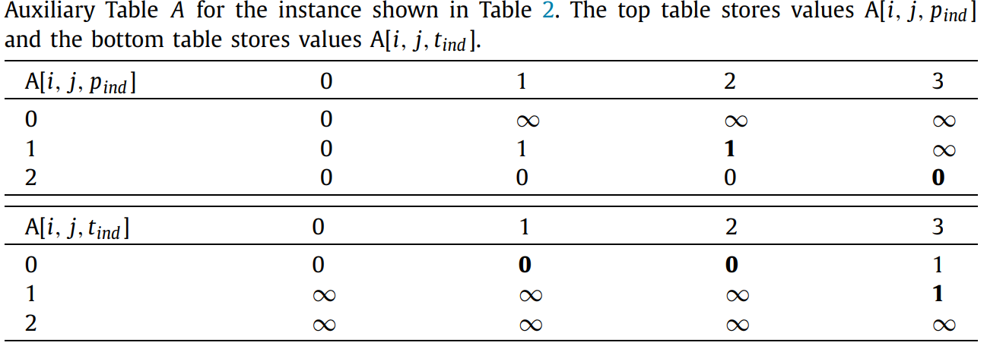
Alternate-μOPPM

Slide 12
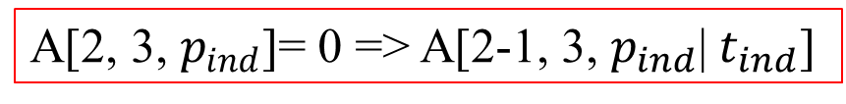
Alternate-μOPPM
A[2, 3, $p_{ind}$]= 0 => A[2-1, 3, $p_{ind}$| $t_{ind}$]

Slide 13
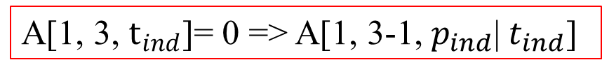
Alternate-μOPPM
A[1, 3, $t_{ind}$]= 0 => A[1, 3-1, $p_{ind}$| $t_{ind}$]

Slide 14
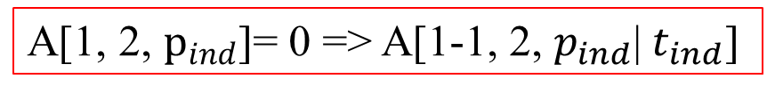
Alternate-μOPPM
A[1, 2, $p_{ind}$]= 0 => A[1-1, 2, $p_{ind}$| $t_{ind}$]

Slide 15
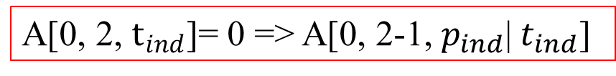
Alternate-μOPPM
A[0, 2, $t_{ind}$]= 0 => A[0, 2-1, $p_{ind}$| $t_{ind}$]

Slide 16

Alternate-μOPPM
A[0, 1, $t_{ind}$]= 0 => A[0, 1-1, $p_{ind}$| $t_{ind}$]

Slide 17
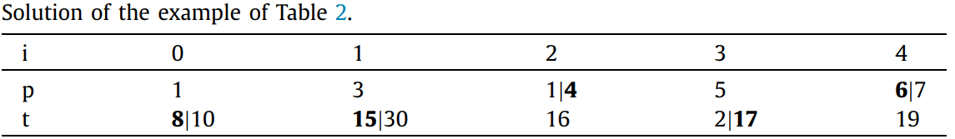
Alternate-μOPPM

Slide 18
Handling Larger Texts
use filtration techniques
x [i] = 1 if max(x[i]) < min(x[i + 1])
x [i] = 0 if min(x[i]) ≥ max(x[i + 1])
x [i] = ∗ otherwise
p = (6, 2|3, 5)
t = (3|4, 5, 6|8, 6|7, 3, 5, 4|6, 7|8, 4)
p | 6 | 2|3 | 5
p’ | 0 | 1
t | 3|4 | 5 | 6|8 | 6|7 | 3 | 5 | 4|6 | 7|8 | 4
t’ | 1 | 1 | * | 0 | 1 | * | 1 | 0

Slide 19
Handling Larger Texts
p = (6, 2|3, 5)
t = (3|4, 5, 6|8, 6|7, 3, 5, 4|6, 7|8, 4)
one true match t[3..5] = (6, 3, 5)
one spurious match t[5..7] = (5, 4, 7) or (5, 4, 8)
p | 6 | 2|3 | 5
p’ | 0 | 1
t | 3|4 | 5 | 6|8 | 6|7 | 3 | 5 | 4|6 | 7|8 | 4
t’ | 1 | 1 | * | 0 | 1 | * | 1 | 0

Slide 20

Conclusion
μOPPM with One Determinate String
Time complexity: $O(mr\lg{r})$
Space complexity: $O\left(mr\right)$
alternate-μOPPM
Time complexity: $O\left(rm(m+\lg{r)}\right)$
Space complexity: $O\left(m^{2}\right)$

Slide 21


