Slide 1
Hashiwokakero is NP-complete
Daniel Andersson,
Information Processing Letters 109, 2009, pp. 1145–1146
Presenter: Guan-Ting Chen
Date: Apr. 18, 2023

Slide 2
Abstract
In a Hashiwokakero puzzle, one must build bridges to connect a set of islands. We show that deciding the solvability of such puzzles is NP-complete.

Slide 3
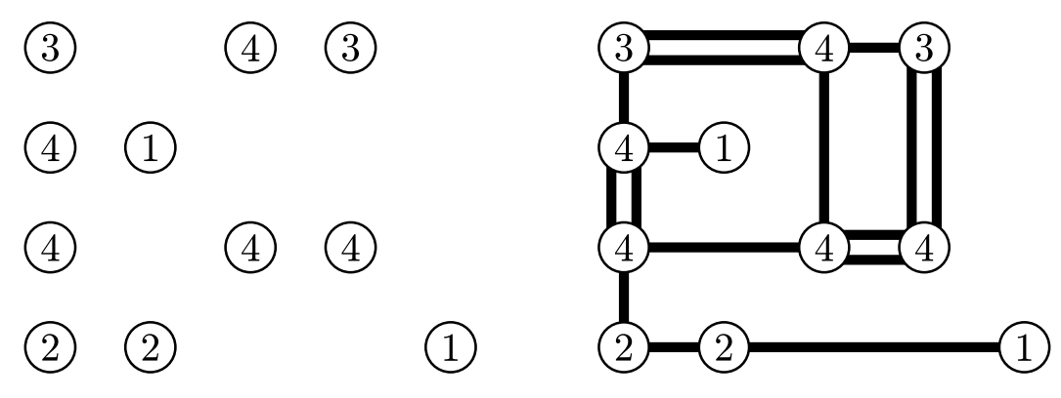
Hashiwokakero puzzle
圖上有許多標示數字的小島，數字代表了與之相連之橋的數量
橋必須直線相連，不能彎曲
橋不能交叉或重疊或跨過其他小島
橋必須連接兩個小島

Slide 4
Reduction (1 / 3)
NP-hard
NP-complete
Hamiltonian Circuit
Simple
Hashiwokakero Puzzle

Slide 5
Reduction (2 / 3)
P
1
1
1
4
4
1
D
C
1
4
4
1
* 2
A
B
1
1

Slide 6
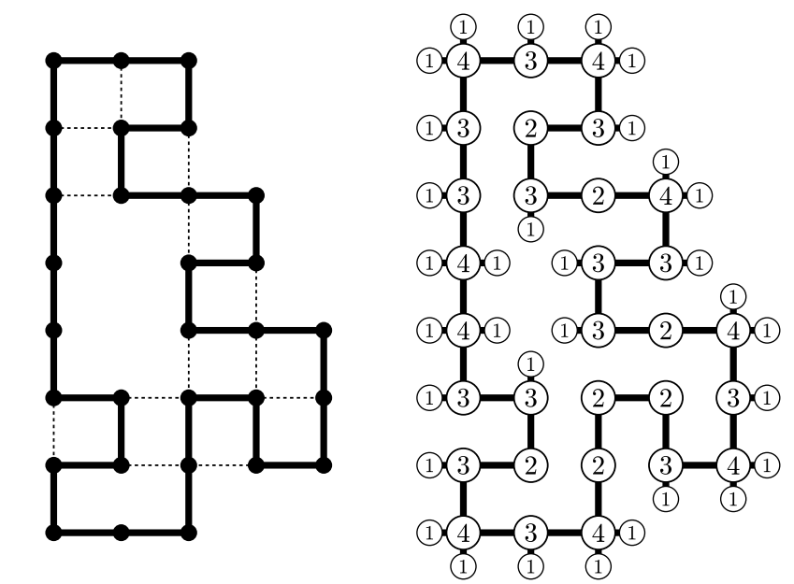
Reduction (3 / 3)

