Slide 1
Solving Hashiwokakero Puzzle Game with Hashi Solving Techniques and Depth First Search
Malik Reza F., Efendi R., Pratiwi Eriska A.
Bulletin of Electrical Engineering and Informatics, vol. 1, no. 1, pp. 61-68, 2012.
Presenter: Yun-An Chen
Date: Apr. 18, 2023

Slide 2
Abstract
Hashiwokakero is a logic puzzle game that sharpen the brain and very popular in Japan. This paper discusses on how to find a solution in the Hashi puzzle game using Hashi Solving techniques, such as Just Enough Neighbor, One Unsolved neighbor, Few Neighbors, Leftovers and Isolation. Hashi Solving techniques are used to find and build bridges that can definitely be built across the island, while Depth First Search (DFS) will search and build bridges that have not been found by Hashi Solving techniques. The results have shown that Hashi Solving Techniques and DFS able to solve every Hashi puzzle scenario.

Slide 3
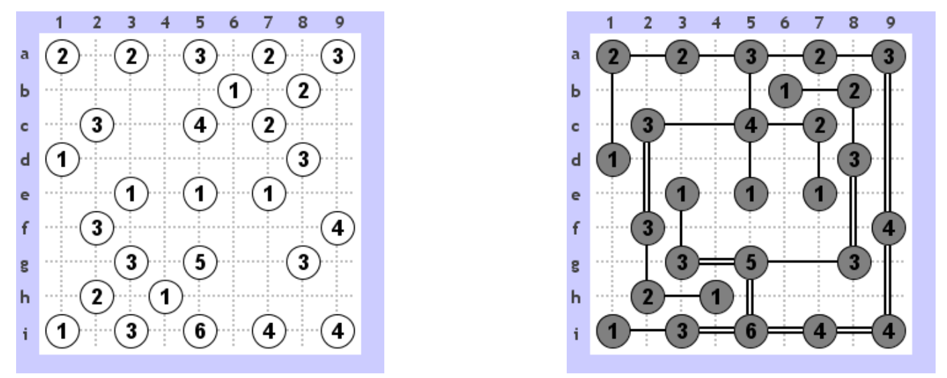
Hashiwokakero
One bridge can be connected to islands that located on the same x or y coordinate.
The bridge should not be overlapping with other bridges.
There may only have maximum 2 bridges between the same two islands.

Slide 4
Hashi Solving Techniques
Just Enough Neighbor Technique
One Unsolved Neighbor Technique
Few Neighbors Technique
Leftovers Technique
Isolation Technique

Slide 5
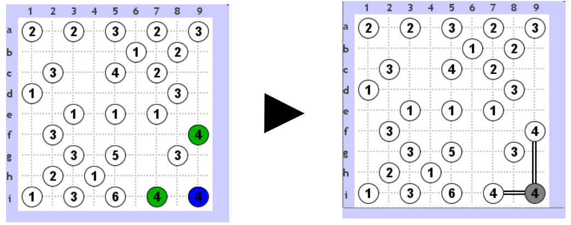
Hashi Solving Techniques
Just Enough Neighbor Technique

Slide 6
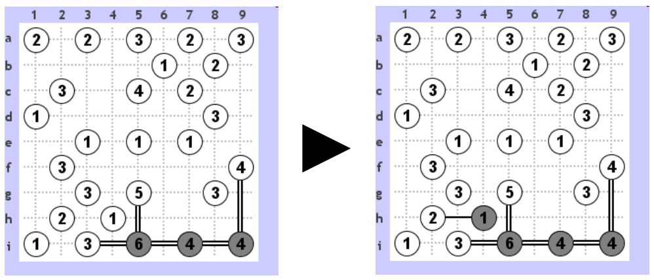
Hashi Solving Techniques
One Unsolved Neighbor Technique

Slide 7
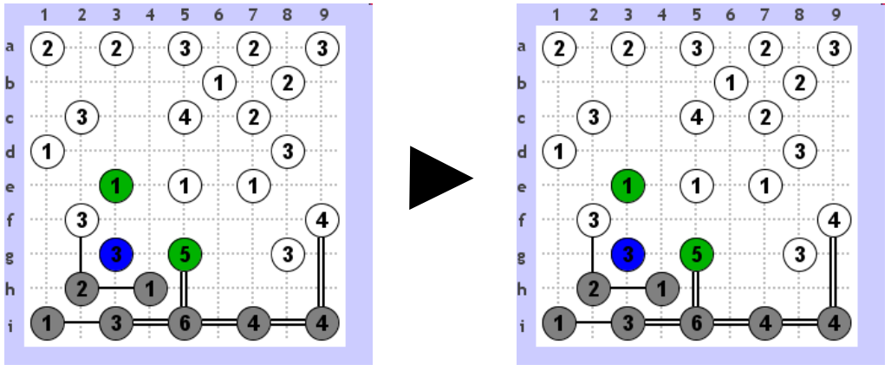
Hashi Solving Techniques
Few Neighbors Technique

Slide 8
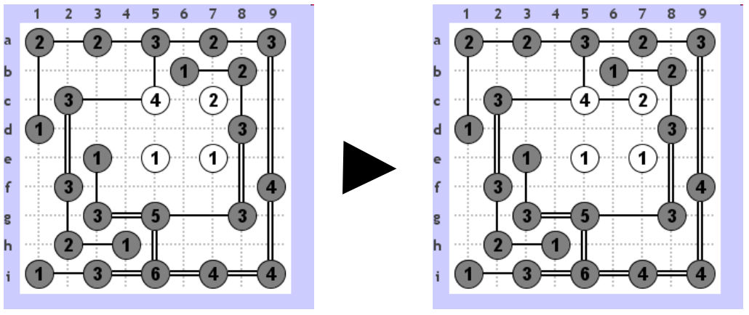
Hashi Solving Techniques
Leftovers Technique

Slide 9
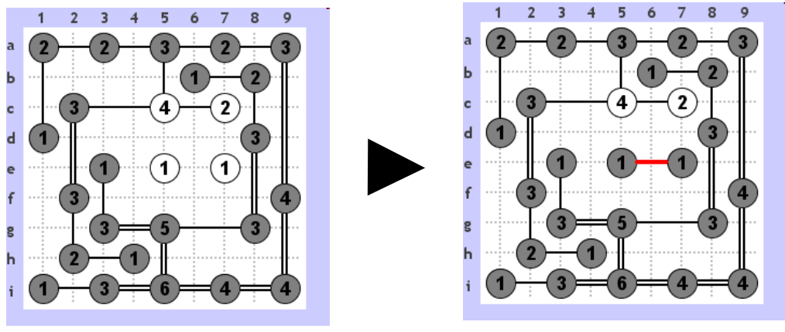
Hashi Solving Techniques
Isolation Technique

Slide 10
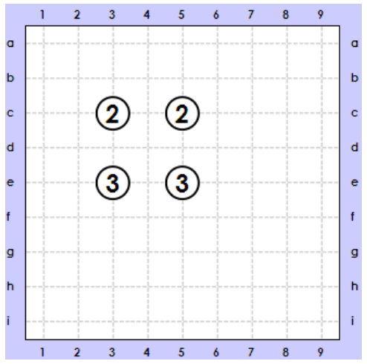
Depth First Search
C3
(2)
Right = 2
Down = 0
C5
(2)
C5
(2)
Right = 1
Down = 1
No bridges can be built
E5
(3)
Right = 0
Down = 1
E3
(3)
Left = 2
Down = 0
No bridges can be built
All islands are fully connected

Slide 11
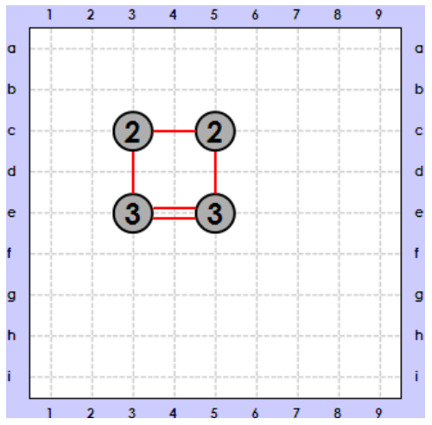
Depth First Search
C3
(2)
Right = 2
Down = 0
C5
(2)
C5
(2)
Right = 1
Down = 1
No bridges can be built
E5
(3)
Right = 0
Down = 1
E3
(3)
Left = 2
Down = 0
No bridges can be built
All islands are fully connected

Slide 12
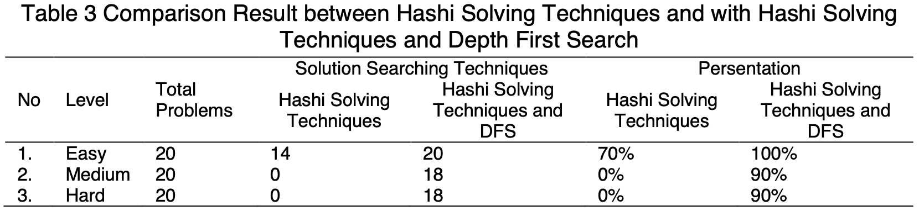
Analysis and Result
Solution Searching by using Hashi Solving Techniques and using Hashi Solving Techniques and Depth First Search

