Slide 1
Order preserving pattern matching revisited
Md. Mahbubul Hasan, A.S.M. Shohidull Islam Mohammad Saifur Rahman, M. Sohel Rahman Pattern Recognition Letters 55 (2015) 15–21 Presenter：Kuan-Lin Lai Date：2018/09/26

Slide 2
Abstract
In this paper, we study the order preserving pattern matching (OPPM) problem, which is a very recent variant of the classic pattern matching problem. We revisit this variant, present a new interesting pattern matching algorithm and for the first time consider string regularities from this new perspective.

Slide 3
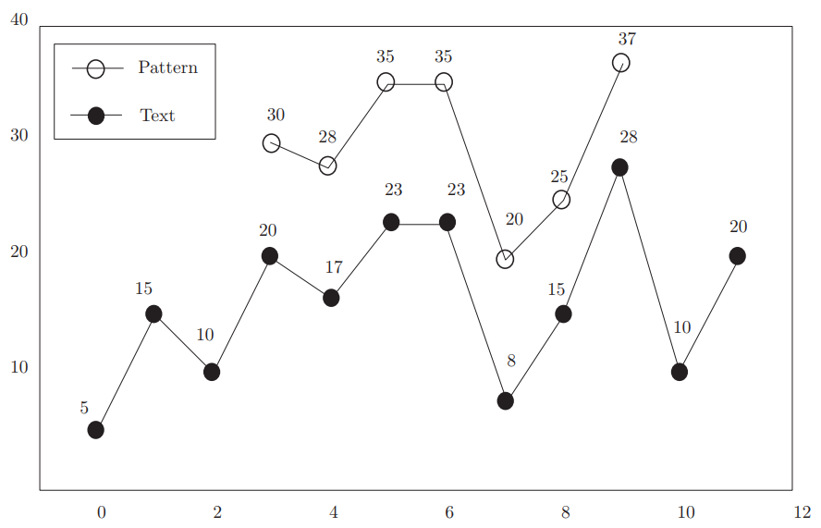
Text T= 5,15,10,20,17,23,23,8,15,28,10,20 Pattern P=30,28,35,35,20,25,37

Slide 4
Preliminaries
If a string S = (S[1], S[2],..., S[n]) The rank of a number c in a string S is defined as follows：
rank_{S}(c) = 1 + |{i | S[i] < c, 1 ≤ i ≤ |S|}|
The order preserving representation (OPR) of a string S：
σ (S) = rank_{S}(S[1]), rank_{S}(S[2]),..., rank_{S}(S[|S|]).
EX： S = 30,28,35,35,20,25,37
σ (S) = 4 3 5 5 1 2 7

Slide 5

Modified Z-function
The Z-function, Z_{i}(S) is the length of the longest substring of S that starts at position i and matches a prefix of S
Given a string S, the modified Z-function Z_{i}(S), 1 ≤ i ≤ |S| is the length of the longest prefix P of suffix_{i}(S)such that σ (P) = σ (S[1, |P|]). EX： S = ( 11, 18, 24, 20, 25, 29 )
Z(S) = 6 2 1 3 2 1

Slide 6
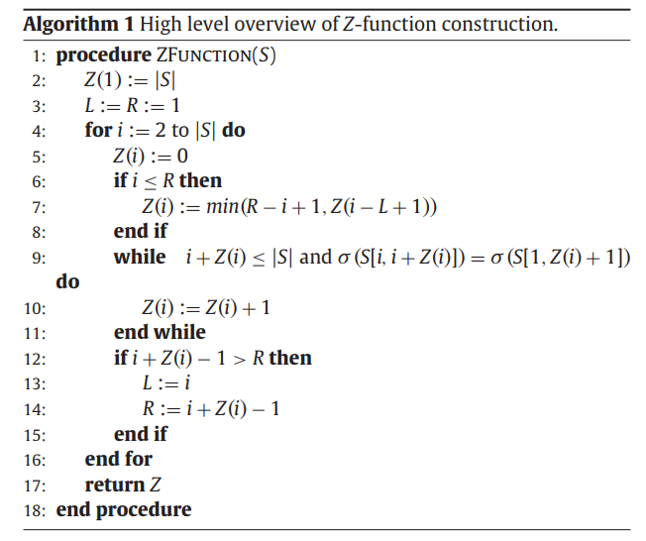
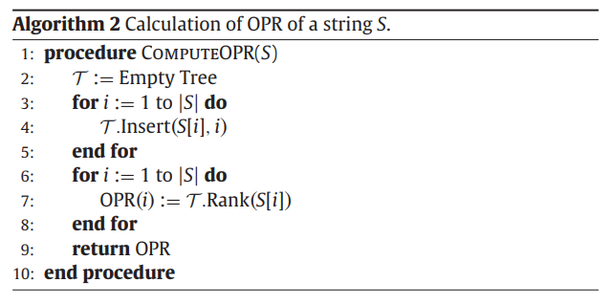
Z-function construction

Slide 7
Z-function construction：min( R-i+1, Z(i-L+1) )
Example 1
Example 2
L = 1 2 2 4 4
R = 1 3 3 6 6
S = ( 11 18 24 20 25 29 )
Z(S) = 6 2 1 3 2 1 If σ (S[L,R]) = σ (S[1, R-L+1]) => σ (S[i,R]) = σ (S[i-L+1, R-L+1])
L = 1 2 3 3 3 R = 1 2 6 6 6 S = ( 5, 15, 10, 20, 17, 23 ) Z(S) = 6 1 4 1 2 1

Slide 8
Correctness of this algorithm
Lemma1： Let S and T be two strings such that σ (S) = σ (T). Now assume that s and t are any numbers. Then we must also have σ (Ss) = σ (Tt).
Lemma2： Let S and T are two strings such that |S| = |T| and σ (S) = σ (T). Now let U and V are any two strings. Then σ (SU) = σ (TV).

Slide 9
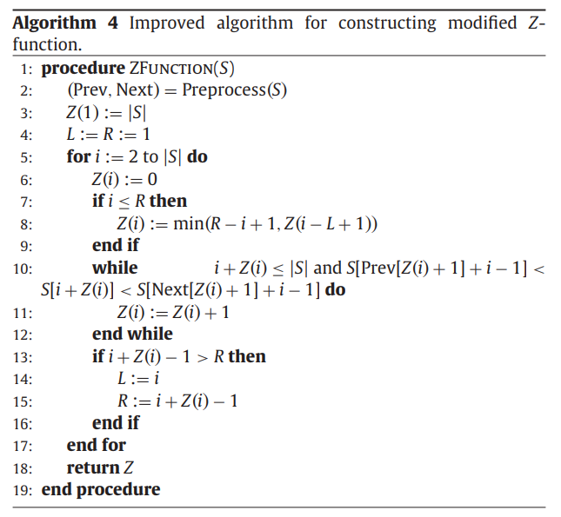
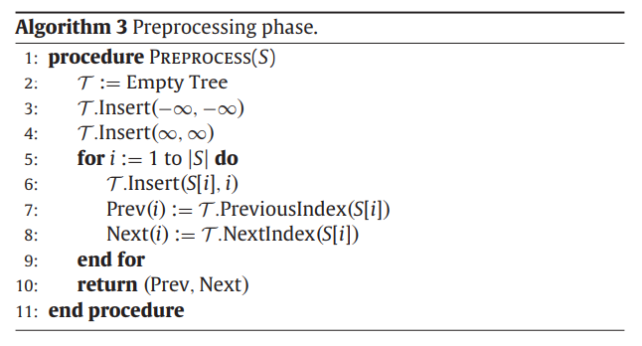
Improve Z-function construction

Slide 10
Preprocess
Prev(i) is the unique j such that j < i and S[j] is the largest value that is less than S[i].
Next(i) is the unique j such that j < i and S[j] is the smallest value that is greater than S[i] EX： S = ( 11 18 24 20 25 29 )
Prev −∞ 1 2 2 3 5 Next ∞ ∞ ∞ 3 ∞ ∞

Slide 11
Improve Z-function construction：
S[Prev[Z(i)+ 1] + i − 1] < S[i + Z(i)] < S[Next[Z(i)+ 1] + i − 1]
L = 1 2 2 4 4
R = 1 3 3 6 6
S = ( 11 18 24 20 25 29 ) Prev −∞ 1 2 2 3 5 Next ∞ ∞ ∞ 3 ∞ ∞ Z(S) = 6 2 1 3 2 1

Slide 12
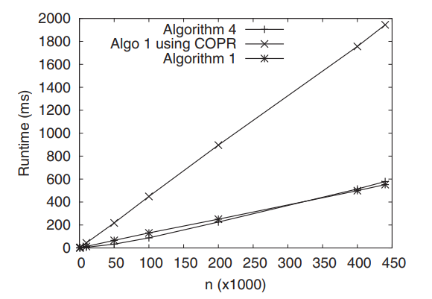
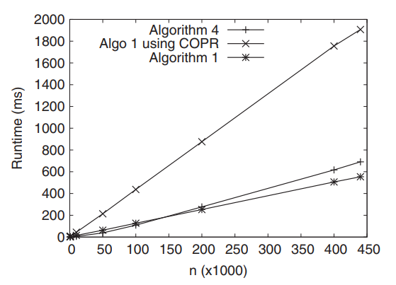
Experiments
Semi-synthetic data
Fully synthetic data

Slide 13
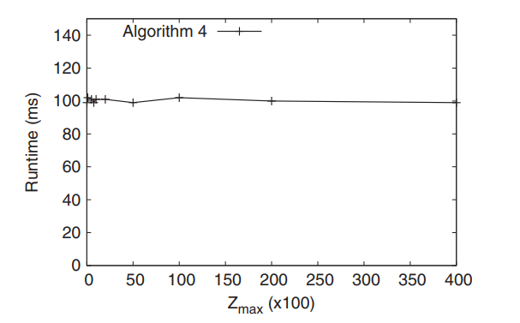
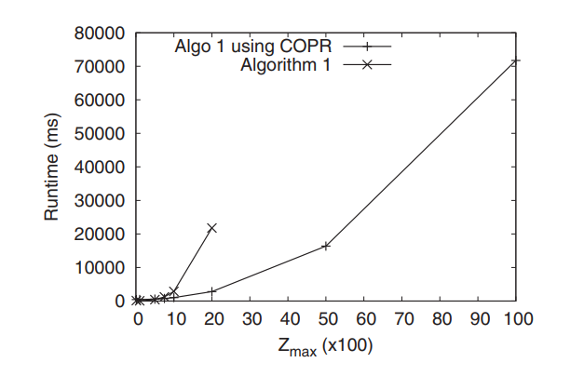
Experiments(conti.)

Slide 14
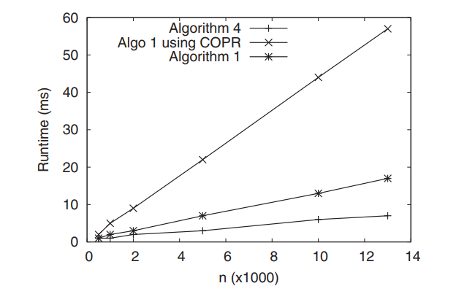
Experiments(conti.)

Slide 15
Data & Code：http://goo.gl/4L5WJA

