Slide 1
Optimisation of pipeline route in the presence of obstacles based on a least cost path algorithm and laplacian smoothing
Ju Young Kang , Byung Suk Lee
International Journal of Naval Architecture and Ocean Engineering 9 (2017) 492-498
Speaker: Feng-Yang Tsai
Date: 2018.09.26
Notes:
https://www.google.com.tw/maps/place/%E6%96%AF%E7%89%B9%E6%8B%89%E6%96%AF%E5%85%8B%E8%90%8A%E5%BE%B7%E5%A4%A7%E5%AD%B8/@55.9604939,-5.243658,8z/data=!4m5!3m4!1s0x4888441df658a4b5:0x60143d33c0e3adbe!8m2!3d55.8621213!4d-4.2422837
https://www.google.com.tw/maps/place/%E9%87%9C%E5%B1%B1%E5%A4%A7%E5%AD%B8/@35.2324603,129.0644651,14z/data=!4m5!3m4!1s0x0:0x43d6042e21f10697!8m2!3d35.2331576!4d129.07951

Slide 2
Abstract(1/2)
Subsea pipeline route design is a crucial task for the offshore oil and gas industry, and the route selected can signiﬁcantly affect the success or failure of an offshore project. Thus, it is essential to design pipeline routes to be eco-friendly, economical and safe. Obstacle avoidance is one of the main problems that affect pipeline route selection. In this study, we propose a technique for designing an automatic obstacle avoidance. The Laplacian smoothing algorithm was used to make automatically generated

Slide 3
Abstract(2/2)
pipeline routes fairer. The algorithms were fast and the method was shown to be effective and easy to use in a simple set of case studies.

Slide 4
Pipelines are essential for oil and gas projects.
It is essential, therefore, that their design should be cost-effective whilst meeting their operational requirements.
Design parameters:
Route selection
Pipesizing
Material
Coating
Wall thickness
Free span
Cathodic protection

Slide 5
Factors affecting design:
ﬂow rate
ﬂuid properties
Seabed terrain
on-bottom stability
thermal expansion.
Det Norske Veritas(DNV) Offshore Standard and Rec-
ommended Practice
Most of these tasks can be computerized, but pipeline route selection still requires much human intervention due to difﬁculties in automation.
Notes:
https://www.google.com.tw/maps/place/%E6%8C%AA%E5%A8%81%E5%A5%A7%E6%96%AF%E9%99%B8/@59.8948518,10.6353454,11z/data=!4m5!3m4!1s0x46416e61f267f039:0x7e92605fd3231e9a!8m2!3d59.9139019!4d10.752182
挪威商立恩威驗證股份有限公司( DET NORSKE VERITAS，簡稱DNV)創立於1864年，總部位於挪威奧斯陸，
1.船舶、機械、機械電氣設備檢驗 2.海上探油平台、海陸油管檢驗 3.技術顧問諮詢服務
目前全球共有8,000多名員工，超過300個分支機構分布於全球100多個國家中。目前台灣分公司在台北及高雄各設有辦公室。

Slide 6
Matori, A.N., Lee, H.Y., 2009. Suitability Analysis of Subsea Pipeline Route Using GIS. Map Malaysia. GIS Development. based on the commercial program ArcGIS 3.2.
Automatic pipeline route design with efﬁcient obstacle avoidance algorithms.
Least Cost Path (LCP) algorithm
Dijkstra ' s Algorithm
A* Algorithm

Slide 7
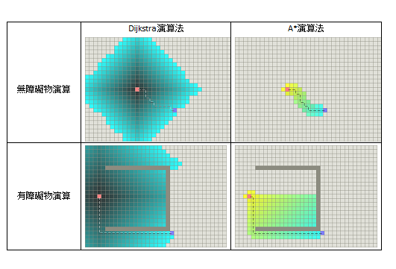
Fig. 1.(圖片取自 Amit's Thoughts on Path-Finding and A-Star)

Slide 8
Most digital display systems project images using ﬁxedpicture-element (pixel) arrays, and the pixels are normally arranged in a 2D grid for convenience.
GIS relies on digital displays, and therefore grid-based path ﬁnding algorithms will often be more advantageous for offshore pipeline route design than the graph-based algorithm.
However, the graph structure can easily be extended to a grid type byconsidering each pixel as a node. The whole terrain can therefore be discretized as an array of nodes.

Slide 9
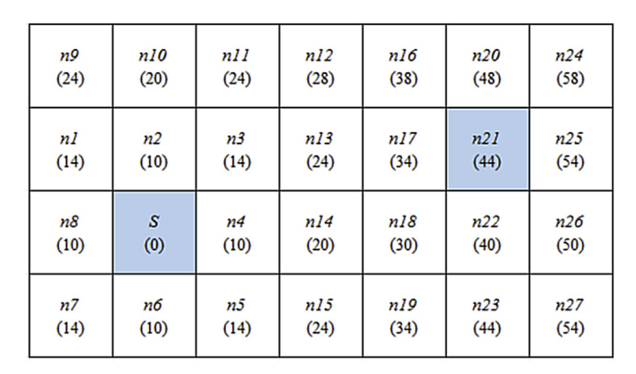
(S / n3 / n13 / n17 / n21), (S / n4 /n13 / n17 / n21), (S / n4 / n14 / n17 / n21) ,
(S / n4 / n14 / n18 / n21) total cost is equally 44.
Fig. 2. An example grid of nodes showing the calculation of the shortest path
using Dijkstra ' s Algorithm.

Slide 10
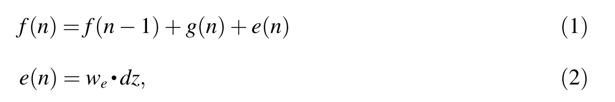
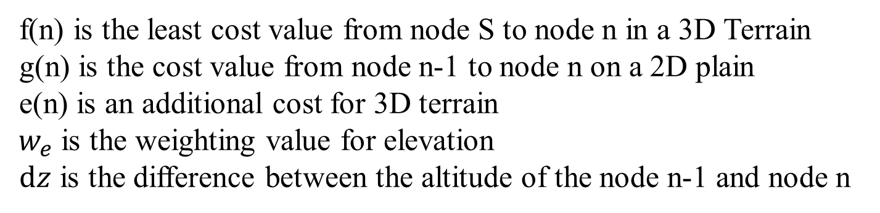
To apply the LCP algorithm to a 3D terrain, the vertical levels of the nodes should be taken into consideration in determining the movement cost.
Eq.
Eq.
f(n) is the least cost value from node S to node n in a 3D Terrain
g(n) is the cost value from node n-1 to node n on a 2D plain
e(n) is an additional cost for 3D terrain
$w_{e}$ is the weighting value for elevation
$ⅆz$ is the difference between the altitude of the node n-1 and node n

Slide 11
There are three ways to avoid obstacles in the LCP algorithm:
1.removing nodes
2.removing edges
3.imposing a very high weighting to the appropriateedges.
In first approach the nodes assigned as obstacles are not considered at all, thereby reducing the calculation time.
For this reason, the method of node removal was used for obstacle avoidance in this study.

Slide 12
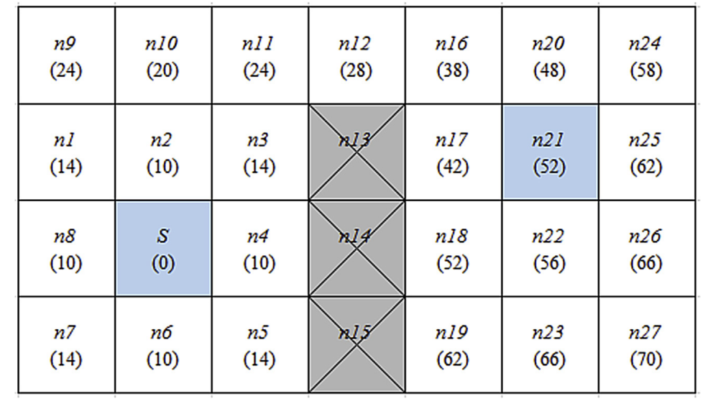
The obstacles are placed on n13, n14, and n15. There are two optimal paths from S to n21:
(S / n3 / n12 / n16 / n21)
(S / n3 / n12 / n17 /n21),
and the actual cost of these paths is 52.
Fig. 3. An example of a grid-based terrain with obstacles.

Slide 13
Smoothing algorithm
minimum allowed bend radius
because the bend radius of the pipeline must not be less than this value throughout its entire length tovensure that the stresses in the pipe wall do not exceed the allowable limits usually speciﬁed by the design codes.

Slide 14
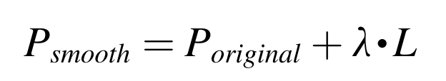
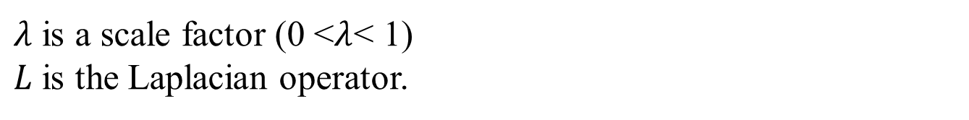
The Laplacian smoothing is an iterative algorithm, This algorithm replaces the original vertex on the initial path with a new one determined by a weighted average of neighbouring points in an iterative manner.
Eq.(3)
$λ$ is a scale factor (0 <$λ$< 1)
$L$is the Laplacian operator.

Slide 15
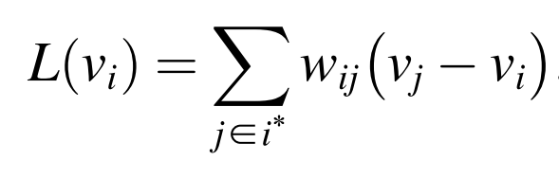
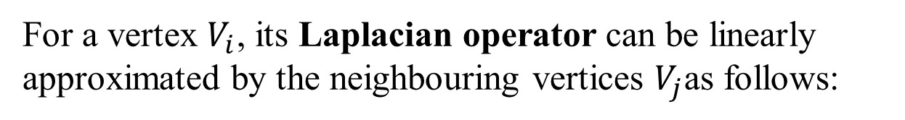
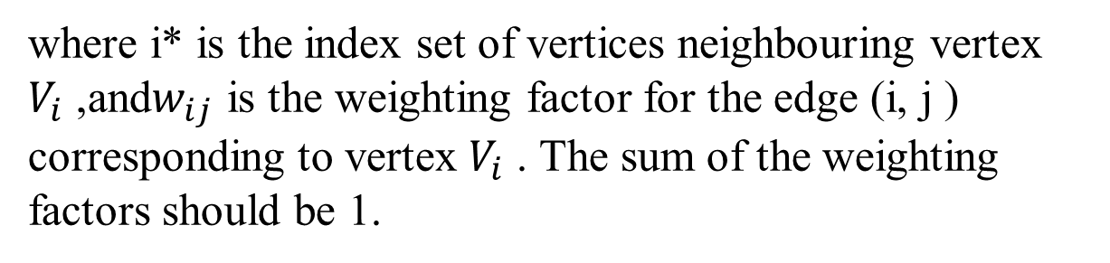
For a vertex $V_{i}$, its Laplacian operator can be linearly approximated by the neighbouring vertices $V_{j}$as follows:
Eq.(4)
where i* is the index set of vertices neighbouring vertex $V_{i}$ ,and$w_{ij}$ is the weighting factor for the edge (i, j ) corresponding to vertex $V_{i}$ . The sum of the weighting factors should be 1.

Slide 16
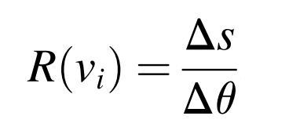
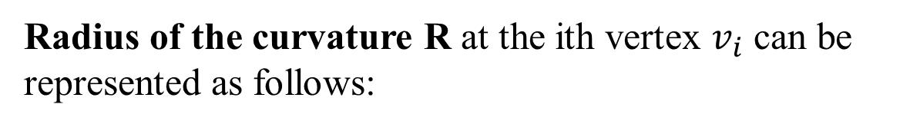
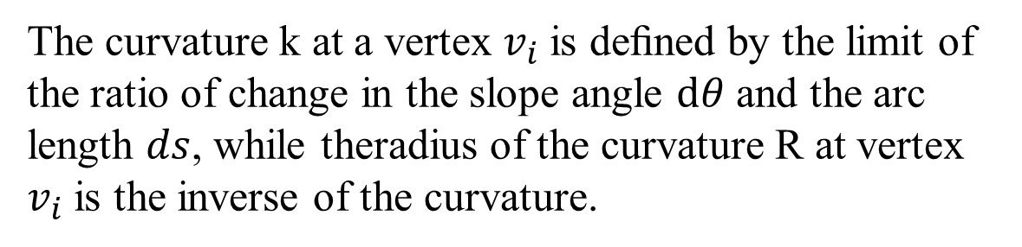
The Laplacian smoothing algorithm can be controlled directly and the curvature of the pipeline can always be checked to ensure that the path is ‘fair ’ .
The curvature k at a vertex $v_{i}$is deﬁned by the limit of the ratio of change in the slope angle $ⅆθ$ and the arc length $ds$, while theradius of the curvature R at vertex $v_{i}$is the inverse of the curvature.
Radius of the curvature R at the ith vertex $v_{i}$ can be represented as follows:
Eq.(5)

Slide 17
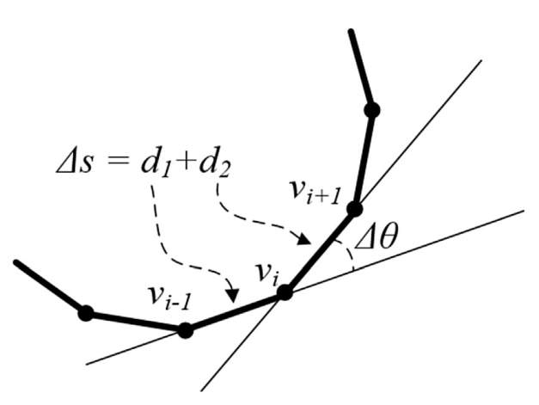
Fig. 4. Curvature calculation for a polyline.

Slide 18
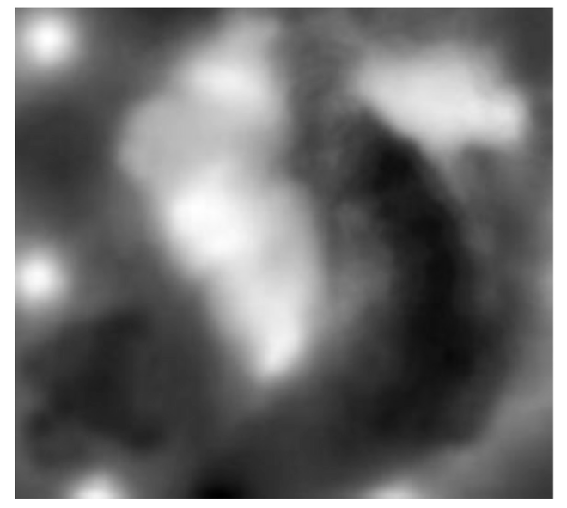
Fig. 5. Open Graphics Library (OpenGL) application programming interface

Slide 19
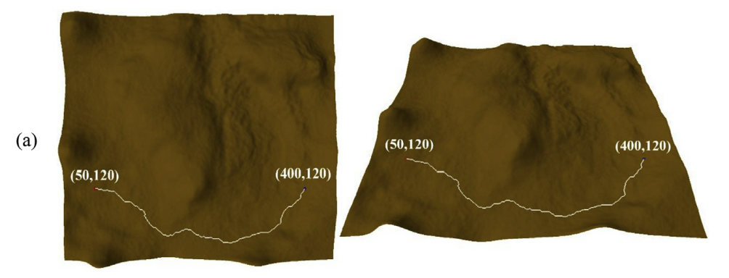
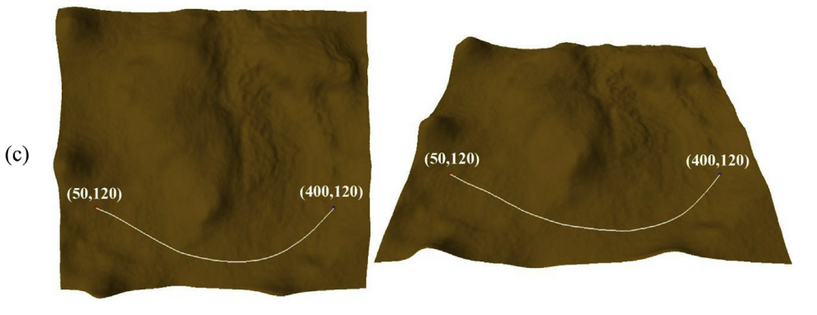
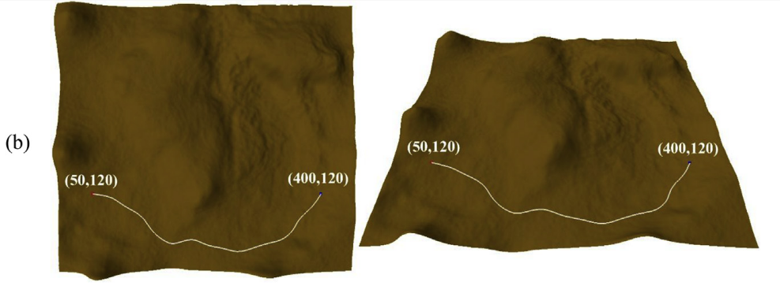
Fig. 6. (a) Raw unsmoothed LCP (1.025 km);
(b) smoothed to 30 km bend radius;
(c) smoothed to 90 km bend radius.

Slide 20
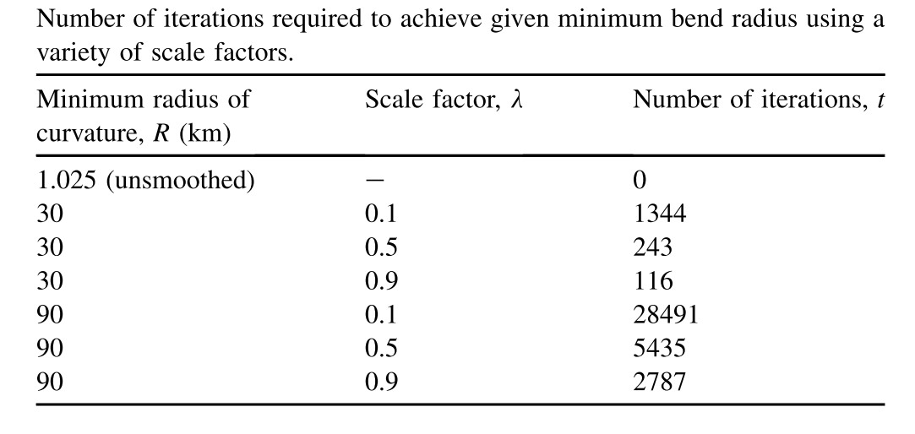
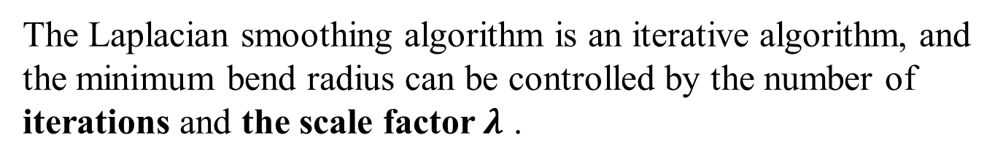
Tabel 1
The Laplacian smoothing algorithm is an iterative algorithm, and the minimum bend radius can be controlled by the number of iterations and the scale factor$λ$ .

Slide 21
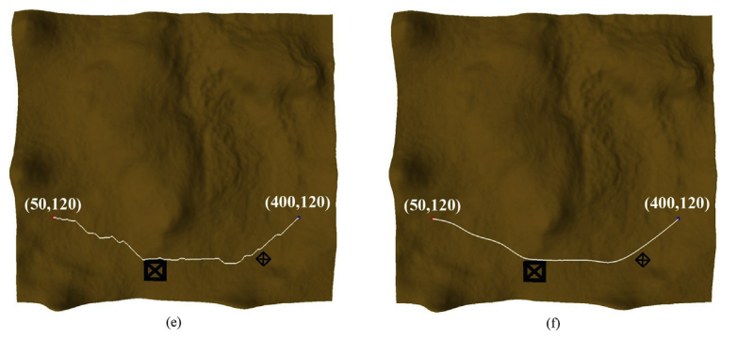
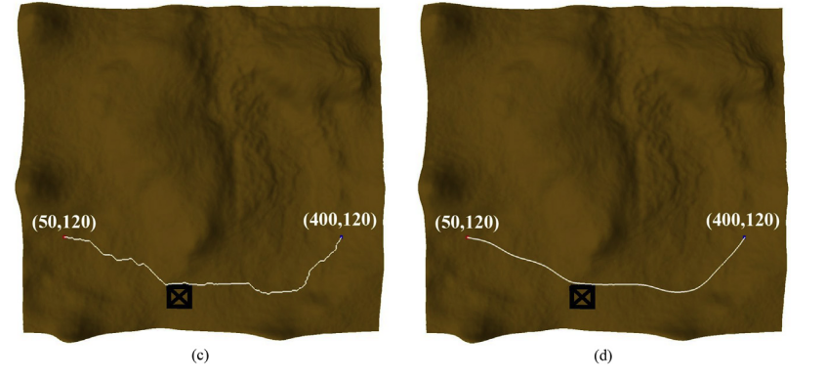
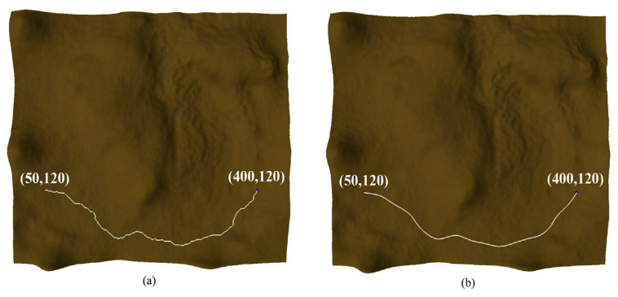
Fig. 7. LCPs obtained in a variety of scenarios:
(a) no obstacle, unsmoothed;
(b) no obstacle, minimum bend radius = 30 km
(c) one obstacle, unsmoothed; (d) one obstacle, 30 km;
(e) two obstacles, unsmoothed; (f) two obstacles, 30 km.

