Slide 1
Accurate and Fast Dynamic Time Warping Approximation Using Upper Bounds
Bilel Ben Ali, Youssef Masmoudi, and Souhail Dhouib
Proceedings of 38th International Conference on Telecommunications and Signal Processing (TSP), 2015, Pages 1 – 6, Prague, Czech
Speaker: Jheng-Yan Lyu
Date: 2018.10.03

Slide 2
Abstract (1/2)
The purpose of Dynamic Time Warping (DTW) is to determine the shortest warp path, corresponding to the optimal alignment between two sequences. It is one of the most used methods for time series distance measure. DTW was introduced to the community as a Data Mining utility for various tasks for time series problems such as classification and clustering. Many variants of DTW aim to accelerate the calculation of this distance and others order to overcome the weakness points of DTW as the singularity problem. We propose a new approach called Dynamic Warping Window (DWW) for speeding up DTW algorithm based on upper bound.

Slide 3
Abstract (2/2)
It gives an accurate approximation of DTW in linear time. It accelerates the calculation of DTW distance. Results show that the new approach provides a good compromise between accuracy of DTW approximation and the non-degradation of KNN classification results.

Slide 4
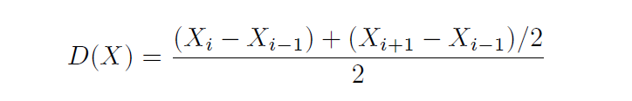
DERIVATIVE DYNAMIC TIME WARPING(DDTW)
To avoid the problem of singularity caused by DTW alignment. DDTW minimizes the number of duplicate points.

Slide 5
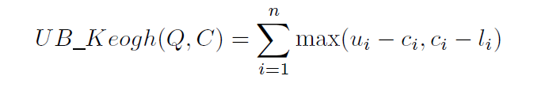
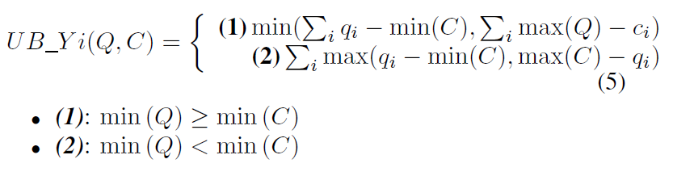
DYNAMIC WARPING WINDOW(DWW)
UB Keogh upper bound:
UB Yi upper bound:

Slide 6
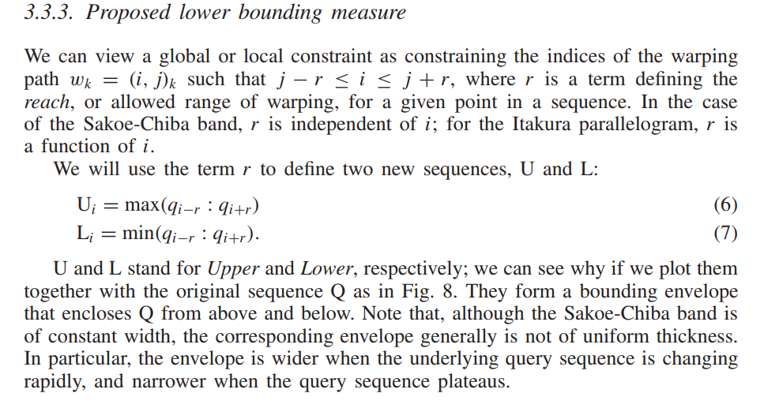
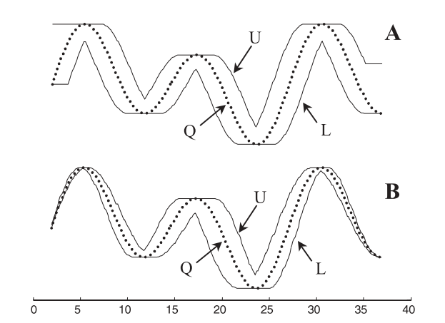
Upper Bound Measure
s

Slide 7
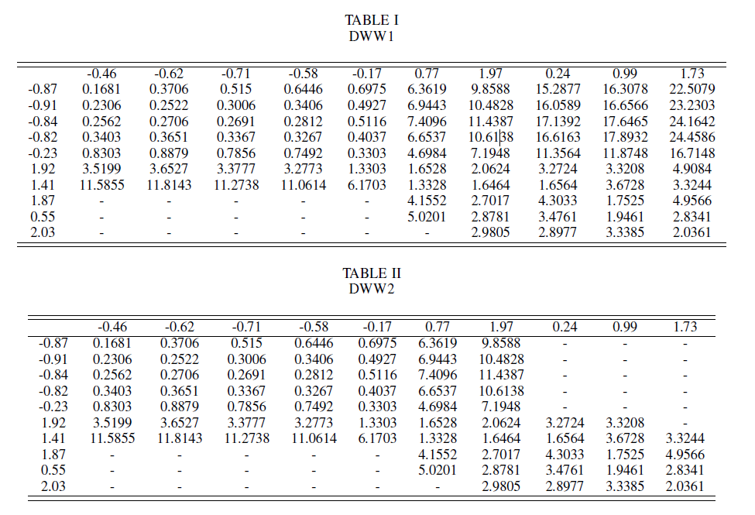
DYNAMIC WARPING WINDOW(DWW)
sad

Slide 8
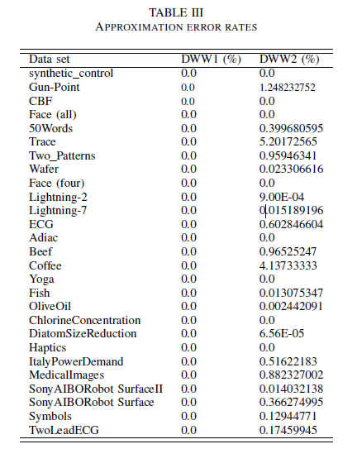

EXPERIMENTAL RESULTS
Dynamic Warping Window accuracy

Slide 9
CPU time computation using KNN classification

Slide 10
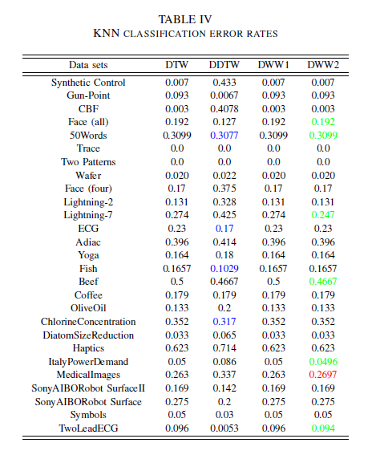
EXPERIMENTAL RESULTS

