Slide 1
Ensemble learning of rule-based evolutionary algorithm using multi-layer perceptron for supporting decisions in stock trading problems
Shingo Mabu, Masanao Obayashi, Takashi Kuremoto
Applied Soft Computing 36 (2015) 357–367
Presenter: Cheng-Han Wu
Date:2018/10/3

Slide 2
Abstract(1/2)
Classification is a major research field in pattern recognition and many methods have been proposed to enhance the generalization ability of classification. Ensemble learning is one of the methods which enhance the classification ability by creating several classifiers and making decisions by combining their classification results. On the other hand, when we consider stock trading problems, trends of the markets are very important to decide to buy and sell stocks. In this case, the combinations of trading rules that can adapt to various kinds of trends are effective to judge the good timing of buying and selling.

Slide 3
Abstract(2/2)
Therefore, in this paper, to enhance the performance of the stock trading system, ensemble learning mechanism of rule-based evolutionary algorithm using multi-layer perceptron (MLP) is proposed, where several rule pools for stock trading are created by rule-based evolutionary algorithm, and effective rule pools are adaptively selected by MLP and the selected rule pools cooperatively make decisions of stock trading. In the simulations, it is clarified that the proposed method shows higher profits or lower losses than the method without ensemble learning and buy & hold.

Slide 4
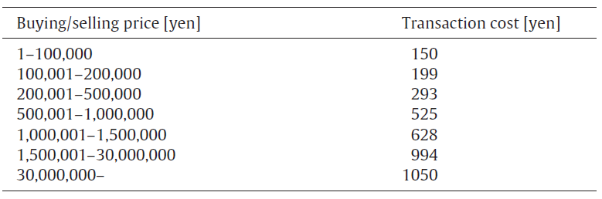
Simulation periods
Period 1:
Training: Jan. 4, 2007–Dec. 30, 2008
Testing: Jan. 4, 2010–Dec. 30, 2010
Period 2:
Training: Jan. 4, 2008–Dec. 30, 2010
Testing: Jan. 4, 2011–Dec. 30, 2011

Slide 5
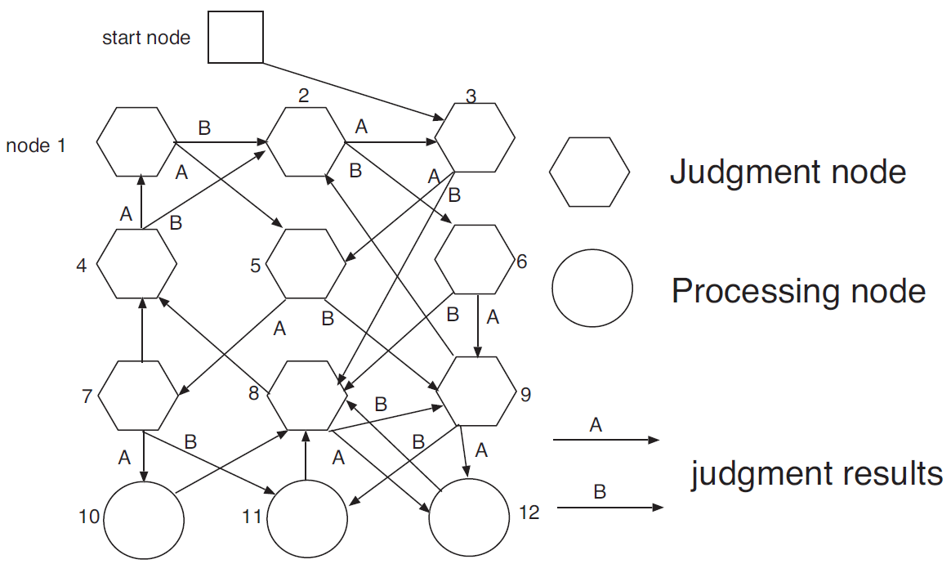
Genetic network programming (GNP)

Slide 6
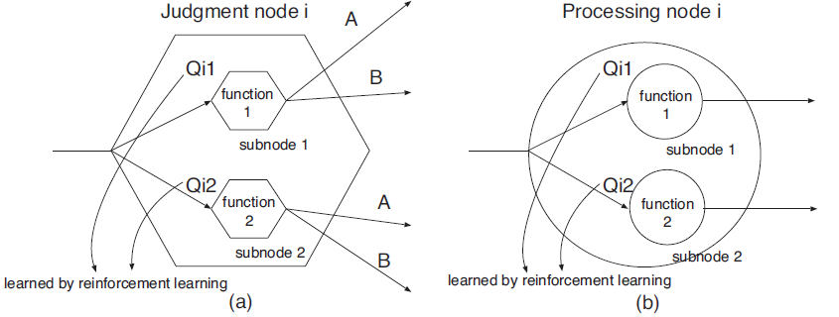

GNP-RF
$$Q_{ip}←Q_{ip}+α(r+γQ_{jq}−Q_{ip})$$
$$α∈\left(0,1.0\right],γ∈[0,1.0]$$

Slide 7
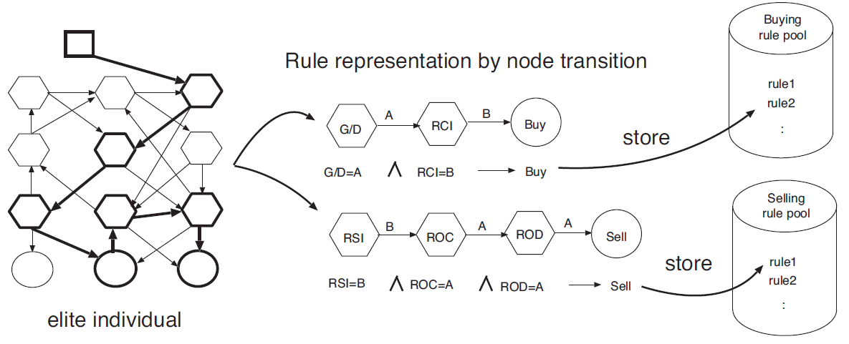

Rule pool generation (1/2)
$$If X_{1}=A and X_{2}=B and X_{3}=C, then Y=D$$

Slide 8
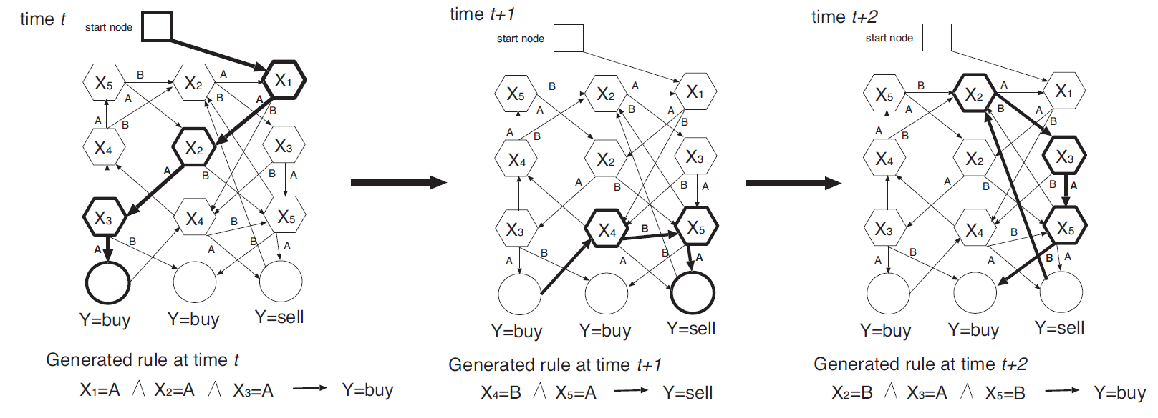
Rule pool generation (2/2)

Slide 9
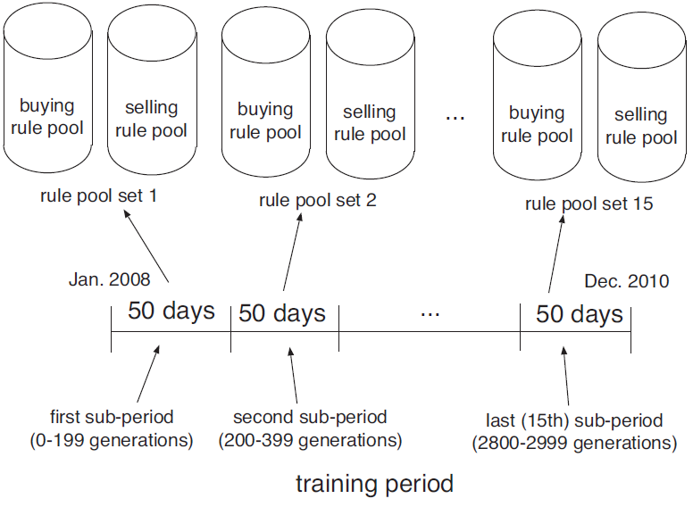
Rule pool extract
2008-2010 in Tokyo stock exchange

Slide 10
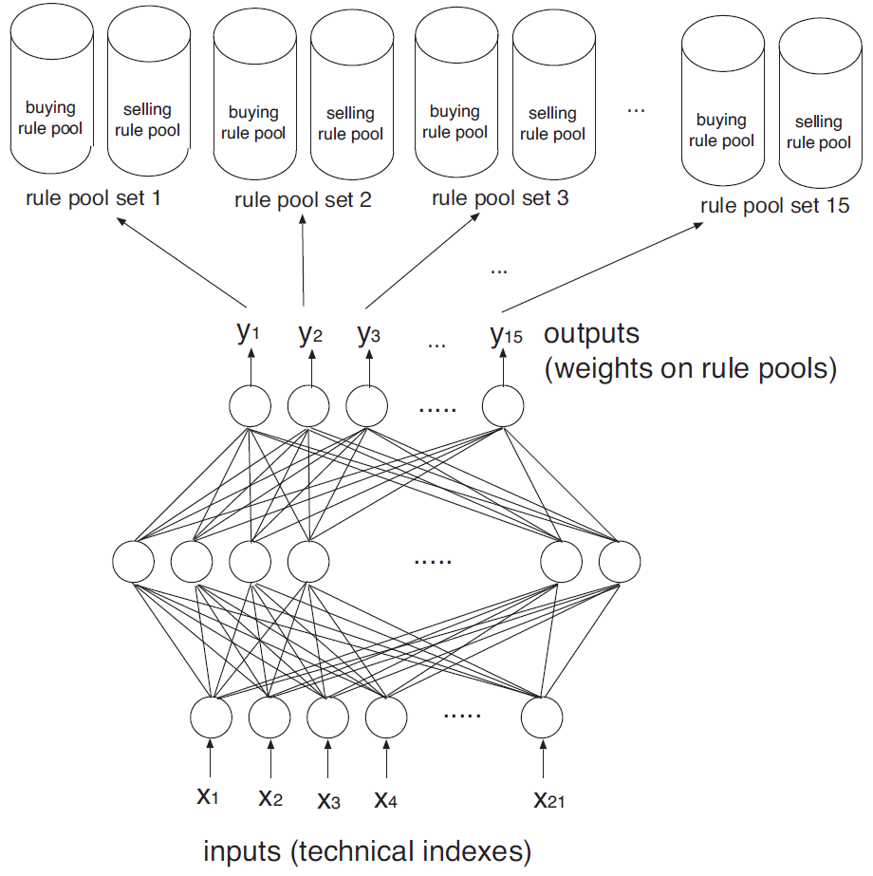
MLP

Slide 11
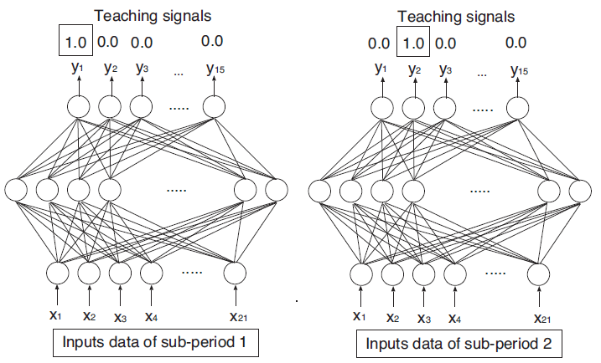
MLP training

Slide 12
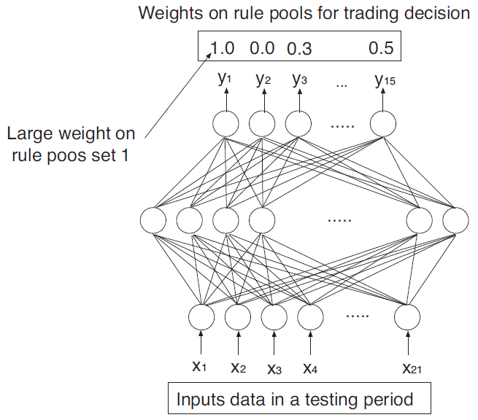
MLP testing

Slide 13

MLP output
$Match\left(d,r\right)=\left\{\begin{aligned}1 if matching \\ 0 otherwise\end{aligned}\right.$
$m_{p,c}\left(d\right)=\frac{1}{|R_{p,c}|}\sum_{r∈R_{p,c}}{Match\left(d,r\right)}$
${Score}_{c}\left(d\right)=\sum_{p∈P_{c}}{y_{p}\left(d\right),c∈\{buy,sell\}}$

Slide 14
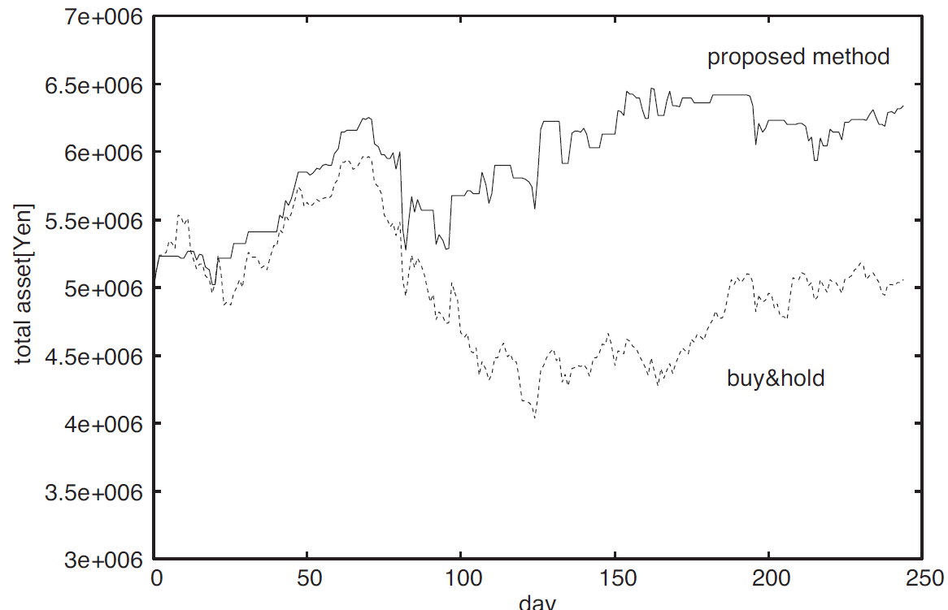
Total asset

Slide 15
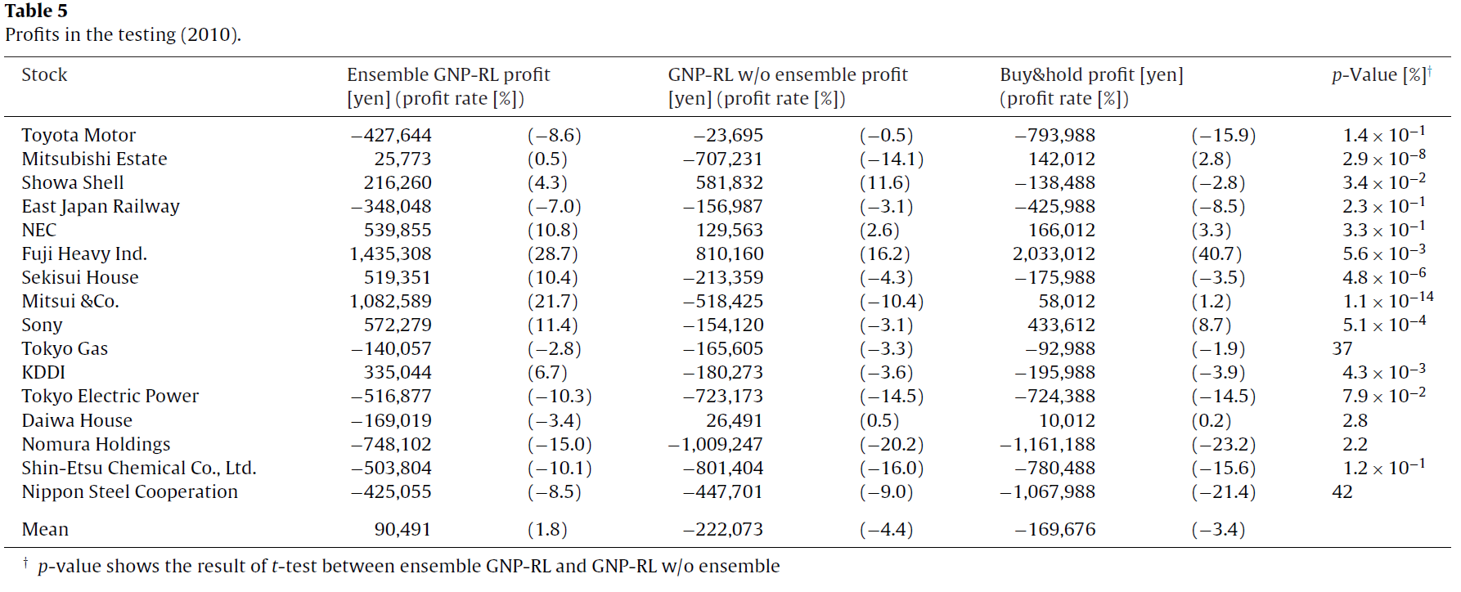
Result in 2010

Slide 16
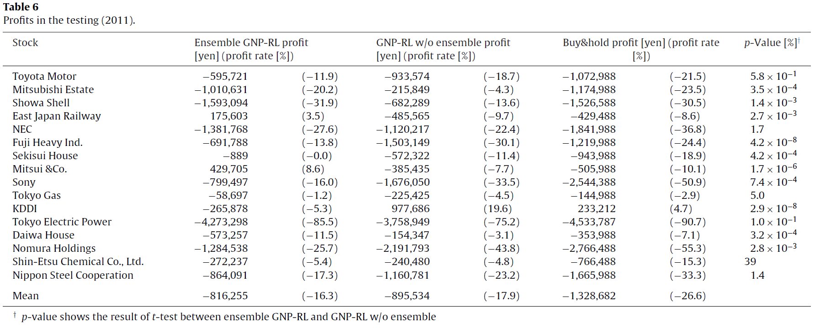
Result in 2011

