Slide 1
A model and algorithm for sequence alignment
S. V. Znamenskij
Program System: Theory And Applications 2015 189-197
Speaker: Du-Cheng Wu
Date: 2018.10.03
Notes:
https://goo.gl/61DG2A
所在城市:https://goo.gl/CAKxv3
所在的州:https://goo.gl/zwKsNb
Birth:12.02.1954

Slide 2
Abstract(1/2)
The change detection problem is aimed at identifying common and different strings and usually has non-unique solutions. The identification of the best alignment is canonically based on finding a longest common subsequence (LCS) and is widely used for various purpose. However, many recent version control systems prefer alternative heuristic algorithms which not only are faster but also usually produce better alignment than finding LCS.
Two basic shortcoming of known alignment algorithms are outlined in the paper:
(1)even when the length of the longest common substring is close to that of the LCS, the latter may consist of a great number of short uninformative substrings;

Slide 3
Abstract(2/2)
(2)known alternative algorithms start with identifying the most informative common string, which sometimes omits from consideration common subsequence containing arbitrarily many aligned substrings of similar quality.
The sequence alignment problem is considered to be an abstract model for change detection in collaborative text editing designed to minimize the probability of merge conflict. A new cost function is defined as the probability of overlap between detected changes and a random string. This optimization avoids both shortcoming mentioned above. The simple cubic algorithm is proposed.

Slide 4
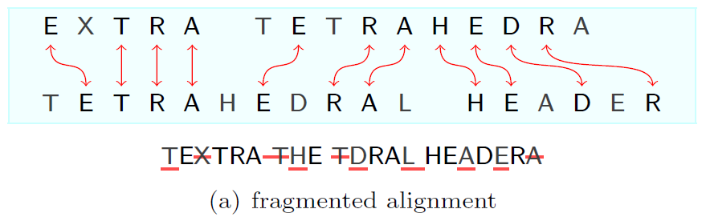
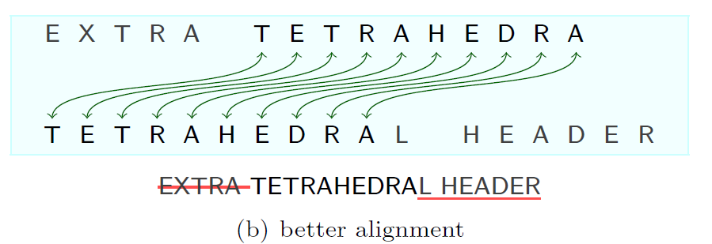
Non-conflicting substring(NCS)
A: EXTRA TETRAHEDRA
B: TETRAHEDRAL HEADER
LCS:ETRAERAHEDR
NCS:TETRAHEDRA

Slide 5

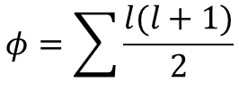
Non-conflicting substring(NCS)
The cost function of NCS
$$φ=\sum{\frac{l(l+1)}{2}}$$
String of length $l$ contains exactly $\frac{l(l+1)}{2}$ different substrings

Slide 6
Non-conflicting substring(NCS)
 | 0 | T | E | T | R | A | H
0 | 0
T | 0
R | 0
A | 0
T | 0
E | 0
T | 0
R | 0

Slide 7
Non-conflicting substring(NCS)
 | 0 | T | E | T | R | A | H
0 | 0 | 0
T | 0 | 1
R | 0 | 1
A | 0 | 1
T | 0 | 1
E | 0 | 1
T | 0 | 1
R | 0 | 1

Slide 8

Non-conflicting substring(NCS)
 | 0 | T | E | T | R | A | H
0 | 0 | 0 | 0
T | 0 | 1 | 1
R | 0 | 1 | 1
A | 0 | 1 | 1
T | 0 | 1 | 1
E | 0 | 1 | 1
T | 0 | 1
R | 0 | 1
$$0+\frac{2∗3}{2}>1$$

Slide 9
Non-conflicting substring(NCS)
 | 0 | T | E | T | R | A | H
0 | 0 | 0 | 0
T | 0 | 1 | 1
R | 0 | 1 | 1
A | 0 | 1 | 1
T | 0 | 1 | 1
E | 0 | 1 | 3
T | 0 | 1
R | 0 | 1

Slide 10
Non-conflicting substring(NCS)
 | 0 | T | E | T | R | A | H
0 | 0 | 0 | 0
T | 0 | 1 | 1
R | 0 | 1 | 1
A | 0 | 1 | 1
T | 0 | 1 | 1
E | 0 | 1 | 3
T | 0 | 1 | 3
R | 0 | 1 | 3

Slide 11
Non-conflicting substring(NCS)
 | 0 | T | E | T | R | A | H
0 | 0 | 0 | 0 | 0
T | 0 | 1 | 1 | 1
R | 0 | 1 | 1 | 1
A | 0 | 1 | 1 | 1
T | 0 | 1 | 1 | 2
E | 0 | 1 | 3 | 3
T | 0 | 1 | 3 | 6
R | 0 | 1 | 3 | 6

Slide 12
Non-conflicting substring(NCS)
 | 0 | T | E | T | R | A | H
0 | 0 | 0 | 0 | 0 | 0
T | 0 | 1 | 1 | 1 | 1
R | 0 | 1 | 1 | 1 | 3
A | 0 | 1 | 1 | 1 | 3
T | 0 | 1 | 1 | 2 | 3
E | 0 | 1 | 3 | 3 | 3
T | 0 | 1 | 3 | 6 | 6
R | 0 | 1 | 3 | 6 | 10

Slide 13
Non-conflicting substring(NCS)
 | 0 | T | E | T | R | A | H
0 | 0 | 0 | 0 | 0 | 0 | 0
T | 0 | 1 | 1 | 1 | 1 | 1
R | 0 | 1 | 1 | 1 | 3 | 3
A | 0 | 1 | 1 | 1 | 3 | 6
T | 0 | 1 | 1 | 2 | 3 | 6
E | 0 | 1 | 3 | 3 | 3 | 6
T | 0 | 1 | 3 | 6 | 6 | 6
R | 0 | 1 | 3 | 6 | 10 | 10

Slide 14
Non-conflicting substring(NCS)
 | 0 | T | E | T | R | A | H
0 | 0 | 0 | 0 | 0 | 0 | 0 | 0
T | 0 | 1 | 1 | 1 | 1 | 1 | 1
R | 0 | 1 | 1 | 1 | 3 | 3 | 3
A | 0 | 1 | 1 | 1 | 3 | 6 | 6
T | 0 | 1 | 1 | 2 | 3 | 6 | 6
E | 0 | 1 | 3 | 3 | 3 | 6 | 6
T | 0 | 1 | 3 | 6 | 6 | 6 | 6
R | 0 | 1 | 3 | 6 | 10 | 10 | 10

Slide 15
Non-conflicting substring(NCS)
 | 0 | T | E | T | R | A | H
0 | 0 | 0 | 0 | 0 | 0 | 0 | 0
T | 0 | 1 | 1 | 1 | 1 | 1 | 1
R | 0 | 1 | 1 | 1 | 3 | 3 | 3
A | 0 | 1 | 1 | 1 | 3 | 6 | 6
T | 0 | 1 | 1 | 2 | 3 | 6 | 6
E | 0 | 1 | 3 | 3 | 3 | 6 | 6
T | 0 | 1 | 3 | 6 | 6 | 6 | 6
R | 0 | 1 | 3 | 6 | 10 | 10 | 10

Slide 16
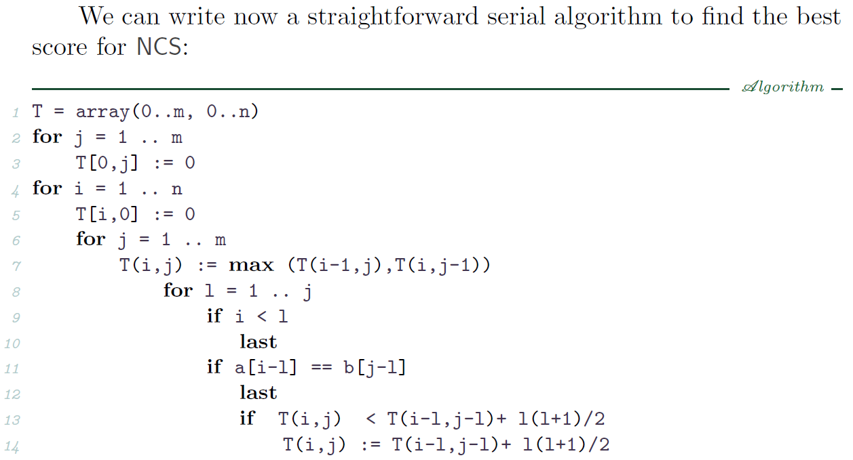
Non-conflicting substring(NCS)

Slide 17
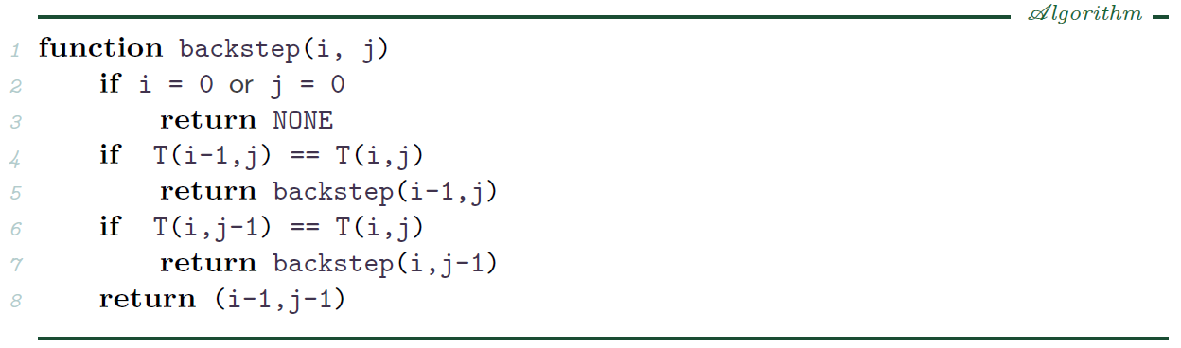
Non-conflicting substring(NCS)

