Slide 1
Massively Parallel Huffman Decoding on GPUs
André Weißenberger, Bertil Schmidt
47th International Conference on Parallel
Processing, August 13–16, 2018, University of Oregon
Eugene, OR, USA.
Presenter : Feng-Yang Tsai
Date: 2018.10.23
Notes:
https://www.google.com.tw/maps/place/%E7%BE%8E%E5%9B%A0%E8%8C%A8%E5%A4%A7%E5%AD%B8/@50.2582658,6.3022308,6.16z/data=!4m5!3m4!1s0x0:0xe9344ff3bb0044ab!8m2!3d49.9926403!4d8.2415552
https://www.google.com.tw/maps/place/%E7%BE%8E%E5%9C%8B%E5%A5%A7%E5%8B%92%E5%B2%A1%E5%B7%9E%E5%B0%A4%E9%87%91/@43.9448743,-123.4698975,8.48z/data=!4m5!3m4!1s0x54c119b0ac501919:0x57ec61894a43894d!8m2!3d44.0520691!4d-123.0867536

Slide 2
Abstract(1/3)
Data compression is a fundamental building block in a wide range
of applications. Besides its intended purpose to save valuable storage on hard disks, compression can be utilized to increase the
effective bandwidth to attached storage as realized by state-of-the-art file systems. In the foreseeing future, on-the-fly compression and decompression will gain utmost importance for the processing of data-intensive applications such as streamed

Slide 3
Abstract(2/3)
Deep Learning tasks or Next Generation Sequencing pipelines, which establishes the need for fast parallel implementations. Huffman coding is an integral part of a number of compression methods. However, efficient parallel implementation of Huffman decompression is difficult due to inherent data dependencies (i.e. the location of a decoded symbol depends on its predecessors). In this paper, we present the first massively parallel decoder implementation that is compatible with Huffman’s original

Slide 4
Abstract(3/3)
method by taking advantage of the self-synchronization property of Huffman codes. Our performance evaluation on three different CUDA-enabled GPUs (TITAN V, TITAN XP, GTX 1080) demonstrates speedups of over one order-of-magnitude compared to the state-of-art CPU-based Zstandard Huffman decoder.

Slide 5
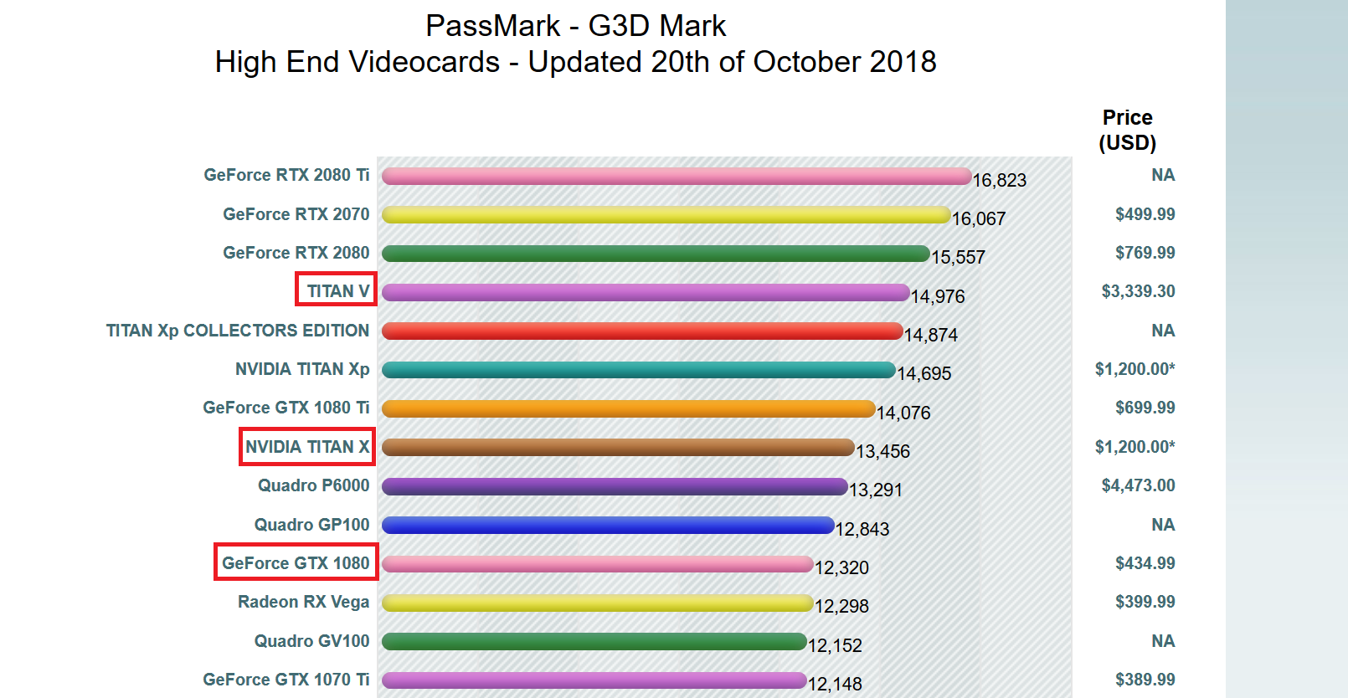
https://www.videocardbenchmark.net/high_end_gpus.html

Slide 6
1.
Provides necessary background information on Huffman coding and reviews related work.
2.
The self-synchronizing property of Huffman codes
3.
Presents our GPU-based decoder and focuses on practical implementation of the algorithm using CUDA
4.
Presents experimental results
5.
Concludes

Slide 7
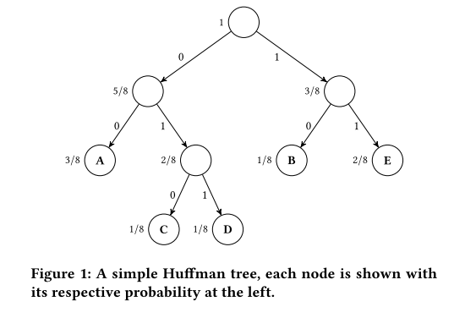
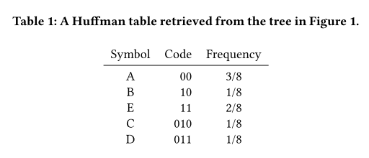
1.Huffman coding
the message ABAEECDA is encoded as
001000111101001100

Slide 8
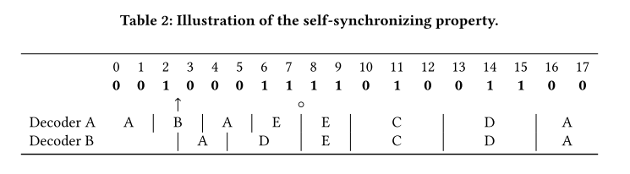
2.Synchronization
A Huffman code which possesses the self -synchronizing property is called self-synchronizing.
bit 7 is referred to as a synchronization point, as both decoders became synchronous. After a synchronization point has been encountered, decoders will always generate the correct output. This property can be used to construct a multi-threaded decoder

Slide 9
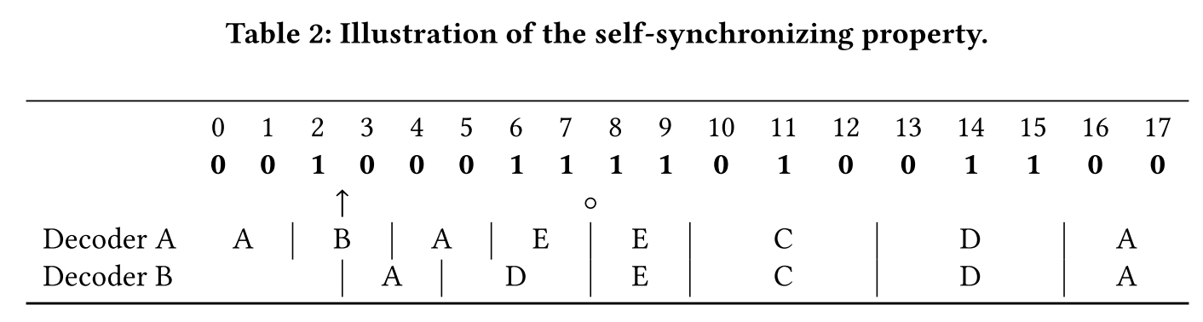
which sets of Huffman codes posses the self-
synchronizing property?
Let x denote the sequence preceding the cut point. z is referred to as a synchronizing sequence for x and y if the concatenations yz and xyz both are sequences of complete codewords.
If this is the case, there is a synchronization point after the last bit of z . In the example of Table 2, x equals 001, y equals 00 and z equals 011.
Notes:
兩個解碼器在遇到同步點前 找出的symbol有可能是錯的
而透過上述方法，就是下面字碼邊界與上面邊界對齊時就可以找到同步點

Slide 10
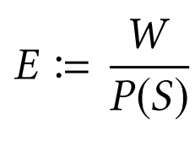
what is the expected number of bits that have to be processed before a synchronization point is reached?
They evaluated the expected number of bits E by
W is the weighted average codeword length
P ( S ) represents the probability of the synchronization point being directly at the end of the codeword that was cut by the block boundary.
In practical tests, this estimation proved to approximate the measured number of bits well. Synchronization was achieved after less than 73 bits on average for the nine tested plain text and binary files.

Slide 11
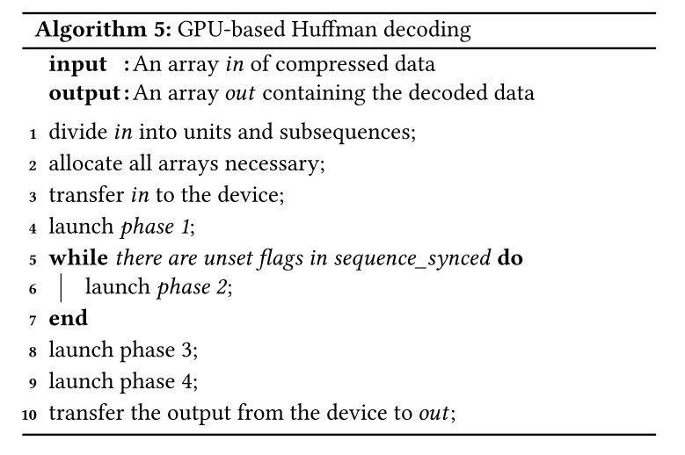
3.Parallel Algorithm Design

Slide 12
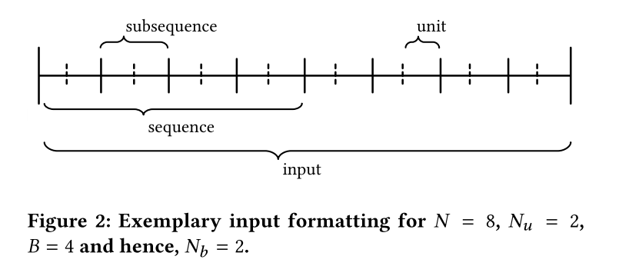
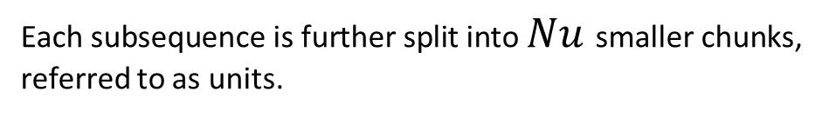
multi-threaded decoder
B adjacent subsequences are grouped into a sequence.
Each subsequence is further split into $Nu$ smaller chunks, referred to as units.
If N is not a multiple of B , the last sequence will contain less than B subsequences.
the number of sequences $N_{b}$ equals⌈ N / B ⌉

Slide 13
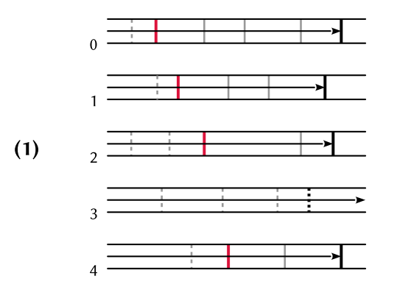
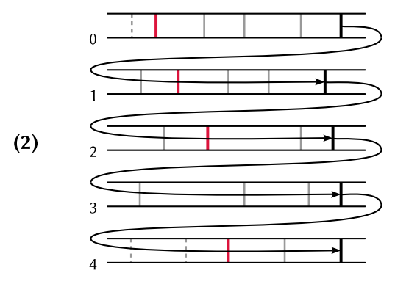
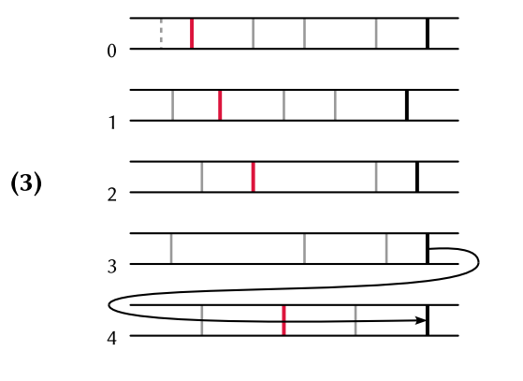
3.Parallel Algorithm Design
Notes:
在階段1中，每個線程都會被分配到不同subsequence，
一旦線程在最後的完整字碼處完成解碼，他將最後一個字碼的第一位置以及
解碼符號的數量寫入相對應Sync_info array裡，為了防止數據爭用，
完成線程必須在此等待，等所有thread都完成解碼所有的subsequence。
thread 3 不包含任何的同步點，所以thread3解碼出來都是不正確的
包括最後一個。
而線程都找到同步點之後，從thread1開始的最後一個字碼開始overflow，
這邊的overflow就是指在前一個subsequence中從最後一個完整字碼之後
繼續解碼，而目前的線程檢測到的最後一個字碼的位置將與前一個線程
檢測到的位置是否有匹配也就是利用Sync_info array來驗證，如果位置匹配，
也就代表完成了，此時目前線程也必須等待，其他thread完成，
而part2可以看到thread2校正了subsequeance3的最後一個字碼的位置
但由於還是找不到同步點，因此還是保持啟用的狀態，而這過程需要重複B次
使得第一個thread能夠到達最後一個subsequeance，
第三部分就是第一次迭代後的結果，並且檢測subsequeance4的同步

Slide 14
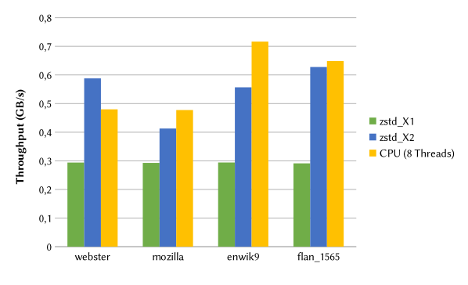
4.EXPERIMENTAL RESULTS
enwik9: [19] Excerpt of the English Wikipedia, consisting of UTF8-coded XML data.
flan_1565: [5] Sparse matrix from the SuiteSparse Matrix Collection.
mozilla: [6] tar-compressed archive of Mozilla 1.0 .
webster: [6] 1913 Webster Unabridged Dictionary in HTML
Format.

Slide 15
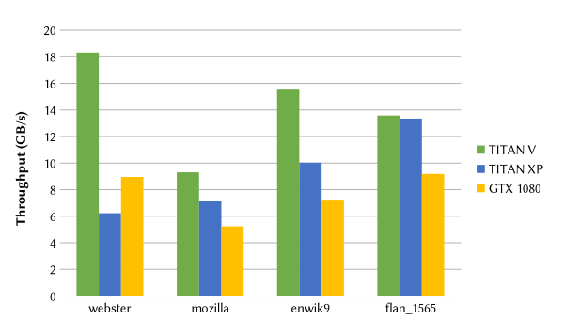

Slide 16
Concludes

Slide 18
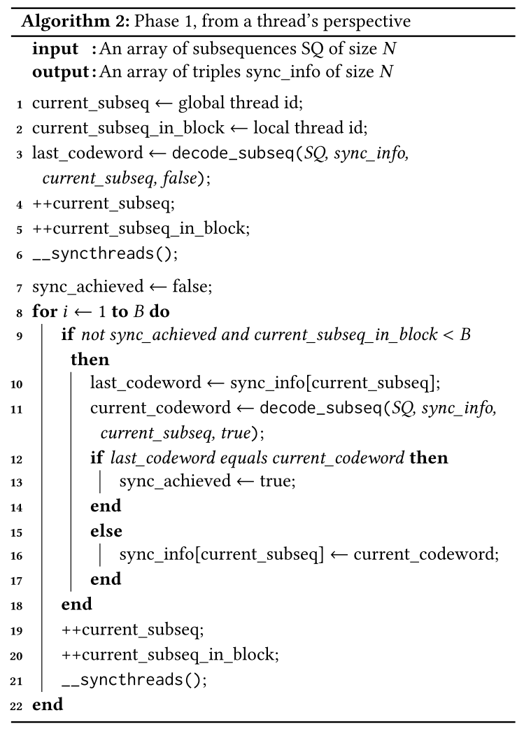

Slide 19
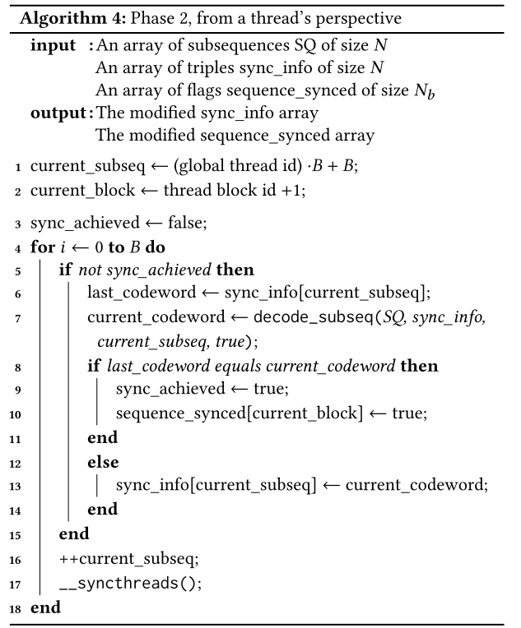

Slide 20
3.Parallel Algorithm Design

Slide 21
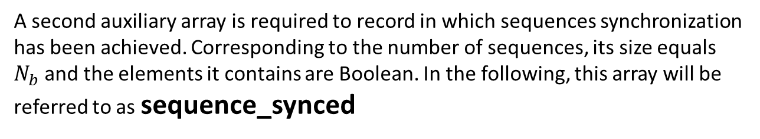
The decoder allocates simple arrays for input and output, as well as an auxiliary array of size N used to detect synchronization points, in the following referred to as sync_info.
sync_info are structures, consisting of three integers: (unit,bit, num_symbols).
A second auxiliary array is required to record in which sequences synchronization has been achieved. Corresponding to the number of sequences, its size equals $N_{b}$ and the elements it contains are Boolean. In the following, this array will be referred to as sequence_synced

Slide 22
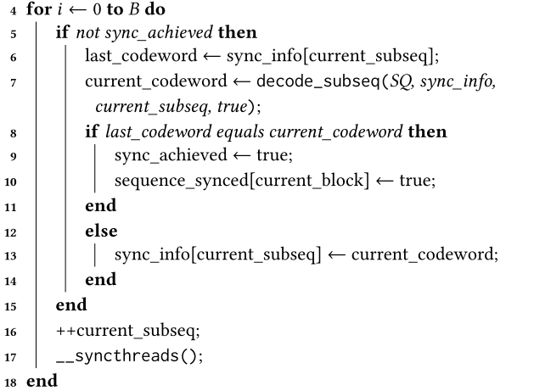

Slide 23
