Slide 1
A dynamic threshold decision system for stock trading signal detection
Pei-Chann Chang(張百棧), T. Warren Liao, Jyun-Jie Lin, Chin-Yuan Fan(樊晉源)
Applied Soft Computing 11 (2011) 3998–4010
Presenter: Cheng-Han Wu
Date:2018/10/23

Slide 2
Abstract(1/2)
Trading signal detection has become a very popular research topic in financial investment area. This paper develops a model using the Piecewise Linear Representations (PLR) and Artificial Neural Networks (ANNs) to analyze the nonlinear relationships between the stock closed price and various technical indexes, and uncovering the knowledge of trading signals hidden in historical data. Piecewise Linear Representation tools are applied to find the best stock turning points (trading signals) based on the historical data. These turning points represent short-term trading signals for selling or buying stocks from the market.

Slide 3
Abstract(2/2)
This study further applies an Artificial Neural Network model to learn the connection weights from these historical turning points, and afterwards an exponential smoothing based dynamic threshold model is used to forecast the future trading signals. The stock trading signal is predicted using the neural network on a daily basis. The dynamic threshold bounds generated provide a guide for triggering a buy or sell decision when the ANN-predicted trading signal goes above or under the threshold bounds. Through a series of experiments, this research shows superior results than our previous research (Chang et al., 2009 [1]) and other benchmark researches

Slide 4
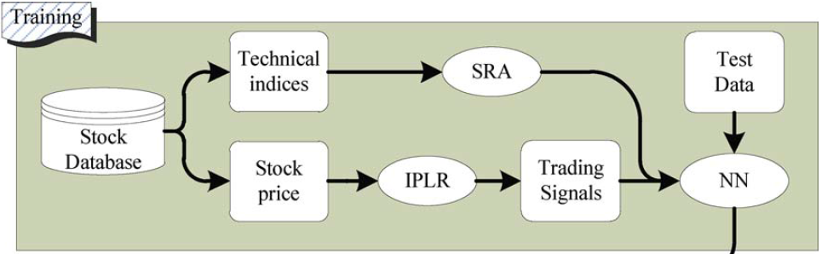
Training

Slide 5
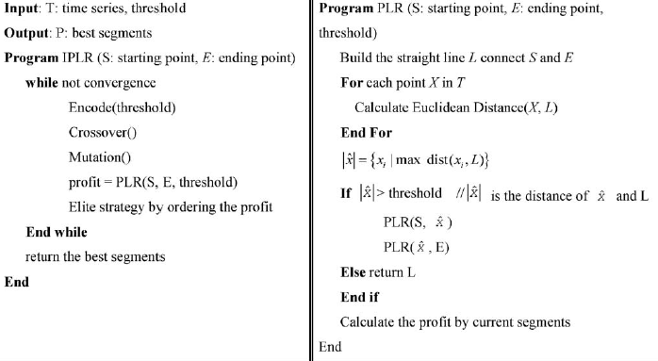
Pseudo code of the PLR

Slide 6
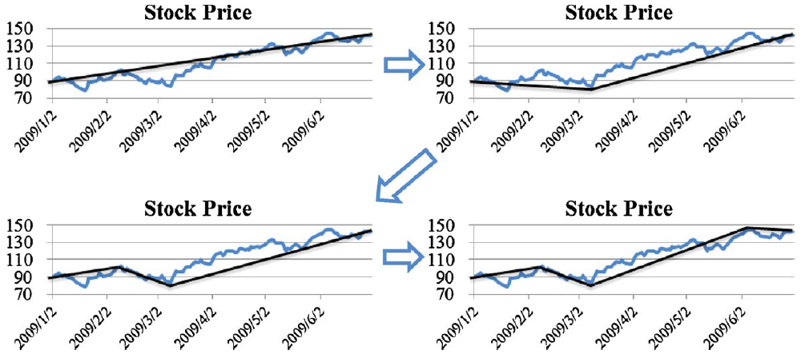
Piecewise Linear Representations (PLR)

Slide 7
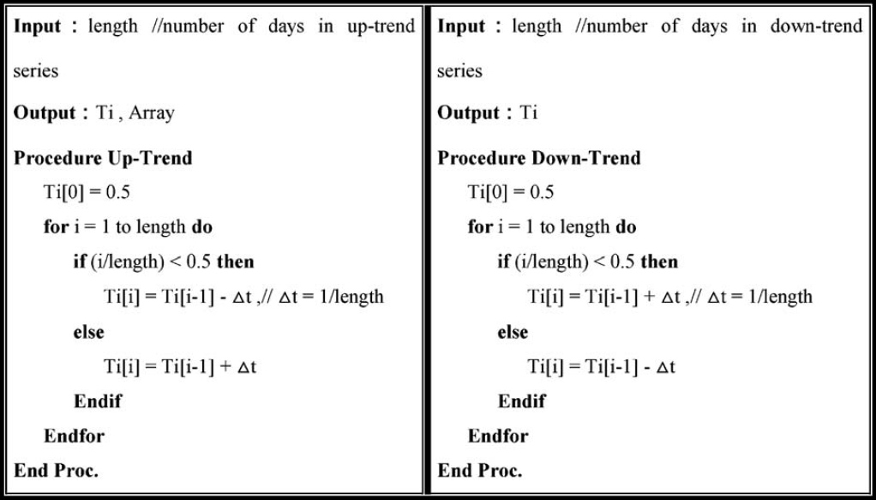
Pseudo code for trading signals generations

Slide 8
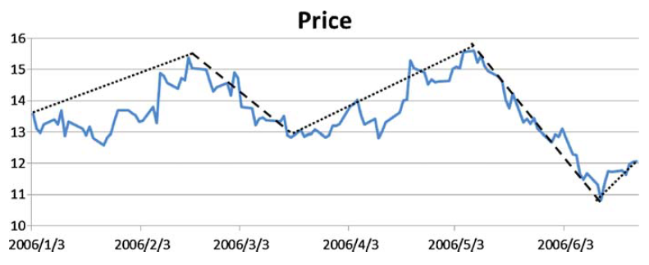
Piecewise Linear Representations (PLR)

Slide 9
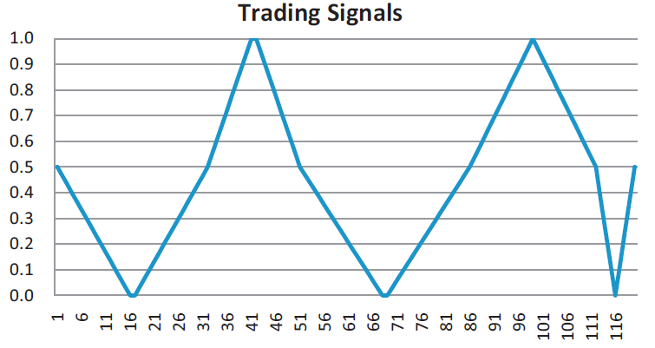
Trading signal from PLR

Slide 10
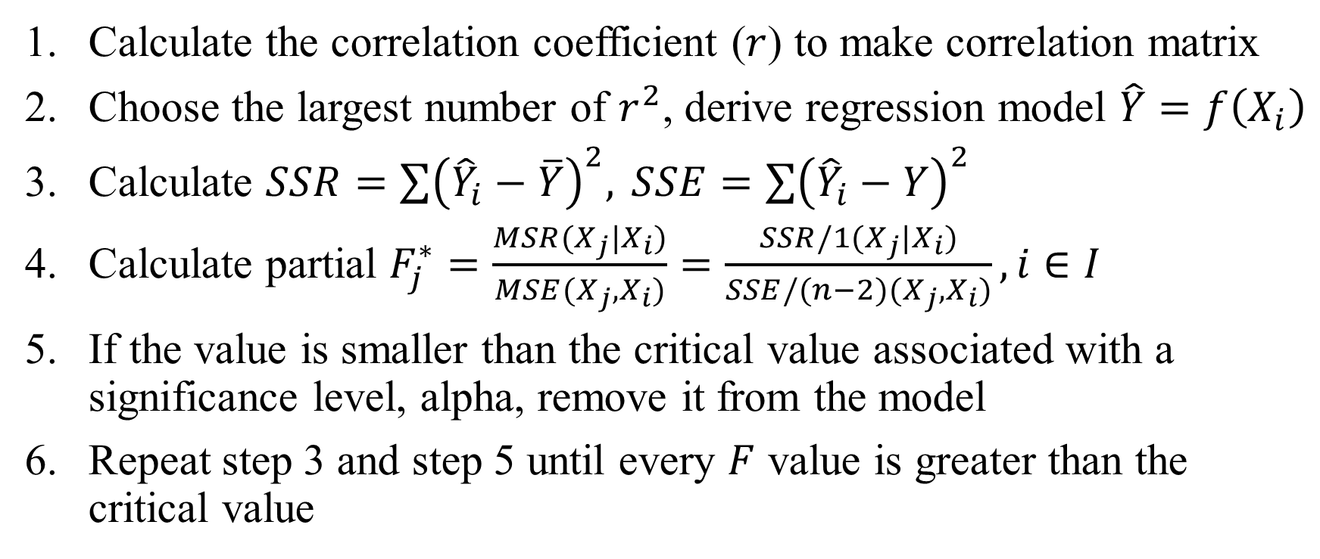
Stepwise regression analysis (SRA)
Calculate the correlation coefficient ($r$) to make correlation matrix
Choose the largest number of $r^{2}$, derive regression model $\hat{Y}=f\left(X_{i}\right)$
Calculate $SSR=\sum{{\left({\hat{Y}}_{i}−\overline{Y}\right)}^{2}, }SSE=\sum{{\left({\hat{Y}}_{i}−Y\right)}^{2}}$
Calculate partial $F_{j}^{∗}=\frac{MSR(X_{j}|X_{i})}{MSE(X_{j},X_{i})}=\frac{SSR/1(X_{j}|X_{i})}{SSE/(n−2)(X_{j},X_{i})}, i∈I$
If the value is smaller than the critical value associated with a significance level, alpha, remove it from the model
Repeat step 3 and step 5 until every $F$ value is greater than the critical value

Slide 11
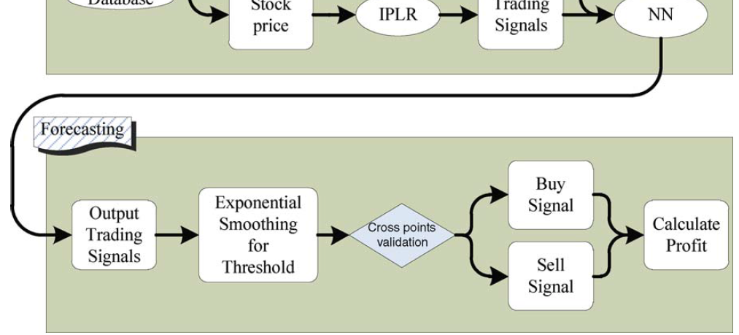
Testing

Slide 12
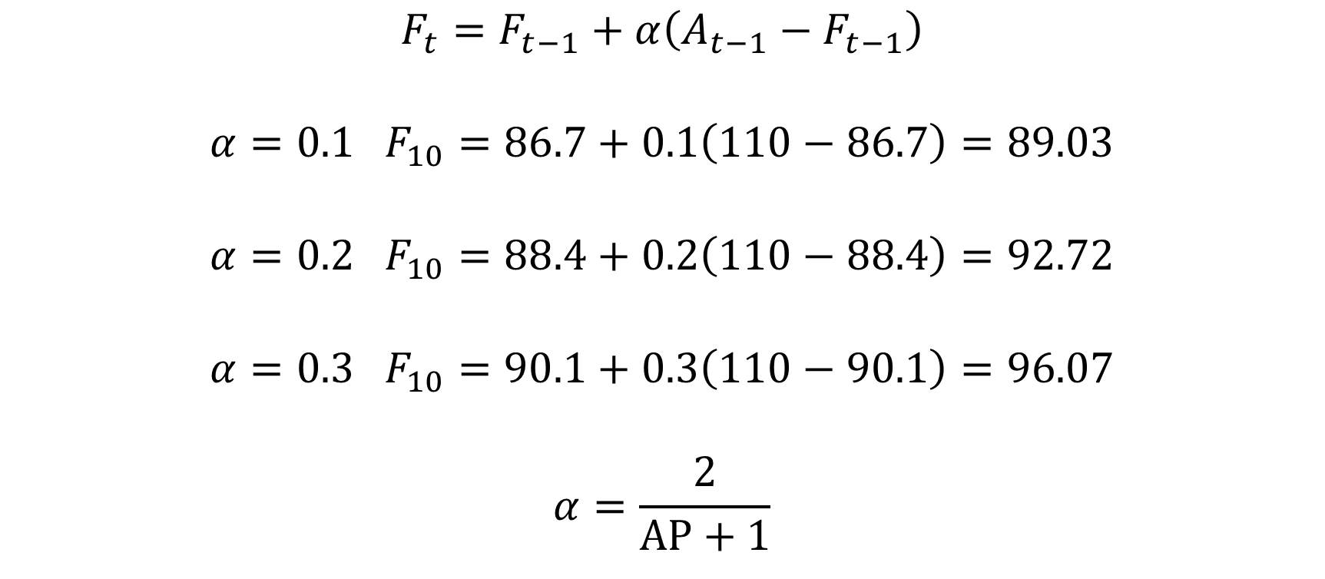
Exponential smoothing
$$F_{t}=F_{t−1}+α\left(A_{t−1}−F_{t−1}\right)$$
$$α=0.1 F_{10}=86.7+0.1\left(110−86.7\right)=89.03$$
$$α=0.2 F_{10}=88.4+0.2\left(110−88.4\right)=92.72$$
$$α=0.3 F_{10}=90.1+0.3\left(110−90.1\right)=96.07$$
$$α=\frac{2}{AP+1}$$

Slide 13
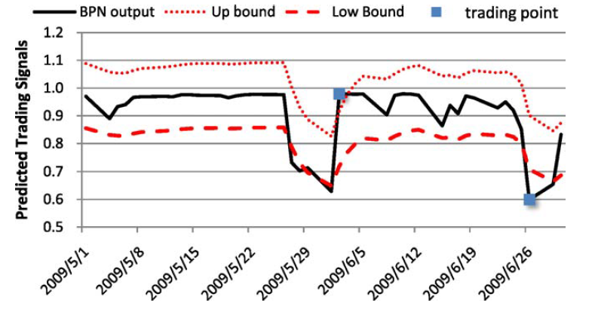
Exponential smoothing

Slide 14
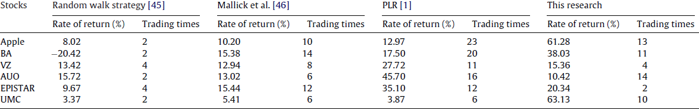
Result

