Slide 1
Time Alignment Measurement for Time Series
Duarte Folgado , Marília Barandas, Ricardo Matias, Rodrigo Martins,
Miguel Carvalho, Hugo Gamboa
Pattern Recognition
81 (2018) 268–279
Presenter: Ke-Xin Zhu
Date: 2018/10/23

Slide 2
Abstract (1/2)
When a comparison between time series is required, measurement functions provide meaningful scores to characterize similarity between sequences. Quite often, time series appear warped in time, i.e, although they may exhibit amplitude and shape similarity, they appear dephased in time. The most common algorithm to overcome this challenge is the Dynamic Time Warping, which aligns each sequence prior establishing distance measurements. However, Dynamic Time Warping takes only into account amplitude similarity.

Slide 3
Abstract (2/2)
A distance which characterizes the degree of time warping between two sequences can deliver new insights for applications where the timing factor is essential, such well-deﬁned movements during sports or rehabilitation exercises. We propose a novel measurement called Time Alignment Measurement, which delivers similarity information on the temporal domain. We demonstrate the potential of our approach in measuring performance of time series alignment methodologies and in the characterization of synthetic and real time series data acquired during human movement.

Slide 4
Two relevant contributions in this paper
This paper presents two relevant contributions.
One of our contributions was the development of a new local cost distance for the DTW algorithm. Using a window instead of an element-to-element approach potentially allows to prevent singularities by looking in a region which takes into account a weighting between the amplitude and the ﬁrst discrete derivative of both signals.
The major contribution of our work is a comprehensive technique to characterize the degree of warping between time series. In this paper we started by presenting a detailed analysis of DTW optimal warping path.

Slide 5
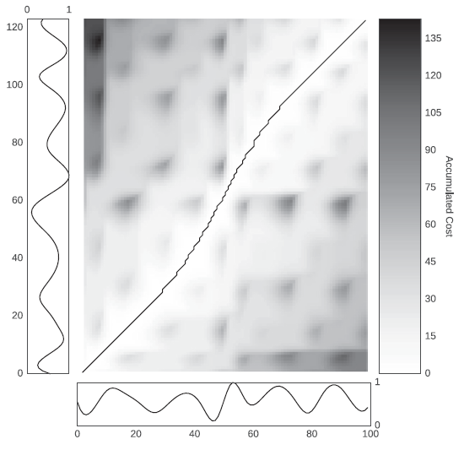
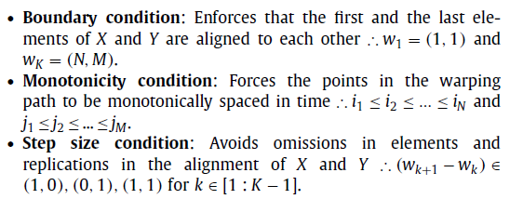

Dynamic Time Warping

Slide 6
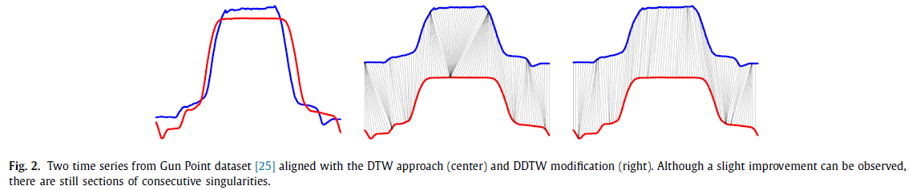
Signal alignment challenges (1/3)
Although DTW has been successfully used for many years, it still encounters some pairwise alignment challenges. E. Keogh reported unintuitive alignments when the algorithm tries to express amplitude variability in the Y-axis by improper warping the X-axis. This behaviour leads to situations deﬁned as “singularities”, where a single point of a particular signal maps a large subsection of another time series.

Slide 7
Signal alignment challenges (2/3)
In order to overcome the singularities challenge they presented the Derivative Dynamic Time Warping (DDTW) approach, which uses the square of the differences between the estimated signal derivatives as shown on Fig. 2.
E. Keogh also introduced a DTW penalty based version called Weighted Dynamic Time Warping (WDTW). In this approach, the cost matrix is modiﬁed in order to incorporate a modiﬁed logistic weight function that assigns additional weight as a function of the phase difference between the reference and test points. Thus, time instants with higher phase difference will be more penalized than instants near the reference.

Slide 8
Signal alignment challenges (3/3)
Despite the attempts to improve the DTW alignment they are still dependent of the data’s nature. For instance, time series that do not comprise higher degree of information on the ﬁrst derivative are susceptible not to beneﬁt from an alignment solely based on the data’s shape. Therefore, an alignment which contemplates a weighting between the amplitude and derivative domains can constitute an added value towards a more versatile application.

Slide 9
Sliding Window Dynamic Time Warping (1/3)
The approach is called Sliding Window Dynamic Time Warping (SW-DTW). The cost measured used by DTW uses an element-to-element distance. In order to use a ”contextual” distance, which takes into account the neighbourhood surrounding each point, we modiﬁed the cost function to take into account the distance between well-deﬁned windows of the signals.

Slide 10
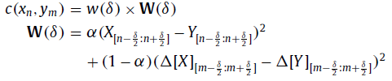
Sliding Window Dynamic Time Warping (2/3)
The modiﬁed local cost measure can be deﬁned as:
where w (δ) is a window function with width δ∈N , ∆ is the operator for the first discrete derivative, α∈ R₀⁺∩ [0 : 1] is a constant that defines the weighting between the cost in amplitude and first order derivative, n and m are the indexes of the values of X and Y , respectively.

Slide 11
Sliding Window Dynamic Time Warping (3/3)
Using a Hanning window function we can assure that points closer to the center of the window have more contribution to the local cost than points located near the window limits. The last elements of X and Y are discarded to guarantee that both time series have the same length. Additionally, signals are prepared by introducing reﬂected copies of the each signal (with the window size) in both ends. This procedures aims to minimize boundary errors on the ﬁrst and last elements of each signal.
δ and α are free parameters and, consequently, must be tuned prior to applying the algorithm. Small windows will tend to similar results compared with the point-to-point DTW distance and excessive large window size will tend to improper feature alignment.

Slide 12
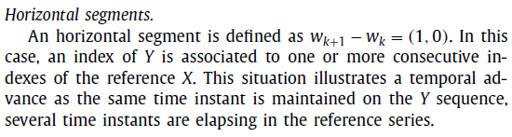
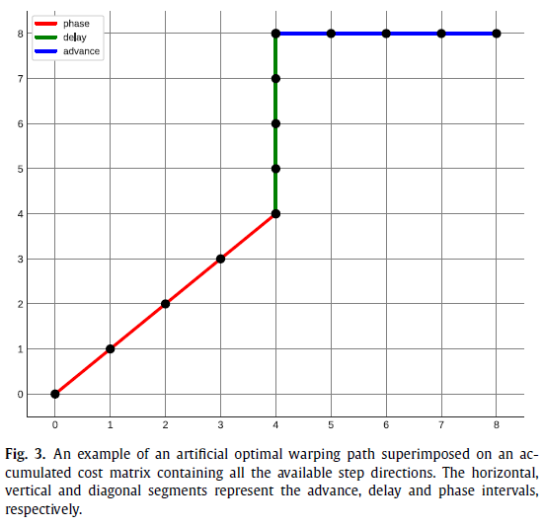
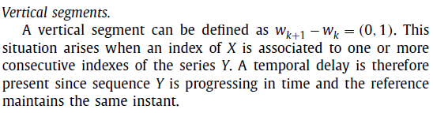

Time Alignment Measurement (1/4)

Slide 13
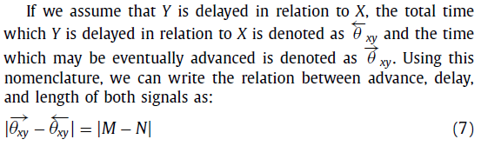
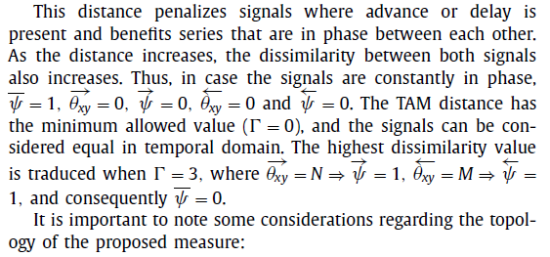
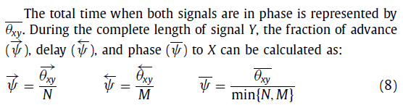

Time Alignment Measurement (2/4)

Slide 14
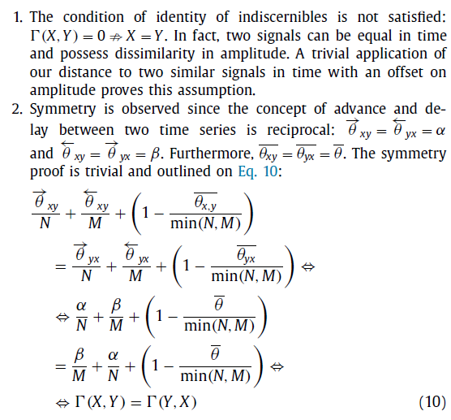
Time Alignment Measurement (3/4)

Slide 15
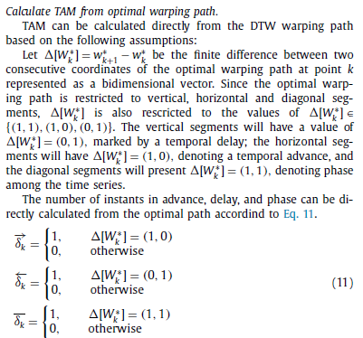
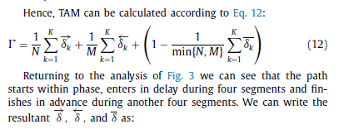

Time Alignment Measurement (4/4)

Slide 16
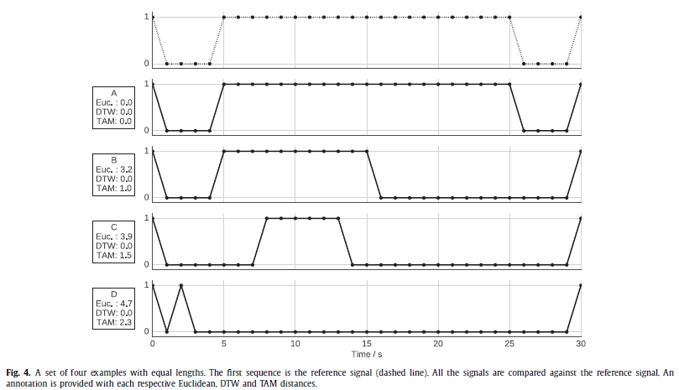
Application (1/5)

Slide 17
Application (2/5)
Equal length time series.
Fig. 4 represents an example where a set of four artificial signals was generated by distorting the first sequence. Although in this example the Euclidean distance increases with the increase of time distortion, it does not reflect a meaningful measurement. The DTW aligns each pair of signals prior computing the distance and thus produces equal scores for all examples. However, TAM produces a meaningful score, which reflects the cost to compress and dilate in time a specific signal.

Slide 18
Application (3/5)
In fact, the distance increases with the degree of time distortion present in each sequence.
Signal A is identical to the reference signal.
The plateau from signal B has an advance of 10 seconds. In order to finish at the same instant, the signal enters in delay at the last segment for another 10 seconds.
Signal C is distorted half of its time as θ_{xy}=15 ⇒ γ= 3*15/30. Signal D represents a significant advance of the plateau, which is represented as a single peak, followed by a significant delay until the end of the signal.

Slide 19
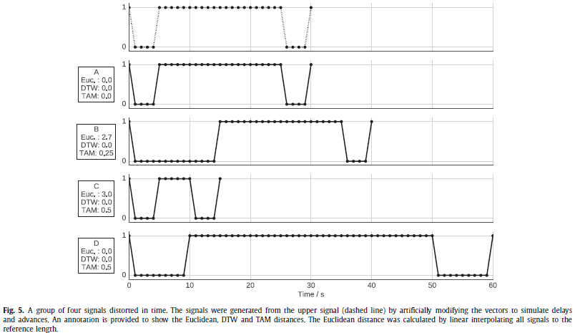
Application (4/5)

Slide 20
Application (5/5)
Unequal length time series.
Fig. 5 represents a group of four signals distorted in time. Signal A shares the same time representation with the reference signal. Signal B possess an initial delay of 10 seconds then enters in phase for the rest of its length. The TAM distance of 0.25 reflects this compression. A higher distance is observed for signal C since a more significant advance is present. Signal D reflects a linear delay lag since two instants in the signal are related to a single instant in signal A , producing a distance value of 0.5. The Euclidean distance was calculated by linear interpolating all signals to share the same length of the reference. Although signal D is different from the reference in time domain, the Euclidean distance is zero.

Slide 21
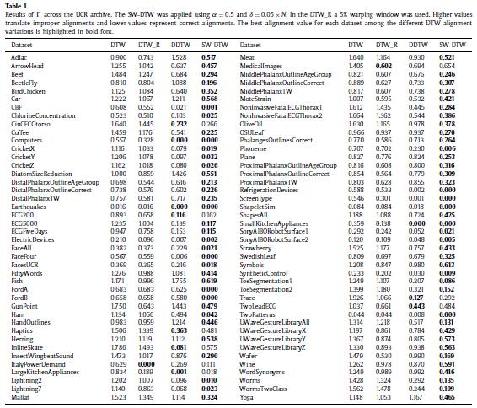
Simulated time series alignment (1/2)

Slide 22
Simulated time series alignment (2/2)
We used the UCR time series archive to test several DTW variations by randomly selecting 40 signals from 84 datasets, which resulted in 3360 different alignments per algorithm variation.
The selected algorithms were the DTW (no warping window), the DTW with a 5% warping window of signal’s length (DTW_R), the DDTW, and the SW-DTW with empirical values of α= 0 . 5 and δ= 0.05 ×N. The scale vector, S , was normalized prior the multiplication in order to guarantee that S ∈ [0.5, 1.5]. The results are summarized in Table 1 .

Slide 23
Repetitive upper limb motion (1/6)
In this subsection, we will present an experiment based upon time series retrieved using inertial sensors during the execution of repetitive motion.
We created a dataset with a total of 240 signals retrieved by six different subjects that executed ten repetitions of a well-deﬁned task under four distinct sets.
The movements performed during each task consisted of: (1) grasping a solderless breadboard used to build electronic circuits; (2) placing the board on a deﬁned position and welding a single perforation in each repetition; (3) grasping the welded board and move it to a deﬁned position.

Slide 24
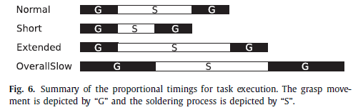
Repetitive upper limb motion (2/6)
The difference among each class is based on the temporal criterion used by the subjects to perform the task as illustrated on Fig. 6.
We divided our study in two perspectives: (1) using one of the subjects as a reference to establish a comparison between a reference subject and the group of the remaining subjects. The objective was to produce a representative distance of how similar the movements were performed against the reference; (2) provide a time series classiﬁcation example, using TAM as a feature.

Slide 25
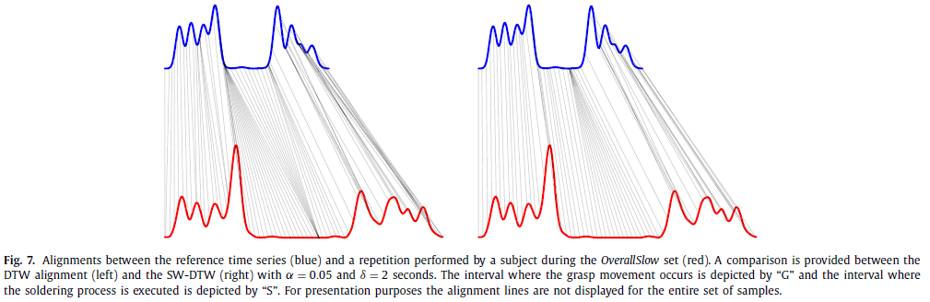
Repetitive upper limb motion (3/6)

Slide 26
Repetitive upper limb motion (4/6)
Fig. 7 illustrates an example of the alignment established by the SW-DTW, where the reference time series is compared against a signal acquired from another subject executing the OverallSlow set. The visual comparison potentially suggests that the alignment produced by SW-DTW reduces the singularity issues. In fact, even in the segment which is prone to lead to singularities, such the plateau, the SW-DTW seems to reasonably map the delay among the two series, which is not observed in the DTW as both an advance and delay are present since two singularities occur.

Slide 27
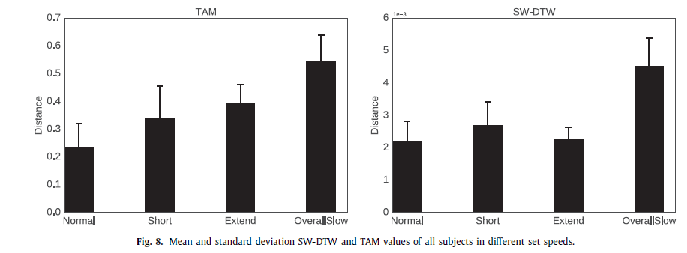
Repetitive upper limb motion (5/6)

Slide 28
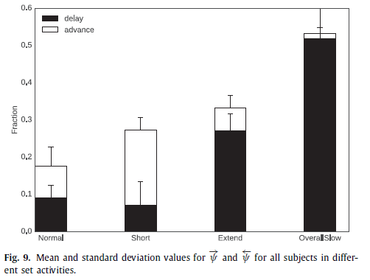
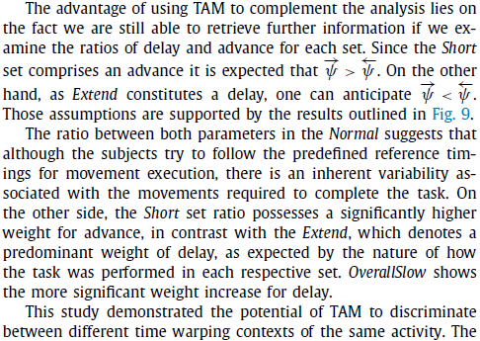
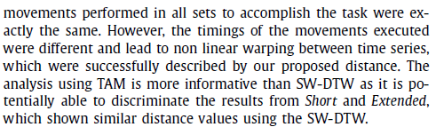
Repetitive upper limb motion (6/6)

Slide 29
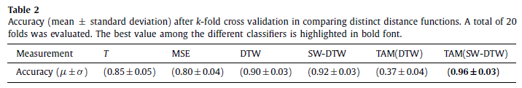
Time series classiﬁcation (1/2)
In this approach we merged the data from all subjects into 4 classes that correspond to each set (Normal, Short, Extended, and OverallSlow). We implemented a 1-NN classiﬁer using the following distance functions: the absolute distance between the length of two series T; Mean Square Error (MSE), which corresponds to the Euclidean distance after interpolating both sequences to the length of the longest sequence; DTW; SW-DTW with α = 0.25 and δ = 4s; TAM(DTW), which corresponds to the TAM value calculated using the DTW alignment and TAM(SW-DTW), which corresponds to the TAM value calculated using the SW-DTW alignment.

Slide 30
Time series classiﬁcation (2/2)
We divided the subjects into training and testing sets with an equal number of elements and used a k-fold cross validation to cover the entire group of possibilities between the distribution of the subjects in the training and testing sets. The results are presented in Table 2.
The highest accuracy was achieved by the TAM calculated using the SW-DTW alignment. These results reinforce the fact that the quality of the previous time series alignment is crucial to achieve representative performance when using our proposed measurement.

