Slide 1
Speeding Up All-Pairwise Dynamic Time Warping Matrix Calculation
Diego F. Silva, Gustavo E. A. P. A. Batista
Proceedings of the 2016 SIAM International Conference on Data Mining
May 5-7, 2016, Miami, Florida, USA
Presenter: Shan-Ru Liu
Date: 2018/10/30

Slide 2
Abstract (1/2)
Dynamic Time Warping (DTW) is certainly the most relevant distance for time series analysis. However, its quadratic time complexity may hamper its use, mainly in the analysis of large time series data. All the recent advances in speeding up the exact DTW calculation are confined to similarity search. However, there is a significant number of important algorithms including clustering and classification that require the pairwise distance matrix for all time series objects. The only techniques available to deal with this issue are constraint bands and DTW approximations.

Slide 3
Abstract (2/2)
In this paper, we propose the first exact approach for speeding up the all-pairwise DTW matrix calculation. Our method is exact and may be applied in conjunction with constraint bands. We demonstrate that our algorithm reduces the runtime in approximately 50% on average and up to one order of magnitude in some datasets.

Slide 4
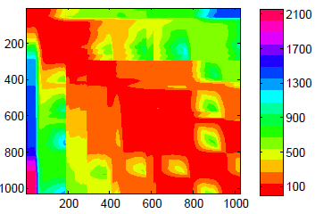
Motivation

Slide 5
PrunedDTW (DTW with Pruned Warping Paths)
Being similar or considerably faster than DTW
Always returning the optimal path between two time series

Slide 6
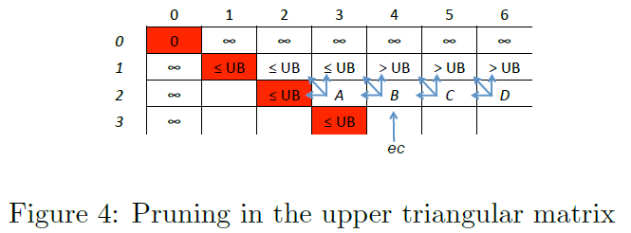
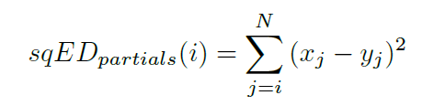

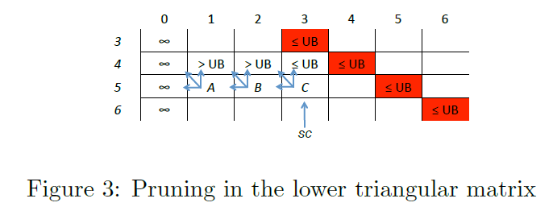
Pruning Strategy

Slide 7
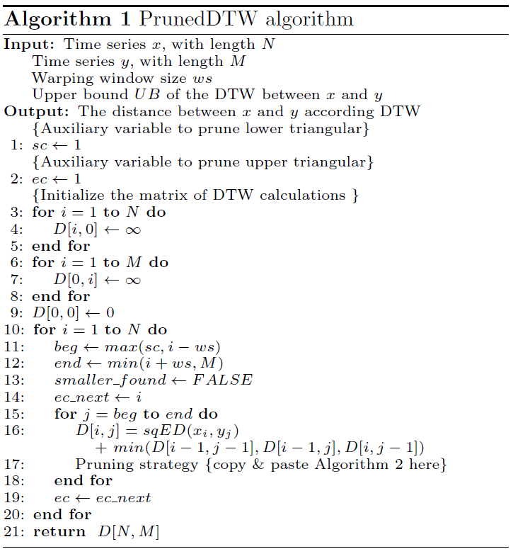
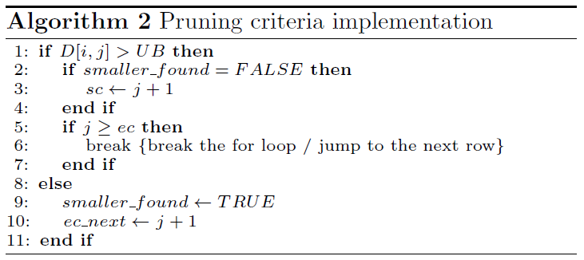
Algorithm

Slide 8
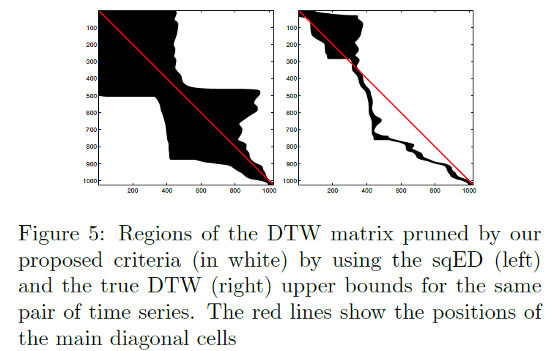
Other UB Approaches

Slide 9
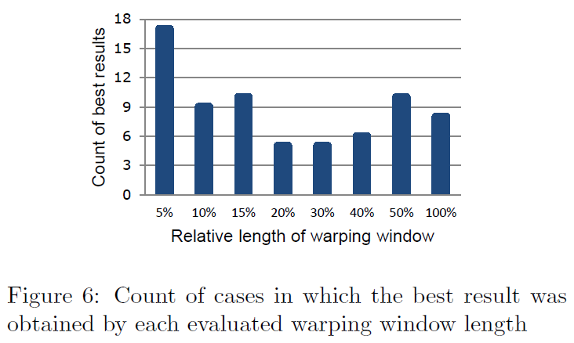
Result (1/4)

Slide 10
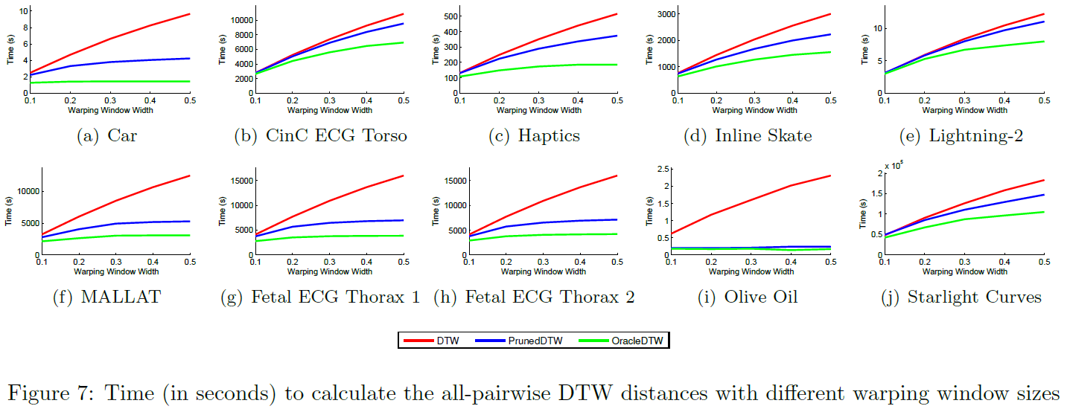
Result (2/4)

Slide 11
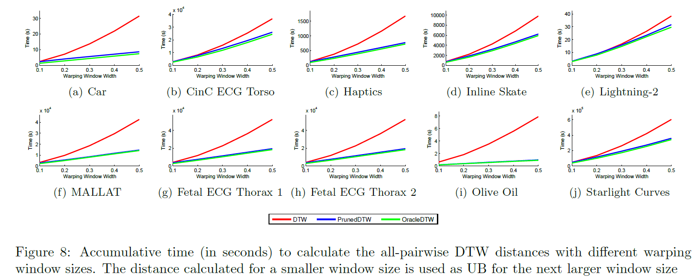
Result (3/4)

Slide 12
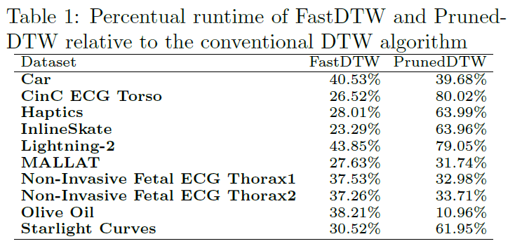
Result (4/4)

