Slide 1
Fast and Accurate Template Averaging for Time Series Classification
Phongsakorn Sathianwiriyakhun, Thapanan Janyalikit, Chotirat Ann Ratanamahatana
Proceedings of 8th International Conference on Knowledge and Smart Technology (KST), 2016, Pages 49 – 54, Chiangmai, Thailand
Speaker: Jheng-Yan Lyu
Date: 2018.10.30

Slide 2
Abstract (1/3)
Time series data are evidently ubiquitous, as we could see them in all kinds of domains and applications. As a result, various data mining tasks are often performed to discover useful knowledge, including commonly performed tasks like time series classification and clustering. Dynamic Time Warping (DTW) is accepted as one of the best available similarity measures, which has been used for distance calculation in both classification and clustering algorithms. However, its known drawback is its exceedingly high computational cost. Recently, data condensation method through template averaging is applied;

Slide 3
Abstract (2/3)
each class of data can be represented by one template which could greatly speed up the classification with DTW especially in large datasets, with the trade off in lower classification accuracies. Subsequently, various attempts have been made to increase the number of representative templates to boost up the accuracies while keeping the computation complexity not too high. However, those algorithms still suffer from many predefined and hard-to-set parameters, while some require high computation time for high accuracy results. Therefore, in this work, we propose an accurate yet simple template averaging method that is parameter free and has much less computation time.

Slide 4
Abstract (3/3)
The experiment results on 20 UCR time series benchmark datasets demonstrate that our proposed method can achieve a few orders of magnitude speedup while maintaining high classification accuracies.

Slide 5
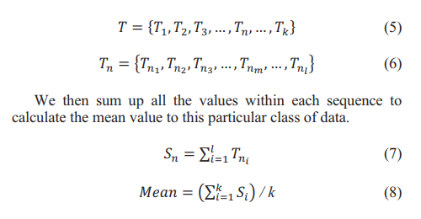

Find initial pivoting sequence for each class
T is a set of k time series sequences of the same class with the length l

Slide 6
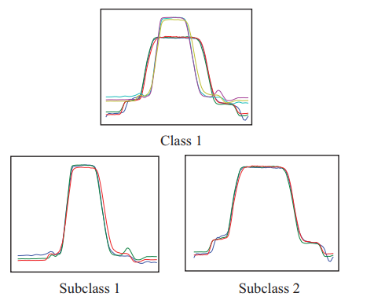
Subclass splitting
Calculate Euclidean distance between the pivot sequence and all other data sequences within the class.
Sort these distance values, and then compute adjacent discrepancies of the values. Then the standard deviation value of these adjacent discrepancies will be used as a threshold to split data into subclasses.
Separate the data into subclasses by splitting at the sequence that has difference larger than half of the computed standard deviation.

Slide 7
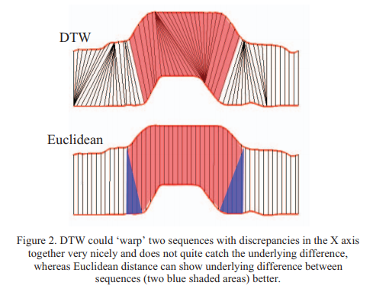
Subclass splitting
The main reason why we use Euclidean distance instead of DTW in this step is much faster to compute
Euclidean distance can better illustrate the differences between the two sequences than DTW could. As demonstrated in Fig.2

Slide 8
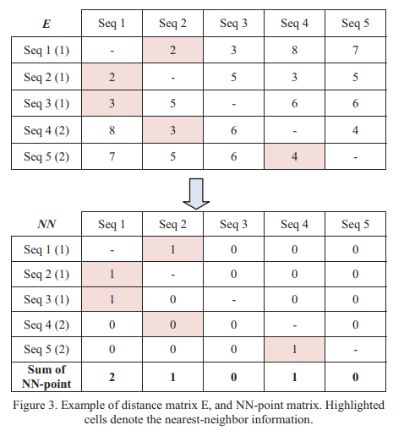
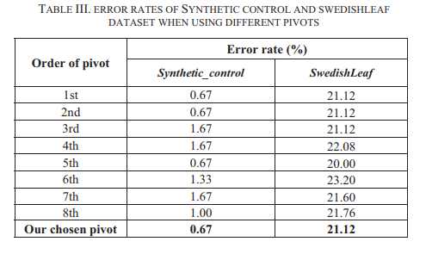
Different Pivots and Nearest-Neighbor Points
sequences 1, 2 and 3 are of class 1 and sequences 4 and 5 are of class 2.

Slide 9
Dynamic time warping Barycenter Averaging(DBA)
DBA is the most recently proposed time series averaging method for DTW
DBA simultaneously averages all of the sequences together.
DBA consists of two important steps:
Compute DTW distances between the selected pivot sequence and other sequences to obtain the warping paths that will be used to align all of the sequences.
Once the warping paths are obtained, they are used to align all of the sequences and calculate the average sequence, and this new averaged sequence will be a new pivot in the next iteration.

Slide 10
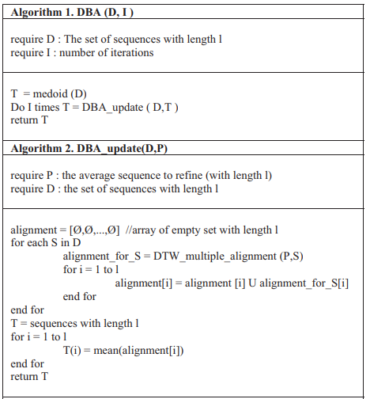
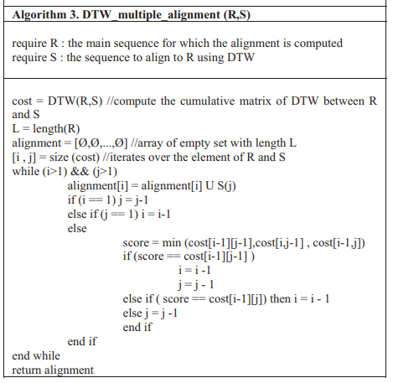
The pseudocode of DBA

Slide 11
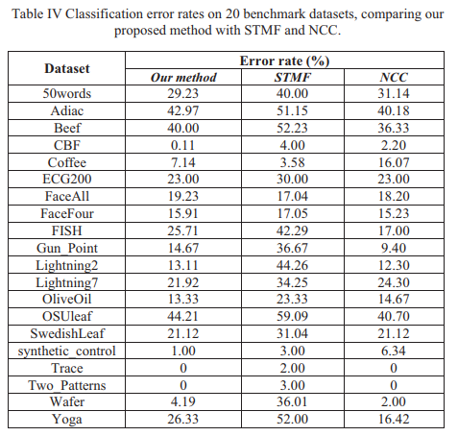
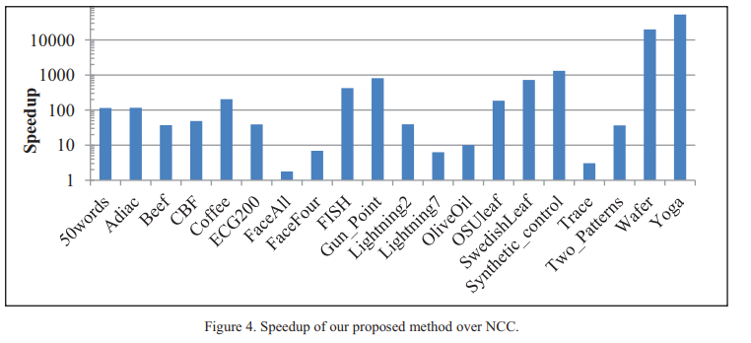
EXPERIMENT AND RESULTS

