Slide 1
Deep super-class learning for long-tail distributed image classification
Yucan Zhou, Qinghua Hu(胡清華), Yu Wang
Pattern Recognition 80 (2018) 118-128
Speaker: Du-Cheng Wu
Date: 2018.10.30
Notes:
https://goo.gl/61DG2A
所在城市:https://goo.gl/CAKxv3
所在的州:https://goo.gl/zwKsNb
Birth:12.02.1954

Slide 2
Abstract(1/3)
Long-tail distribution is widespread in many practical applications, where most categories contain only a small number of samples. As sufficient instances cannot be obtained for describing the intra-class diversity of the minority classes, the separating hyperplanes learned by traditional machine learning methods are usually heavily skewed. Resampling techniques and cost-sensitive algorithms have been introduced to enhance the statistical power of the minority classes, but they cannot infer more reliable class boundaries beyond the description of samples in the training set. To address this issue, we cluster the original categories into super-class to produce a relatively balanced distribution in the super-class space.

Slide 3
Abstract(2/3)
Moreover, the knowledge shared among categories belonging to a certain super-class can facilitate the generalization of the minority classes. However, existing super-class construction methods have some inherent disadvantages. Specifically, taxonomy-based methods suffer a gap between the semantic space and the feature space, and the performance of learning-based algorithms strongly depends on the features and data distribution. In this paper, we propose a deep super-class learning (DSCL) model to tackle the problem of long-tail distributed image classification. Motivated by the observation that classes belonging to the same super-class usually have more similar evaluations on the features than those belonging to different super-classes,

Slide 4
Abstract(3/3)
we design a block-structured sparse constraint and attach it on the top of a convolutional neural network. Thus, the proposed DSCL model can accomplish representation learning, classifier training, and super-class construction in a unified end-to-end learning procedure. We compared the proposed model with several super-class construction methods on two public image datasets. Experimental results show that the super-class construction strategy is effective for the long-tail distributed classification, and the DSCL model can achieve better results than the other methods.

Slide 5
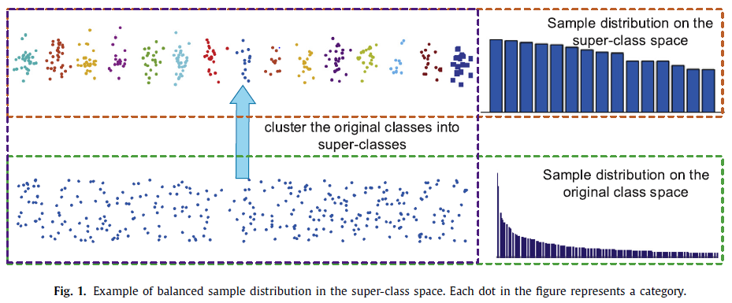
Deep super-class learning(DSCL)

Slide 6
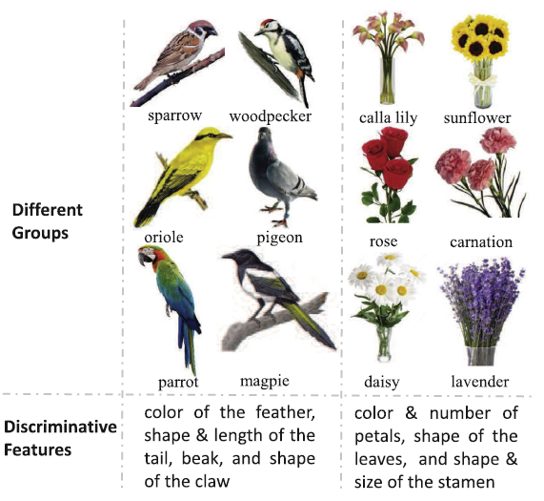
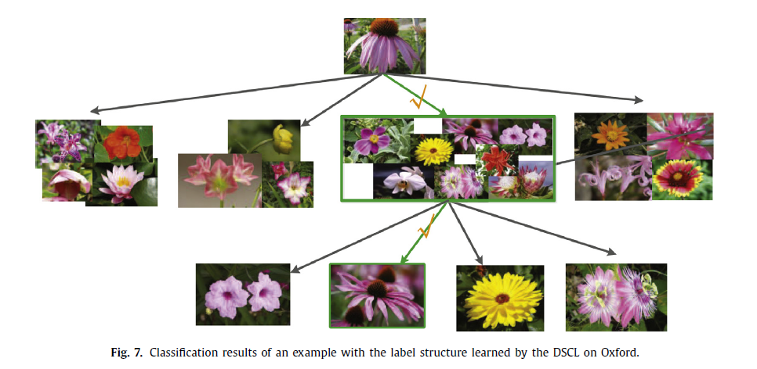
Deep super-class learning(DSCL)

Slide 7
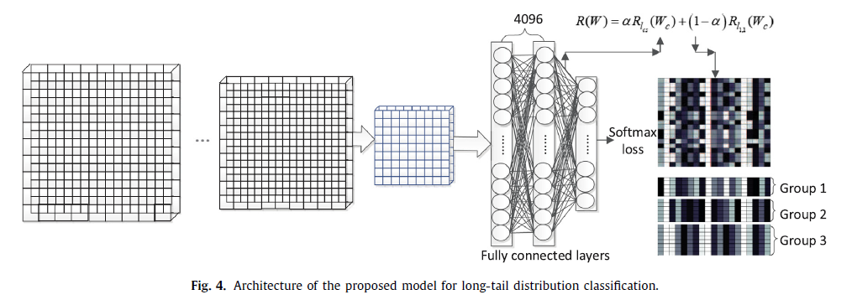
Deep super-class learning(DSCL)

Slide 8




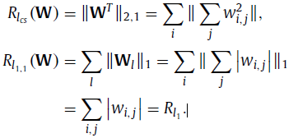
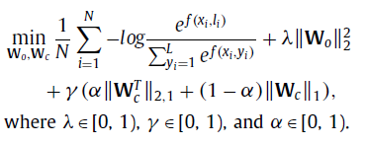
Deep super-class learning(DSCL)

Slide 9
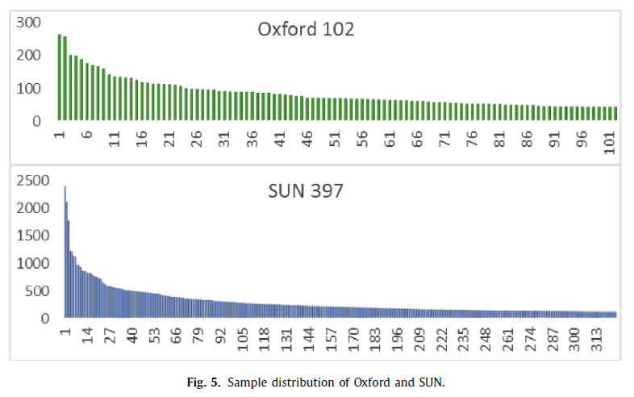
Deep super-class learning(DSCL)
102 flowers
8189 images
each between 40 to 289
324 classes
90261 images
each at least 100 images

Slide 10
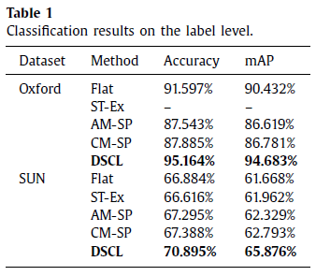
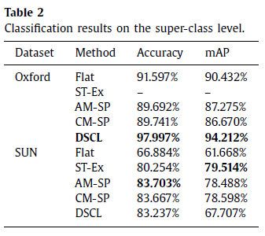
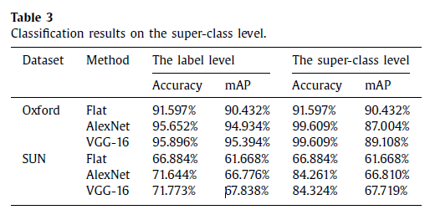
Deep super-class learning(DSCL)

