Slide 1
In Ictu Oculi: Exposing AI Generated Fake Face Videos by Detecting Eye Blinking
Yuezun Li, Ming-Ching Chang and Siwei Lyu
https://arxiv.org/abs/1806.02877
Presenter: Kuo-Feng Huang
Date: 2018/11/13

Slide 2

University at Albany - State University of New York

Slide 3
Abstract
The new developments in deep generative networks have significantly improve the quality and efficiency in generating realistically-looking fake face videos. In this work, we describe a new method to expose fake face videos generated with neural networks. Our method is based on detection of eye blinking in the videos, which is a physiological signal that is not well presented in the synthesized fake videos. Our method is tested over benchmarks of eye-blinking detection datasets and also show promising performance on detecting videos generated with DeepFake.

Slide 4
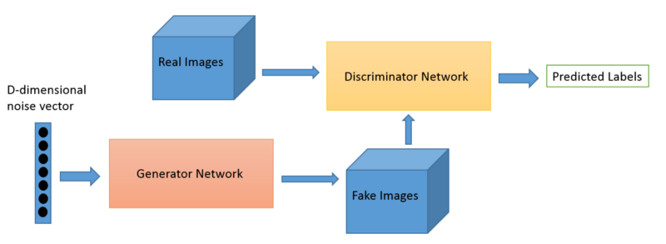
DeepFake
https://www.youtube.com/watch?v=JQGQcQrTy38
DeepFake uses generative adversary networks (GANs) to create videos of human faces of one subject to replace those in an original video.

Slide 5
Blinking
The mean resting blinking rate is 17 blinks/min or 0.283 blinks per second (during conversation this rate increases to 26 blinks/min, and decreases to 4.5 blinks/second while reading)
For now, however, I’ll assume an average rate of 17 blinks/min. The length of a blink is 0.1-0.4 seconds/blink .

Slide 6
Dataset
In our experiments, we use the CEW dataset to train the front-end CNN model, and select 40 videos as our training set for the overall LRCN model and 10 videos as the testing set.
The Closed Eyes in the Wild (CEW) dataset

Slide 7
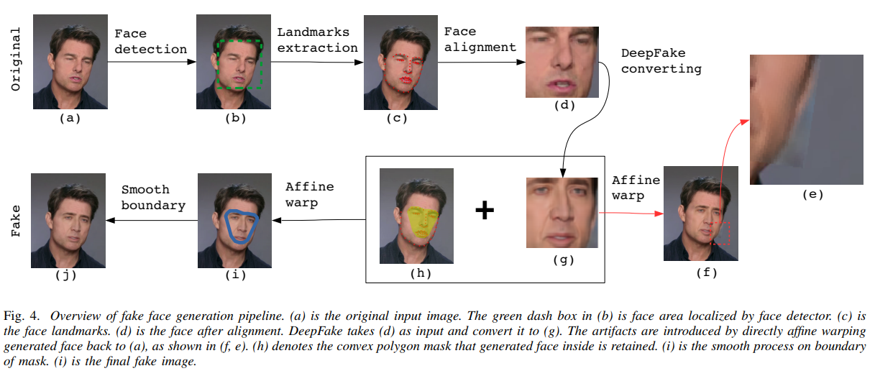
Fake Videos
http://www.cs.albany.edu/∼lsw/downloads.html
In our experiments, we use the CEW dataset to train the front-end CNN model, and select 40 videos as our training set for the overall LRCN model and 10 videos as the testing set.
The Closed Eyes in the Wild (CEW) dataset

Slide 8
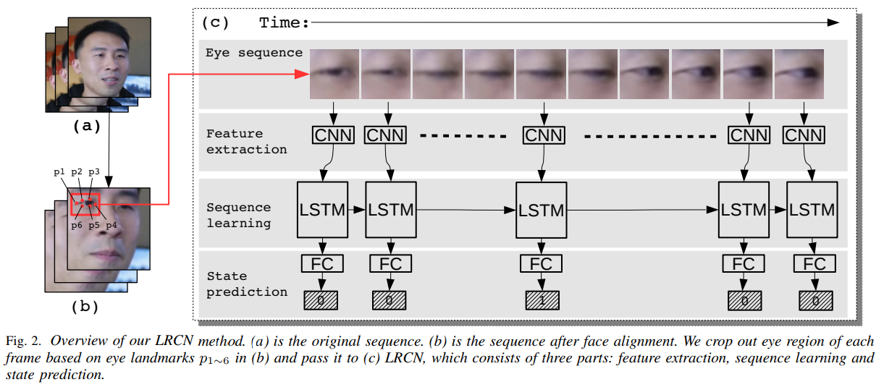
LRCN (Long-term Recurrent Convolutional Networks)

Slide 9
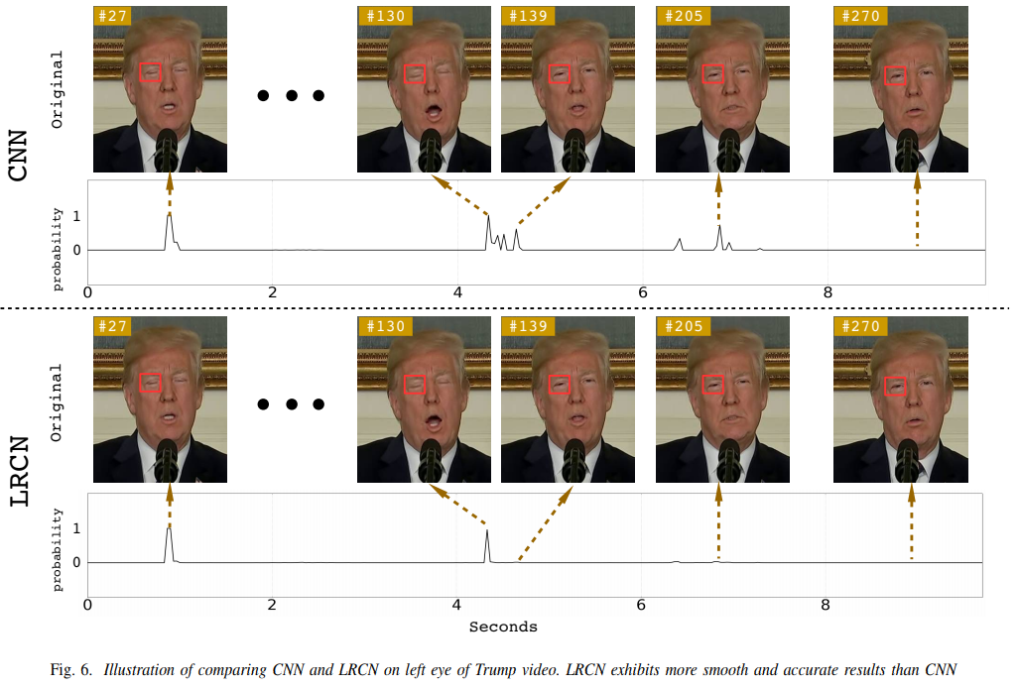
LRCN method

Slide 10
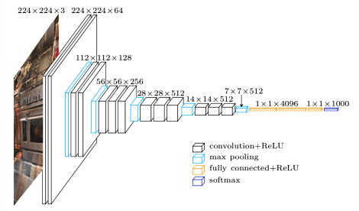
VGG16

Slide 11
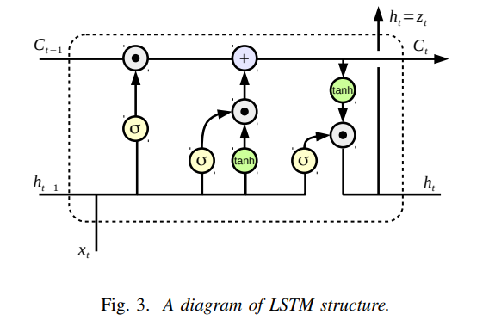
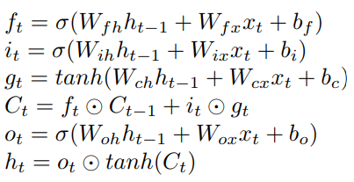
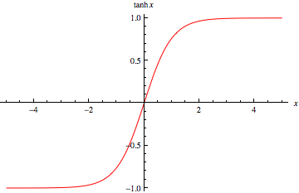
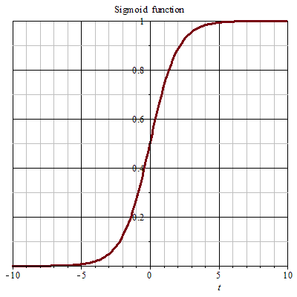


LSTM (Long Short Term Memory Network)
f
i
o
g

Slide 12
Training
The input size is fixed as 224x224 and the batch size is 16. The learning rate starts from 0.01 and decays by 0.9 each 2 epochs. We employ stochastic gradient descent optimizer and terminate training until it reaches the maximum epoch number 100.
We set batch size as 4. The learning rate starts from 0.01 and decay by 0.9 each 2 epochs. We use the ADAM optimizer [33] and terminate training until 100 epochs.
[33] D. P. Kingma and J. Ba, “Adam: A method for stochastic optimization,” arXiv preprint arXiv:1412.6980, 2014.

Slide 13
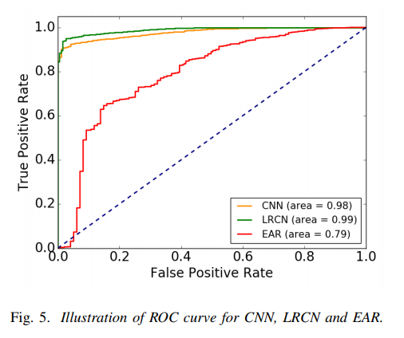
Results

