Slide 1
Parallel Huffman Decoding with Applications to JPEG Files*
Shmuel Tomi Klein , Yair Wiseman
The Computer Journal, Volume 46, Issue 5, 1 January 2003, Pages 487–497
Presenter : Feng-Yang Tsai
Date: 2018.11.11
Notes:
https://www.google.com.tw/maps/search/Bar+Ilan+University,/@32.0615398,34.8034257,11.85z
https://www.google.com.tw/maps/place/Jerusalem+College+of+Technology/@31.8419654,34.9372047,11.15z/data=!4m5!3m4!1s0x0:0x8a4bb3db69092450!8m2!3d31.7650581!4d35.1911581

Slide 2
Abstract
A simple parallel algorithm for decoding a Huffman encoded ﬁle is presented, exploiting the tendency of Huffman codes to resynchronize quickly, i.e. recovering after possible decoding errors, in most cases. The average number of bits that have to be processed until synchronization is analyzed and shows good agreement with empirical data. As Huffman coding is also a part of the JPEG image compression standard, the suggested algorithm is then adapted to the parallel decoding of JPEG ﬁles.

Slide 3
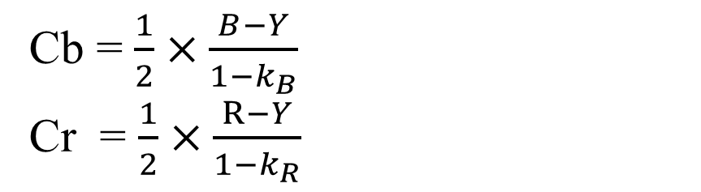
YCbCr
Y = 0.299R + 0.587G + 0.114B
Cb = $\frac{1}{2}×\frac{B−Y}{1−k_{B}}$
Cr = $\frac{1}{2}×\frac{R−Y}{1−k_{R}}$
Cb = 0.1687R – 0.3313G + 0.5B
Cr = 0.5R – 0.4187G – 0.0813B

Slide 4
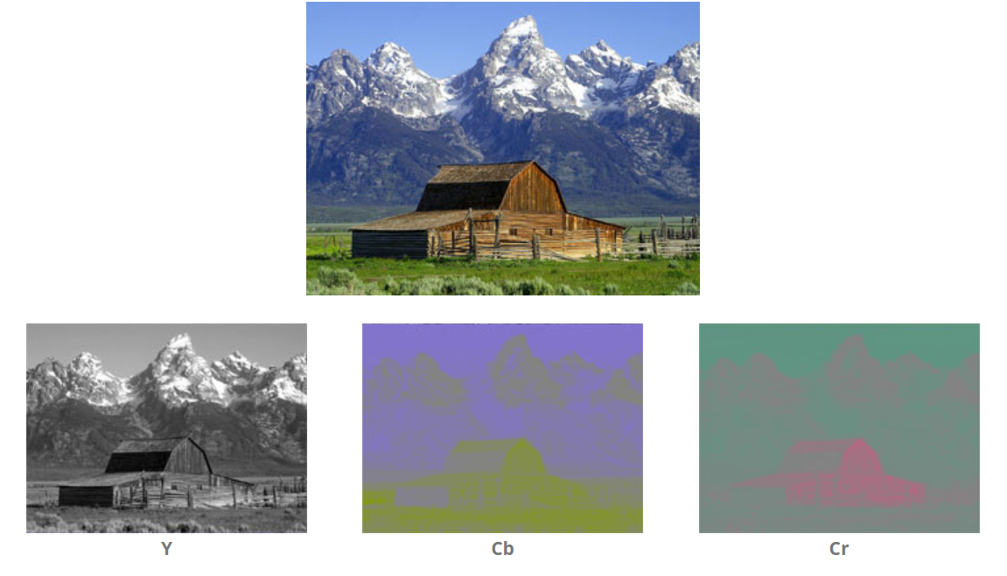

Slide 5
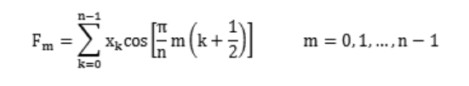
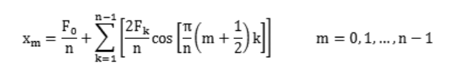
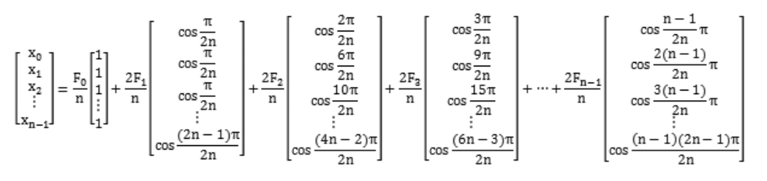
Discrete cosine transform
[x₀,x₁,x₂,…,x_{n-1}]

Slide 6
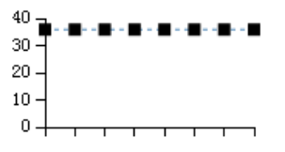
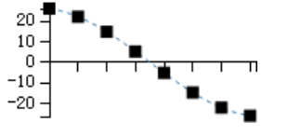
Xm=
[50,55,67,80,-10,-5,20,30]
m=0,1,…..,n-1
DCT
Fm=
[287.0, 106.3 , 14.2 , -110.8 , 9.2 , 65.7, -8.2 , -43.9]
[35.9,35.9,……..,35.9]
[26.0,22.1,14.8,5.2,-5.2,-14.8,-22.1,-26.1]

Slide 7
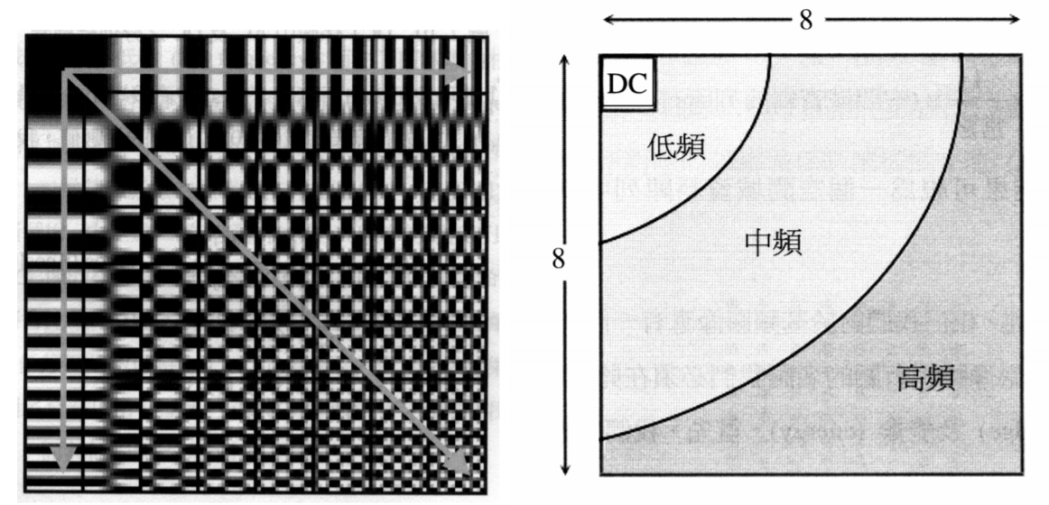

Slide 8



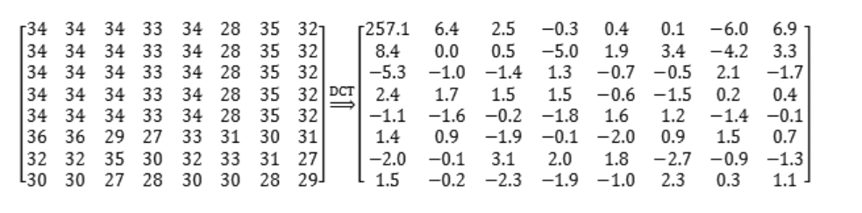

Slide 9

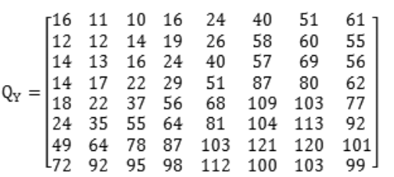
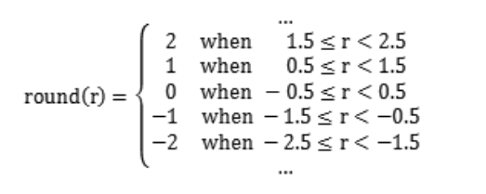
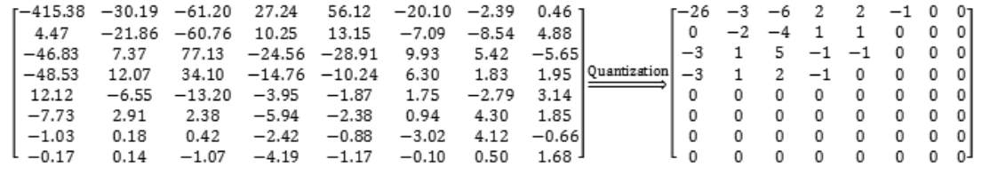
round(-415.38/16)=round(-25.96125)=-26

Slide 10
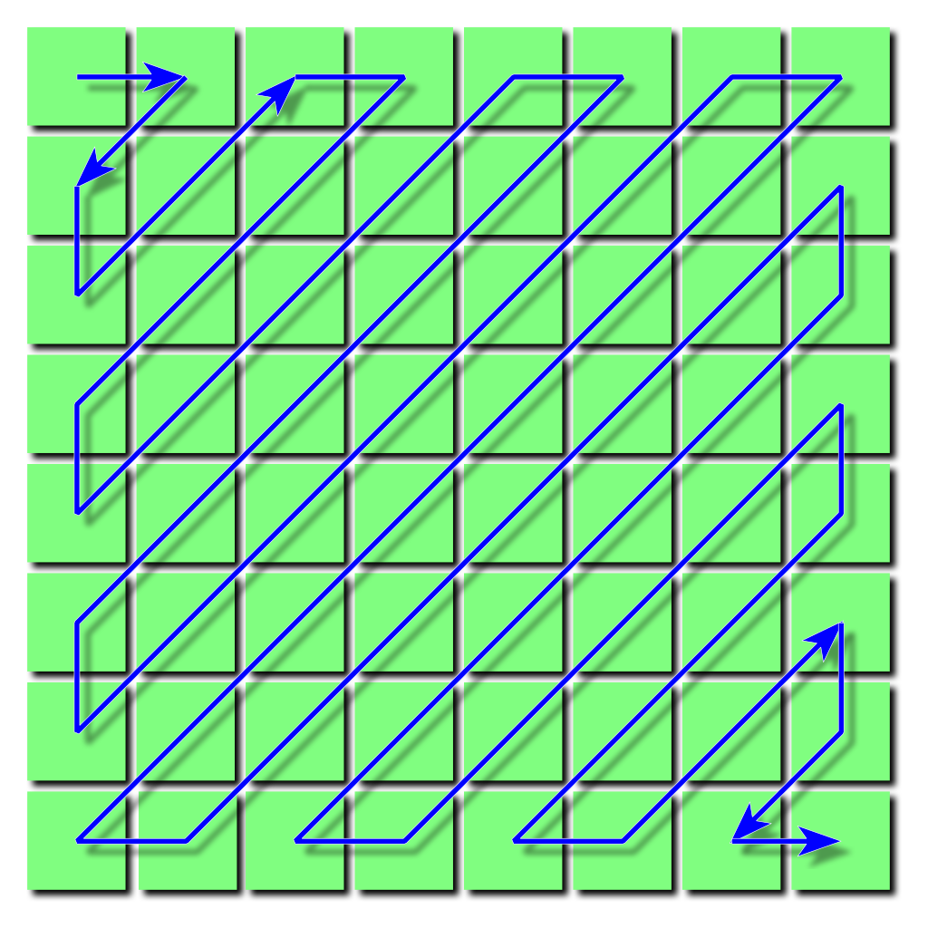
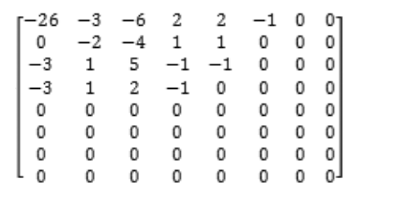
Zigzag encoding
-26,-3,0,-3,-2,-6,2,-4,1,-3,0,1,5,1,2,-1,1,-1,2,0,0,0,0,0,
-1,-1,0,0,0,0,…,0,0

Slide 11
35,7,0,0,0,-6,-2,0,0,-9,0,0,0,0,0,0,0,0,0,0,0,0,0,0,0,0,0,0,8,0,0,0,…,0
Run Length Encoding(RLE)
35 | 7 | 0,0,0,-6 | -2 | 0,0,-9 | 0,0,…,0,8 | 0,0,…,0
(0,35) | (0,7) | (3,-6) | (0,-2) | (2,-9) | (15,0) | (2,8) | EOB
Bit Encoding
 | (0,6, 100011) | (0,3, 111) | (3,3, 001) | (0,2, 01) | (2,4, 0110) | (15,-) | (2,4, 1000) | EOB
Huffman Coding
100 | 100011 | 100 | 111 | 1111 1111 0101 | 001 |  |  |  | … |  |  |  | 1010
100100011100111111111110101001010111111111010001101111111100111111111010010001010
91 CF FE A5 7F D1 BF CF FA 45
Notes:
原理：把資料中重複多次的內容，記錄其內容細節與出現的次數

Slide 12
Value |  | Size | Bits
0 |  | 0 | –
-1 | 1 | 1 | 0 | 1
-3,-2 | 2,3 | 2 | 00,01 | 10,11
-7,-6,-5,-4 | 4,5,6,7 | 3 | 000,001,010,011 | 100,101,110,111
-15,…,-8 | 8,…,15 | 4 | 0000,…,0111 | 1000,…,1111
-31,…,-16 | 16,…,31 | 5 | 0 0000,…,0 1111 | 1 0000,…,1 1111
-63,…,-32 | 32,…,63 | 6 | 00 0000,… | …,11 1111
-127,…,-64 | 64,…,127 | 7 | 000 0000,… | …,111 1111
-255,…,-128 | 128,…,255 | 8 | 0000 0000,… | …,1111 1111
-511,…,-256 | 256,…,511 | 9 | 0 0000 0000,… | …,1 1111 1111
-1023,…,-512 | 512,…,1023 | 10 | 00 0000 0000,… | …,11 1111 1111
-2047,…,-1024 | 1024,…,2047 | 11 | 000 0000 0000,… | …,111 1111 1111

Slide 13
Length | Value | Bits
3 bits | 04 05 03 02 06 01 00 (EOB) | 000 001 010 011 100 101 110
4 bits | 07 | 1110
5 bits | 08 | 1111 0
6 bits | 09 | 1111 10
7 bits | 0A | 1111 110
8 bits | 0B | 1111 1110

Slide 14
Length | Value | Bits
2 bits | 01 02 | 00 01
3 bits | 03 | 100
4 bits | 00 (EOB) 04 11 | 1010 1011 1100
5 bits | 05 12 21 | 1101 0 1101 1 1110 0
6 bits | 31 41 | 1110 10 1110 11
… | … | …
12 bits | 24 33 62 72 | 1111 1111 0100 1111 1111 0101 1111 1111 0110 1111 1111 0111
15 bits | 82 | 1111 1111 1000 000
16 bits | 09 … FA | 1111 1111 1000 0010 … 1111 1111 1111 1110

