Slide 1
Developing Arbitrage Strategy in High-frequency Pairs Trading with Filterbank CNN Algorithm
Yu-Ying Chen(陳盈伃), Wei-Lun Chen(陳韋綸), and Szu-Hao Huang(黃思皓)
2018 IEEE International Conference on Agents
2018 July 28-31, Singapore, Singapore
Presenter: Cheng-Han Wu
Date:2018/11/12

Slide 2
Abstract(1/2)
Pairs trading is a statistical arbitrage strategy, which selects a set of assets with similar performance and produces profits during these asset prices far away from rational equilibrium. Once this phenomenon exists, traders can earn the spread by longing the underperforming asset and shorting the outperforming asset. This paper proposed a novel intelligent high-frequency pairs trading system in Taiwan Stock Index Futures (TX) and Mini Index Futures (MTX) market based on deep learning techniques. This research utilized the improved time series visualization method to transfer historical volatilities with different time frames into 2D images which are helpful in capturing arbitrage signals.

Slide 3
Abstract(2/2)
Moreover, this research improved convolutional neural networks (CNN) model by combining the financial domain knowledge and filterbank mechanism. We proposed Filterbank CNN to extract high-quality features by replacing the random-generating filters with the arbitrage knowledge filters. In summary, the accuracy is enhanced through the proposed method, and it proves that the integrated information technology and financial knowledge could create the better pairs trading system.

Slide 4
Tick Data
Taiwan Stock Index Futures (TX) : 臺股期貨
Mini Index Futures (MTX) : 小型臺指期貨
trading time = 17 million
Date : 2012~2014
Sliding window with 6 months for training and 1 month for testing
Notes:
TX MTX main diff is at daily close price

Slide 5
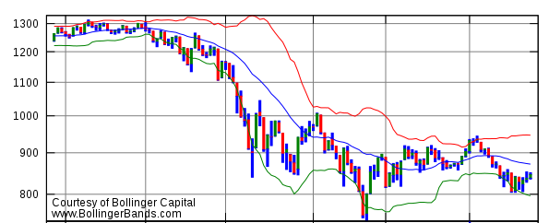

Rule-based Strategy
Bollinger bands
$Upper Bond = μ_{R,T}+multiple×σ_{R,T}$
$Lower Bond = μ_{R,T}−multiple×σ_{R,T}$
$R_{T}=\frac{P_{TX,T}}{P_{MTX,T}}$
$T=160$, $multiple$=2

Slide 6
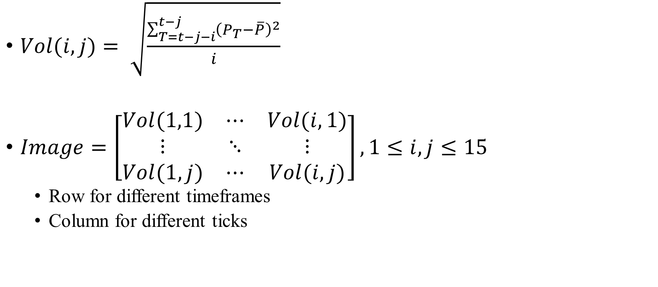
Time Series Visualization
$Vol(i,j)= \sqrt{\frac{\sum_{T=t−j−i}^{t−j}{{\left(P_{T}−\overline{P}\right)}^{2}}}{i}}$
$Image=\left[\begin{matrix}Vol(1,1) & ⋯ & Vol(i,1) \\ ⋮ & ⋱ & ⋮ \\ Vol(1,j) & ⋯ & Vol(i,j)\end{matrix}\right],1≤i,j≤15$
Row for different timeframes
Column for different ticks

Slide 7
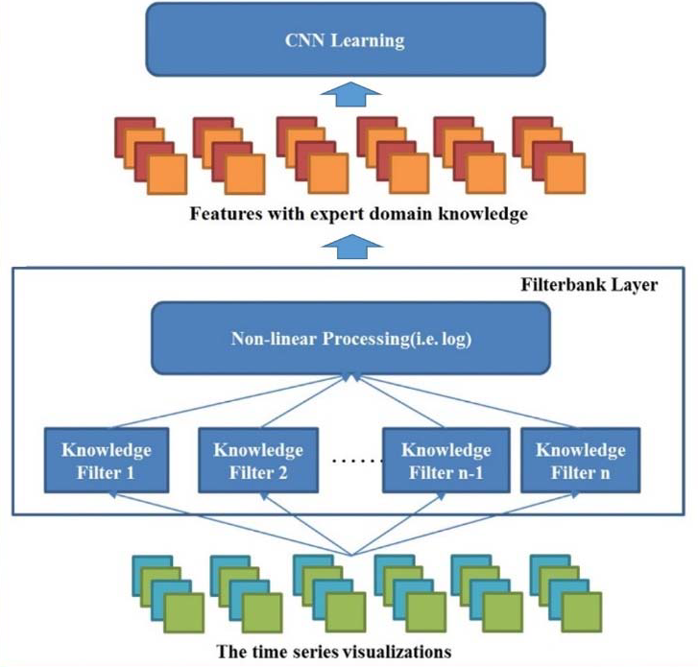
Filterbank CNN

Slide 8

Haar-like filter
$Feature_{Knowledge}= {filter}_{Knowledge}^{T}+Image$
$Log Feature_{Knowledge}=log⁡(Feature_{Knowledge})$

Slide 9
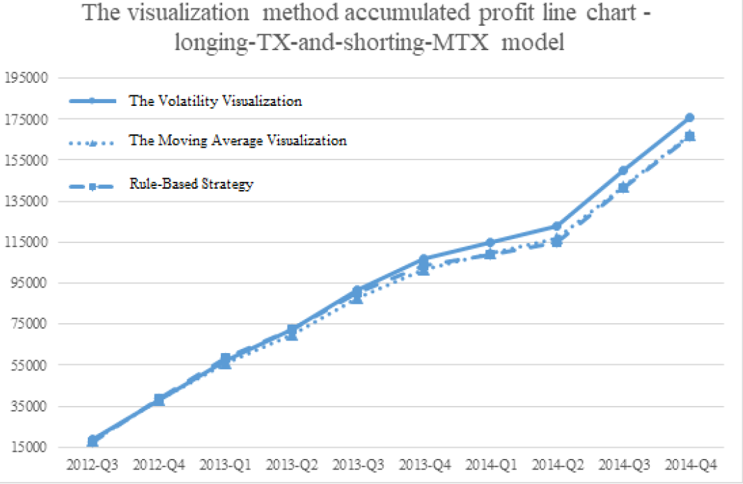
Experimental Result

