Slide 1
Mismatch string kernels for discriminative protein classification
Christina Leslie, Eleazar Eskin, Adiel Cohen, Jason Weston2
and William Stafford Noble
BIOINFORMATICS, Vol. 1, No. 1, 2003, Pages 1–10

Slide 2
Abstract
Motivation:
Classification of protein sequences into functional and structural families based on sequence homology is a central problem in computational biology. Discriminative supervised machine learning approaches provide good performance, but simplicity and computational efficiency of training and prediction are also important concerns.

Slide 3
Abstract
Results:
We introduce a class of string kernels, called mismatch kernels, for use with support vector machines (SVMs) in a discriminative approach to the problem of protein classification and remote homology detection. These kernels measure sequence similarity based on shared occurrences of fixed-length patterns in the data, allowing for mutations between patterns.

Slide 4
Abstract
Thus the kernels provide a biologically well-motivated way to compare protein sequences without relying on family-based generative models such as hidden Markov models. We compute the kernels efficiently using a mismatch tree data structure, allowing us to calculate the contributions of all patterns occurring in the data in one pass while traversing the tree. When used with an SVM, the kernels enable fast prediction on test sequences.

Slide 5
Abstract
We report experiments on two benchmark SCOP data sets, where we show that the mismatch kernel used with an SVM classifier performs competitively with state-of-the-art methods for homology detection, particularly when very few training examples are available. Examination of the highest-weighted patterns learned by the SVM classifier recovers biologically important motifs in protein families and superfamilies.

Slide 6
Abstract
Availability:
SVM software is publically available at
http://microarray.cpmc.columbia.edu/gist.
Mismatch kernel software is available upon request.
Contact: cleslie@cs.columbia.edu

Slide 7
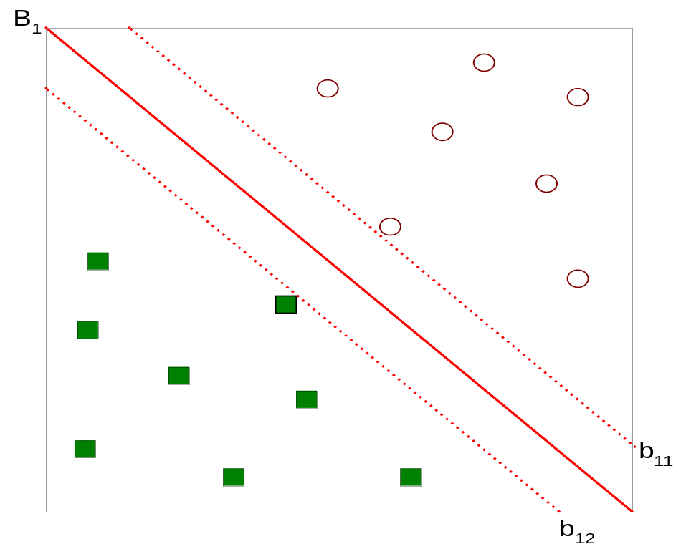



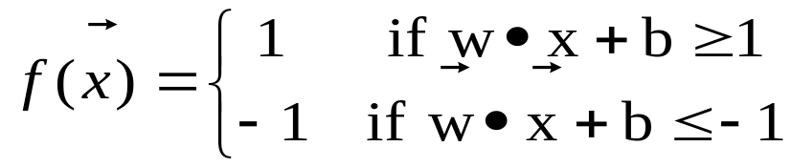
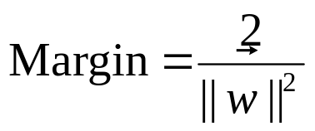
Support Vector Machines
The problem is linearly separable.
Taken from the textbook: Introduction to Data Mining

Slide 8
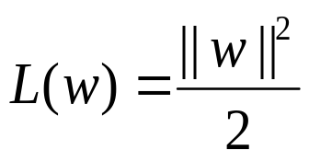
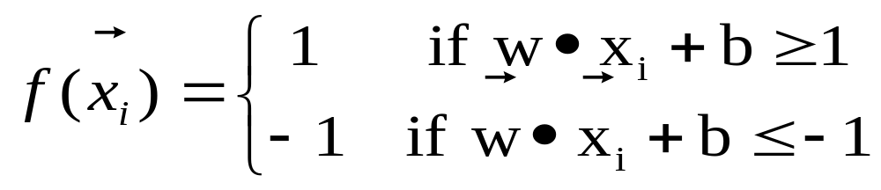

Support Vector Machines
The linearly separable problem.
We want to maximize:
  Which is equivalent to minimizing:
  But subjected to the following constraints:
  So the problem is:
    Numerical approaches to solve it (e.g., quadratic programming)
Taken from the textbook: Introduction to Data Mining

Slide 9
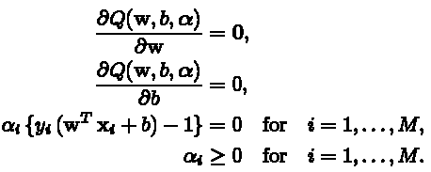


Support Vector Machines
解最小化時須對所將解變數微分
因此得到
代入原最小化公式得

Slide 10

Support Vector Machines
M為資料數目
α_{i}為待解變數，x_{i}為特徵向量，y_{i}為{+1,-1}
x_{i}^{T}x_{j}為向量內積，也可以是兩向量轉換至更高維空間後之內積K(x_{i},x_{j})=g(xi)^{T}g(xj)，稱為kernel function，用於衡量兩向量之相似程度。
x_{i}^{T}x_{j}(或是K(x_{i},x_{j}))一般會先算好存在計憶體中
解得α_{i}後，再求解

Slide 11



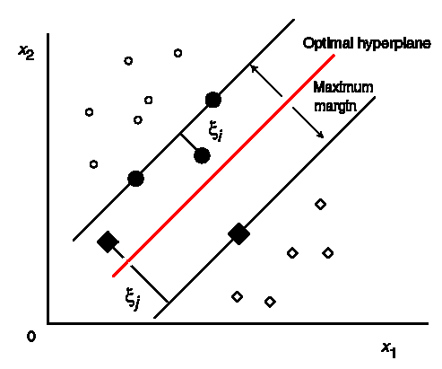
Support Vector Machines
最後再求解
將w和b代入決策函數D(x)=f(x)=y=wx+b得到
SVM可視為將未知的向量x先和已知support vector xi內積(或求Kernel K(xi,x) or H(xi,x))，乘上已知xi之Label yi，然後再加權αi求和
其中0=wx+b為決策邊界

Slide 12
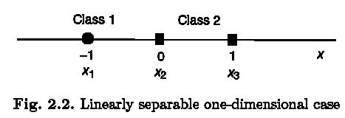

SVM Example
(x1,x2,x3)=(-1,0,1), (y1,y2,y3)=(1,-1,-1)代入公式
得到Q=α1+α2+α3-½*(α1*α1+α3*α3+2*α1*α3)
根據 得到α1-α2-α3=0 ⇒ α2= α1-α3
再代入Q得到Q=2*α1-½*(α1+α3)²
要使Q最小，則α3=0，再代入Q
得到Q=2*α1-½*(α1)^2=-½*(α1-2)²+2
要使Q最小，則α1=2⇒ α2= α1=2

Slide 13
SVM Example
α1= α2=2, α3=0代入斜率公式
得到w=α1*y1*x1=-2，再代入截距公式
得到b=½*{(1-(-2)(-1))+(-1)-(-2)(0))}=-1
決策函數
得到D(x)=2*x1*y1*x+b=-2*x-1
最佳決策邊界在=-½

Slide 14
String Kernel
Φ為字串或序列特徵向量，K為kernel function ， <•>表向量內積，則string kernel定義為
和SVM的kernel類似，string kernel可以視為兩字串(或序列)向量的內積(或相似度)
  Spectrum kernel
  All-subsequence kernel
  Gap-weighted subsequqnce kernel
  Mismatch kernel(for this paper)

Slide 15

SVM & String Kernel
Using string kernel & SVM for string (or sequqnce) classification
String
Non-string

Slide 16
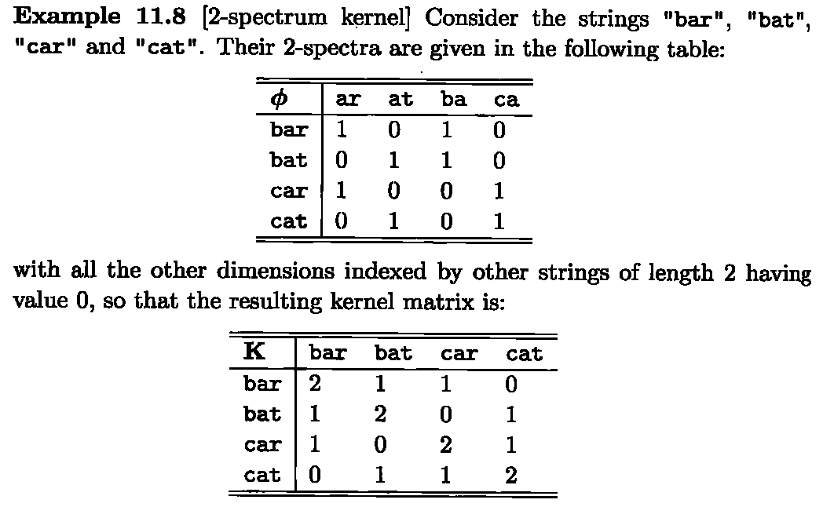
Spectrum Kernel
向量內積

Slide 17
The k-Spectrum of a Sequence
Feature map for SVM based on spectrum of a sequence
The k-spectrum of a sequence is the set of all k-length contiguous subsequences that it contains
Feature map is indexed by all possible k-length subsequences
(“k-mers”) from the alphabet of
amino acids
Dimension of feature space = 20k
Generalizes to any sequence data
AKQDYYYYEI
AKQ
KQD
QDY
DYY
YYY
YYY
YYE
YEI
Taken from Christina Leslie’s PPT

Slide 18
k-Spectrum Feature Map
Feature map for k-spectrum with no mismatches:
For sequence x, F(k)(x) = (Ft (x)){k-mers t}, where Ft (x) = #occurrences of t in x
AKQDYYYYEI
( 0 , 0 , … , 1 , … , 1 , … , 2 )
AAA AAC … AKQ … DYY … YYY
Taken from Christina Leslie’s PPT

Slide 19
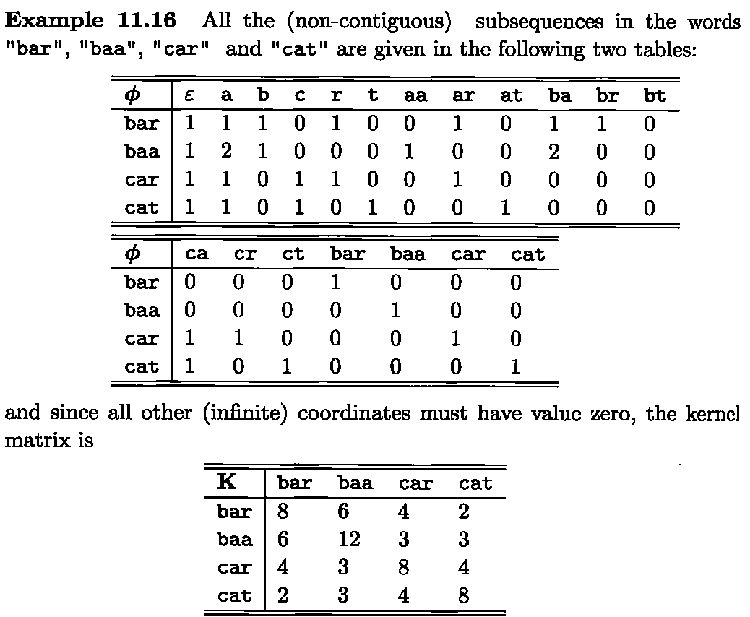
All-subsequence Kernel
→Vector1
→Vector2
→Vector3
→Vector4
→Vector1
→Vector2
→Vector3
→Vector4

Slide 20
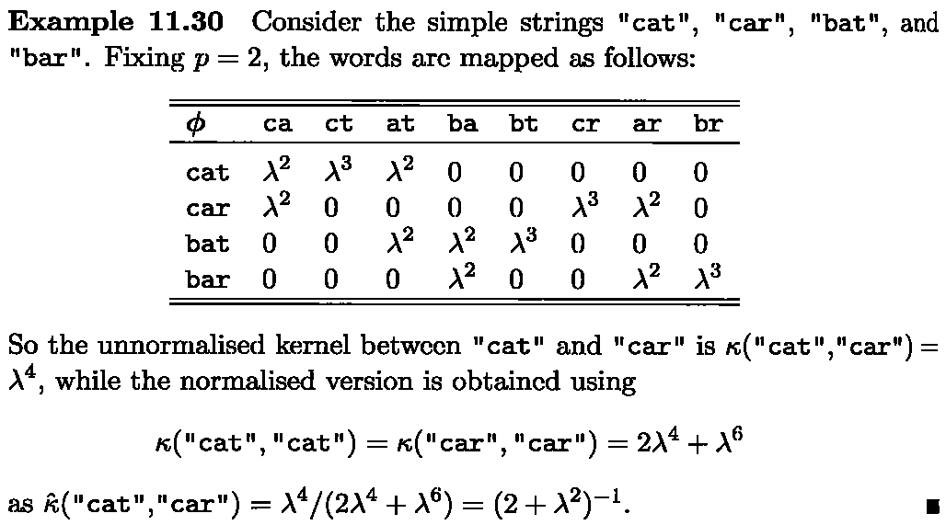
Gap-weighted Subsequqnce Kernel

Slide 21
Mismatch Kernel
The mismatch kernel is calculated based on shared occurrences of (k;m)-patterns in the data, where the (k;m)-pattern generated by a fixed k-length subsequence consists of all k-length subsequences differing from it by at most m mismatches.
(3,1)-pattern
  ABC ↔ ABC, AB_, _BC, A_C

Slide 22
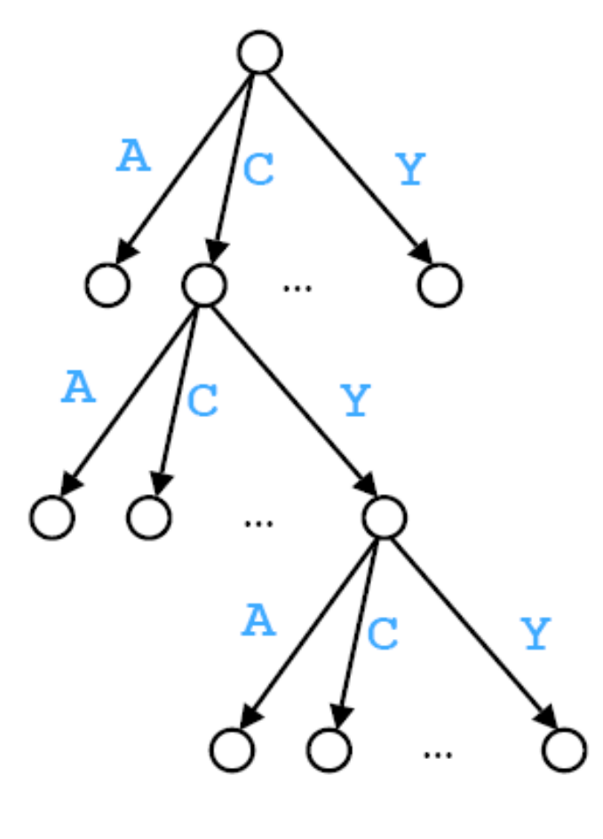
Mismatch Tree
Mismatches can be efficiently tracked through a tree.
Taken from Christina Leslie’s PPT

Slide 23
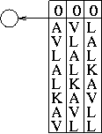
Example: Traversing the Mismatch Tree
Traversal for input sequence: AVLALKAVLL, k=8, m=1
Taken from Christina Leslie’s PPT

Slide 24
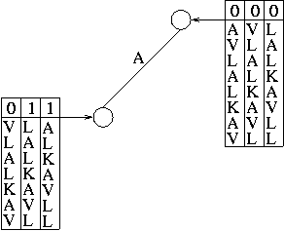
Example: Traversing the Mismatch Tree
Traversal for input sequence: AVLALKAVLL, k=8, m=1
表示mismatch字元個數
Taken from Christina Leslie’s PPT

Slide 25
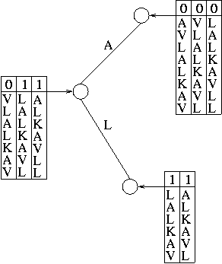
Example: Traversing the Mismatch Tree
Traversal for input sequence: AVLALKAVLL, k=8, m=1
不列入計分
2
L
K
A
V
L
L
Taken from Christina Leslie’s PPT

Slide 26
Example: Computing the Kernel for Pair of Sequences
Traversal of trie for k=3 (m=0)
A
S¹:
EADLALGKAVF
S²:
ADLALGADQVFNG
Taken from Christina Leslie’s PPT

Slide 27
Example: Computing the Kernel for Pair of Sequences
Traversal of trie for k=3 (m=0)
A
S¹:
EADLALGKAVF
S²:
D
ADLALGADQVFNG
Taken from Christina Leslie’s PPT

Slide 28
Example: Computing the Kernel for Pair of Sequences
Traversal of trie for k=3 (m=0)
A
s¹:
EADLALGKAVF
s²:
D
ADLALGADQVFNG
L
Update kernel value for K(s¹,s²) by adding contribution for feature ADL
Taken from Christina Leslie’s PPT

Slide 29


Time Complexity
If the number of symbols is l, the number of k-mers within m mismatches of any given fixed k-mer is
As each k-mer instance that is counted at a leaf node is processed k times as it is passed down the path from the root. Thus to calculate a single kernel value for sequqnce x and y, the complexity is

Slide 30
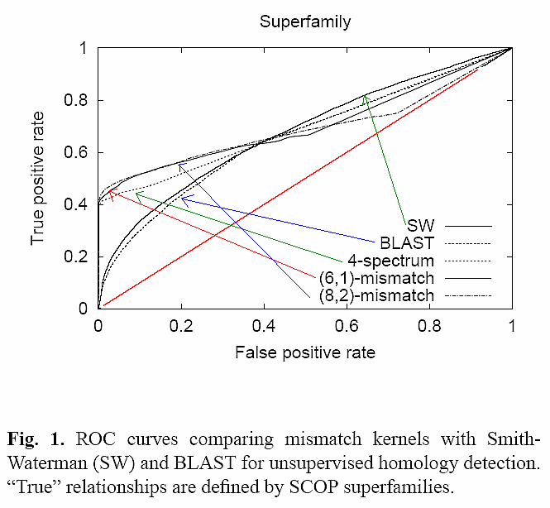

Experiment 1
1.Calculate normalized kernel
2.Calculate induced distance
3.Varying distance threshold & observe: a pair of homologous proteins that is below the threshold is considered a true positive,
while a pair of non-homologous proteins below the threshold is considered a false positive.

Slide 31
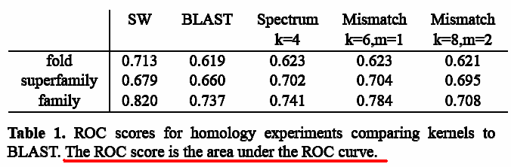
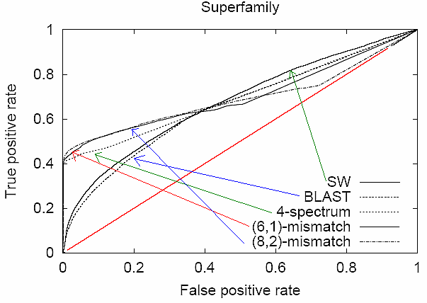
Experiment 1

Slide 32
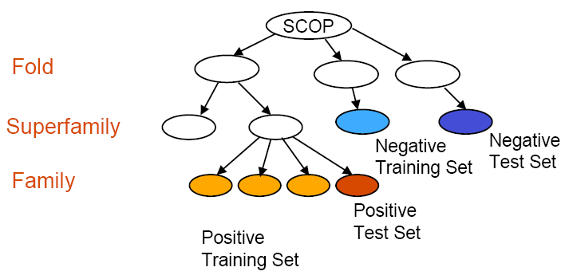
Experiment 2
Positive training examples are chosen from the remaining families in the same superfamily, and negative test and training examples are chosen from disjoint sets of folds outside the target family’s fold.
Tested with experiments on SCOP dataset from Jaakkola et al.
Experiments designed to ask: Could the method discover a new family of a known superfamily?
Taken from Christina Leslie’s PPT

Slide 33
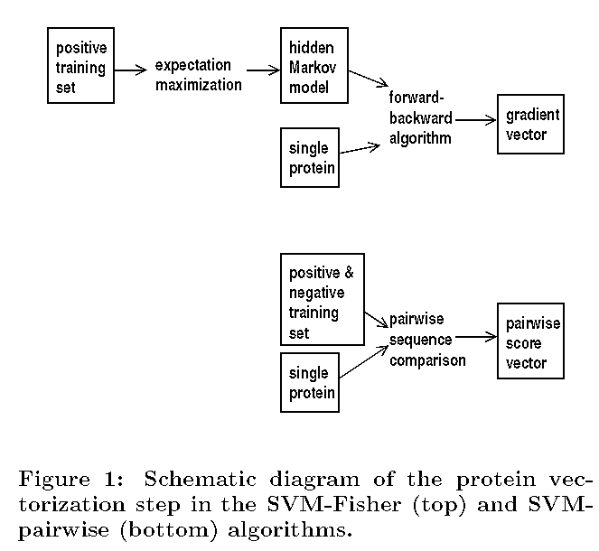
SVM Fisher & pairwise

Slide 34
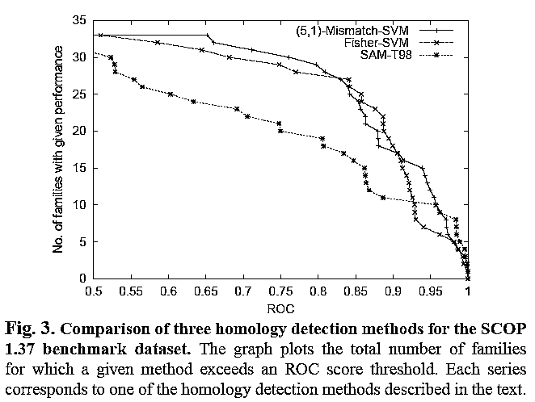
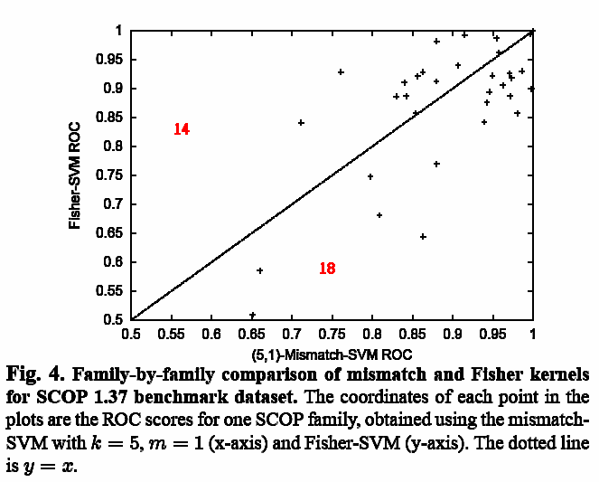
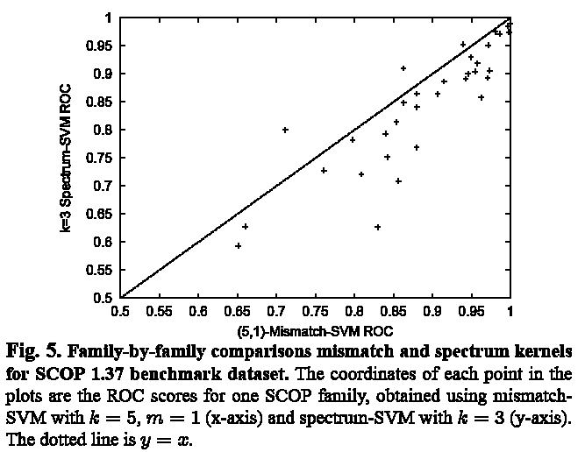
Experiment 2
(5,1)-Mismatch kernel obviously outperforms 3-spectrum kernel but is only slightly better than Fisher-SVM.

Slide 35
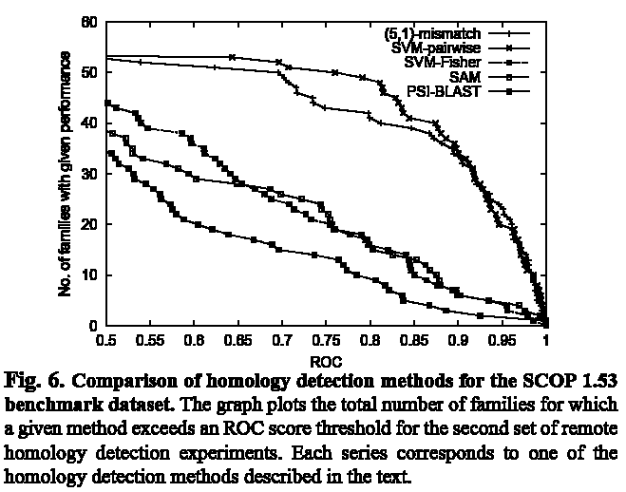
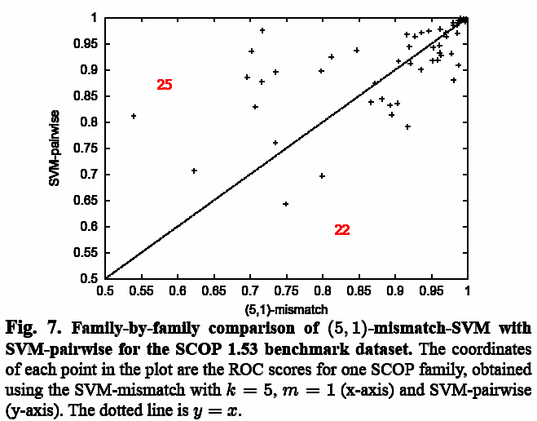
Experiment 2
Although (5,1)-Mismatch kernel does not outperforms SVM-pairwise, it is faster.

Slide 36
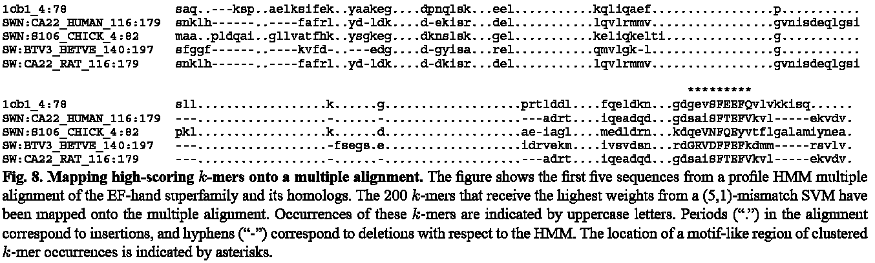
Experiment 3
A sequence that contains many k-mers with large, positive weights is very likely to be a member of the positive class defined by the classifier. Therefore, in the case of protein classification, we expect these highly informative k-mers to correspond to conserved regions in the protein family alignment.

