Slide 1
Fixed-Parameter Algorithms for Protein Similarity Search Under mRNA Structure Constraints
Guillaume Blin, Guillaume Fertin,
Danny Hermelin, and Stèphane Vialette
Graph-Theoretic Concepts in Computer Science
31st International Workshop, WG 2005, Metz, France, June 23-25, 2005
Speaker: Chun-Jen Chen
Date: Feb. 17, 2009

Slide 2
Abstract
In the context of protein engineering, we consider the problem of computing an mRNA sequence of maximal codon-wise similarity to a given mRNA (and consequently, to a given protein) that additionally satisfies some secondary structure constraints, the so-called MRSO problem [2]. Since the MRSO problem is known to be APX-hard [8], Bongartz proposed in [8] to attack the problem using the concept of parameterized complexity.
115/11/07

Slide 3
Abstract
In this paper we follow this suggested approach by devising fixed-parameter algorithms for several interesting parameters of MRSO. We believe these algorithms to be relevant for practical applications today, as well as for several future applications. Furthermore, our results extend the known tractability borderline of MRSO, and provide new research horizons for further improvements of this sort.
115/11/07

Slide 4
An mRNA is a string over the alphabet
Σ = {A,C, G,U}
The pairs {A,U}, {G,C}, and {G,U} are known as complementary nucleotide pairs.
115/11/07

Slide 5
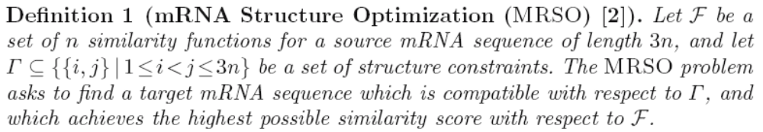
115/11/07

Slide 6
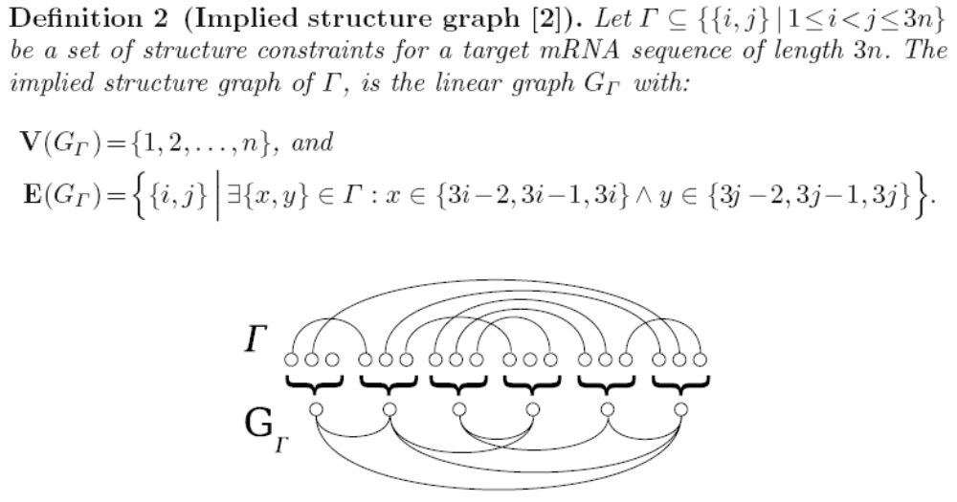
115/11/07

Slide 7
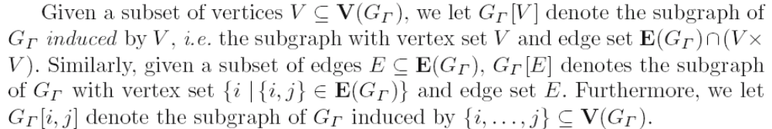
G_{Γ} [V]：V集合裡面所有點，加上G_{Γ} 中兩端
點都在V集合裡的edge
G_{Γ} [E]：E集合裡的所有edge，加上E(G_{Γ})裡
的所有edge的兩端點
115/11/07

Slide 8

An assignment for a pair of vertices
i, j ∈ V(G_{Γ} ), i → t_{3i−2}t_{3i−1}t_{3i} and
j → t_{3j−2}t_{3j−1}t_{3j} , is compatible with respect to G_{Γ} , if either {i, j} E(G_{Γ}) or t_{i} and t_{j} are complementary nucleotides for any {i, j} ∈ Γ ∩{3i−2, 3i−1, 3i} × {3j− 2, 3j−1, 3j}
115/11/07

Slide 9
χ: The number of edge crossings in G_{Γ}
δ: The number of degree 3 vertices in G_{Γ}
Our initial interest in parameters χ and δ arises from the fact that we believe them to be small in many practical applications
It turns out that MRSO is polynomial-time solvable when either χ or δ are fixed.
115/11/07

Slide 10
Definition 3 (Nice edge bipartition).
Let G_{Γ} be an implied structure graph with n vertices. An edge bipartition P = (E_{t},E_{b}) of G_{Γ} is a partitioning of the edges in G_{Γ} into E_{t} and E_{b}, the top and bottom edges of P respectfully, such that
E_{t} ∪ E_{b} = E(G_{Γ}), E_{t} ∩ E_{b} = ∅ and E_{t} ≠ ∅. Furthermore, P is said to be nice if the subgraph G_{Γ}[Et] is outerplanar.
115/11/07

Slide 11
Definition 4 (Corresponding similarity functions).
Let (G_{Γ} ,F) be an instance of MRSO with F = f₁, . . . , f_{n}. Also, let φ : V → Σ³ be a codon assignment for some V ⊆ V(G_{Γ} ). The corresponding set of similarity functions of assignment φ, denoted F_{φ} = f_{φ}¹ , . . . , f_{φ}^{n}, is defined as follows:
– For all i ∈ V : f_{φ} ^{i} (φ(i)) = f_{i}(φ(i)), and f_{φ} ^{i} (C) = −∞ for any C = φ(i).
– For all j ∈ V(G_{Γ} ) − V : f _{j} ^{φ} = f_{j}.
115/11/07

Slide 12
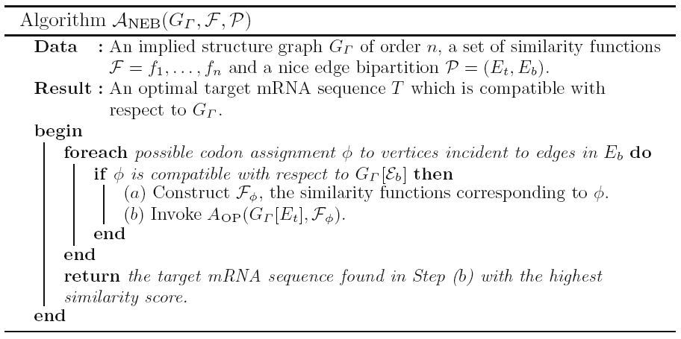

Slide 13
Lemma 1. Given an instance (G_{Γ} ,F) for MRSO accompanied by a nice edge bipartition P = (E_{t},E_{b}) of G_{Γ} , A_{NEB} computes an optimal target mRNA sequence for this instance in O(64^{2ε}n) time, where n = |V(G_{Γ})| and ε= |E_{b}|.

