Slide 1
Rapid Identification of Repeated Patterns in Strings, Arrays and Trees (Karp, Miller and Rosenberg, 1972)
Efficient Algorithms on Texts, 1997
– Section 8.1 KMR Algorithm
M. Crochemore & W. Rytter
Date: Feb. 25, 2009
Introducer: Hsing-Yen Ann

Slide 2
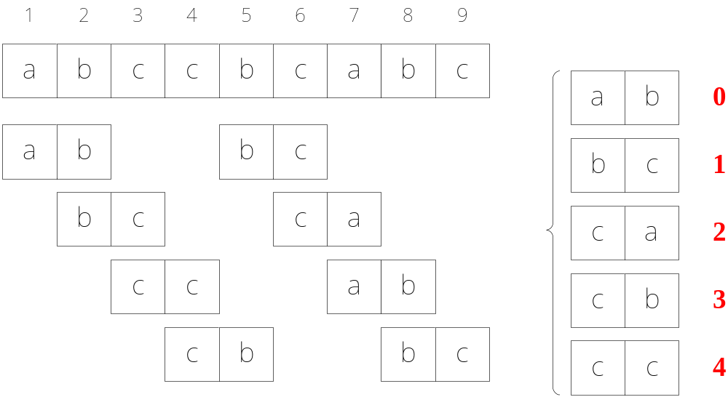
The r-grams
The set of all length-r substrings of text T
For example: 2-grams

Slide 3
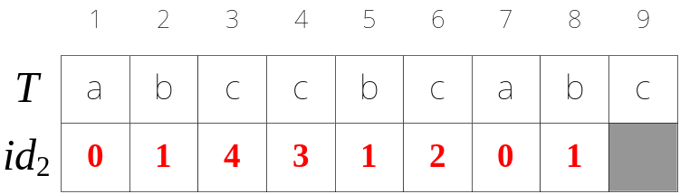
The Identification of Repeated Patterns Problem
Problem definition:
  Input: a text T of length n and the gram size r
  Output: the array id_{r} , where id_{r}[i] denotes the id of
  the r-gram for each start location i

Slide 4
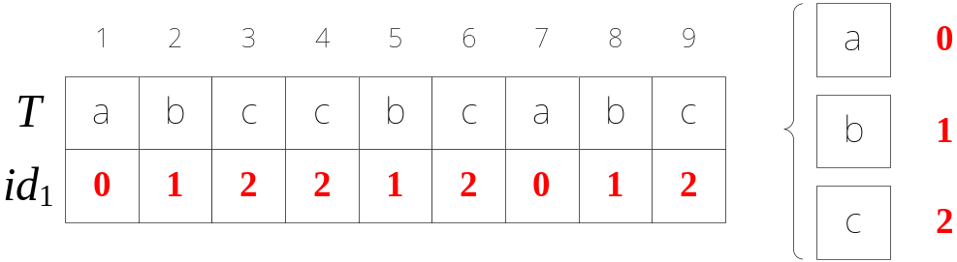
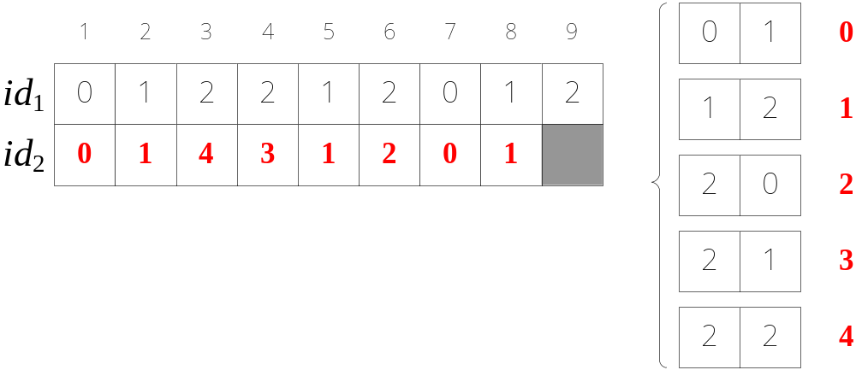
KMR Algorithm (1/4)
1-grams
2-grams

Slide 5
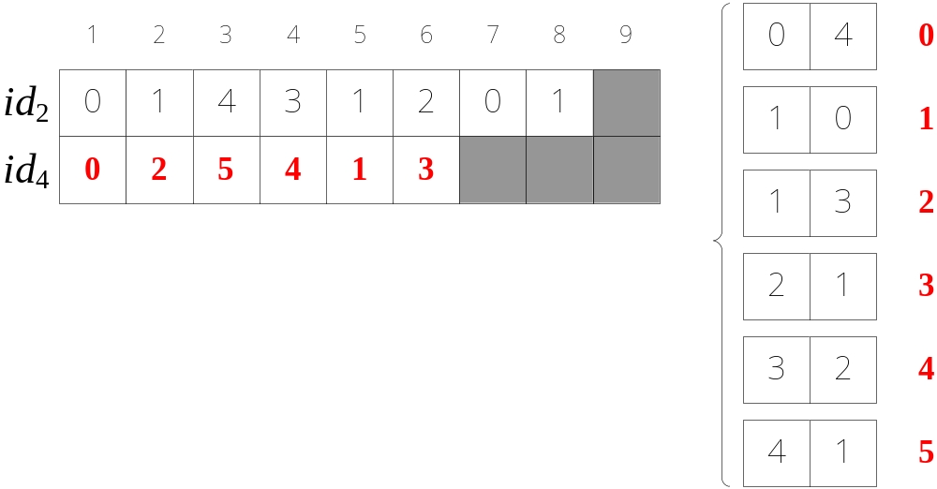
KMR Algorithm (2/4)
4-grams

Slide 6
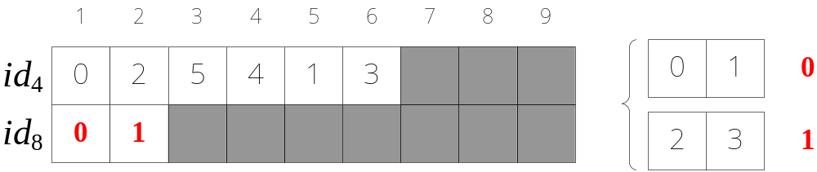
KMR Algorithm (3/4)
8-grams

Slide 7
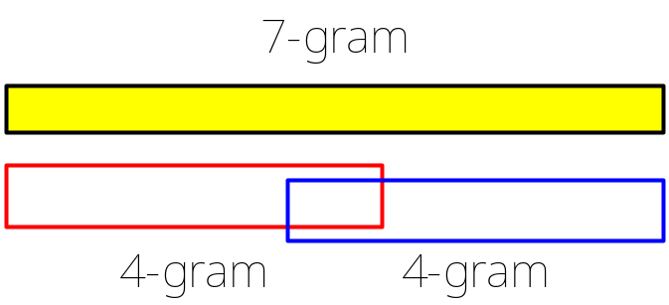
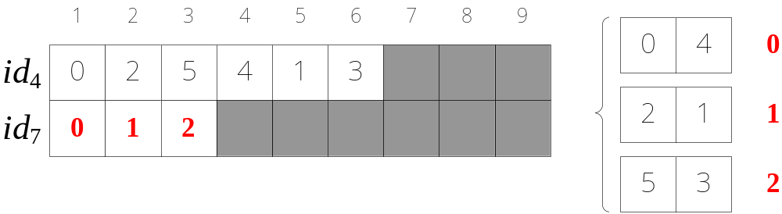
KMR Algorithm (4/4)
How about 7-gram?
Can be solved by two 4-grams

Slide 8
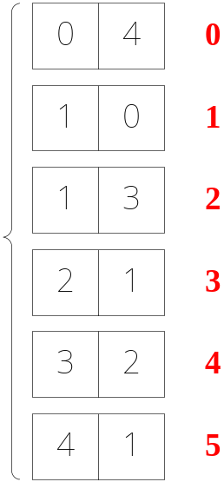
A Small but Difficult Problem
How to renumber the pairs for each iteration efficiently?
  By using merge sort, O(n log n) time
  By using vEB tree, O(n log log n + n²) time
  (Note that U = O (n²) )
How to achieve O(n) time?
  Bucket sort + radix sort

Slide 9
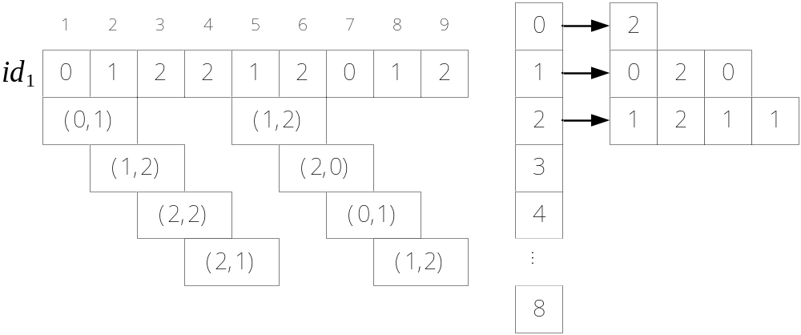
Radix Sort with Buckets (1/2)
Pass 1: sort by right elements

Slide 10
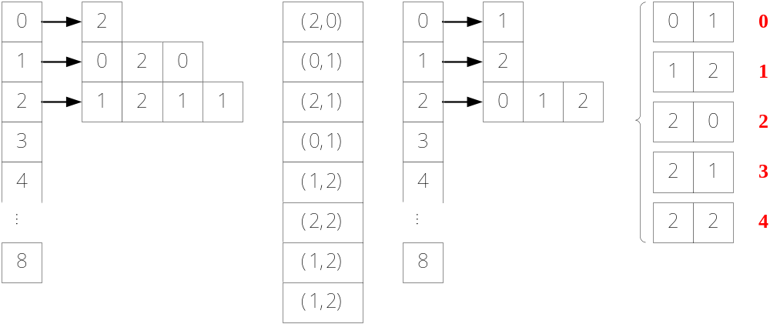
Radix Sort with Buckets (2/2)
Pass 2: sort by left elements

Slide 11
Conclusions
Given a text T of length n, the preprocessing requires O(n log n) time and space.
After the preprocessing, for each gram size r, the array id_{r} can be computed in O(n) time and space.
Later, another improved algorithm solved this problem in linear time.

