Slide 1
The String Edit Distance Matching Problem with Moves
Graham Cormodc, S. Muthukrishnan
Proceedings of the thirteenth annual ACM-SIAM symposium on Discrete algorithms, pp. 667-676, 2002
Date: July 19, 2006
Introducer: Hsing-Yen Ann

Slide 2
Abstract (1)
The edit distance between two strings S and R is defined to be the minimum number of character inserts, deletes and changes needed to convert R to S. Given a text string t of length n, and a pattern string p of length m, informally, the string edit distance matching problem is to compute the smallest edit distance between p and substrings of t. A well known dynamic programming algorithm takes time O(nm) to solve this problem, and it is an important open problem in Combinatorial Pattern Matching to significantly improve this bound.

Slide 3
Abstract (2)
We relax the problem so that (a) we allow an additional operation, namely, substring moves, and (b) we approximate the string edit distance upto a factor of O(log n log* n). Our result is a near linear time deterministic algorithm for this version of the problem. This is the first known significantly subquadratic algorithm for a string edit distance problem in which the distance involves nontrivial alignments. Our results are obtained by embedding strings into L₁ vector space using a simplified parsing technique we call Edit Sensitive Parsing (ESP). This embedding is approximately distance preserving, and we show many applications of this embedding to string proximity problems including nearest neighbors, outliers, and streaming computations with strings.

Slide 4
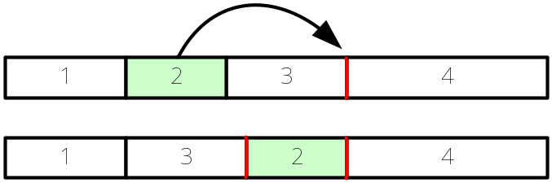
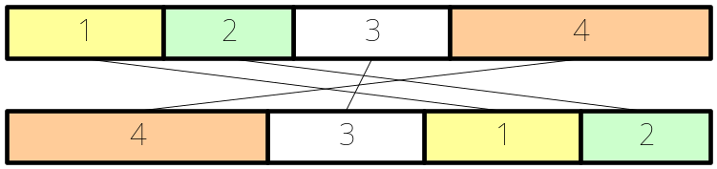

Problem Definition
Edit distance with moves:
-- character insert, character delete
-- block move (in working string, non-overlap)
-- to find the minimum number of operations
NP-hard
Can be reduced to block permutation problem
Shapira's GREEDY algorithm:
In this paper, a more complex O(log n log* n)-approximate algorithm is given which runs in time O(n log n).

Slide 5
String Embedding (1)
Input: string S over an alphabet set σ.
Embed S as V(S), a characteristic vector in L₁ space with
O(|σ| ^{|S|})-dimensions.
V(S) is a sparse vector which contains O(|S|) non-zero dimensions.
d(R, S): string edit distance with moves
||V(R)-V(S)||: L₁ distance between characteristic vector of R and S.

Slide 6
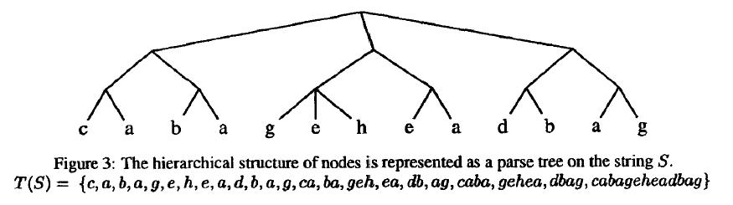
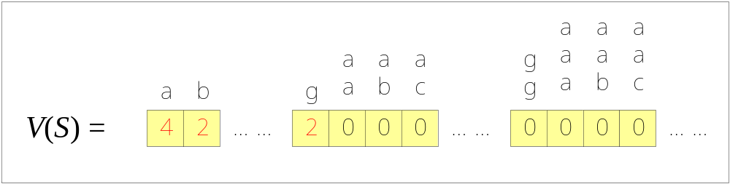
String Embedding (2)

Slide 7
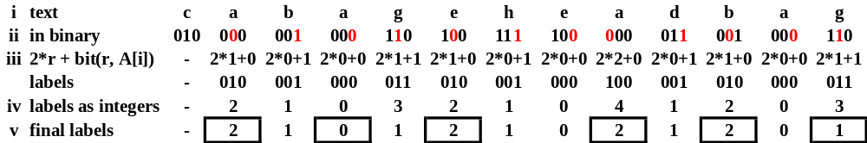
Edit Sensitive Parsing (1)
For long strings without repeats
Alphabet reduction: label(A[i]) =2l+bit(l, A[i])
New alphabet size: 2 log|σ|
After performed log*|σ| iterations, |σ| = 6.
Change |σ| to 3 with no repeats
Any edit operation on S[k] will only affect its neighbor landmark which located in range [k- log*|σ|+1, k+5]

Slide 8

Edit Sensitive Parsing (2)

Slide 9





Edit Sensitive Parsing (3)
Lemma 2.3
For any two landmark positions i and j, we have .
Lemma 2.4
Determining the closest landmark to position i depends on only contiguous positions to the left and 5 to the right.
Lemma 2.6
Inserting consecutive characters into S to get S' means for all levels i.
Lemma 2.8
If a single permitted edit operation transforms a string S into S' then .

Slide 10
Analysis
Using bucket sort, hashing can be done in O(1) time
ESP tree can be computed in O(|S| log* |S|) time
and in O(|S|) space
L₁ distance can be computed in O(|S|) time
Total time: O(n log n)
Approximate rate: O(log n log* n)

