Slide 1
A Dihedral Angle Database of Short Sub-Sequences for Protein Structure Prediction
The 2nd Asia-Pacific Bioinformatics Conference Vol. 29 (2004) 131-137
Saravanan Dayalan, Savitri Bevinakoppa, Heiko Schroder
Presenter: Jen-Hui, Wang
Date: August 17, 2006

Slide 2
Abstract
Protein structure prediction is considered to be the holy grail of bioinformatics. Ab initio and homology modelling are two important groups of methods used in protein structure prediction. Amongst these, ab initio methods assume that no previous knowledge about protein structures is required. On the other hand homology modelling is based on sequence similarity and uses information such as classification, structure, sequence and dihedral angles for prediction.

Slide 3
Abstract
Even though there are many databases for structural and sequence information, there are not many databases for dihedral angles that store all occurring dihedral values of sub-sequences. The existing ones have imitations like not being able to retrieve dihedral values for amino acids of a specific sub-sequence or being designed only for a specific set of proteins based on sequence identity (proteins with < 20% sequence identity). They hence have disadvantages when used in protein structure prediction based on short sub-sequences and exact matches. This paper presents a dihedral angle database for short sub-sequences up to length five. In this database dihedral angles of all proteins were extracted from the Protein Data Bank (PDB) regardless of the percent of sequence similarity. This paper also shows how the database can be used for protein structure prediction using exact matches.

Slide 4
Prediction of protein structures
Ab Initio
  without reference from other known structures
  Vander walls forces, bonding characteristics and the charge of amino acid
Homology modeling
  knowledge-based modeling
  similar sequences(>20% identity) may have similar structures

Slide 5
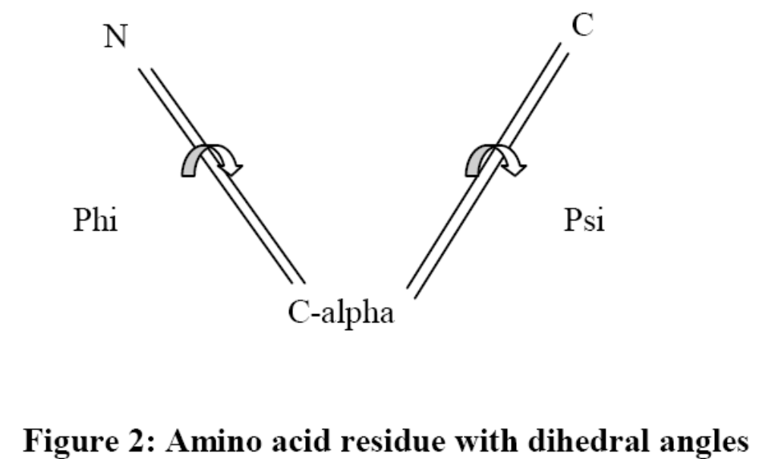
Dihedral angles

Slide 6
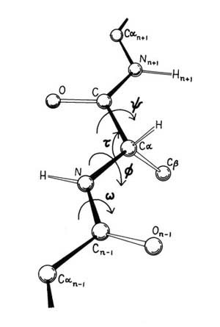
Dihedral angles

Slide 7
Protein Database
Protein sequence database
  MIPS (Mewes and Apweiler 1988)
  SWISS-PORT (Bairoch et al 1996)
  TrEMBL (Mewes and Apweiler 1998)
Composite protein sequence databases
  OWL (Bleasby et al 1994)
Protein structure databases
  PDB (Berman et al 1999)

Slide 8
Protein Databases
Structure classification databases
  SCOP (Murzin et al 1995)
  CATH (Orengo et al 1997)
Pattern databases
  PRINTS (Attwood et al 1998)
Even though there are many databases for proteins, there not many databases that store dihedral value.

Slide 9
Dihedral angle databases
CADB
  Conformation Angles DataBase of proteins (Sheik et al 2003)
  http://cluster.physics.iisc.ernet.in/cadb/
CDB
  Conformational DataBase (Oleg et al 1998)

Slide 10
CADB
stores main-chain and side-chain conformations angles of protein structures
users being able to study the interrelationship between main-chain and side-chain conformation angles and a World Wide Web interface
has used about 7000 protein structures out of the PDB
there is a limitation in its use when a program wants to analyse dihedral angles of all protein structures
it will not be able to answer a query that requires dihedral values of multiple amino acids based on their positions with each other

Slide 11
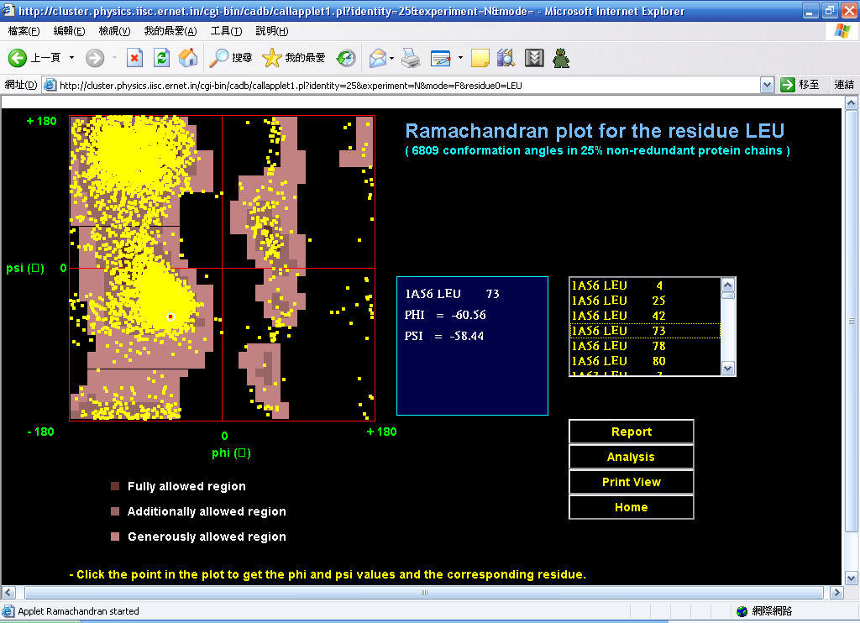

Slide 12
CDB
has data from 473 high-quality non-homologous protein structures from the PDB (<20% sequence identity)
for each amino acid residue CDB holds information such as the PDB code, amino acid code, one letter code for residue, values of dihedral angles….
the program using CDB will not be able to analyse all dihedral values occurring in the PDB and hence the result of an analysis would be inconsistent

Slide 13
Dihedral Angle Database (DAB)
all proteins from the PDB were considered regardless of the degree of the sequence identity between them
contains all occurring dihedral values of sub-sequences of amino acids from length one to five, DAB has entries containing all occurring dihedral angles for each of a total of 3,348,420 combinations (20 + 400 + 8000 + 16000 + 3200000)

Slide 14
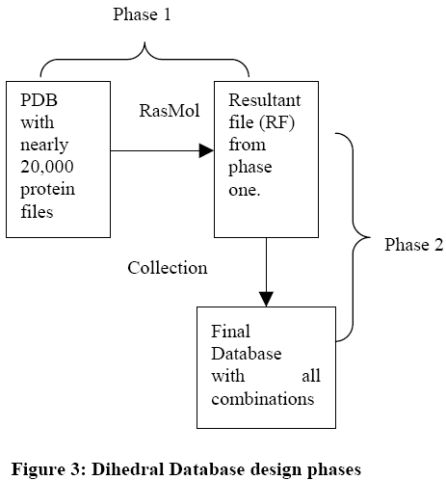
Design

Slide 15
Design
phase 1
  dihedral angles (Phi, Psi and Omega) were extracted for all proteins in the PDB using RasMol and the extracted results were stored in a resultant file (RF)

Slide 16
Design
phase 2
  RF was scanned for occurrence of every combination of amino acid sub-subsequence from length one to five
  For each of this occurrence the following information was stored:
    PDBCode
    One letter code of the polypeptide chain
    Amino acid sequence number
    Phi, Psi, Omega

Slide 17
Examples
consider a prediction program that analyses the effect of ALA preceding and succeeding ALA, it could be written as ALA1-ALA2-ALA3

Slide 18
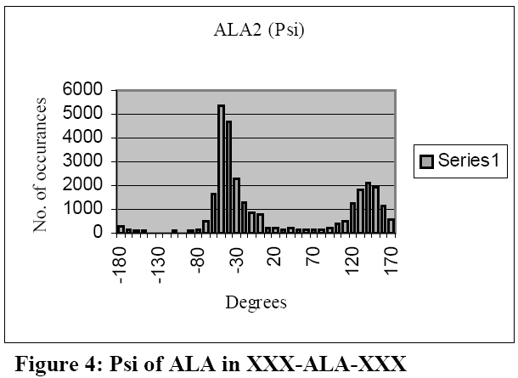
Examples
This graph shows that majority of the occurrences of Psi lies from -70 degrees to -20 degrees and from 120 degrees to 160 degrees

Slide 19
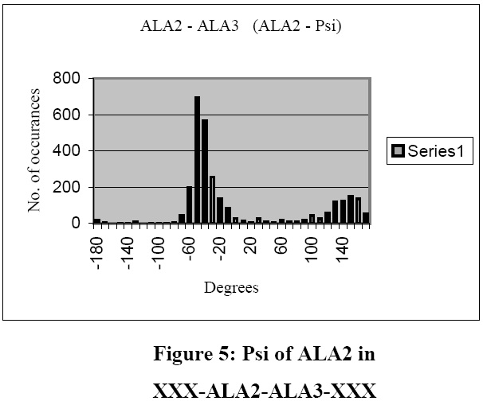
Examples
This graph shows that even though the number of occurrences has reduced from more than 5000 to around 700, the distribution pattern remains the same except for some areas like 150 degrees to 170 degrees

Slide 20
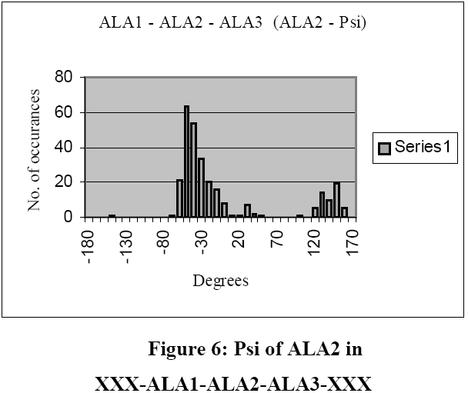
Examples
This graph shows a continuing pattern in the Psi value distribution of ALA2 in spite of being surrounded by ALA1 and ALA3, the prediction program could conclude that the Psi value of ALA2 is unaffected by the presence of ALA1 and ALA3

Slide 21
Examples
Each amino acid is assigned a number and their combinations stored according to an order
For example the sub-sequence HIS-CYS-ALA might translate to 2-3-9, The program would now compute the dihedral values collection entry position as:
  20² * (2-1) + 20¹ * (3-1) + 20⁰ * (9) = 449
  hence the program could jump to the entry 449 to extract the dihedral values

