Slide 1
Faster Algorithm for String Matching with k Mismatches
Amihood Amir, Moshe Lewenstin, Ely Porat
Journal of Algorithms, Vol. 50, 2004, pp. 257-275
Date : Aug. 17, 2006
Annotated by : Hsing-Yen Ann

Slide 2
Abstract
The string matching with mismatches problem is that of finding the number of mismatches between a pattern P of length m and every length m substring of the text T. Currently, the fastest algorithms for this problem are the following. The Galil–Giancarlo algorithm finds all locations where the pattern has at most k errors (where k is part of the input) in time O(nk).

Slide 3



Abstract (cont’d)
The Abrahamson algorithm finds the number of mismatches at every location in time . We present an algorithm that is faster than both. Our algorithm finds all locations where the pattern has at most k errors in time . We also show an algorithm that solves the above problem in time .

Slide 4
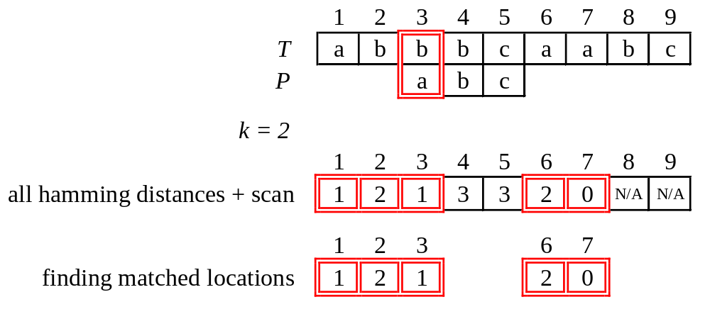
Problem Definition (1/2)
Example:
Notes:
Hamming distance ham(P, T_{[3,5]})=1. It means only one mismatch.

Slide 5
Problem Definition (2/2)
String matching with k mismatches:
Input:
  Text T = t₁t₂...t_{n}
  Pattern P = p₁p₂...p_{m}
  A natural number k
Output:
  All pairs <i, ham(P, T_{[i,i+m-1]})>,
  where 1≦i ≦n and ham(P, T_{[i,i+m-1]})≦k
  ham(): hamming distance (# of errors)

Slide 6


Previous Results
Finding all hamming distances + linear scan.
  By Convolution
  Previous:
Finding possible locations with at most k errors + verifying then.
  By Kangaroo Method
  Previous: O(nk)
Choose strategy 1 when .
Improved to in this paper by
Counting + Kangaroo Method.

Slide 7
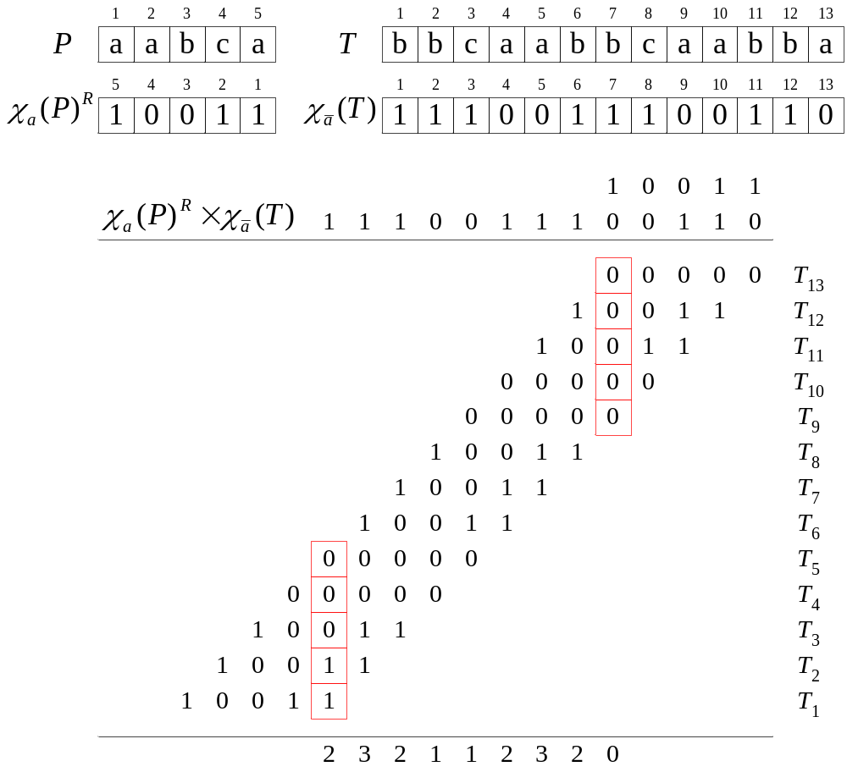
Convolution (1/2)

Slide 8


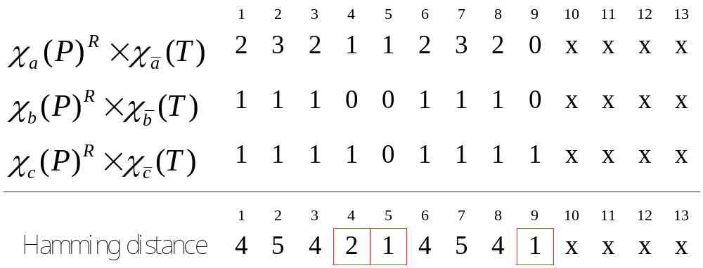
Convolution (2/2)
The sum is equal to the hamming distance.
Use FFT for polynomial multiplication, time:

Slide 9
Kangaroo Method (1/2)
Introduced by Landau and Vishkin.
Using Suffix trees + Lowest Common Ancestor.
Constant-time “jumps” over longest equal substrings in the text and pattern.
O(1) for jumping to next mismatch.
O(k) for verifying a candidate location with k mismatches.
At most n candidates ➔ O(nk) time
O
(1)
O
(1)
O
(1)
T
a
b
b
a
b
c
e
a
b
a
b
c
P
a
b
c
a
b
c
a
a
c

Slide 10
Kangaroo Method (2/2)
The LCA of two leaves represents the longest common prefix (LCP) of these 2 suffixes
$
s = abbaab$
aab$
abbaab$
a
b
7
$
a
b
a
b
$
b
a
6
a
b
a
b
$
4
a
$
b
a
$
b
3
5
2
$
1

Slide 11
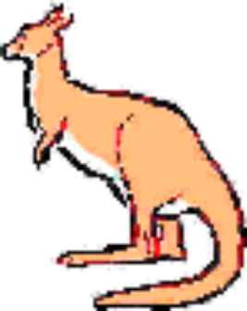
The Kangaroo Method
(for k-mismatches)
Create suffix tree for: s = P#T$
Check P at each location i of T by kangrooing
Example:
P = A B A B A A B A C A B
T = A B B A C A B A B A B C A B B C A B C A …
i
Finding LCP(s, P₀, T_{i})

Slide 12
The Kangaroo Method
(for k-mismatches)
Create suffix tree for: s = P#T$
Check P at each location i of T by kangrooing
Example:
P = A B A B A A B A C A B
T = A B B A C A B A B A B C A B B C A B C A …
i
Length of LCP(s, P₀, T_{i}) = 4

Slide 13
The Kangaroo Method
(for k-mismatches)
Create suffix tree for: s = P#T$
Check P at each location i of T by kangrooing
Example:
P = A B A B A A B A C A B
T = A B B A C A B A B A B C A B B C A B C A …
i
Kangrooing distance = LCP(s, P₀, T_{i}) +1 = 5

Slide 14
The Kangaroo Method
(for k-mismatches)
Create suffix tree for: s = P#T$
Check P at each location i of T by kangrooing
Example:
P = A B A B A A B A C A B
T = A B B A C A B A B A B C A B B C A B C A …
i
Finding LCP(s, P₅, T_{i+5})

Slide 15
The Kangaroo Method
(for k-mismatches)
Create suffix tree for: s = P#T$
Check P at each location i of T by kangrooing
Example:
P = A B A B A A B A C A B
T = A B B A C A B A B A B C A B B C A B C A …
i
Length of LCP(s, P₅, T_{i+5}) = 2

Slide 16
The Kangaroo Method
(for k-mismatches)
Create suffix tree for: s = P#T$
Check P at each location i of T by kangrooing
Example:
P = A B A B A A B A C A B
T = A B B A C A B A B A B C A B B C A B C A …
i
Kangrooing distance = LCP(s, P₅, T_{i+5}) +1 = 3

Slide 17
The Kangaroo Method
(for k-mismatches)
Create suffix tree for: s = P#T$
Check P at each location i of T by kangrooing
Example:
P = A B A B A A B A C A B
T = A B B A C A B A B A B C A B B C A B C A …
i
Finding LCP(s, P₈, T_{i+8})

Slide 18
The Kangaroo Method
(for k-mismatches)
Create suffix tree for: s = P#T$
Check P at each location i of T by kangrooing
Example:
P = A B A B A A B A C A B
T = A B B A C A B A B A B C A B B C A B C A …
i
Length of LCP(s, P₈, T_{i+8}) = 3

Slide 19
The Kangaroo Method
(for k-mismatches)
Create suffix tree for: s = P#T$
Check P at each location i of T by kangrooing
Example:
P = A B A B A A B A C A B
T = A B B A C A B A B A B C A B B C A B C A …
i
Next iteration: i = i + 1

Slide 20
Two-Stage Algorithm
Marking stage
  Identifying the potential starts of the pattern.
  Reducing the # to be verified.
Verification stage
  Verifying which of the potential candidates is indeed a pattern occurrence.
  Using the Kangaroo method for speed-up.

Slide 21
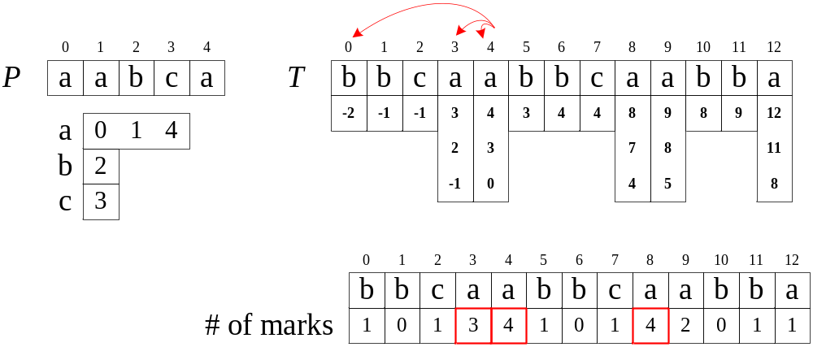
Counting (1/2)
k = 2 ➔ m – k = 3

Slide 22
Counting (2/2)
For each symbol in T, mark its possible start index.
There are O(nm) marks.
If an start index has only j marks where j < m - k,
the # of mismatch is at least m - j > m - (m - k) = k .
The number of candidates (≧ m - k marks) is at most
nm / (m - k) = O(n) by pigeonholing principle.
Each candidate can be verified in O(k) time.
Time: O(n) x O(k) = O(nk)
Notes:
Pre-process the pattern P. Find the smallest index in P of each alphabet.
Mark the location in T corresponding to the alphabet.
Count the marked locations respectively.

Slide 23
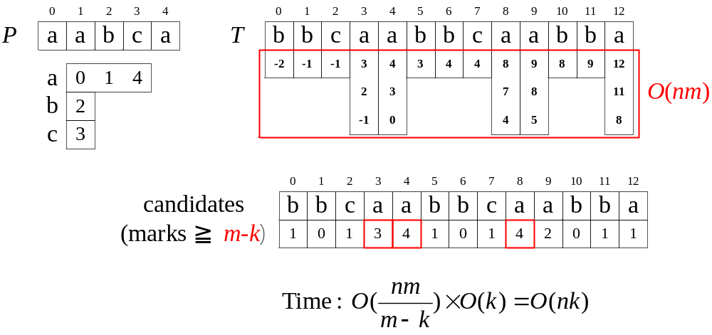
Better Counting (1/3)

Slide 24
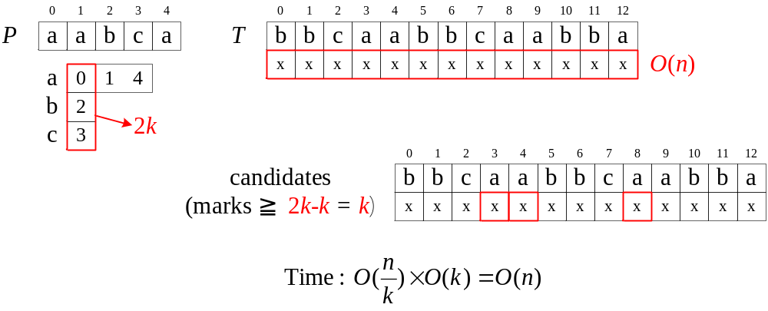
Better Counting (2/3)
If the alphabet is large

Slide 25
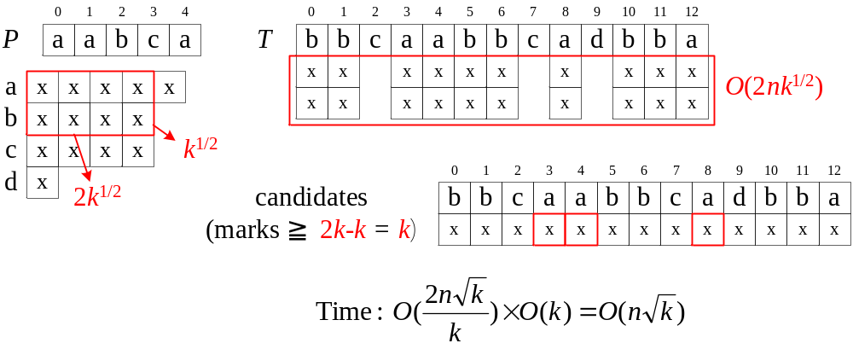
Better Counting (3/3)
If there many frequent symbols

Slide 26
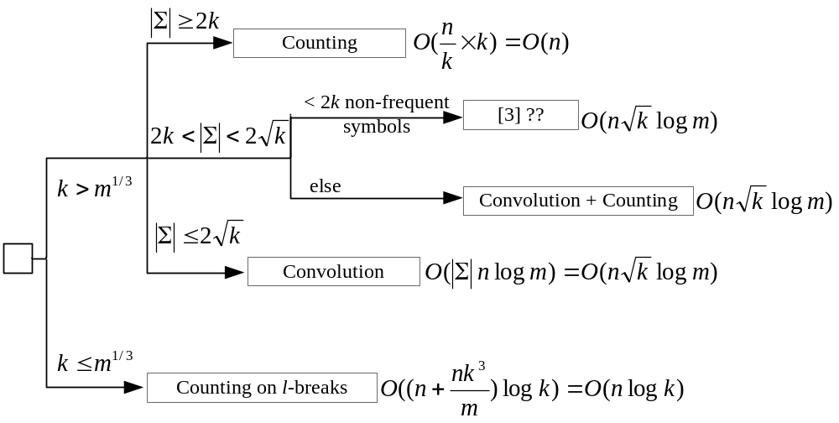
Algorithms for Four Different Cases

