Slide 1
Pattern Matching with Swaps
Amir, Aumann, Landau, M. Lewenstein, N. Lewenstein
Journal of Algorithms, Vol. 37, 2000, pp. 247-266
Date : Sept. 14, 2006
Introducer: Hsing-Yen Ann

Slide 2
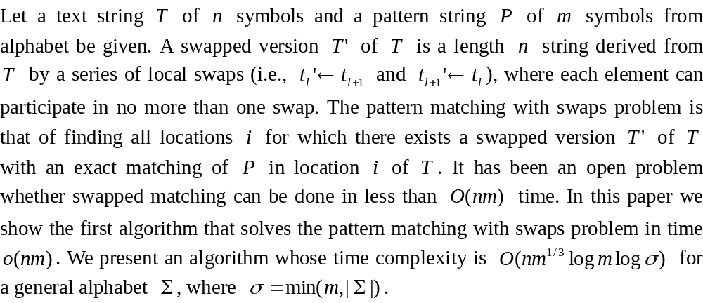
Abstract

Slide 3
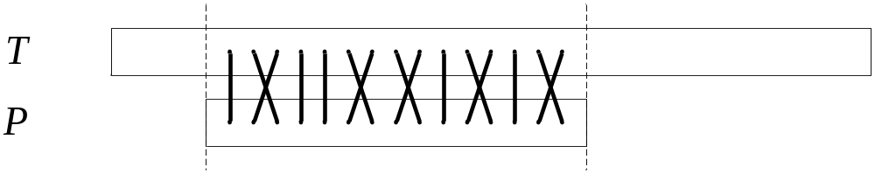
Problem Definition (1/2)
Pattern matching with swaps
Input: Text T = t₁t₂...t_{n} and pattern P = p₁p₂...p_{m}
Output: All locations i, where P has a swapped match in T.
Restriction:
1. only adjacent characters are swapped
2. identical characters are not swapped

Slide 4
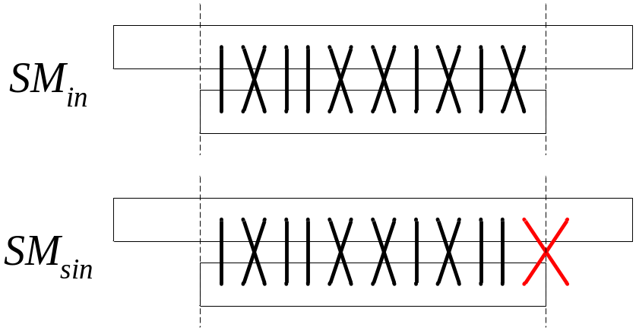
Problem Definition (2/2)
SM_{in}: Swapped matching with no swaps across the boundaries.
SM_{sin}: Swapped matching with no swap across the begin boundary.
Find all SM_{sin} first, then apply some verification to find out all SM_{in}.

Slide 5


Solving Strategy
Swapped matching problems over general alphabets.
Reduced to: ( reduced problems)
Swapped matching problems over binary alphabet.
Reduced to:
Less-than matching with don't care problems.
Solve the Less-than matching with don't care problem in time.

Slide 6
Transformation to Less-Than Matching Problems (1/5)
Partition P into maximal alternating substrings.
Find streams and create a-start(T) and b-start(T). [EvenOdd(T), OddEven(T)]
Using a-start(T) and b-start(T) find all locations i for which P has a partitioned SM_{sin} match in T. (less-than matching)
Using convolutions to verify the SM_{in} locations.

Slide 7
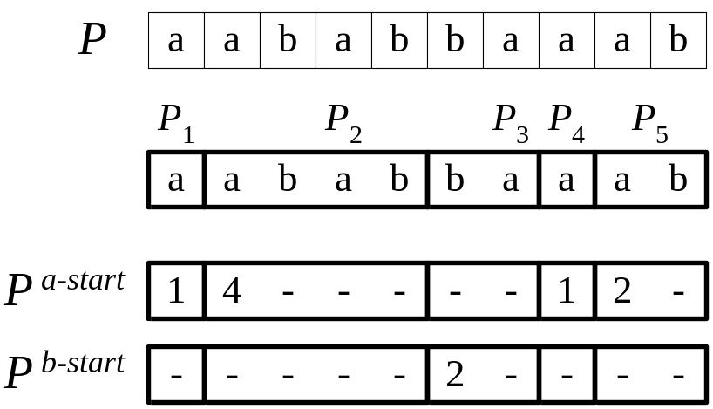
Transformation to Less-Than Matching Problems (2/5)
Partition P into maximal alternating substrings.
P is swapped matching to T iff for each block P_{i},
P_{i} is swapped matching to corresponding block in T.
Time: O(n)

Slide 8
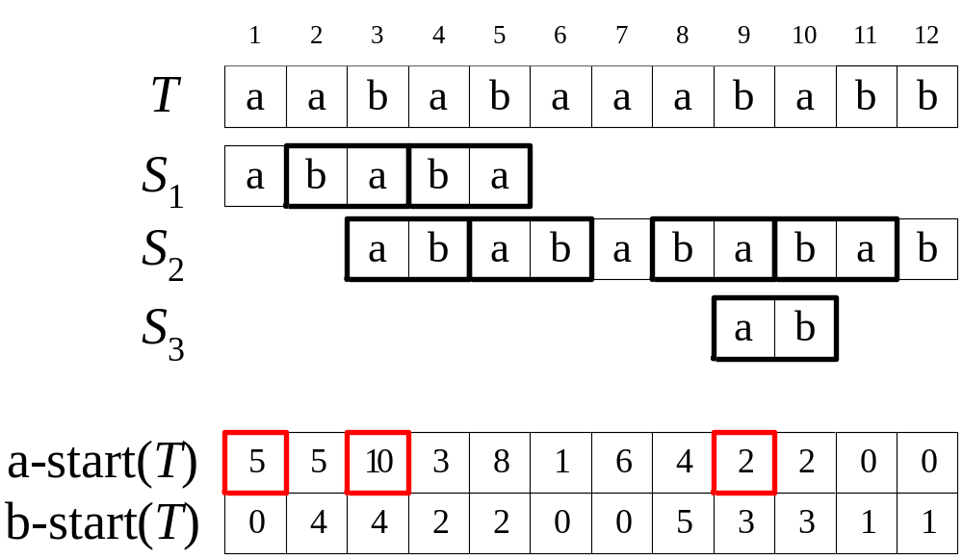
Transformation to Less-Than Matching Problems (3/5)
Find streams and create a-start(T) and b-start(T).
A stream is an alternating string that swapped matching to T.
There are two swap direction on location i.
Time: O(n) !!

Slide 9
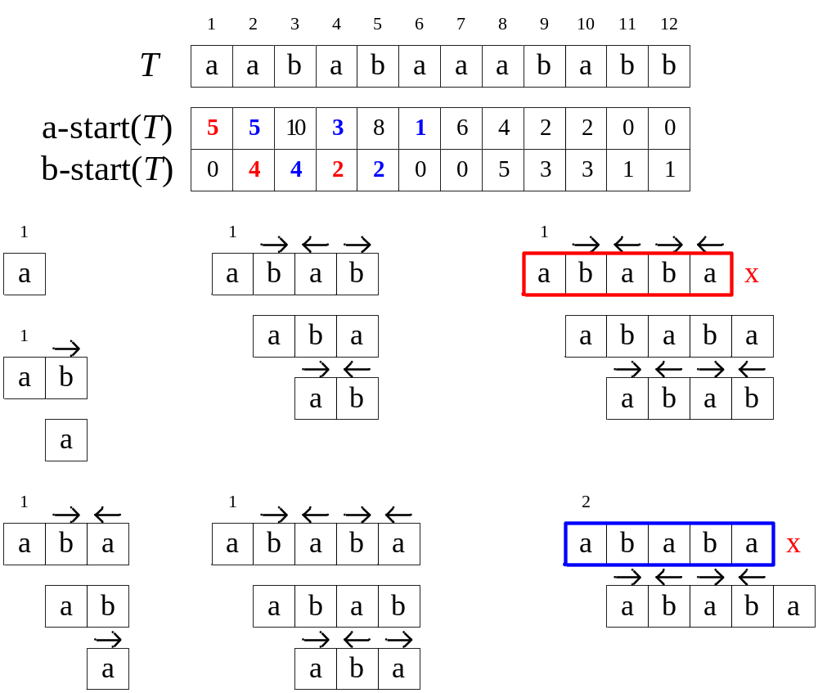
Transformation to Less-Than Matching Problems (4/5)
At most 3 "Active List" in the same time.

Slide 10
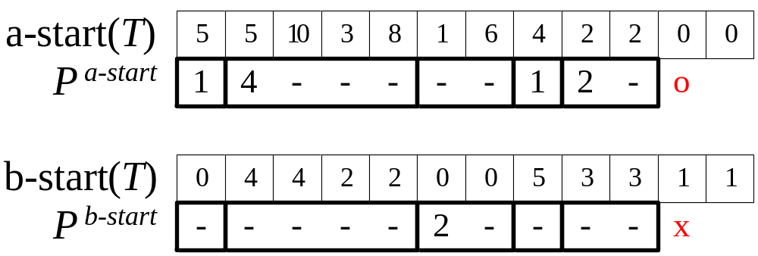
Transformation to Less-Than Matching Problems (5/5)
There is a partitioned SM_{sin} match for P in T at location i, iff at location i both P ^{a-start} is less-than a-start(T) and P ^{b-start} is less-than b-start(T).
Time:

Slide 11
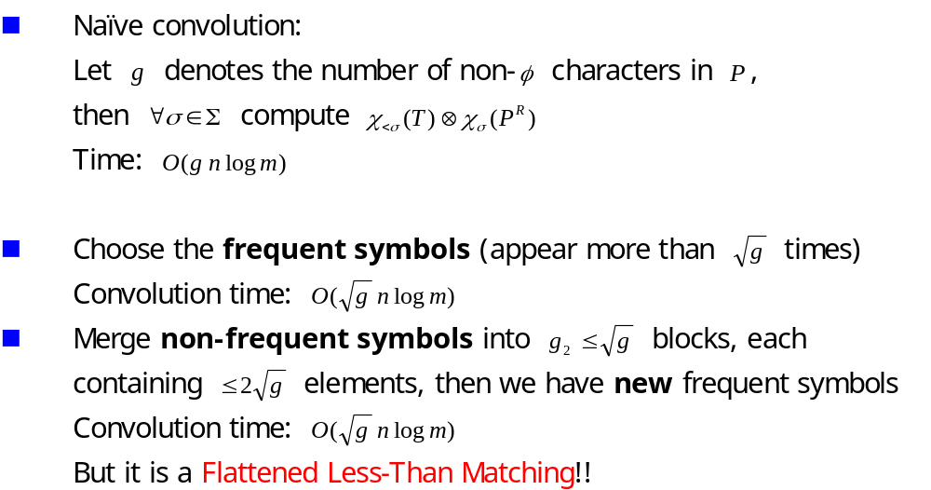
Less-Than Matching

Slide 12
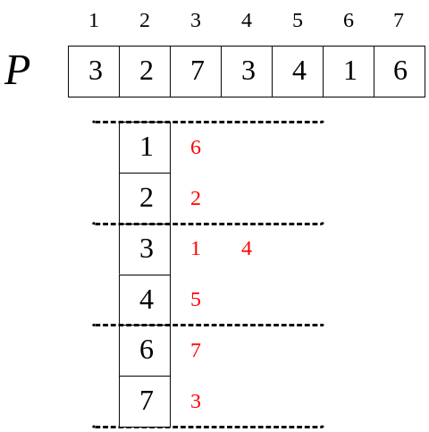
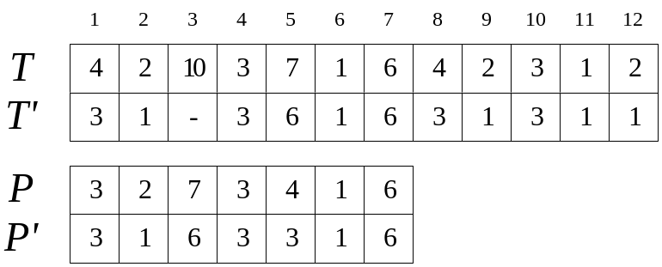
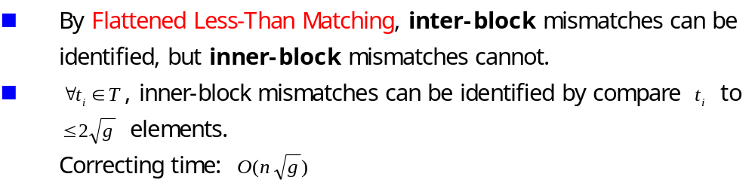
Flattened Less-Than Matching

Slide 13
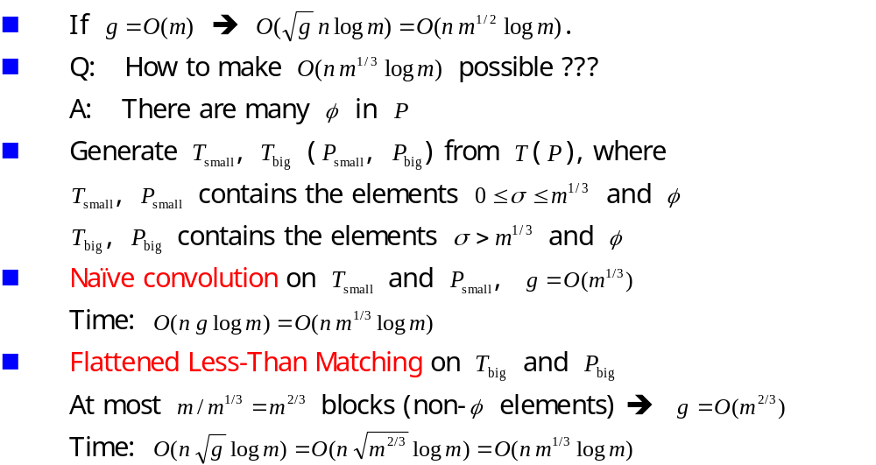
Make Less-Than Matching Faster

Slide 14
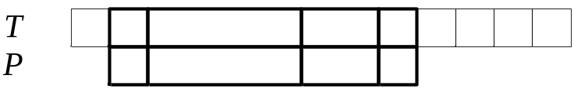
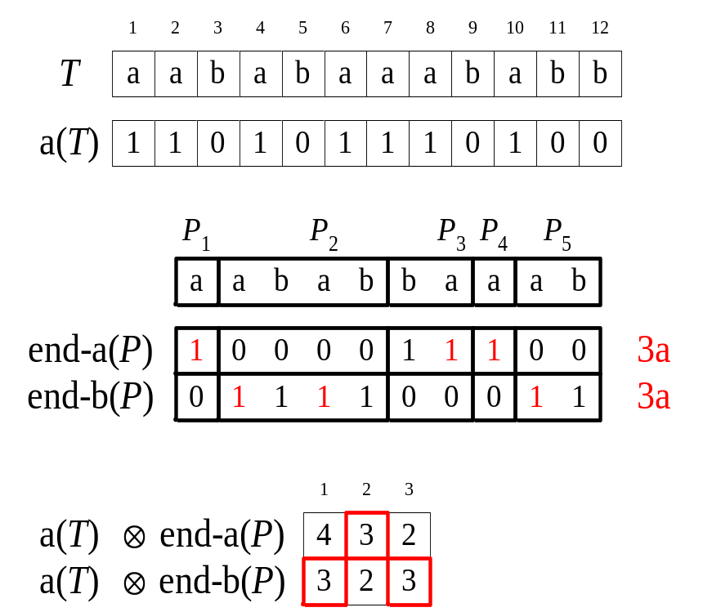

Using Convolutions to Verify the SM_{in} Locations
There is a SM_{in} match for P in T, iff there are equal numbers of 'a' in both corresponding blocks of P and T.
Time:

Slide 15
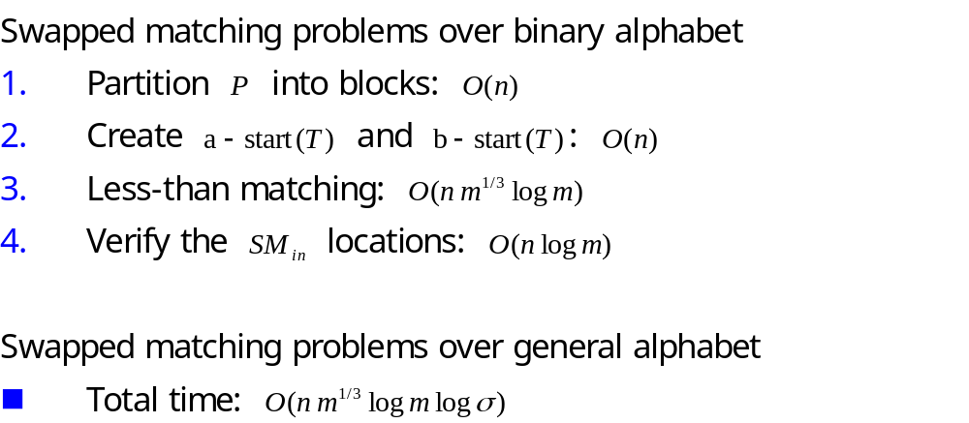
Conclusion

