Slide 1
Energy-Based Reconstruction of a Protein Backbone from its α-Carbon Trace by a Monte-Carlo Method
J Comput Chem 23: 715–723, 2002
RAJMUND KAZ´ MIERKIEWICZ, ADAM LIWO, HAROLD A. SCHERAGA
Presenter: Jen-Hui, Wang
Date: September 28, 2006

Slide 2
Abstract
An automatic procedure is proposed for reconstruction of a protein backbone from its C^{α}-trace; it is based on optimization of a simplified energy function of a peptide backbone, given its α-carbon trace. The energy is expressed as a sum of the energies of interaction between backbone peptide groups that are not neighbors in the sequence, the energies of local interactions within all amino acid residues, and a harmonic penalty function accounting for the conservation of standard bond angles. The energy of peptide group interactions is calculated using the assumption that each peptide group acts as a point dipole. For local interaction energy, use is made of a two-dimensional Fourier series
expansion of the energies of model terminally blocked amino acid residues, calculated with the Empirical Conformational Energy Program for Peptides (ECEPP/3) force field in the angles λ⁽¹⁾ and λ⁽²⁾ defining the rotation of peptide groups adjacent to a C^{α} carbon atom about the corresponding C^{α} . . . C^{α} virtual-bond axes.

Slide 3
Abstract
To explore all possible rotations of peptide groups within a fixed C^{α} -trace, a Monte Carlo search is carried out. The initial angles are calculated by aligning the dipoles of the peptide groups that are close in space, subject to the condition of favorable local interactions. After the Monte Carlo search is accomplished with the simplified energy function, the energy of the structure is minimized with the ECEPP/3 force field, with imposition of distance constraints corresponding to the initial C^{α} -trace geometry. The procedure was tested on model α-helices and β-sheets, as well as on the crystal structure of the immunoglobulin binding protein (PDB code: 1IGD, an α/β protein). In all cases, complete backbone geometry was reconstructed with a root-mean-square (rms) deviation of 0.5 Å from the all-atom target structure.

Slide 4
Introduction
There are three types of methods for the reconstruction of all-atom chains from α-carbon traces:
  methods that use fragment libraries or other information from the PDB
  methods based on geometric criteria, i.e. positioning the peptide groups in the C^{α}-trace to obey the constraints arising from the bond-length and bond-angle geometry and the planarity of the peptide groups
  methods based on optimizing the energy of the backbone, given a C^{α}trace

Slide 5
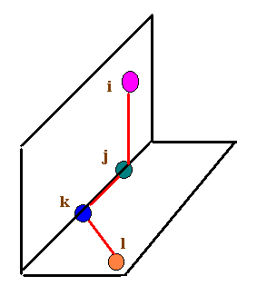
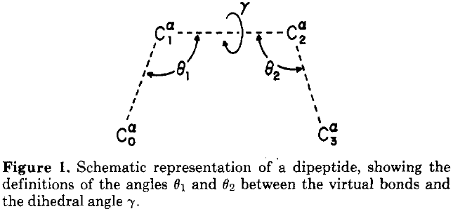
Dipeptide

Slide 6
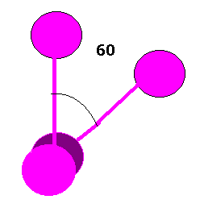
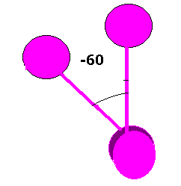

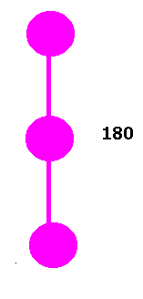

Dihedral

Slide 7
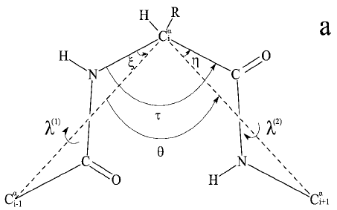
Single residue
λ defines the orientation of the planar peptide group, λ⁽¹⁾ and λ⁽²⁾ are the angles for rotation of the peptide planes about the virtual bonds C^{α}₀…C^{α}₁ and C^{α}₁…C^{α}₂ respectively.
The positive rotation is the clockwise one for either λ₁ or λ₂ (with λ₁ = λ₂ = 0。 when Φ = Ψ = 0。) when looking from the central C^{α} atom
The values of λ₁ and λ₂ are then given by angles between the respective peptide planes and the new C^{α}₀-C^{α}₁-C^{α}₂ plane

Slide 8
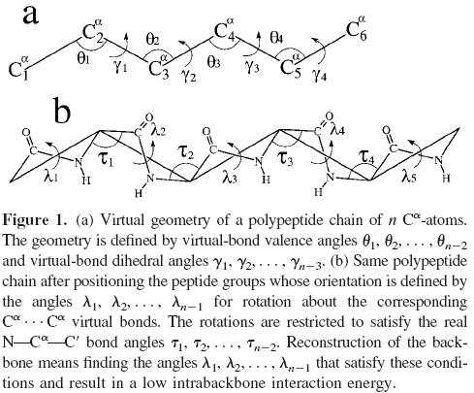
Methods

Slide 9
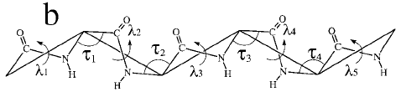

Methods
As can easily be realized, not all combinations of angles λ⁽¹⁾ and λ⁽²⁾ are allowed, because of the constraint imposed by a fixed value of the valence-bond angle τcentered at the middle C^{α} atom
For each peptide group p_{i} , i = 1, 2, …, n-1, define a unique angle λ:
The angles λ₁, λ₂,…, λ_{n-1} will hereafter be used as variables defining the orientation of peptide groups

Slide 10
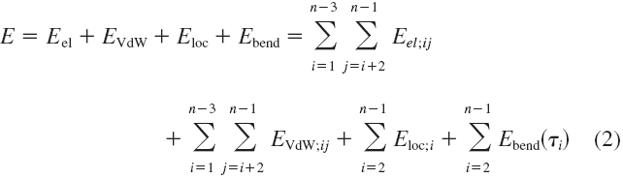
Energy function
seek the values of the angles λ₁, λ₂,…, λ_{n-1} that minimize the energy of the backbone
E_{el} : energy of electrostatic interactions between the atom of the peptide groups
E_{VdW}: energy of van der Waals interactions between the atom of the peptide groups
E_{loc}: local-interaction, includes all noncovalent interactions within peptide residue
E_{bend}: distortion of the valence-bond angles τ

Slide 11
Energy function
The term E_{bend} is introduced to keep the anglesτ at the standard values used in the ECEPP/3 force field, which is implemented in the subsequent stage of refinement (unrestricted variation of the angles λ⁽¹⁾ and λ⁽²⁾ would lead to variation of τ)
In the computation of E_{el} and E_{VdW}, we do not consider neighboring peptide groups because the corresponding energy of electrostatic interaction is included in the local interaction energy E_{loc}

Slide 12
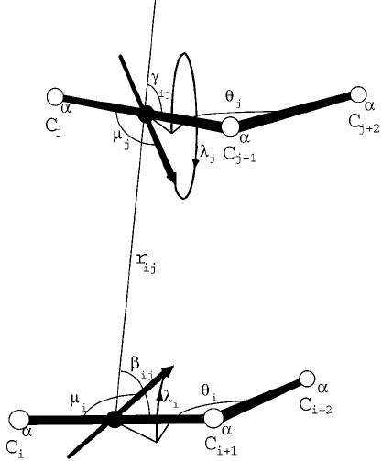
Dipole model
to compute the electrostatic component of the energy of peptide-group interaction, we represent each peptide group as a point dipole located in the middle between the consecutive C^{α} atoms and lying in the peptide-group plane
The dipole moment is computed according to the charge distribution on the peptide-group atoms

Slide 13
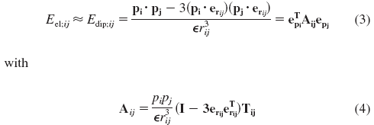
Energy function
The energy of electrostatic interaction between peptide groups p_{i} and p_{j}:
T_{ij} is a matrix transforming the reference system of peptide group p_{j} to that of p_{i}
p_{i} and p_{j} are the vectors of the dipole moments of peptide groups p_{i} and p_{j}
r_{ij} is the distance between the centers of the virtual bonds
e_{rij} is the unit vector pointing from p_{i} to p_{j}
e_{pi} is the unit vector of the dipole moment of the peptide group p_{i}
εis the dielectric constant

Slide 14
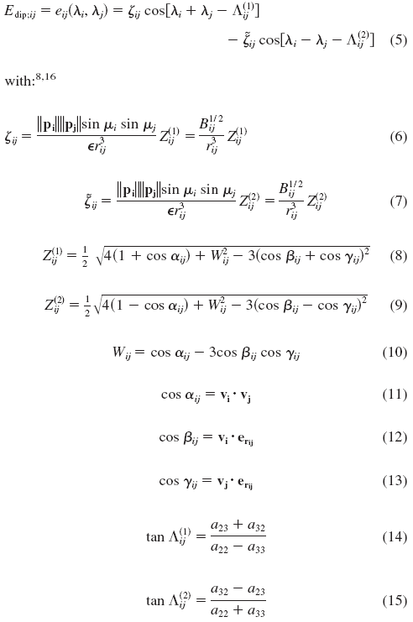
Energy function
For a given configuration of C^{α}’s, E_{el;ji} is a function of angles λ_{i} and λ_{j}, in further discussion, we will consider only those components of the dipole moment vectors that are perpendicular to the C^{α}…C^{α} virtual-bond axes
a: the elements of the matrix A_{ij}
u_{i}: the angle between the dipole-moment vector of peptide group p_{i} and the corresponding virtual-bond axis
v_{i}: the unit vectors pointing from C^{α}_{i} to C^{α}_{i+1}

Slide 15




Energy function
k is a nonspecific force constant, which is proportional to the step number p
with K_{o} being an arbitrary constant equal to 100 in this work and N being the number of steps
τº is the value of the standard valence angle N-C^{α} -C

Slide 16
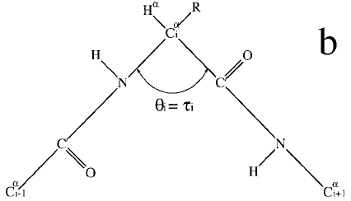
Procedure
For a given C^{α}-trace the angles λ₁, λ₂, . . . , λ_{n-1} cannot be varied freely, because the constraints imposed by fixed values of the bond angles τ₁, τ₂ , . . . , τ_{n-1} must be obeyed
Implement a procedure from earlier article, in which the C^{α}_{i}-C_{i}-N_{i+1}-C^{α}_{i+1} atoms of the ith peptide group lie on a straight line and the O_{i} and H_{i+1} atoms are attached to C_{i} and N_{i+1}, respectively, with right bond angles
In this case, the λ’s can vary freely without distorting the bond angles
Therefore, start the optimization of peptide-group rotations by assuming a linear arrangement fo the peptide-group atoms

Slide 17
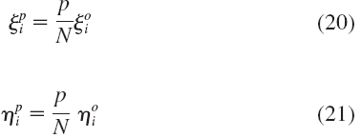

Procedure
After optimization is accomplished with such linearity, modify the ζ’, η’s, τ’s as follows:
N: number of steps in transforming a linear peptide group into a peptide group with real geometry
p: step number
Superscript o: a standard ECEPP/3 value of the corresponding angle

Slide 18
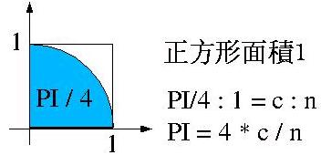
Monte Carlo method
A technique that provides approximate solutions to problems expressed mathematically. Using random numbers and trial and error, it repeatedly calculates the equations to arrive at a solution
Example:

Slide 19
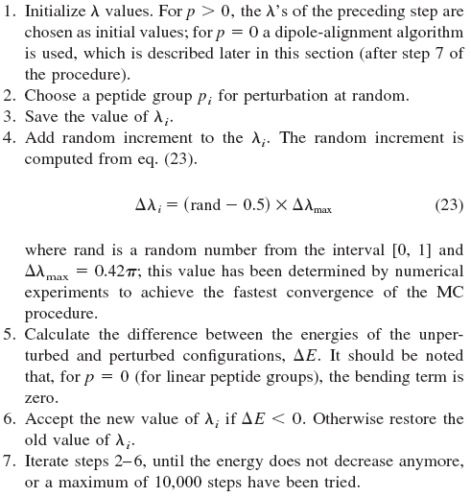
Monte Carlo algorithm

Slide 20
Results
Three test cases:
  Ac-Ala-NHMe in α-helical conformation
  16-residue fragment of betanova
    Three-Stranded Antiparallel β-Sheet
  Immunoglobin-Binding Protein
    α/β Protein

Slide 21
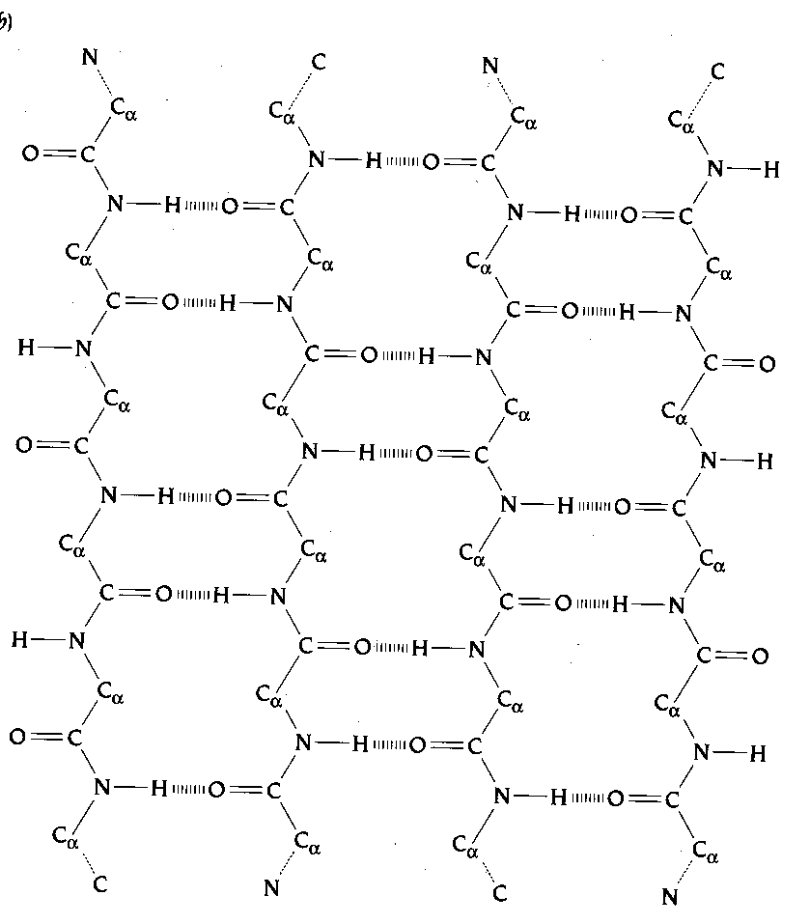
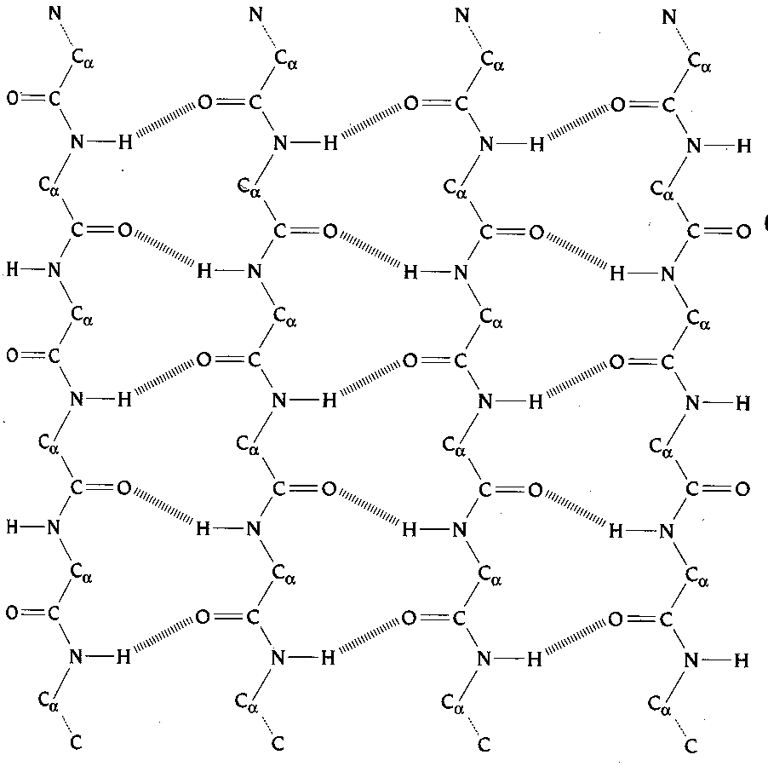
Parallel and anti-parallel β-sheets
Anti-parallel
Parallel

Slide 22
Results
Ac-Ala-NHMe (full α-helix)
  There are three dipole paths detected, based on hydrogen-bonding contacts between peptide groups: 20-17-14-11-8-5-2, 19-16-13-10-7-4, and 18-15-12-9-6-3
  After energy minimization with the ECEPP/3 force field, average value of the dihedral angles Φ and Ψ become -67.5˚ and -39.0 ˚

Slide 23
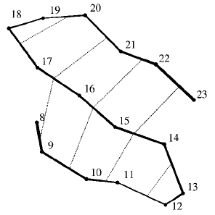
Results
Betanova
(Three-Stranded Antiparallel β-Sheet)
The dipole paths based on hydrogen bonding contacts are 9-17-21, 22-16-10, 11-15-23, 20-18, and 14-12

Slide 24
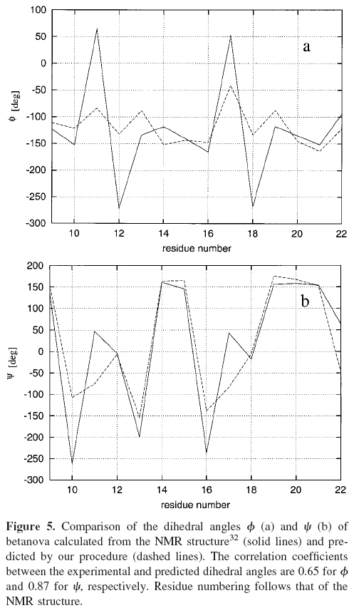
Results (Betanova)

Slide 25
Results
Immunoglobin-Binding Protein
  (an α/β Protein)
The structure contains a four-stranded β-sheet packed against an α-helix formed by residues(28-41)
The recognized sequences of dipoles forming the dipole path network are as follows:
  26-6, 7-25, 24-8, 52-56-9-23, 22-10-57-51, 50-58-11-21, 20-12-59-49, 19-13-60-48, 18-14-61, 55-53 (forming the dipole paths of the β-sheet part),
  41-38-35-32-29, 42-39-36-33-30, 40-37-34-31(forming the dipole paths of the _x0001_α-helix).

Slide 26
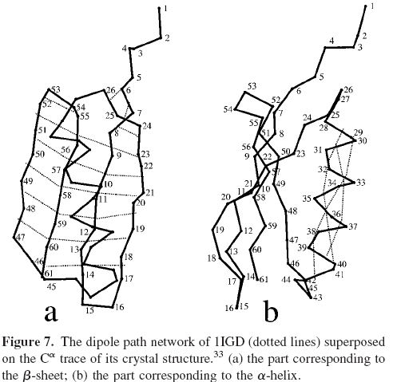
Results

